Slide 1
DAXLIB
Zero to community hero

Slide 2
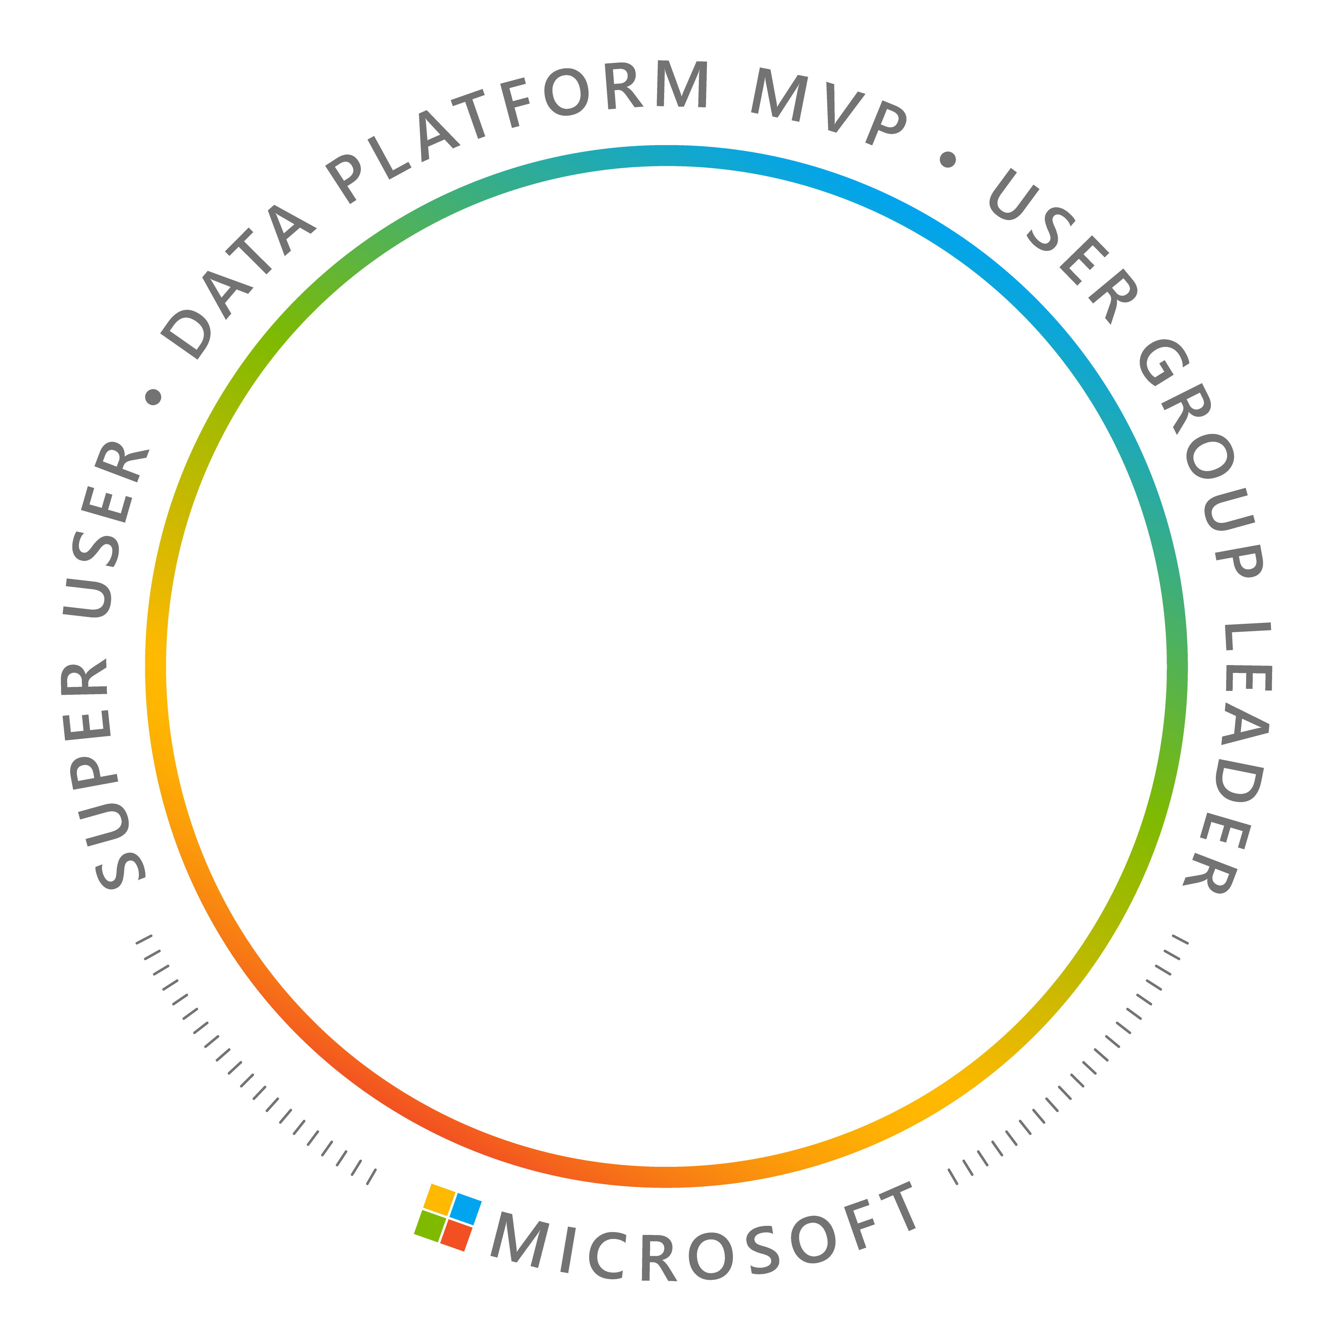



Jake Duddy
Data Engineer, Zure UK
Microsoft MVP (Data Platform)
Fabric Super User
https://evaluationcontext.github.io/

Slide 3





Big thank you to our great sponsors

Slide 4


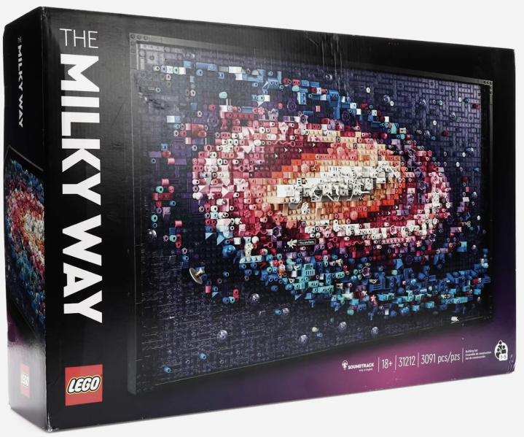
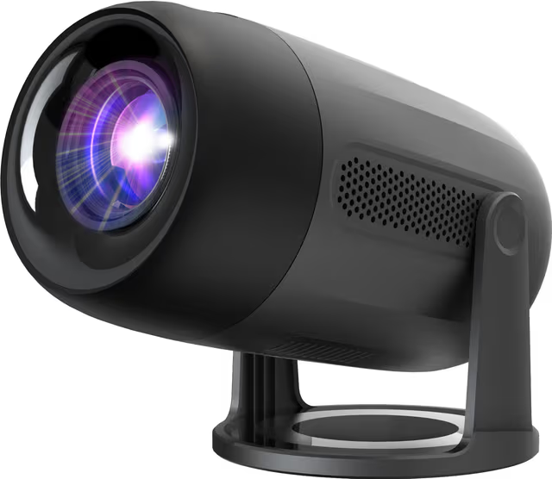

Raffle prizes from the sponsors

Slide 5
User Defined Functions
UDF

Slide 6
DAX UDFs
UDF
User Defined Functions ≠ User Data Functions
Build your own DAX functions that you can call like any other DAX function
DRY (Don't Repeat Yourself)
  Reuse code
  Doesn't improve performance
  Can make measures simpler/less verbose
  Can make bulk updates easier
They are built for semantic model authors

Slide 7
UDF
Anatomy of a UDF
  Defined once. Called like any DAX function.
/// Sum of large sales
/// @param {int} num
function SumLargeSales =
( num: INT64 EXPR ) =>
CALCULATE(
SUM( Sales[Amount] ),
Sales[Amount] > num
)
Comments
Name
Parameters
Expression

Slide 8
UDF
Model-dependent
  Has expectations on semantic model schema
/// Sum of large sales
/// @param {int} num
function SumLargeSales =
( num: INT64 EXPR ) =>
CALCULATE(
SUM( Sales[Amount] ),
Sales[Amount] > num
)
Comments
Name
Parameters
Expression

Slide 9
UDF
Model-independent
  Has NO expectations on semantic model schema
/// Sum of large values
/// @param {columnref} colRef
function SumLarge =
( colRef: COLUMNREF,
num: INT64 EXPR ) =>
CALCULATE(
SUM( colRef ),
colRef > num
)
Comments
Name
Parameters
Expression

Slide 10
Demo create a UDF

Slide 11
DAXLIB
Package manager for UDF

Slide 12

Installing a library
DAXLIB
Browse & search libraries at daxlib.org
Upgrading = installing a newer version
Install:
Copy the TMDL
Tabular Editor 3
Semantic Link Labs

Slide 13
Demo
Install & use a library

Slide 14
Your first library the fork & pull request workflow

Slide 15
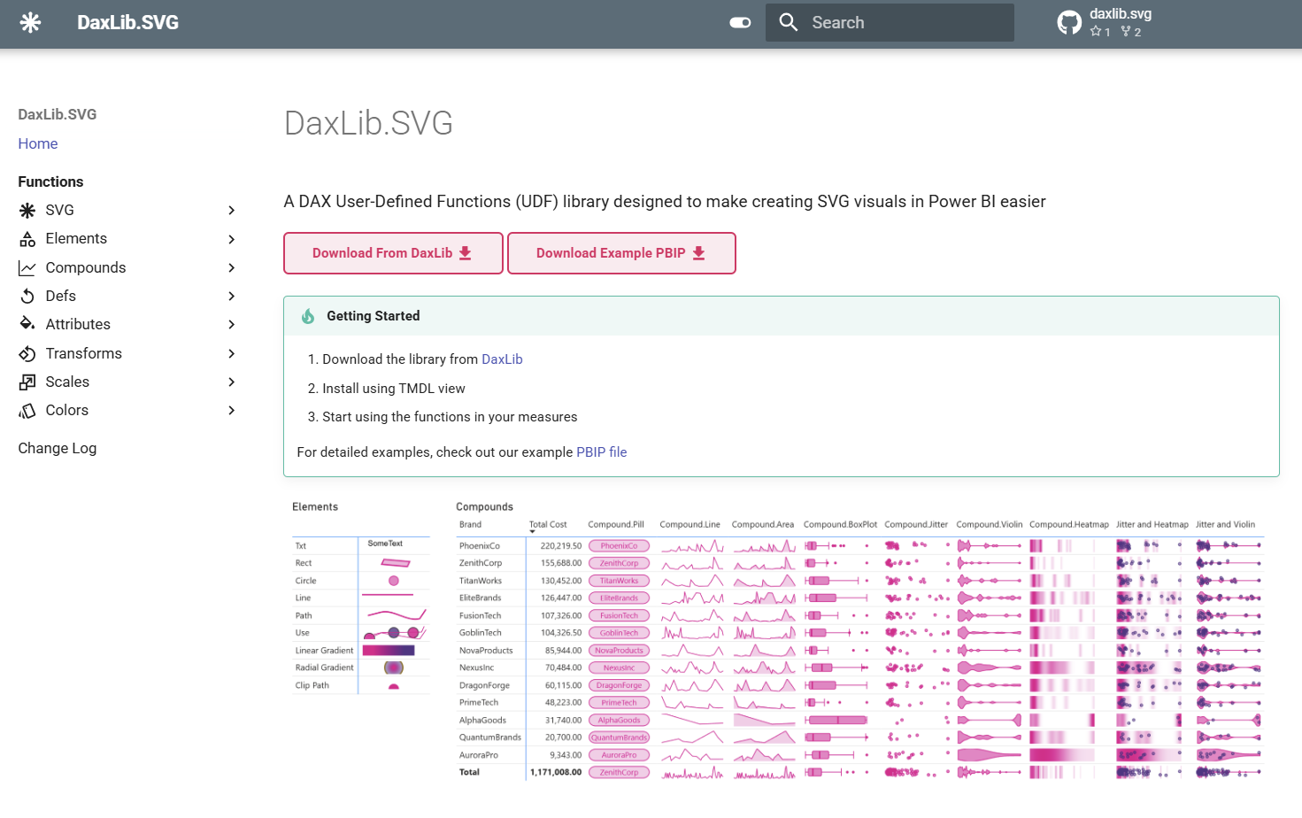
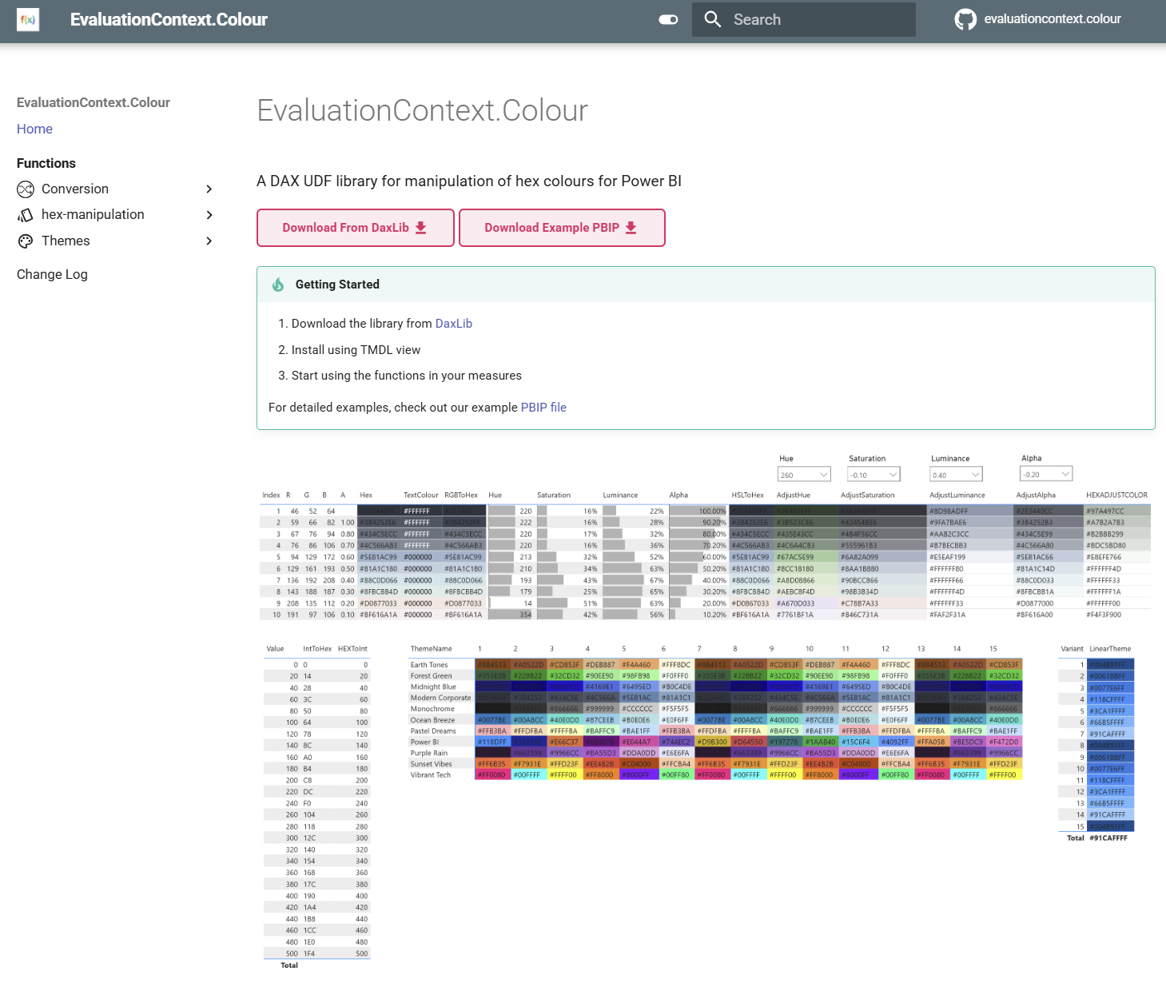
What have I done?
FIRST LIBRARY
DaxLib.SVG
11.9k downloads [#2]
A DAXLib library designed to make creating SVG visuals in Power BI easier.
Build sparklines, heatmaps, and custom visualizations with pure DAX.
EvaluationContext.Colour
4.2k downloads [#8]
A DAXLib UDF library for manipulation of hex colours in Power BI.
Blend, lighten, darken, and transform colours directly in your DAX measures

Slide 16




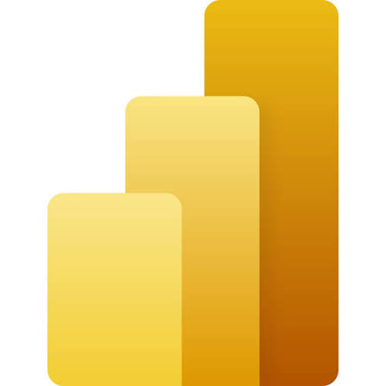
Development requirements
git
Github account
vscode
TMDL extension
Power BI

Slide 17
DAXLIB requirements
FIRST LIBRARY
Model-independent
Naming conventions
No reserved keywords
Annotations
Versioned
No model references

Slide 18
DAXLIB requirements
FIRST LIBRARY
Model-independent
Naming conventions
No reserved keywords
Annotations
Versioned
Function names: PascalCase (<Publisher>.<Library>.<Function>)
Parameters: camelCase
Variables: PascalCase

Slide 19
DAXLIB requirements
FIRST LIBRARY
Model-independent
Naming conventions
No reserved keywords
Annotations
Versioned
No DAX function names
No Dax. / DaxLib. prefixes

Slide 20
DAXLIB requirements
FIRST LIBRARY
Model-independent
Naming conventions
No reserved keywords
Annotations
Versioned
<function def>
annotation DAXLIB_PackageId = Contoso.Conversion
annotation DAXLIB_PackageVersion = 1.0.0

Slide 21
DAXLIB requirements
FIRST LIBRARY
Model-independent
Naming conventions
No reserved keywords
Annotations
Versioned
SemVer — published packages are immutable (i.e. 0.1.0)

Slide 22
Anatomy of a library
FIRST LIBRARY
manifest.daxlib: id, version, authors, description
lib/functions.tmdl: your UDFs in TMDL
README.md*
icon.png*
* (maximum size of 100 KB)
packages
├─ a
├─ b
├─ c
│ └─ contoso.conversion
│ ├─ 1.0.0/
│ └─ 2.0.0/
│ ├─ lib/
│ │ └─ functions.tmdl
│ ├─ manifest.daxlib
│ ├─ README.md
│ └─ icon.png
├─ ...
└─ z

Slide 23

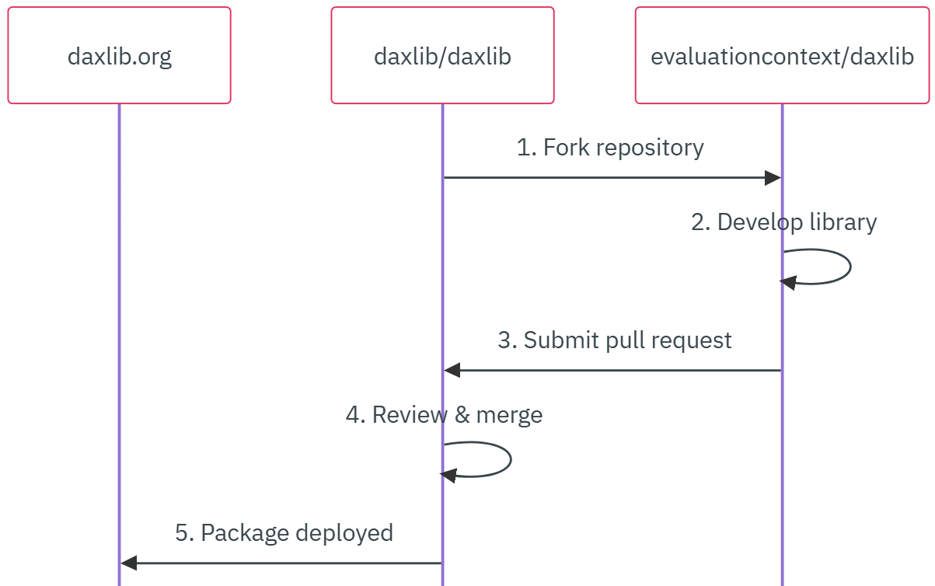
FIRST LIBRARY
Workflow

Slide 24
Fork → branch
FIRST LIBRARY
Workflow
TIP
Start from DaxLib.Sample
Notes:
Fork daxlib/daxlib
Branch + add /packages/c/contoso.conversion
Tip: start from DaxLib.Sample

Slide 25
Develop → pull request
FIRST LIBRARY
Workflow
Notes:
Add your UDFs to lib/functions.tmdl
Remove createOrUpdate
Remove indent
Add annotations
annotation DAXLIB_PackageId = Contoso.Conversion
annotation DAXLIB_PackageVersion = 2.0.0
Open a pull request to daxlib/daxlib

Slide 26
Review → merge → publish
FIRST LIBRARY
Workflow
Notes:
DAXLib maintainers review every PR
Approved & merged → live on daxlib.org

Slide 27
Publish a new version
FIRST LIBRARY
Packages are immutable !
New version folder
Bump the version #
  manifest.daxlib
  annotations
Submit a new PR
contoso.conversion
├─ 1.0.0/
│ ├─ lib/
│ │ └─ functions.tmdl
│ ├─ manifest.daxlib
│ ├─ README.md
│ └─ icon.png
└─ 2.0.0/
├─ lib/
│ └─ functions.tmdl
├─ manifest.daxlib
├─ README.md
└─ icon.png

Slide 28
Demo publishing a small library

Slide 29
Scaling up medium & large libraries

Slide 30
Workflow
SCALING UP

Slide 31
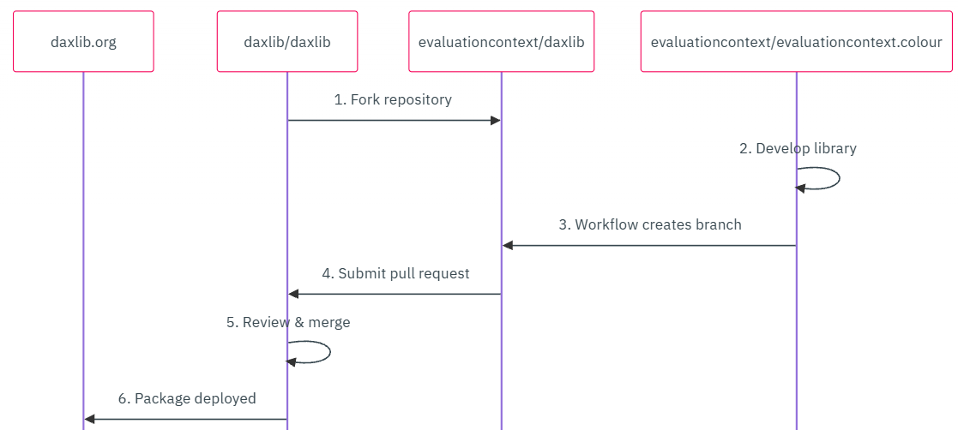
Workflow
SCALING UP
Create library repo

Slide 32
Workflow
SCALING UP
Create library repo

Slide 33
Workflow
SCALING UP
Develop → action

Slide 34
Develop → action
SCALING UP
Add a fork PAT as a secret on your repo
Run publish-package — it opens the PR
Fixes? Commit & re-run — the PR updates itself

Slide 35
Workflow
SCALING UP
Pull request

Slide 36
Workflow
SCALING UP
Review → merge → publish

Slide 37
Set up from the template
SCALING UP
Create a repo from daxlib/lib-quickstart-template
Library lives in src/
Publish workflow in .github/
Keep your daxlib fork — required to publish
├─ .github/workflows/
│ └─ publish-package.yml
├─ src/
│ ├─ lib
│ │ └─ functions.tmdl
│ ├─ manifest.daxlib
│ ├─ README.md
│ └─ icon.png
└─ README.md

Slide 38
Why a dedicated repo?
SCALING UP
collaboration
Contributors, branches & code review
Work happens on your repo — not in someone else’s fork
issues
Users report bugs & request functions
One place to track, triage and close
docs
A real documentation site
GitHub Pages, generated from your repo
validation
Unit tests & continuous integration
Catch breaking changes before they ship
annotations
Placeholders that update themselves
Version annotations filled automatically at publish
multiple function-files
Split functions across several TMDL files and sub folders
Smaller files, better diffs, organization

Slide 39
Your library is a dependency
SCALING UP
Your functions run inside other people’s models — bugs and slowdowns ship to every consumer.
documented
README, docs site + /// comments
performant
Measured, not guessed
tested
Validated before every release

Slide 40
Validation

Slide 41
Unit tests
VALIDATION
DAX query view
Automated pipeline
Manual
DAX Query View
One row per case: TestName, Expected, Actual, Passed
DEFINE
FUNCTION Lib.Dbl =
(x : INT64) => x * 2
EVALUATE
ROW(
"Test", "doubles 21",
"Expected", 42,
"Actual", Lib.Dbl(21),
"Passed", Lib.Dbl(21) = 42
)

Slide 42
Unit tests
VALIDATION
DAX query view
Automated pipeline
Manual
John Kerski
  DAX Query View Testing Pattern: test queries saved in the PBIP with a name ending in .Tests
  PQL.Assert: supplies the assertions, so every test returns the same TestName / Expected / Actual / Passed schema
// Lib.Tests.dax
EVALUATE
UNION(
ROW("TestName", "Dbl doubles 21",
"ExpectedValue", 42,
"ActualValue", Lib.Dbl(21),
"Passed",
PQL.Assert.ShouldEqual(Lib.Dbl(21), 42)),
ROW( … next test case … )
)

Slide 43
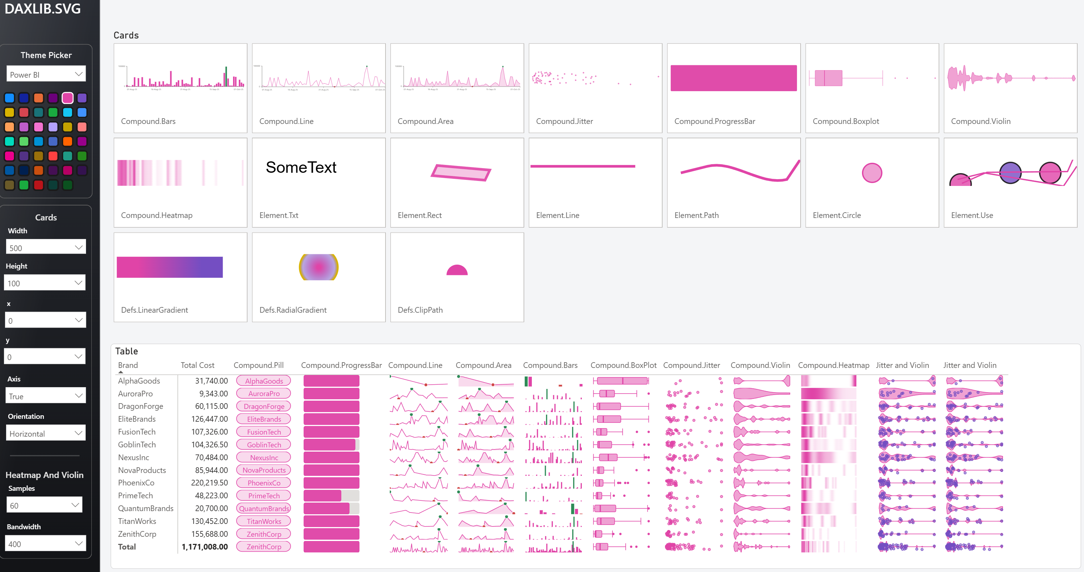
Unit tests
VALIDATION
DAX query view
Automated pipeline
Manual

Slide 44
Performance

Slide 45

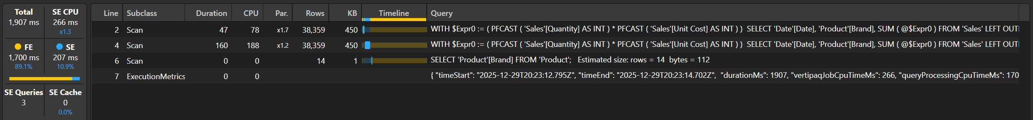
Performance tests
VALIDATION
DAX Studio
DAX Performance Testing notebook

Slide 46

Performance tests
VALIDATION
DAX Studio
DAX Performance Testing notebook
Fabric DAX Performance Testing notebook (Fabric Toolbox)
Runs a list of DAX queries against a model and logs server timings to a Lakehouse, so runs are repeatable and comparable
Cache state per run:
  Cold: clears everything (pauses capacity, clears cache)
  Warm: clears cache then primes with one query
  Hot: runs each query several times before timing
Use: run before and after a change to a function and compare timings by cache state

Slide 47
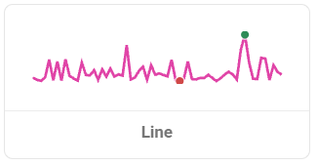
Performance validation
PERFORMANCE
Tested using Contoso 1 Million Row Dataset (SQLBI)
Tested against:
  Table proxy: EVALUATE { [measure] }
  Card proxy: EVALUATE SUMMARIZECOLUMNS( Product[Brand], "foo", [measure] )
With large and small Axis parameters:
  Large Axis: 'Date'[Date]
  Small Axis : 'Date'[YearMonth]
5 runs per measures, for warm and hot cache
T-test — Δ statistically different?

Slide 48
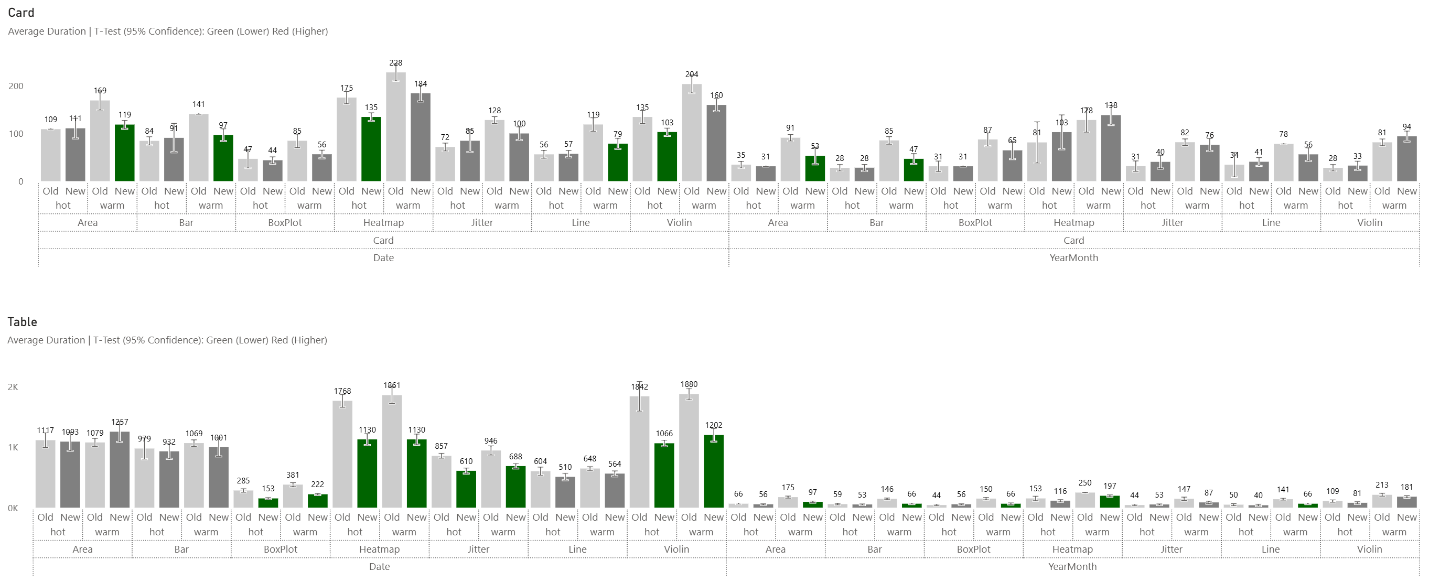
Performance validation
PERFORMANCE
Green = Good, Red = Bad

Slide 49
Usability

Slide 50
Usable functions
USABILITY
Optional parameters
Model modes
/// documentation
Sensible defaults, so callers only set what they need. Add at the end.
function Lib.Foramt =
(
x: SCALAR
decimals: VAL = 2
) =>

Slide 51
Usable functions
USABILITY
Optional parameters
Model modes
/// documentation
Not every DAX function works in every semantic model mode
DirectQuery: PATH, PATHITEM and some text functions have limitations

Slide 52
Usable functions
USABILITY
Optional parameters
Model modes
/// documentation
/// comments above the function show up in IntelliSense
/// Formats a number with thousands separators and fixed decimals
/// @param decimals Number of decimals (default 2)
Users see the description and parameters while typing, no docs needed

Slide 53
Documentation

Slide 54
Documentation that scales
DOCUMENTATION
README.md is a good start (example) but a dedicated documentation site gives more flexibility as your library grows
Static site generators:
  MkDocs
  Docusaurus
  Hugo
  …
Host free on GitHub Pages, build in CI
Link it as projectUrl in manifest.daxlib

Slide 55
Automate documentation
DOCUMENTATION
JSDoc: /// with @param and @returns (SQLBI convention)
Parse: script extracts tags from functions.tmdl into JSON metadata
Merge: Jinja based page template
Generate: Markdown pages generated and auto-organised into folders
Publish
Keep comments lean — IntelliSense shows them, and functions.tmdl has size limits
https://evaluationcontext.github.io/posts/DAXUDF-AutoDocs/

Slide 56
Takeaways

Slide 57
Takeaways
WRAPPING UP
If you have an idea or solution that fills a gap, be a hero and share it
Start small — you can always graduate later
docs.daxlib.org/contribute

Slide 58
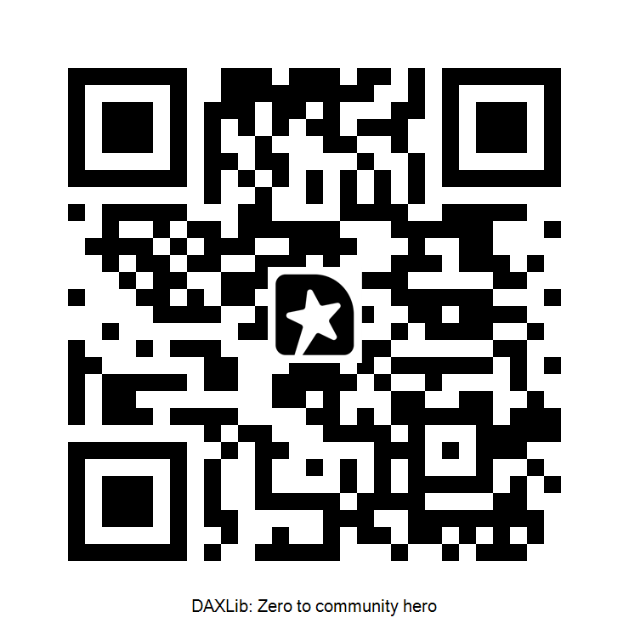
Thank you! questions?

