Slide 1
Unlocking New Possibilities
Enhancing Power BI with SVGs
Jake Duddy

Slide 2






Jake Duddy
Data Platform Microsoft MVP
Fabric Community Super User
EvaluationContext Blog
Devon and Cornwall Power BI Group Co-organizer
Jake Duddy
evaluationcontext.github.io/
linkedin.com/in/jakeduddy/

Slide 3
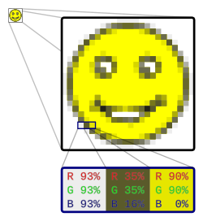
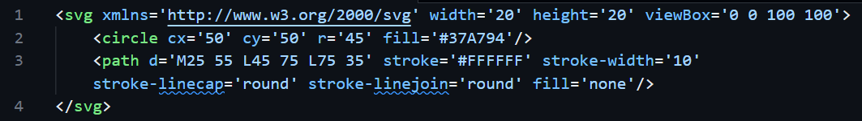

Vector vs Raster
Raster | Vector
JPEG, PNG etc Colour per pixel Blurry or pixelated when scaled up or down | SVG Defined as Code Scales to any size without losing quality Animation

Slide 4
SVG Elements
Shapes
  Rectangles <rect>
  Circles <circle>
  Ellipses <ellipse>
  Lines <line>
  Polygons <polygon>
  Path <path>
  Text <text>
Filters <feGaussianBlur> <feComponentTransfer> …
Animation
foo

