Slide 1
Fabric-CICD
From Click Ops to DevOps

Slide 2
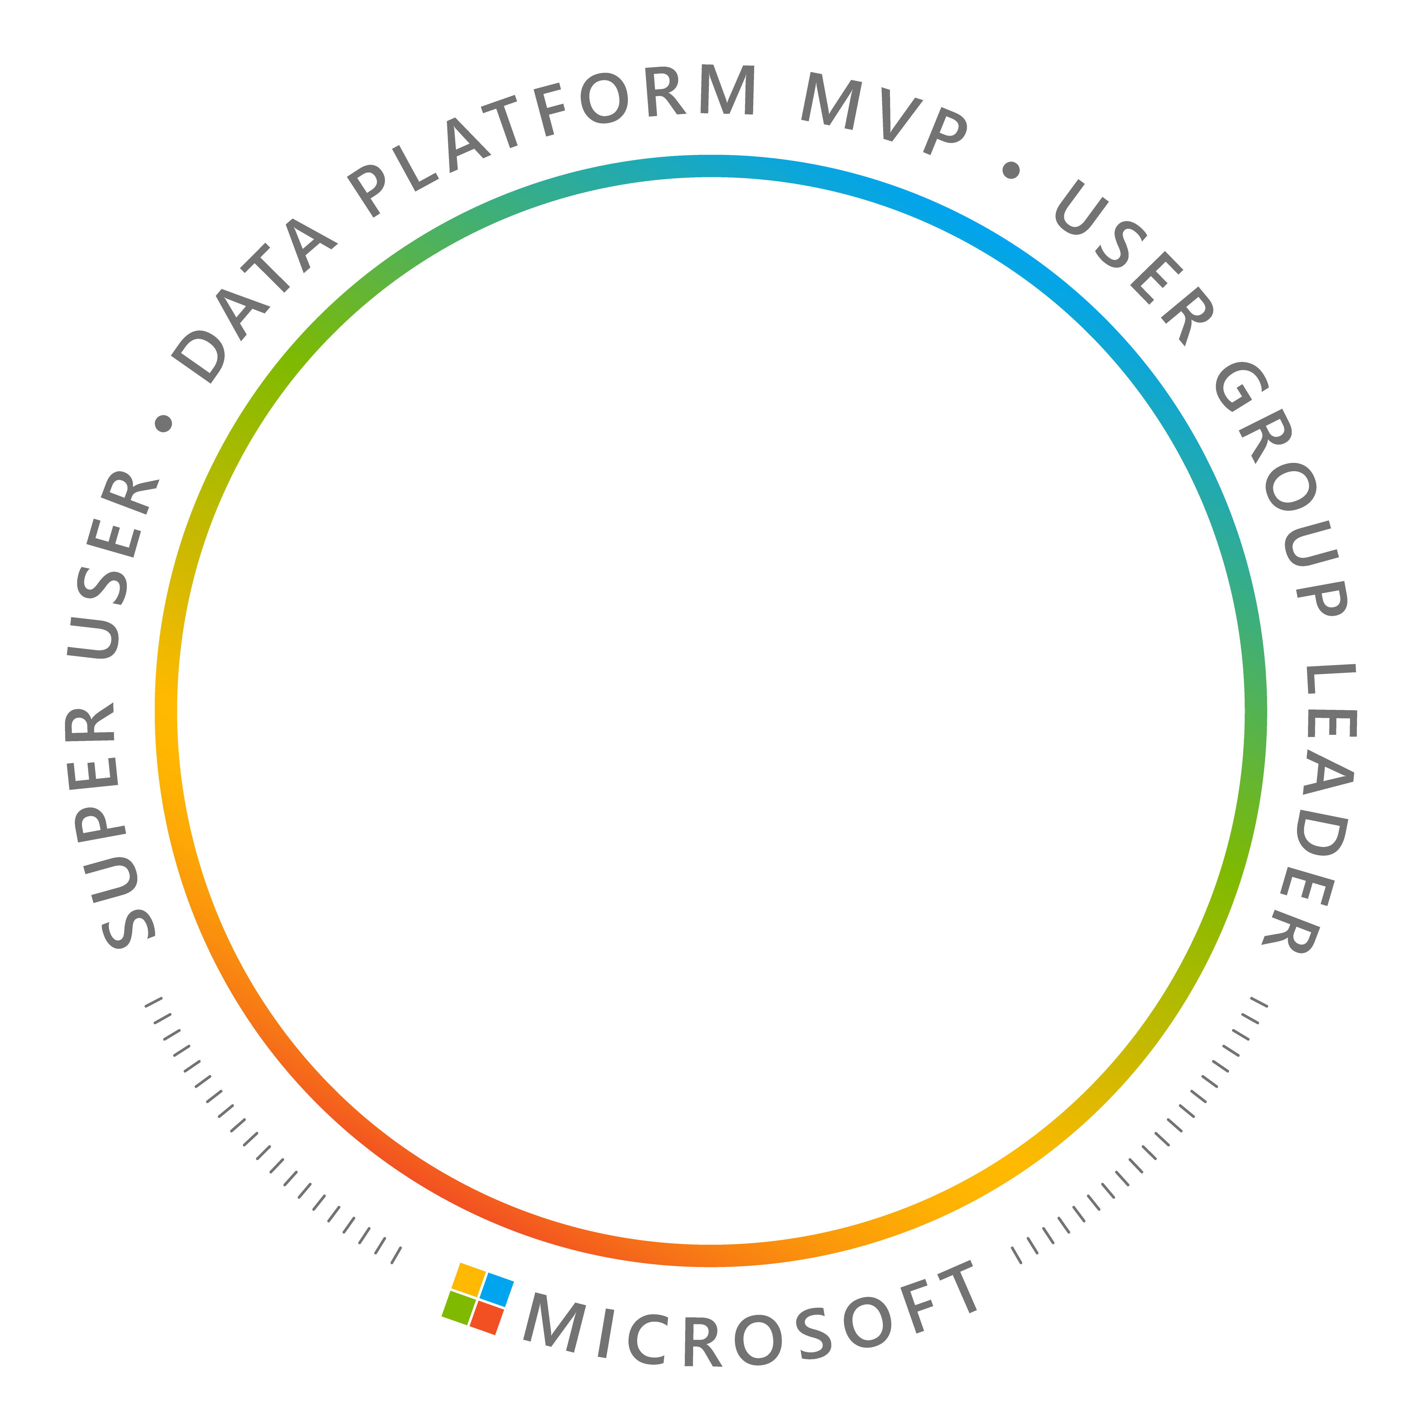



Jake Duddy
Data Engineer, Zure UK
Microsoft MVP (Data Platform)
Fabric Super User
evaluationcontext.com

Slide 3
Agenda
CI/CD options in Fabric
Problems
fabric-cicd
Branching Strategies
Scope: deploying items between workspaces and environments.
Workspace creation, capacities, and other infrastructure belong to IaC (Terraform), and dataops are not covered today.

Slide 4
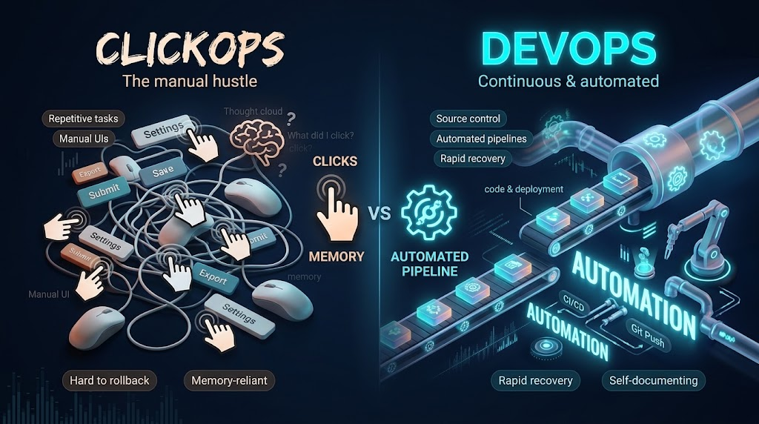

Slide 5
Why DevOps?
Automate what you already do by hand, instead of relying on runbooks and tribal knowledge.
Less manual toil
Pipelines do the repetitive deploy steps, not people
Fewer errors
Same steps run the same way every time
Isolated environments
Develop and test separately from the production that serves users
Testing and approvals
Checks and sign-off rituals built into every release

Slide 6
Native options
Git integration
Workspace ↔ branch sync; you commit and update
Variable libraries
One item holds a value set per environment
Deployment pipelines
UI stages dev → test → prod with deployment rules
Deployment plans
Item order and pre/post actions per deploy
REST APIs and CLI
Script it yourself: update from git, deploy stage, bulk import

Slide 7
Demo

Slide 8
Thank you! questions?

Slide 9
Thank you! questions?
Git integration
Workspace ↔ branch sync; you commit and update
Variable libraries
One item holds a value set per environment
Deployment pipelines
UI stages dev → test → prod with deployment rules
Deployment plans
Item order and pre/post actions per deploy

Slide 10
The Binding Problem

Slide 11
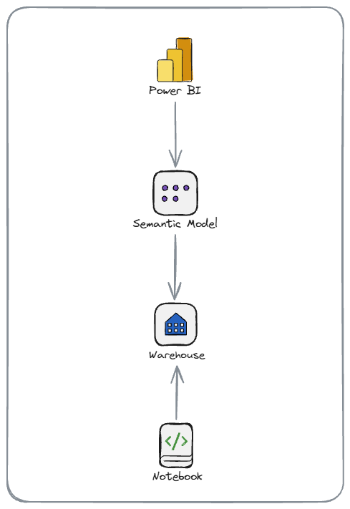
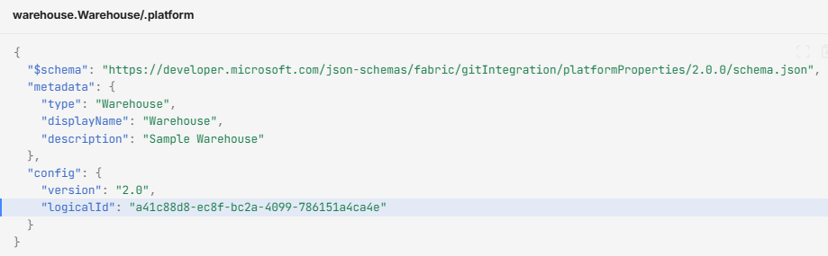
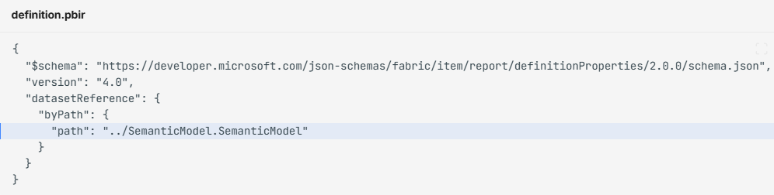
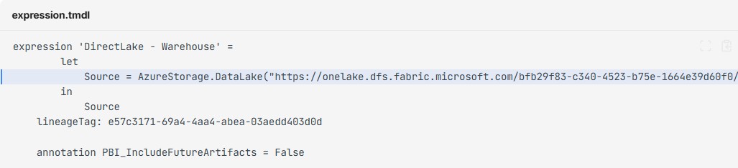
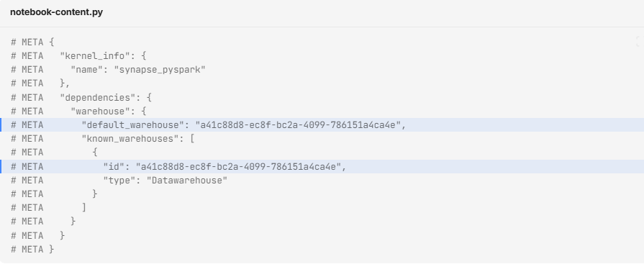
Items References
logicalId
Name/URL
objectId

Slide 12


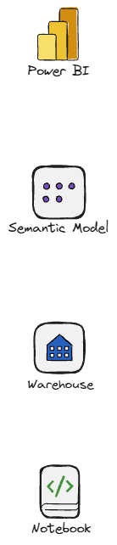

When Autobinding Fails

Slide 13
The binding matrix
Source item | Depends on | Auto-bind in Git | Why
Notebook | Lakehouse | Yes* | *Only with Lakehouse Auto-Binding in Git on, per notebook
Notebook | Environment | Yes
Pipeline | Notebook, Pipeline, Lakehouse, Dataflow | Yes
Pipeline | Spark Job Definition, Semantic model | No | Activity stores the object ID
Pipeline / Copy job | Warehouse | No | artifactId rebinds, SQL endpoint does not
Report | Semantic model | Partial | Relative byPath; paginated reports: No
Semantic model | SQL endpoint, Warehouse, KQL, SQL DB | No | Connection string holds workspace URL and GUID
Dataflow Gen2 | Lakehouse / Warehouse | Source: Partial · Dest: No | Source only when authored as relative reference
Spark Job Definition | Lakehouse | No | defaultLakehouseArtifactId is an object ID
Shortcut, Eventstream, GraphQL | Lakehouse, Eventhouse, Warehouse | Yes
Variable library | ItemReference | No | workspaceId + itemId stored as raw GUIDs
Auto Binding only work within the same workspace
Source (golden): MS Learn, Understand dependency binding in cross-workspace deployment, learn.microsoft.com/fabric/cicd/cross-workspace-dependency-binding. Abridged; check your pair there.

Slide 14
Variable libraries
Consumer item | Basic types | ItemReference | ConnectionReference
Data pipeline | Yes | Yes | Yes
Notebook (NotebookUtils) | Yes | Yes | Yes
Notebook (%%configure) | Yes | No | No
Lakehouse shortcut | Yes | Yes | No
User data functions | Yes | Yes | Yes
Dataflow Gen2 | Yes | No | No
Copy job | Yes | No | No
Deployment plan (preview) | Yes | No | No
Eventstream | Yes | No | No
Plan (Fabric IQ) | Yes | No | No
Semantic model, report, Environment | No | No | No
Problems
Chicken-and-egg: the target item must exist before its GUID can be recorded, so a fresh environment cannot be pre-authored.
Active set is workspace state: a new workspace starts on the Default value set.
The library must live in the consuming item's workspace.

Slide 15
Deployment Pipelines
Item | Data source rule | Parameter rule | Default lakehouse rule
Semantic model | Yes | Yes | No
Dataflow Gen1 | Yes | Yes | No
Paginated report | Yes | No | No
Mirrored database | Yes | No | No
Notebook | No | No | Yes
Everything else (pipelines, Dataflow Gen2, lakehouses, warehouses, reports, KQL, Eventstream) | No | No | No
Problems
Three rule types, five item types
Set per item, per stage, in the UI. A rule exists only once the item is in the target stage, so the first deploy carries dev's configuration.
No source control
No approvals
Source: Microsoft Learn, Create deployment rules, 2026.

Slide 16

Deployment plans
Problems
fabric-cicd doesn't support them
Stops at the first failed item or action

Slide 17
fabric-cicd
Code-first deployments for Microsoft Fabric

Slide 18
What is fabric-cicd
Open-source Python library from Microsoft
Deploys a repo folder into a workspace
Abstraction over the Fabric REST APIs

Slide 19
Supported item types
Anything with source control support and a public create/update API.
Notebook
Environment
DataPipeline
Dataflow
CopyJob
SemanticModel
Report
VariableLibrary
SparkJobDefinition
UserDataFunction
Lakehouse *
Warehouse *
SQLDatabase *
MirroredDatabase *
Eventhouse
KQLDatabase
KQLQueryset
Eventstream
Reflex
GraphQLApi
* Metadata only. The item is created, the data is not moved. Tables, schema and rows are your job

Slide 20
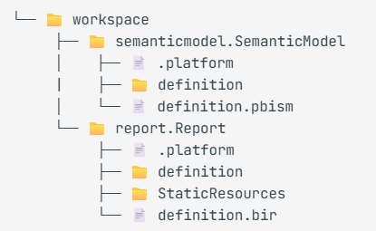
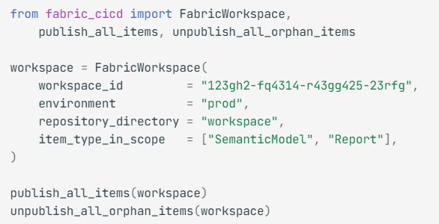
The basic deployment: deploy.py

Slide 21
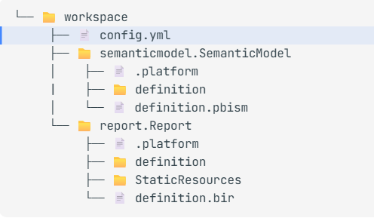
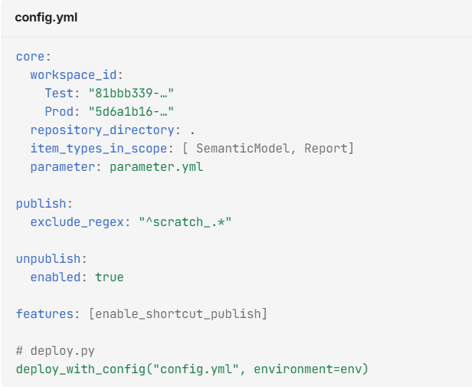
Config Deployment

Slide 22
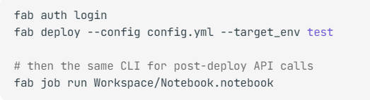
Fabric CLI

Slide 23
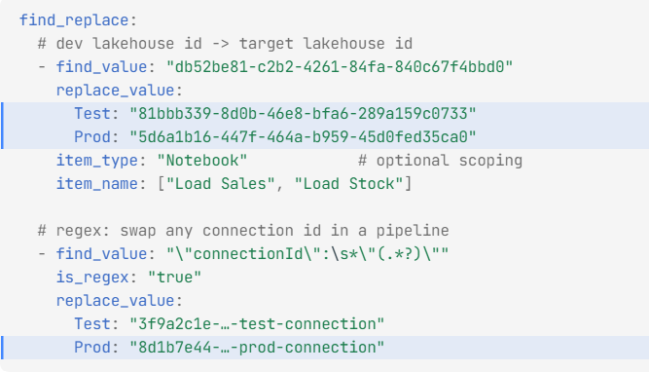
parameter.yml

Slide 24
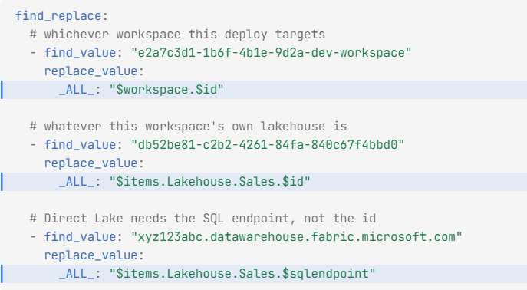
Dynamic replacement
We can define how an item should connect in different environment before items ever exist, we don’t need the objectId beforehand

Slide 25
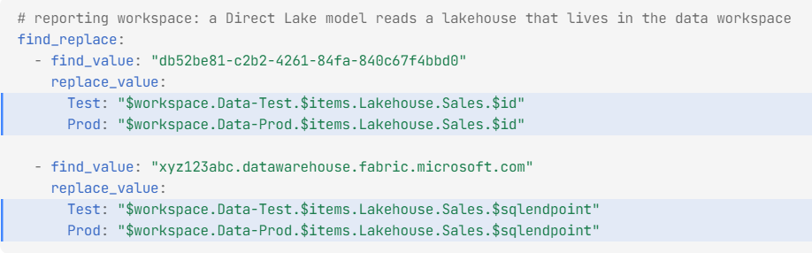
Cross-workspace replacement

Slide 26
Bulk publish
FABRIC-CICD
# one Bulk Import Item Definitions API call per dependency tier instead of one request per item
append_feature_flag("enable_experimental_features")
append_feature_flag("enable_bulk_publish") # or: fab deploy --config config.yml --bulk_publish
How it works
one call per tier, Fabric orders within it
Faster than serial publish; Fabric's own dependency handling decides the order inside each call
Items are published as a unit, so a failure surfaces per batch rather than per item
Still behind the experimental feature flag; check the release notes before relying on it
Since 1.4.0 (7 Oct 2026)
dynamic variables work on the bulk path
Builds a dependency graph from $items.* references and publishes in tiers, one bulk call per tier
Waits for SQL endpoints and query URIs to provision between tiers
Variables are validated before the deploy starts, so a bad rule fails fast instead of mid-run
Source: fabric-cicd docs, Optional features; fabric-cicd changelog v1.4.0 (7 Oct 2026), dynamic replacement variables in bulk publish mode (#1117)

Slide 27
Branching strategies
STRATEGIES · BRANCHING
Strategy | Branches | Workspaces | Pick it when
Trunk-based | feature/* → main | Dev syncs main; Test and Prod deployed from a tag or commit | Small team, fast cadence, strong CI
Release branches | feature/* → main → release/x.y | Dev and Test follow main; Prod follows release/* | You need a stable cut to test and hotfix while main moves on
Branch per environment | feature/* → dev → test → main | One workspace per branch, all via Git integration | No pipeline yet; promotion is a merge
GitFlow | develop, release/*, hotfix/*, main | Dev follows develop; Prod follows main | Many parallel releases; usually too heavy for data teams

Slide 28



Branching and workspaces
STRATEGIES
pull request
cut
feature/*
main (default)
release/*
Git integration
fabric-cicd, on merge
fabric-cicd
fabric-cicd, on approval
fabric-cicd
Feature workspace
Dev workspace
Test workspace
Prod workspace

Slide 29
Demo
Deploy to test and prod with fabric-cicd and Azure DevOps
Notes:
Remember to deploy without

Slide 30
One identity per tier, no humans in prod
Non-prod SPN
dev and test workspaces
Admin on Dev and Test workspaces only
Used by CI and by the Test stage
Developers: Contributor on Dev, Viewer on Test
Prod SPN
production workspaces only
Admin on Prod workspaces, nothing else
Own service connection, usable only by the Prod stage of deploy.yml
Workload identity federation: no secret to leak or rotate
People in prod
no standing elevated access
Developers and users: Viewer at most
Break-glass through Entra PIM: eligible role, time-boxed, justified, approved, audited
Every other change arrives through release/*
If a person can edit prod by hand, the pipeline is optional. Remove the permission and the pipeline becomes the only door.

Slide 31
Two pipelines: CI validates, CD promotes
CI pipeline
ci.yml, runs on every pull request
Lints definitions, checks parameter.yml, runs notebook unit tests
Dry-run or transient deploy with the non-prod identity
Wired in as branch-policy build validation
Out of scope for today
Deployment pipeline
deploy.yml, runs on merge and release
Promotes one known commit to one workspace
fabric-cicd publish, then unpublish orphans
main deploys Test; release/* deploys Prod
Runs as the identity of the target tier

Slide 32
Deployment strategies
Strategy | Trigger | What you get | Trade-off
Deploy on merge | Every merge to main runs the Test stage | Lowest latency; Test always equals main | Every commit lands in Test, so CI has to be good
Release-branch cut | Creating release/x.y runs the Prod stage behind an approval | Batches tested changes; hotfix on the branch; main keeps moving | Branches to tidy up afterwards
Tag-based promotion | Pushing tag v1.2 runs the Prod stage | Immutable pointer; rollback is redeploying the previous tag | Tags are easy to push by mistake; guard with conditions
Manual run | Someone runs the pipeline and picks environment and commit | Full control; fine for redeploys and rollbacks | Click-ops creeps back in
Mix them by tier: deploy on merge for Test, release-branch cut for Prod.
Keep the manual run for rollback only: same pipeline, pointed at the previous release branch.

Slide 33
Azure DevOps controls on deployment
Branch policies
on main and release/*
Minimum reviewers, no self-approval
Build validation runs ci.yml before merge
No direct pushes; release/* is created from main only
Environment checks
Prod is an ADO Environment, not just a stage
Approvals: named approvers, not the requester
Branch control: only refs/heads/release/* may deploy
Exclusive lock, business hours, required YAML template
Identity and secrets
who the pipeline is when it runs
One service connection per tier, with pipeline permissions
Workload identity federation, no client secret
Variable groups linked to Key Vault; deployment history per environment
Approval gates live on the Environment, so every pipeline that targets prod inherits them.
Branch control plus a release/*-only trigger means a stray push to main can never reach production.

Slide 34
Takeaways
WRAPPING UP
Native features are incomplete
fabric-cicd most complete solution
Single workspace story is good, multi-workspace still painful
Deployment plans start to cover Data-ops
DevOps is automating what you team already does, and makes it repeatable. Pick an approach that works for you!

Slide 35
Resources
WRAPPING UP
fabric-cicd documentation and source
microsoft.github.io/fabric-cicd · github.com/microsoft/fabric-cicd
Dependency binding matrix (golden source)
learn.microsoft.com/fabric/cicd/cross-workspace-dependency-binding
Optimizing for CI/CD in Microsoft Fabric (Knightley et al.) · Azure DevOps tutorial
blog.fabric.microsoft.com/en-us/blog/optimizing-for-ci-cd-in-microsoft-fabric · learn.microsoft.com/fabric/cicd/tutorial-fabric-cicd-azure-devops
EvaluationContext.com
https://evaluationcontext.com/#category=cicd

Slide 36
Thank you! questions?

