Slide 1
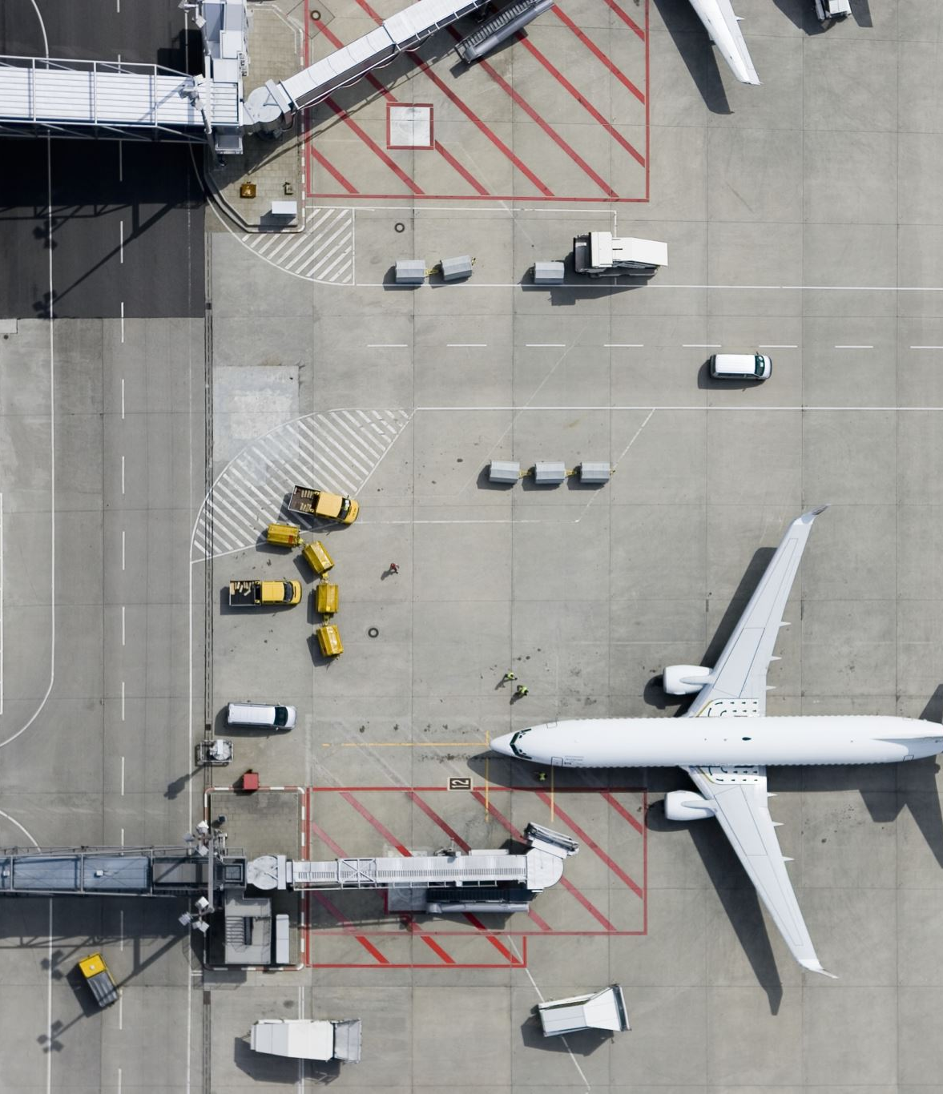
Predicting Airport Delays
By Jonathan Hooper,
Evan Burch, and Anurag Dwivedi

Slide 2
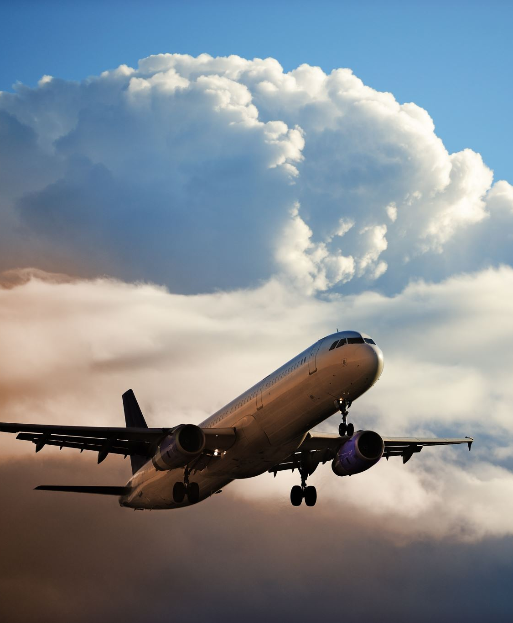
Problem Statement
As global population grows and time becomes more precious, air travel is essential for long-distance mobility. The IATA predicts 4.7 billion air passengers in 2024, up from 4.5 billion in 2019. Yet, flight delays remain a significant challenge. According to the Bureau of Transportation and the FAA, flight delays increased from ~19% to ~21% in 2023, costing over $30 billion annually.

Slide 3
Related Works
Meel P, et. al [3] designed 5 models to predict flight delay based on machine learning models such as Logistic Regression, Decision Tree Regression, Bayesian Ridge, Regression and Gradient Boosting Regression.
Domestic flights in 2015
Strength: utilization of data visualizations
Weakness: meteorological statistics
Chakrabarty, Navoneel, et al [4] proposed a machine learning model using Gradient Boosting Classifier for predicting flight arrival delay in 2019.
Strength: handling imbalance of dataset

Slide 4

Data Set
This dataset is a comprehensive collection of flight-related information for the year 2019, encompassing a wide array of attributes that describe various aspects of flight operations.
The dataset consists of 26 attributes, offering a balanced blend of different data types.

Slide 5
Month | Month
DAY_OF_WEEK | Day of Week
DEP_DEL15 | TARGET Binary of a departure delay over 15 minutes (1 means there was a delay)
DEP_TIME_BLK | Departure time block
DISTANCE_GROUP | Distance group to be flown by departing aircraft
SEGMENT_NUMBER | The segment that this tail number is on for the day
CONCURRENT_FLIGHTS | Concurrent flights leaving from the airport in the same departure block
NUMBER_OF_SEATS | Number of seats on the aircraft
CARRIER_NAME | Carrier
AIRPORT_FLIGHTS_MON | Avg Airport Flights per Month
AIRLINE_FLIGHTS_MON | Avg Airline Flights per Month
AIRLINE_AIRPORT_FLIGHTS_MONTH | Avg Flights per month for Airline AND Airport
AVG_MONTHLY_PASS_AIRPORT | Avg Passengers for the departing airport for the month
AVG_MONTHLY_PASS_AIRLINE | Avg Passengers for airline for month
FLT_ATTENDANTS_PER_PASS | Flight attendants per passenger for airline
GROUND_SERV_PER_PASS | Ground service employees (service desk) per passenger for airline
PLANE_AGE | Age of departing aircraft
DEPARTING_AIRPORT | Departing airport
LATITUDE | Latitude of departing airport
LONGITUDE | Longitude of departing airport
PREVIOUS_AIRPORT | Previous airport that aircraft departed from
PRCP | Inches of precipitation for day
SNOW | Inches of snowfall for day
SNWD | Inches of snow on ground for day
TMAX | Max temperature for day
AWND | Max wind speed for day
Data Set Features

Slide 6
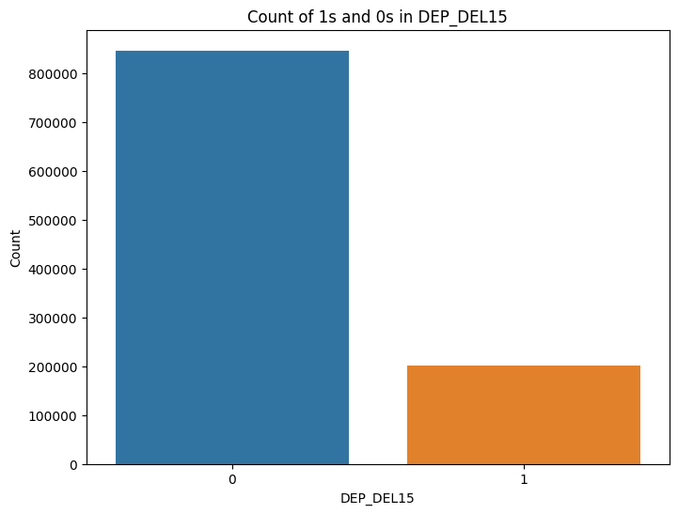
How many Flights Delayed
0 = On-time 1 = Delayed

Slide 7
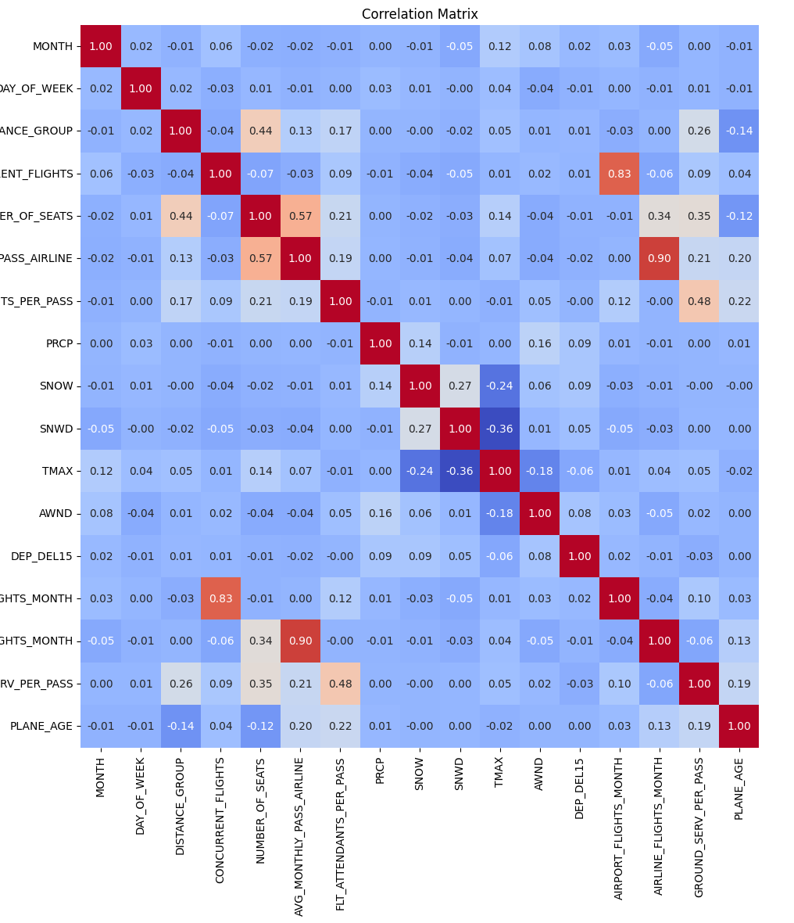
Data Collection/Analysis
The dataset used in our analysis was acquired from Kaggle [5]; the data was acquired and provided by Bureau of Transportation and NOAA
In our data analysis process, we focused primarily on data visualization, cleaning, and wrangling methods to prepare the dataset for exploration.
Utilization of box plots and histograms for data visualization, gaining insights into distribution and tendencies.

Slide 8

Data Preprocessing
Preprocessing steps:
Fill in missing values
Outlier Analysis
Feature Engineering
Used LabelEncoder(): Converting Categorical labels into numerical variables

Slide 9

Machine Learning Models
Logistic Regression: This is a fundamental algorithm for binary classification problems.
K-Nearest Neighbors (KNN): KNN is a supervised machine learning algorithm used to solve classification and regression problems.
Decision Tree Classifier: This algorithm uses a tree-like model (set of rules) to make decisions; similar to how humans make decisions.

Slide 10
Logistic Regression
Target feature imbalance likely causing poor F1 score
Attempted to use RSMOTE to solve this
Accuracy Measures
accuracy: 80.83%
f1_score: 0.03
roc_auc_score: 50.60%

Slide 11

K-Nearest Neighbors (KNN)
Hyper-Parameters via GridSearchCV
n_neighbors: [3, 5, 7, 9],
weights: ['uniform', 'distance'],
metric: ['euclidean', 'manhattan', 'minkowski']
Accuracy Measures
accuracy: 80.06%
f1_score: 0.31
roc_auc_score: 58.60%

Slide 12
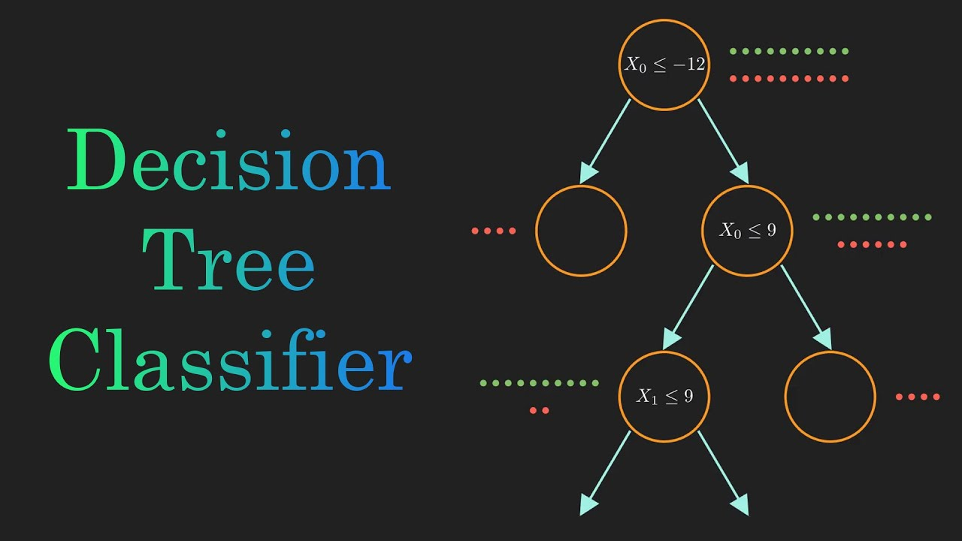
Decision Tree Classifier
Hyper-Parameters via GridSearchCV
random_state: range(100)
Accuracy Measures
accuracy: 76.80%
f1_score: 0.32
roc_auc_score: 58.60%

Slide 13
Results
Machine Learning Algorithms | Test Accuracy | F1 Score | ROC Accuracy
Logistic Regression | 80.83% | 0.03 | 50.60%
KNN | 80.06% | 0.31 | 58.60%
Decision Tree Classifier | 76.80% | 0.32 | 58.60%

Slide 14
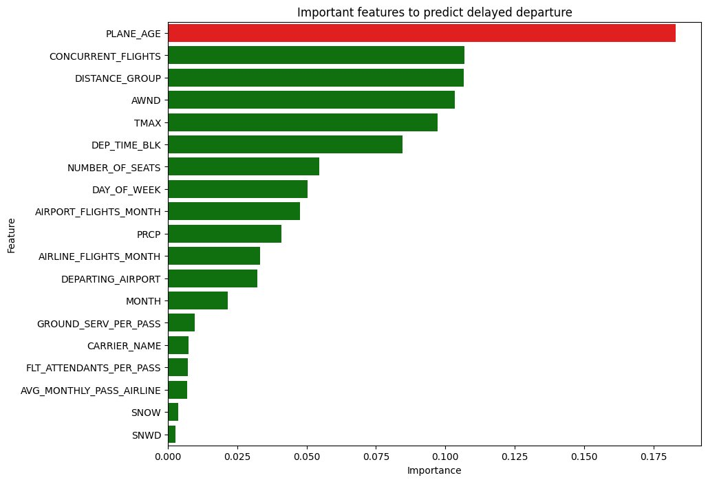
Feature Importance

Slide 15
Conclusion
We are able to build a few machine learning models to accurately predict whether a flight will be delayed or not. By leveraging our extensive dataset of flight schedules, weather, airport operations, and passenger trends, these models discern key delay factors and enhance forecasting accuracy, aiding stakeholders in preempting and addressing disruptions. Such advancements improve reliability for passengers, optimize airline operations, and enhance resource utilization for airports, fostering a more sustainable and economically beneficial airline industry.

Slide 16
Future Improvements
More in-depth data visualizations
Different Models: Try more complex models such as Random Forests, Gradient Boosting Machines, or Neural Networks which might be better at handling complex patterns.
Algorithmic Approaches: Use algorithms specifically designed to handle imbalanced datasets, such as SMOTE for over-sampling or ensemble methods like Balanced Random Forest.
Evaluation Metrics: Since the dataset is imbalanced, metrics like f1-score, precision-recall curve, and AUC-PR might be more appropriate for evaluating model performance than accuracy.

Slide 17
References
[1] Dooley, R. (2024, February 20). Survey predicts air travel boom for 2024: What it means for passengers. Forbes. https://www.forbes.com/sites/rogerdooley/2023/12/06/air-travel-boom-predicted-for-2024/?sh=4c20537fabf7
[2] OST_R: BTS: Transtats. BTS. (n.d.). https://www.transtats.bts.gov/homedrillchart.asp
[3] P. Meel, M. Singhal, M. Tanwar and N. Saini, "Predicting Flight Delays with Error Calculation using Machine Learned Classifiers," 2020 7th International Conference on Signal Processing and Integrated Networks (SPIN), Noida, India, 2020, pp. 71-76, doi: 10.1109/SPIN48934.2020.9071159.
[4] Esmaeilzadeh, E., & Mokhtarimousavi, S. (2020). Machine Learning Approach for Flight Departure Delay Prediction and Analysis. Transportation Research Record, 2674(8), 145-159. https://doi.org/10.1177/0361198120930014
[5] Wadkins, J. (2022, January 17). 2019 airline delays w/weather and airport detail. Kaggle. https://www.kaggle.com/datasets/threnjen/2019-airline-delays-and-cancellations/data

