Slide 1
Cobalt Database Project
By Evan Liberto

Slide 2
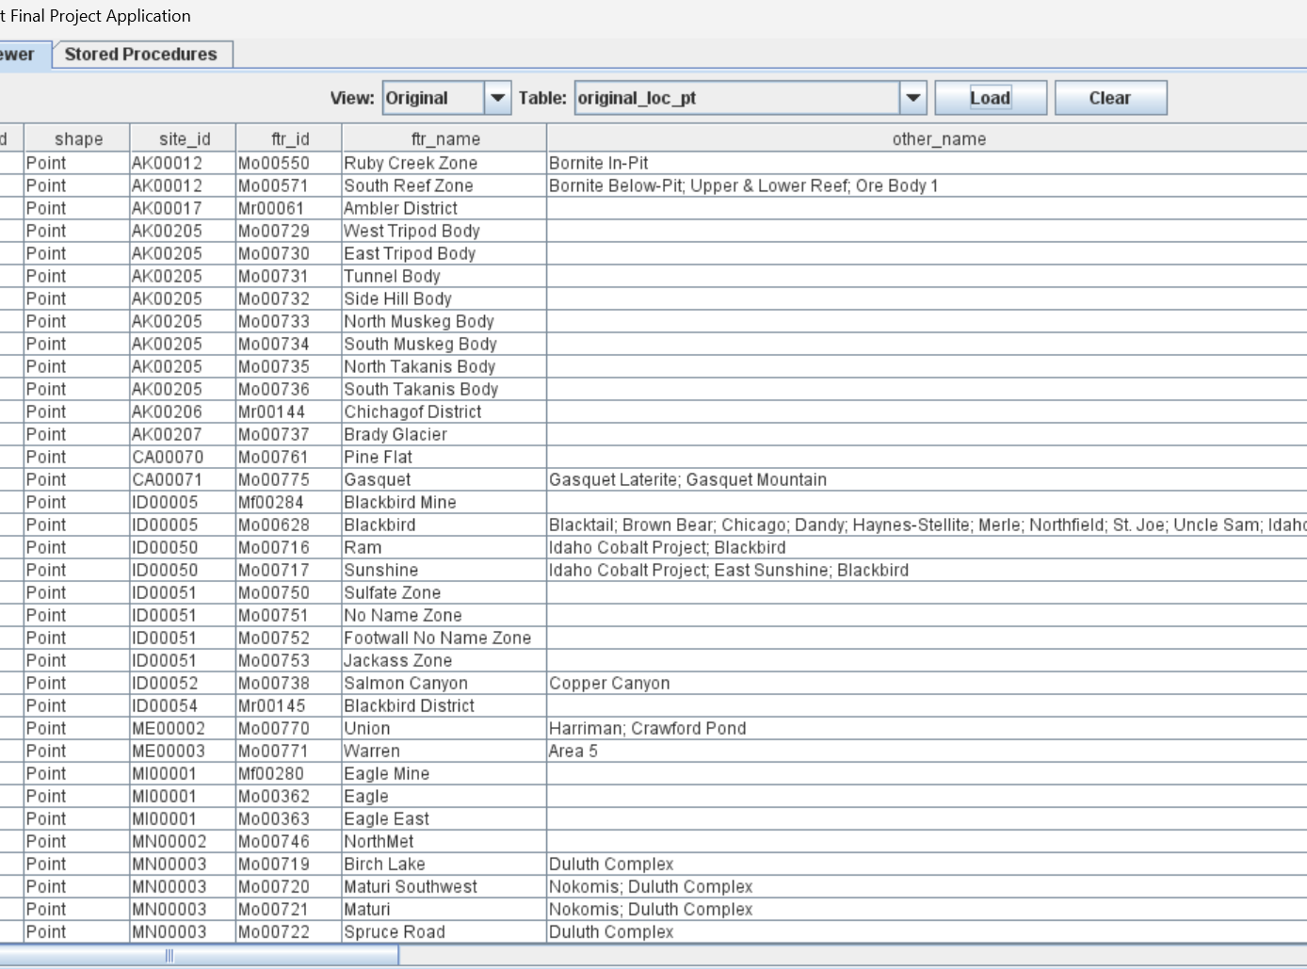
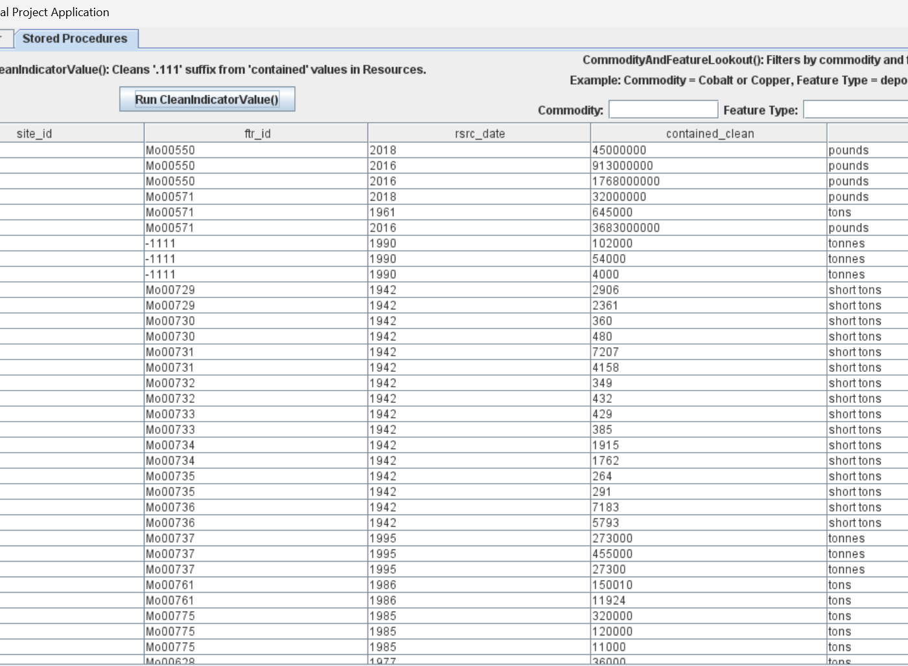
Overview of Final Project
Java application for viewing and exploring USGS cobalt data
Connects to MySQL database using embedded SQL
Displays both original and normalized tables
Two stored procedures.
Designed with an interactive GUI using Java Swing

Slide 3
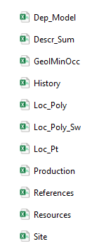
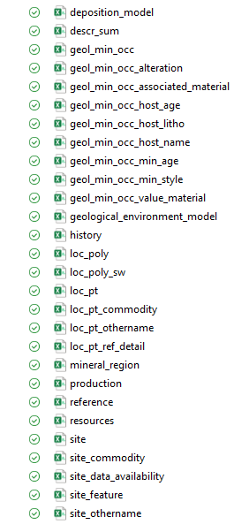
What I’m Most Proud Of
Normalization
Started with 11 CSV files.
Full of overlapping data
Multivalued attributes.
After bringing all the tables to 3NF, I had designed a database with 28 different tables.
Created scripts to populate normalized tables from the original data.
Linked related tables to each other using foreign key relationships.

Slide 4
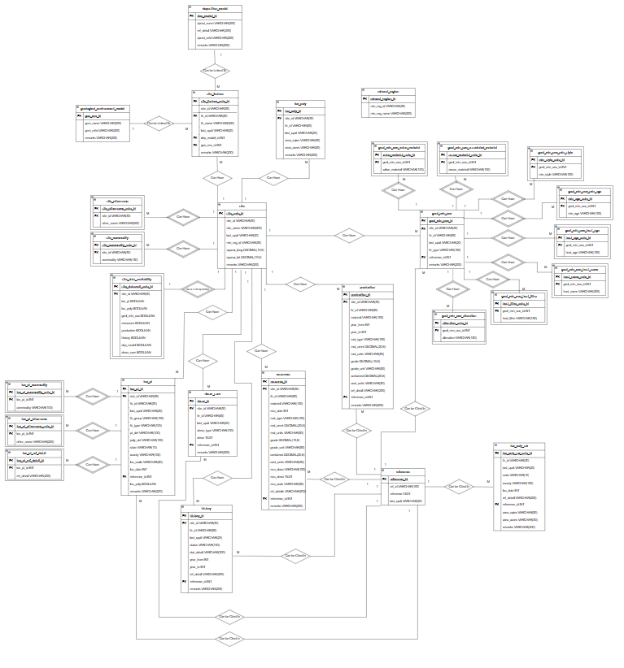
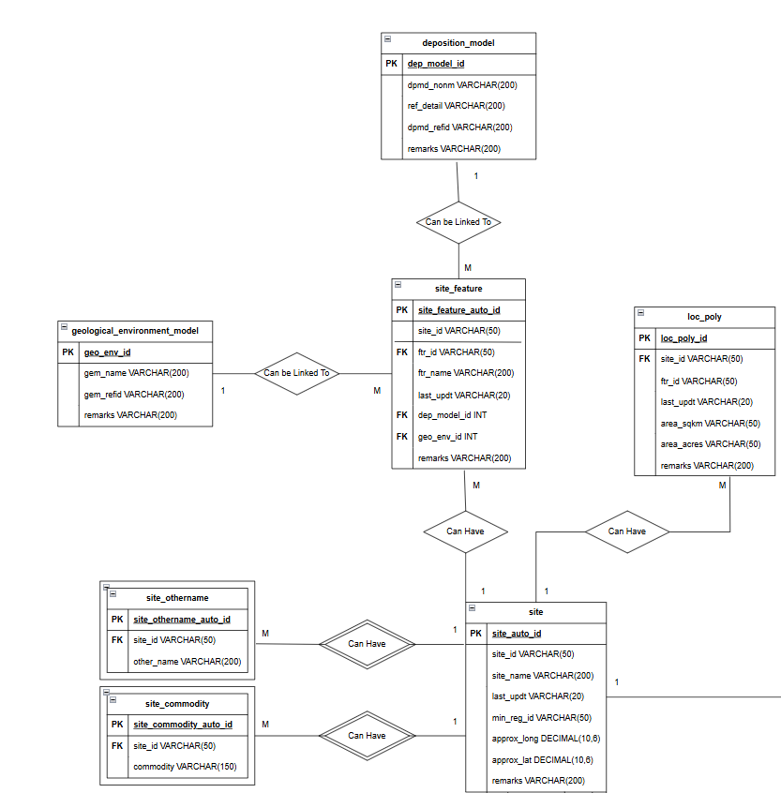
ER Diagram
Strong and Weak Relationships
Primary and Foreign Key Relationships
Resolved all Many to Many Relationships

Slide 5
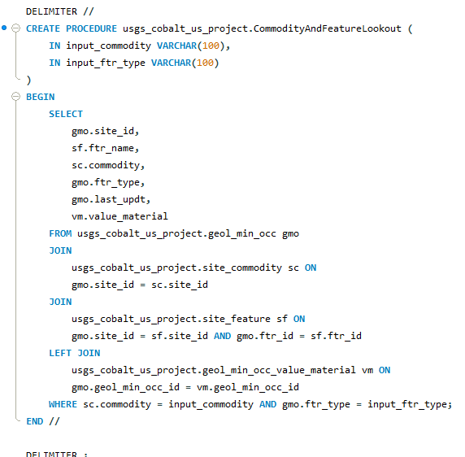
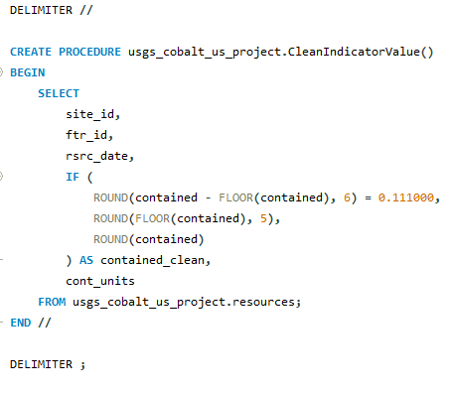
Custom SQL Procedures

Slide 6
Thank You

