Slide 1
Software Development 3
Introduction

Slide 2
Information
Martina Curran
Room: W304
Email: mcurran@ait.ie

Slide 3
About this course
1 Semester
4hrs a week
Practical
Attendance is Compulsory!

Slide 4
Learning outcomes
Explain the performance implications of developing software with specific programming language – Java
Explain what an architectural design pattern is. Select and apply an architectural design pattern in order to solve a real world problem.
Explain what abstract classes and interfaces are, suggesting when it is appropriate to use each.
Design and implement client server communication.
Design and implement a 3 tier architecture (user interface, business logic, persistence) in Java.

Slide 5
Marking Scheme
Weekly Assignments | Approx Weeks 3 & 7 | 10% (5% each)
Project | End of Semester | 20%
Exam (Alternative Assessment) | End of Semester | 70%

Slide 6
Overview of JAVA- Platform Independence
Traditional compiler:
A compiler takes source code and compiles it into machine code which can be understood by one particular operating system. C++ is compiled in this way i.e. the .C code files are compiled to .exe machine code files on a PC.
The compiler is dependent on the operating system.
code
PC
compiler
LINUX
compiler
UNIX
compiler
compiling
PC MC
LINUX MC
UNIX MC
Machine code

Slide 7
Overview of JAVA- Platform Independence
In JAVA Compiling is split into a 2 stage process - compiling source code and interpreting the resulting byte code.
Each machine has its own set of machine instructions called machine code.
Java compiler creates common byte code.
A platform dependent JVM interprets the byte code ( i.e. converts the common byte code into a particular machine code) e.g. machine code for a PC

Slide 8
Overview of JAVA- Platform Independence
Java code. (.java files)
Java Bytecode (.class files)
Java Compiler (javac command)
Interpeting (java command)
(1) compiling
(2) interpreting
SPARC
Power PC
Pentium
Java Bytecode (.class files)

Slide 9
Overview of JAVA- Platform Independence
A platform dependent JVM converts the common byte code into machine instructions which can be understood by its operating system. This is called “interpreting”.
So a separate JVM is needed for different platforms. The JVM for UNIX/NT/Linux are different but take common bytecode as their input.
Interpreters are slower than compilers because they translate as they go.
Using the “Just-In-Time” compiler, Java increases the execution speed which rivals that of C++.

Slide 10
Overview of JAVA- JRE, JVM,JDK
JVM - Java Virtual Machine
JVM is the Java interpreter (“java” command). One JVM needed per platform type e.g. UNIX. Converts byte code (.class files) in to machine code which can be understood by an OS.
Note: Have to have the JVM in order to execute class files. This is different to traditional compilation methods.

Slide 11
Overview of JAVA- JRE, JVM,JDK
JRE - Java Run Time Environment
The JRE is a set of files and contains the JVM, Java core classes, and supporting files.
JRE is used to execute programs by end users.

Slide 12
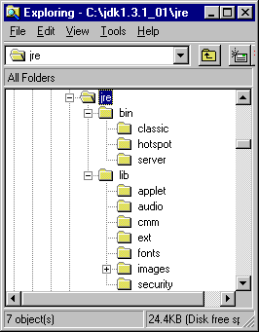
Overview of JAVA- JRE, JVM,JDK
JRE - Java Run Time Environment
Directory structure of the JRE.
All these files are part of the JRE.
The JVM is in the /bin directory.

Slide 13
Overview of JAVA- JRE, JVM,JDK
JDK - Java Development Kit
The JDK is a set of tools used by software designers to develop JAVA code. Example of a tool is an appletviewer.
The JDK includes a JRE directory as developers will also need to run their code to test it.

Slide 14
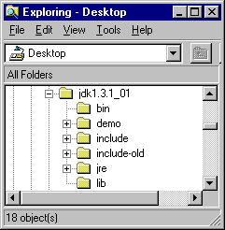
Overview of JAVA- JRE, JVM,JDK
JDK - Java Development Kit
Directory structure of the JDK.
The JRE has its own directory within the JDK.

