Slide 1
Software Development 3
RMI

Slide 2
Distributed Programming in Java
Many different techniques for building client/server systems
  Use low level sockets
  Use JDBC to make database queries and updates
  Use Java’s remote method invocation (RMI) to communicate between remote Java objects
  Use an object request broker that supports Java

Slide 3
RMI
RMI applications often comprise two separate programs:
  Client
  Server

Slide 4
RMI Server
A typical server program:
  Creates some objects.
  Makes these objects remotely accessible
  Waits for clients to invoke methods on these objects.

Slide 5
RMI Client
A typical client program:
  Obtains a remote reference to one or more remote objects on a server.
  Invokes methods on remote object.

Slide 6
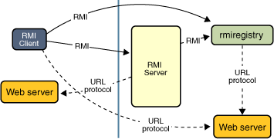
RMI
RMI provides the mechanism by which the server and the client communicate and pass information back and forth. Such an application is sometimes referred to as a distributed object application.

Slide 7
Remote Class
A Remote Class has two parts: the interface and the class itself.
  The Remote interface must have the following properties:
    The interface must be public.
    The interface must extend the interface java.rmi.Remote.
    Every method in the interface must declare that it throws java.rmi.RemoteException. Other exceptions may also be thrown.

Slide 8
Create an RMI Application
Create a new Java Project for this example!

Slide 9
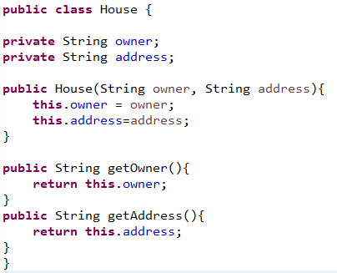
Create an RMI Application
Suppose we want to be able to access a House Class (Local Version) remotely:

Slide 10
Remote Class
In order to make House Remote (also called distributed) it will need to have the following properties:
  It must implement a Remote interface.
  It should extend the java.rmi.server.UnicastRemoteObject class.
    Objects of such a class exist in the address space of the server and can be invoked remotely.
  It can have methods that are not in its Remote interface. These can only be invoked locally.

Slide 11
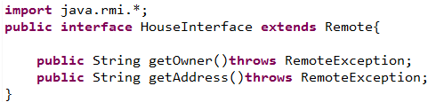
The Remote Interface Called “HouseInterface”

Slide 12
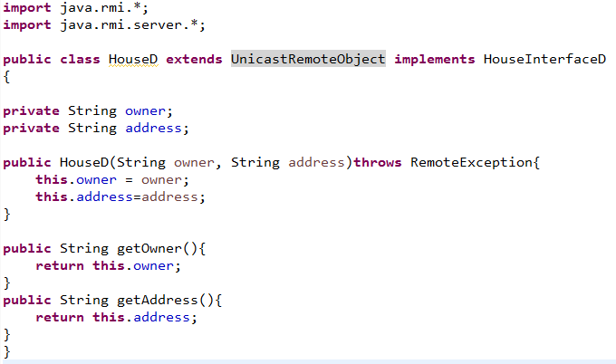
House Class (Distributed Version)

Slide 13
The Server
Register at least one remote object must be registered with the Object Registry.
  The rmiregistry Object Registry only accepts requests to bind and unbind objects running on the same machine, so it is never necessary to specify the name of the machine when one is registering an object.

Slide 14
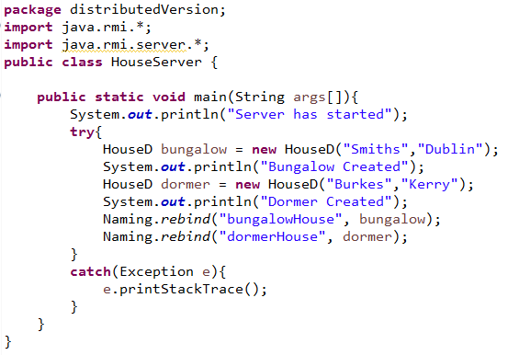
The Server

Slide 15
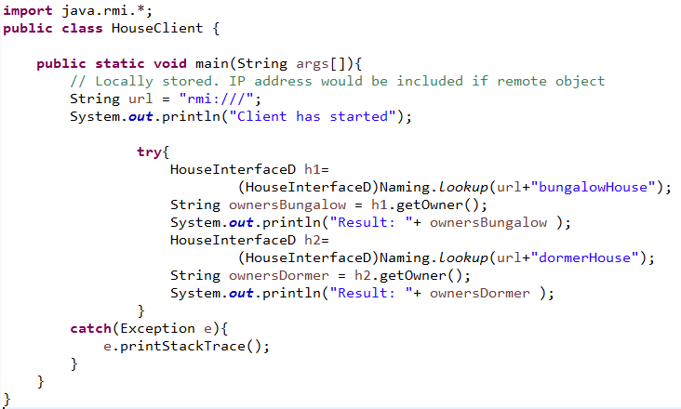
The Client

Slide 16
Running the Application
Create the code in Eclipse
Compile the code in Eclipse
You should now have 2 directories .../src ../bin
Open 3 command prompts and navigate to the bin directory
In the bin directory Run rmic program
“rmic HouseD”
  generates HouseD_Stub class
  generates HouseD_Skel class
In one of the command shells - start the RMI registry using the command “rmiregistry”
In another command shell – start the server “java HouseServer” or run in Eclipse
Later - In another command shell – start the client “java HouseClient” or run in Eclipse

Slide 17
RMI Registry
Registry server effectively maintains a table holding:
  object references
  Names
  IP addresses

Slide 18
The Client
Identify the target machine where the RMI registry and remote objects are located. In this situation no IP address is specified so the remote objects are on the same machine
String url = "rmi:///";
Request the RMI registry on the target machine to return an object reference corresponding to the well known name “bungalow”
Naming.lookup(url+ “bungalow");

Slide 19
The Client
The RMI Registry “Naming” returns all object references as type Object. In java doc you can see on the class hierarchy that the Object class is the ancestor of all classes.
Note: the object whose well known name was “bungalow” was bound in the RMI Registry as a House object reference but here it is cast as a HouseInterface. Object references of classes which implement interfaces can be stored as interface types.
(HouseInterface)Naming.lookup
(url+“bungalow");

Slide 20
The Client
h1 is a reference to the car object.
HouseInterface h1=
(HouseInterface)Naming.lookup(url+
“bungalow");
Methods can now be called on the object reference h1 as if the object was stored on the same machine
String h1Address = h1.getAddress();

