Slide 1






Web Development 3
Lecture 1 – Rich Internet Applications
Lecturer: James Byrne (jamesbyrne@ait.ie)

Slide 2



Topics
History of internet and WWW
Architecture of a web application
What is Web 2.0?
Types of web sites (content , social,..)
Rich Internet Applications
Web 2.0 technologies (E.g. AJAX, RIA’s, how JavaScript fits in)

Slide 3

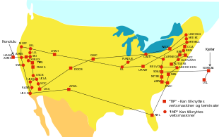
History of the Internet and the WWW
Late 1960’s , ARPA (Advanced Research Projects Agency) of the
U.S Department of Defense implemented a network of computer systems (ARPANET) of about a dozen ARPA funded universities and research institutions.
The TCP/IP communications protocols were developed for the ARPANET by computer
scientists Robert Kahn and Vint Cerf
ARPA developed the TCP and IP protocols and the ARPANET evolved into today’s Internet

Slide 4

History of the Internet and the WWW
In 1989, Tim Berners-Lee of CERN ( the European Organization for nuclear Research) began to develop a technology for sharing information via hyperlinked text documents. This was called HTML. He also wrote the Hypertext Transfer Protocol (HTTP)
In 2004 he was knighted by the Queen and in 2009 as recognized by TIME as one of the Top 100 most Important People of the 20th Century.

Slide 5
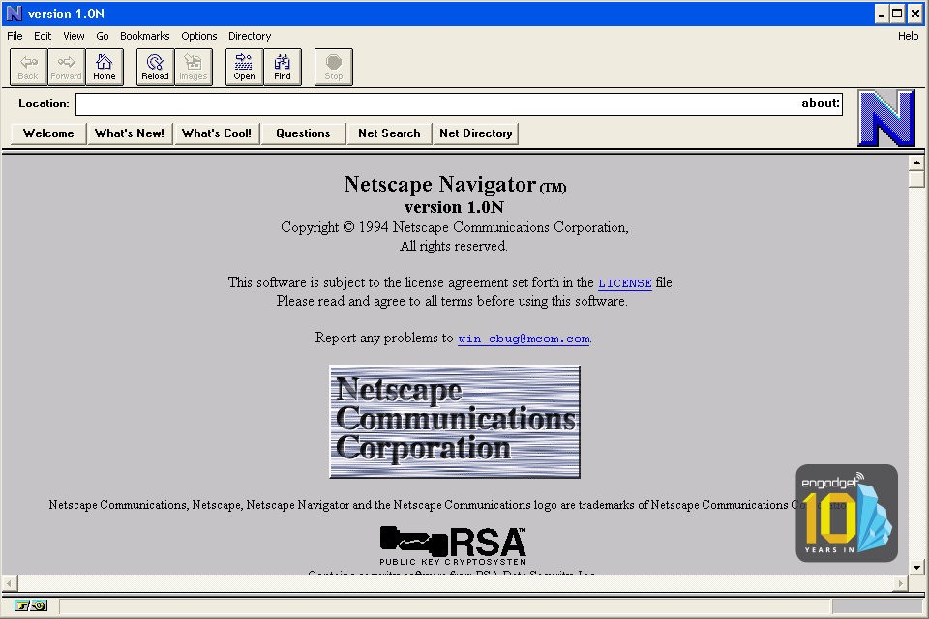
History of the Internet and the WWW
Web use exploded with the availability in 1993 of the Mosaic browser. The team that developed Mosaic, went on to found Netscape.

Slide 6
History of the Internet and the WWW
In October 1994, Tim Berners-Lee founded an organization – called the World Wide Web consortium (W3C)
W3C’s primary goal is to make the web universally accessible
W3C is now a standards organization.
Web technologies standardised by the W3C are called
Recommendations.

Slide 7
History of the Internet and the WWW
W3C recommendations include
  XHTML
  CSS
  HTML (now considered legacy)
  XML
  HTML5
Ref www.w3.org

Slide 8

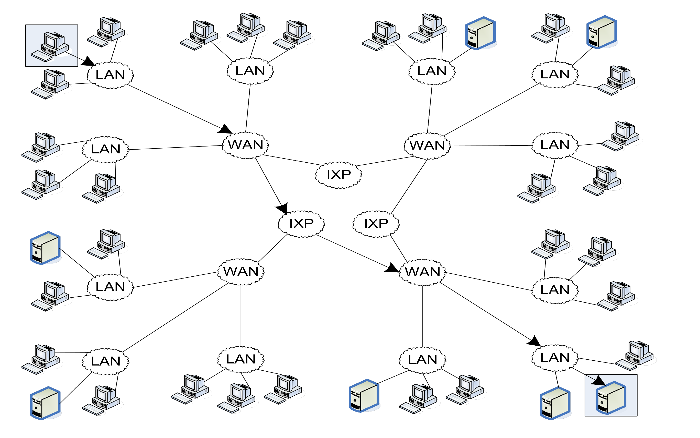
Architecture of the Internet
LAN – Local Area Network IXP – Internet Exchange Point
WAN – Wide Area Network

Slide 9

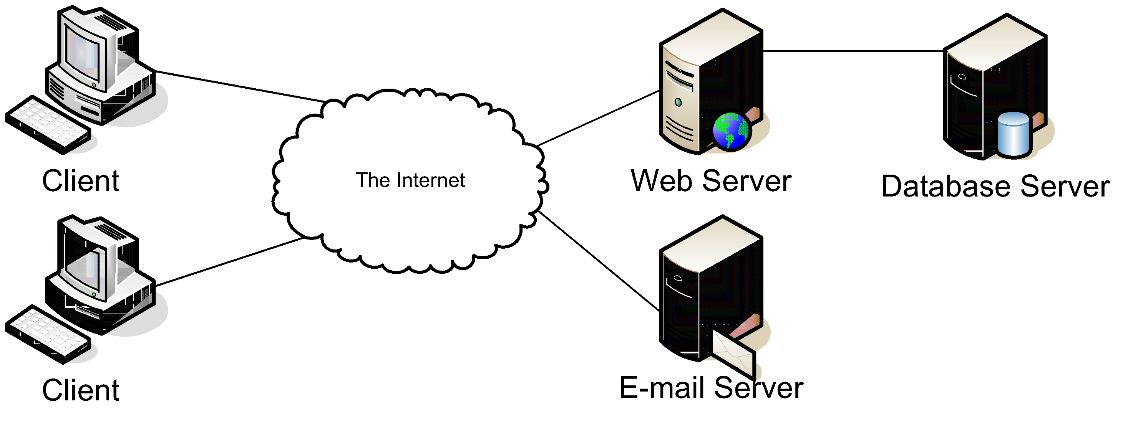
Architecture of a Web Application (Typical)
Client Tier
Server Tier
Database Tier

Slide 10

Processing a static web Page
Two Protocols that Web Pages Depend on
  Hyper-Text Transfer Protocol (HTTP)
  Transmission Control Protocol/Internet Protocol (TCP/IP)
Terms
  Hyper-Text Markup Language (HTML)
  Static Web Page
  Dynamic Web Page
  HTTP Request
  HTTP Response

Slide 11
















Processing a static web Page
HTTP request
XHTML
file
`
HTTP response
Web browser
Web server

Slide 12
Processing a static web Page
A simple HTTP request
GET / HTTP/1.1
Host: www.example.com
A simple HTTP response
HTTP/1.1 200 OK
Content-Type: text/html
Content-Length: 136 Server: Apache/2.2.3
<html>
<head>
<title>Example Web Page</title>
</head>
<body>
<p>This is a sample web page</p>
</body>
</html>

Slide 13

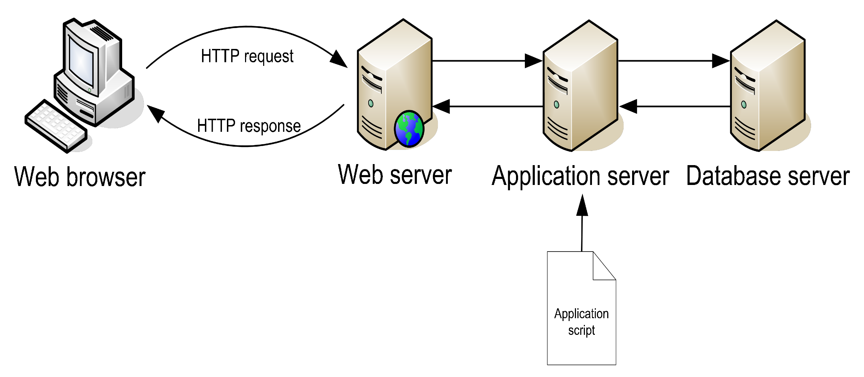



















Processing a dynamic web Page
Covered in other modules
HTTP request
`
HTTP response
Web Browser
Web Server
Database Server
Covered in this module
PHP
Script

Slide 14

Server Side Technologies and Databases
Server-side languages
  PHP
  JSP
  ASP.NET
  Perl
  Python
  Node.js
  Groovy/Grails
  Ruby on Rails
Database servers
  MySQL
  Oracle
  DB2
  MS SQL Server
  MariaDB
  Sybase
  MongoDB
. . . .
. . . .

Slide 15

What is Web 2.0?
In 2003 there was a noticeable shift in how people and business were using the web and developing web-based applications.
The term Web 2.0 was coined by Dale Dougherty of
O’Reilly Media in 2003 to describe this trend
Reference: O’ Reilly, T. “What is Web 2.0: Design Patterns and Business Models for the Next Generation of Software,” September 2005
http://www.oreillynet.com/pub/a/oreilly/tim/news/2005/09/30/what-is-web- 20.html?page=1

Slide 16



Web 2.0 compared to Web 1.0
Web 1.0 (the state of the web through the 1990s and early 2000s) was focused on a relatively small number of companies and advertisers producing content for users to
access.
static
Web 2.0 companies use the web as a platform to create community based sites (e.g. social networking sites, blogs, wikis, etc.)
dynamic

Slide 17

Characteristics of Web 2.0
Web 2.0 is characterized by participation – a design that encourages user interaction and community contributions.
Many Web 2.0 companies are built almost entirely on user-generated content. E.g. Facebook, Twitter, YouTube, eBay, Wikipedia.
Rich Internet Applications (RIAs) are being developed using technologies (such as Ajax) that have the look and feel of desktop software.

Slide 18
Characteristics of Web 2.0
Web Services allow you to incorporate functionality from existing applications and websites into your own web applications e.g. Amazon Web Services.
or create “mash-up” applications using for example Google Maps web services and eBay web services to find auction items in a certain geographical area

Slide 19

Rich Internet Applications
What are Rich Internet Applications?
  They are web applications that have the functionality and features of traditional desktop applications.
  These applications typically runs in a web browser (does not need any extra software installation)
  Transfers the processing necessary for the user interface to the web client

Slide 20

Benefits of Rich Internet Applications
Richer (Visual and User Experience)
More Responsive
Client/Server Balance
Asynchronous Communication
Network Efficiency

Slide 21

RIA Technologies
Term “RIA” introduced by Macromedia (now Adobe).
Referred to applications created using their technology
Widely used now also to refer to applications using other (non-Adobe technologies) such as Ajax.

Slide 22

RIA Technologies - AJAX
AJAX (Asynchronous JavaScript and XML), a term from Adaptive Path’s Jesse James Garret in February 2005.
AJAX allows partial page updates – meaning updates of individual pieces of a web page without having to reload the entire page.
Technologies include (HTML5, CSS, JavaScript, the DOM, XML/JSON, and XMLHttpRequest object)

Slide 23

Client/Server Roles – RIA’s
Application sent from server to client as web page with embedded code
Application running on client provides user with interactive interface
Data and business logic on server
Data sent by server in response to client requests
Client uses data to update interface. Processing now on client side and on server.
User interaction based on hyperlinks, form input, GUI controls

Slide 24

Web vs. Desktop Applications
Web Applications
  Run in a browser and do not require software installation
  Updates are transparent to the user
  User can access application from any computer
Desktop Applications
  Applications must be installed and maintained
  Rich user interface
RIAs combine the advantages of both

Slide 25

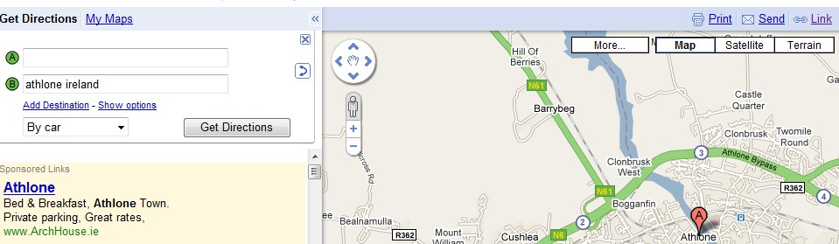
Typical Features of RIA’s
Interactive user controls, Moving and zooming map
Example- Google Maps
Partial page updates and dynamic forms(multi-purpose
panel, input boxes added dynamically)
Data retrieved interactively
From server without refreshing entire page (new map data as map is moved)

Slide 26

Web 2.0 Technology Survey
Rich Internet Application Client Technologies
AJAX client
Web Browser XHTML/HTML5
CSS(3)
Dreamweaver
JavaScript JavaScript Events DOM
Flash (adobe)
XML and RSS
Web servers
Ajax-enable RIAs Restful API
PHP(or other) Ruby on rails
ASP.NET and ASP.NET Ajax
Java Server Faces Web Services
Flex
Database
Microsoft Silverlight
Rich Internet Application Server Technology
Ref :- Internet and World Wide Web how to Program 4/e – Deitel

Slide 27
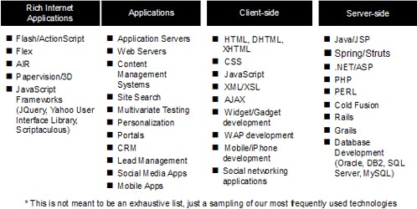
Web 2.0 Technology Survey

