Slide 1



Web Development 3
Lecture 2 – PHP Programming 1
Lecturer: James Byrne (jamesbyrne@ait.ie)

Slide 2





Topics
PHP data types, variables and constants
Getting data from a HTTPRequest (GET and POST)
Expressions, operators and functions
PHP documentation

Slide 3

History of PHP
Version | Year | Description
1 | 1995 | "Personal Home Page Tools (PHP Tools)"
2 | 1997 | PHP : Hypertext Process – First official version
3 | 1998 | Development moves to multiple people, core rewrite
4 | 2000 | Introduced the Zend Engine
5 | 2004 | Introduced Zend Engine II, Improved OOP, added PHP Data Objects
6 | - | Abandoned Version never released
7 | 2015 | Introduced Zend Engine 3. Just In Time Compilation.

Slide 4

PHP Overview
PHP is a recursive acronym for "PHP: Hypertext Preprocessor".
PHP is a server side scripting language that is embedded in HTML. It is used to manage dynamic content, databases, session tracking, even build entire e-commerce sites.
It is integrated with a number of popular databases, including MySQL, PostgreSQL, Oracle and Microsoft SQL Server.
PHP is relatively performant in its execution, especially when compiled as an Apache module on the Unix side.
PHP supports a large number of major protocols such as POP3, IMAP, and LDAP.
PHP is forgiving: PHP language tries to be as forgiving as possible.
PHP Syntax is C-Like.

Slide 5
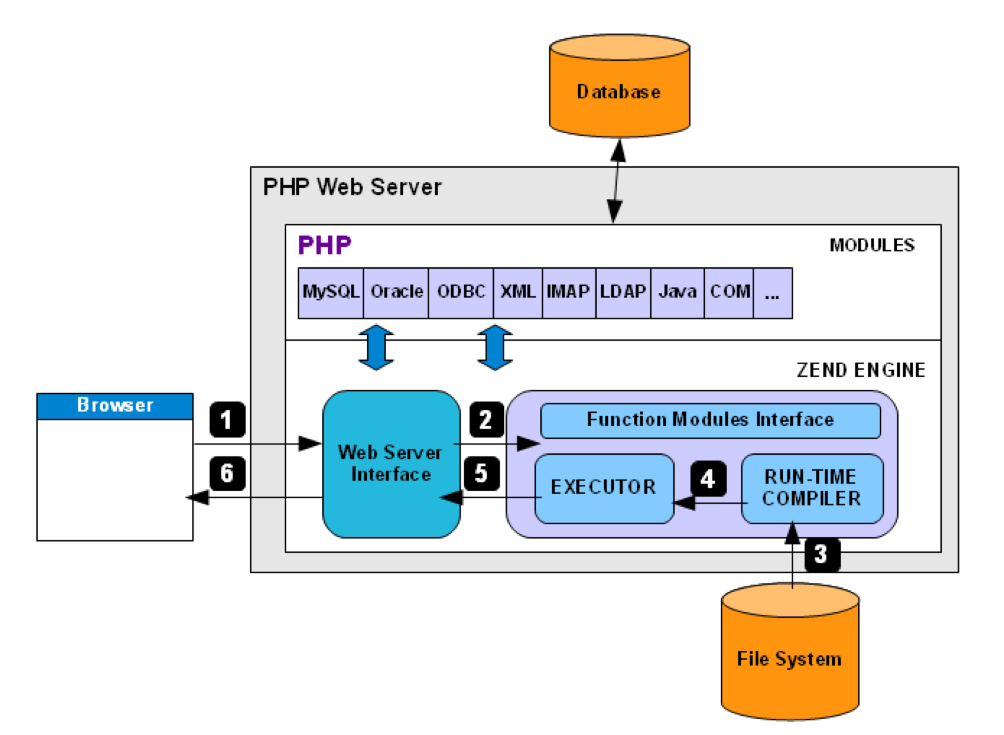


PHP Overview
Client Request
Web server forward to PHP Engine
Read PHP script from file system, compile and send to executor
Executor runs the compile code
Resulting HTML output sent to Web Server Interface
Response sent back to client
HTML output
PHP Scripts

Slide 6

Escaping to PHP
PHP parsing engine needs a way to differentiate PHP code from other elements in the page. The mechanism is known as 'escaping to PHP'.
  Canonical PHP tags (The most universally effective PHP tag style)
<?php...?> If you use this style, you can be positive that your tags will always be correctly interpreted.
  Short-open (SGML-style) tags
<?...?> Short tags are, as one might expect, the shortest option You must do one of two things to enable PHP to recognize the tags (Configuration needed)
  ASP-style tags - mimic the tags used by Active Server Pages to delineate code blocks.
<%...%> To use ASP-style tags, you need to set the configuration option in your php.ini file.
  HTML script tags
<script language = "PHP">...</script>

Slide 7

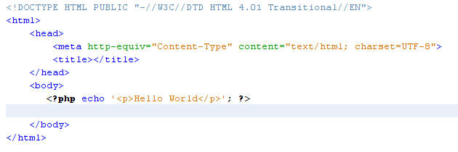

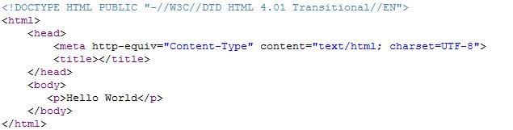
Hello World in PHP

Slide 8

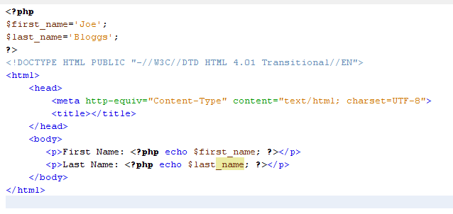
Variables in PHP
PHP Variable Declarations
Embedded PHP in HTML

Slide 9
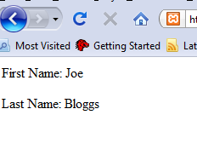
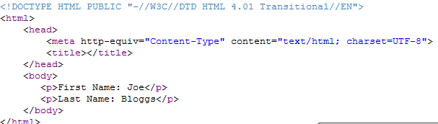
Variables in PHP
Resulting Web Page
Generated Source

Slide 10

PHP Syntax
Syntax Rules
  PHP statements end with a semicolon.
  PHP ignores extra whitespace in statements.
  PHP is case sensitive
  PHP can be run from the command prompt (great for simple testing)
c:\xampp\php\php.exe –a
(Will open an interactive php shell)
c:\xampp\php\php.exe myphpfile.php
(Will evaluate the PHP script – NB args can be passed in but not for $GET,
$POST etc.)

Slide 11

PHP Data Types
The six PHP data types
Integer
double
boolean
string
array
object

Slide 12
PHP Data Types
Integer values (whole numbers)
15
-21
// an integer
// a negative integer
Double values (numbers with decimal positions)
21.5
-124.82
// a floating-point value
// a negative floating-point value
The two Boolean values
String values
true | // | equivalent | to | true, yes, or on
false | // | equivalent | to | false, no, or off
'Ray Harris' | // | a string with single quotes
"Ray Harris" | // | a string with double quotes
'' | // | an empty string
null | // | a NULL value

Slide 13

PHP Variable Declaration
Using the assignment operator (=)
as you declare a variable and give it a value
$count = 10;
$list_price = 9.50;
$first_name = 'Bob';
$first_name = "Bob";
$is_valid = false;
// an integer literal
// a double literal
// a string literal
// a string literal
// a Boolean literal
$product_count = $count; | // $product_count | is | 10
$price = $list_price; $name = $first_name; | // $price is 9.50 // $name is "Bob"
$is_new = $is_valid;
// $is_new is FALSE

Slide 14

PHP Variable Names
Rules for creating variable names
Variable names are case-sensitive.
Variable names can contain letters, numbers, and underscores.
Variable names can’t contain special characters.
Variable names can’t begin with a digit or two underscores.
Variable names can’t use names that are reserved by PHP such as the variable named $this that’s reserved for use with objects.
Always begin with $

Slide 15
PHP Constants
How to declare a constant
define('MAX_QTY', 100);
define('PI', 3.14159265);
define('MALE', 'm');
// an integer constant
// a double constant
// a string constant

Slide 16

PHP Form Data
An HTML form that does an HTTP GET request
<form action="display.php" method="get">
<label>First name: </label>
<input type="text" name="first_name"/><br />
<label>Last name: </label>
index.html
<input type="text" name="last_name"/><br />
<label>&nbsp;</label>
<input type="submit" value="Submit"/>
</form>
The URL for the HTTP GET request
//localhost/.../display.php?first_name=Ray&last_name=Harris
Getting the data and storing it in variables
$first_name = $_GET['first_name'];
$last_name = $_GET['last_name'];

Slide 17

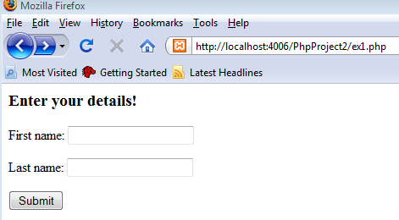
PHP Form Data - GET
Create a page with a form that will result in a HTTP GET request

Slide 18
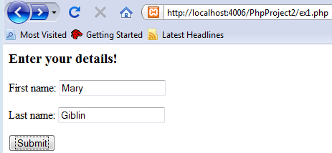
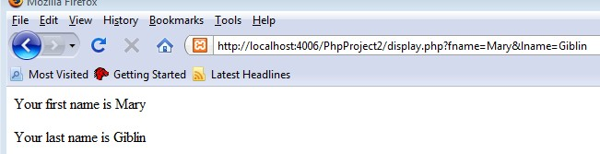
PHP Form Data - GET
Create a page (display.php) that “gets” the data from the array, stores it in variables and displays it in the markup
Enter details and submit
Result
Notice URL when using GET

Slide 19

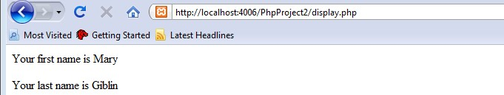
PHP Form Data - POST
Update the form page and display.php to use POST instead of GET. Notice Url
An HTML form that specifies the POST method
<form action="display.php" method="post">
Code that gets the data from the $_POST array
$first_name = $_POST['first_name'];
$last_name = $_POST['last_name'];

Slide 20

PHP Using GET
When to use the HTTP GET method
When the request is for a page that gets data from a database server.
When the request can be executed multiple times without causing any problems.

Slide 21

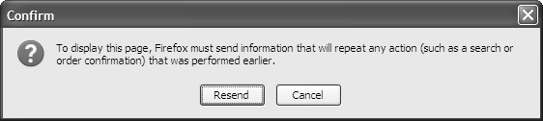
PHP Using POST
When to use the HTTP POST method
When the request is for a page that writes data to a database server.
When executing the request multiple times may cause problems.
When you don’t want to include the parameters in the URL for security reasons.
When you don’t want users to be able to include parameters when they bookmark a page.
When you need to transfer more than 4 KB of data.
The firefox dialog if a users tries to refresh (f5) a POST.

Slide 22

PHP String Expressions
How assign string expressions
Use single quotes to improve PHP efficiency
$first_name = 'Bob';
$last_name = 'Roberts';
Assign NULL values and empty strings
$address2 = '';
$address2 = null;
// an empty string
// a NULL value
Use double quotes for variable substitution
$name = "Name: $first_name";
$name = "$first_name $last_name";
// Name: Bob
// Bob Roberts
Mix single and double quotes for special purposes
$last_name = "O'Brien";
$line = 'She said, "Hi."';
// O'Brien
// She said, "Hi."

Slide 23

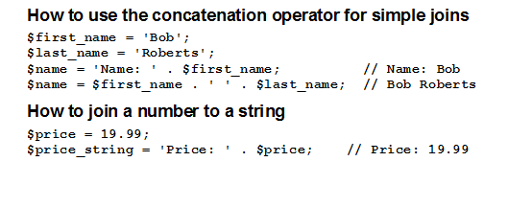
PHP Concatenation Operator (.)
Similar to + operator in Java and JavaScript

Slide 24

PHP Echo Statement
The syntax for the echo statement
echo string_expression;
How to use an echo statement within HTML
<p>Name: <?php echo $name; ?></p>
How to use an echo statement to output HTML tags and data
<?php
echo '<p>Name: ' . $name . '</p>';
?>

Slide 25

PHP Arithmetic Operators
Common arithmetic operators
Operator Example | Result
+ 5 + 7 | 12
- 5 - 12 | -7
* 6 * 7 | 42
/ 13 / 4 | 3.25
% 13 % 4 | 1
++ $counter++ | adds 1 to counter
-- $counter-- | subtracts 1 from counter

Slide 26

PHP Arithmetic Operators - Examples
Some simple numeric expressions
$x | = | 14;
$y | = | 8;
$result | = | $x | + | $y; | // | 22
$result | = | $x | - | $y; | // | 6
$result | = | $x | * | $y; | // | 112
$result | = | $x | / | $y; | // | 1.75
$result | = | $x | % | $y; | // | 6
$x++; |  |  |  |  | // | 15
$y--; |  |  |  |  | // | 7

Slide 27
PHP Arithmetic Operators - Examples
Statements that calculate a discount
$list_price = 19.95;
$discount_percent = 20;
$discount_amount = $list_price * $discount_percent * .01;
$discount_price = $list_price - $discount_amount;

Slide 28

PHP Arithmetic Operators -Precedence
The order of precedence
Order | Operators |  | Direction
1 | ++ |  | Left to right
2 | -- |  | Left to right
3 | * | / % | Left to right
4 | + | - | Left to right
Order of precedence and the use of parentheses
3 + 4 * 5
(3 + 4) * 5
// 23
// 35

Slide 29

PHP Compound Assignment
The compound assignment operators
.=
+=
-=
*=
/=
%=

Slide 30

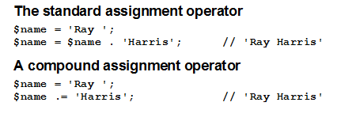
PHP Compound Assignment – String data

Slide 31

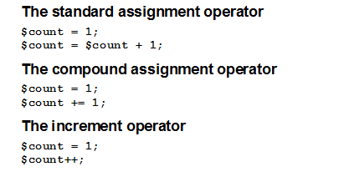
PHP Compound Assignment – Incrementing

Slide 32
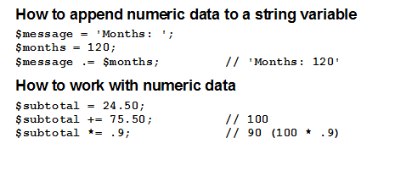
PHP Compound Assignment – Incrementing

Slide 33

PHP Formatting Numbers
A function for formatting numbers
number_format($number[, $decimals])
Statements that format numbers
$nf | = | number_format(12345); |  | // | 12,345
$nf | = | number_format(12345, 2); |  | // | 12,345.00
$nf | = | number_format(12345.674, | 2); | // | 12,345.67
$nf | = | number_format(12345.675, | 2); | // | 12,345.68

Slide 34

PHP Formatting Dates
A function for getting the current date
date($format)
Commonly used characters for date formatting
Character | Description
Y | A four-digit year such as 2010.
y | A two-digit year such as 10.
m | Numeric representation of the month with leading
 | zeroes (01-12).
d | Numeric representation of the day of the month with
 | leading zeroes (01-31).
Statements that format a date
$date = date('Y-m-d'); | // 2010-06-12
$date = date('m/d/y'); | // 06/12/10
$date = date('m.d.Y'); | // 06.12.2010
$date = date('Y'); | // 2010

Slide 35

PHP Checking Values
Three functions for checking variable values
isset($var) empty($var) is_numeric($var)
Function calls that check variable values
isset($name) | // | TRUE if $name has | been | set
 | // | and is not NULL
empty($name) is_numeric($price)
// TRUE if $name is empty
// TRUE if $price is a number

Slide 36

PHP Relational & Logical Operators
The relational operators
Operator Example
==
!=
<
<=
$last_name == "Harris"
$test_score == 10
$first_name != "Ray"
$months != 0
$age < 18
$investment <= 0
$test_score > 100
$rate / 100 >= 0.1
>
>=
The logical operators in order of precedence
Operator Example
! | !is_numeric($age)
&& | $age > 17 && $score | < | 70
|| | !is_numeric($rate) | || | $rate | < | 0

Slide 37

PHP Conditional Statements (if)
An if statement with no other clauses
}
An if statement with an else clause
if ( empty($first_name) ) {
$message = 'You must enter your first name.';
} else {
$message = 'Hello ' . $first_name.'!';
}
if | ( $price | <= | 0 ) {
 | $message | = | 'Price must | be | greater than | zero.';

Slide 38
PHP Conditional Statements (if)
An if statement with else if and else clauses
if ( empty($investment) ) {
$message = 'Investment is a required field.';
} else if ( !is_numeric($investment) ) {
$message = 'Investment must be a valid number.';
} else if ( $investment <= 0 ) {
$message = 'Investment must be greater than zero.';
} else {
$message = 'Investment is valid!';
}

Slide 39
PHP Conditional Statements (if)
A compound conditional expression
if ( empty($investment) || !is_numeric($investment)
|| $investment <= 0 ) {
$message =
'Investment must be a valid number > zero.';
}
A nested if statement
if ( empty($months) || !is_numeric($months)
|| $months <= 0 ) {
$message = 'Please enter a number of months
} else {
$years = $months / 12; if ( $years > 1 ) {
$message = 'A long-term investment.';
} else {
$message = 'A short-term investment.';
}
}
> zero.';

Slide 40

PHP Loops (while)
A while loop that stores the numbers 1 through 5
$counter = 1;
while ($counter <= 5) {
$message = $message . $counter . '|';
$counter++;
}
// $message = 1|2|3|4|5|

Slide 41
PHP Loops (while)
A while loop that calculates the future value of a one-time investment
$investment = 1000;
$interest_rate = .01;
$years = 25;
$future_value = $investment;
$i = 1;
while ($i <= $years) {
$future_value =
($future_value + ($future_value * $interest_rate);
$i++;
}

Slide 42

PHP Loops (for)
A for loop that stores the numbers 1 through 5
for ($counter = 1; $counter <= 5; $counter++) {
$message = $message . $counter . '|';
}
// $message = 1|2|3|4|5|

Slide 43
PHP Loops (for)
A for loop that calculates the future value of a one-time investment
$investment = 1000;
$interest_rate = .01;
$years = 25;
$future_value = $investment;
for ($i = 1; $i <= $years; $i++) {
$future_value =
($future_value + ($future_value * $interest_rate));
}

Slide 44

PHP File Inclusion and Control Flow
Name | Description
include($path) | Inserts and runs the specified file. If the function fails it causes a warning that allows the script to continue. The parentheses are optional
include_once($path) | Same as include but makes sure the file is only included once
require($path) | Works the same as the include function, but if this function fails, it causes a fatal error that stops the script
require_once($path) | Same as require but makes sure the file is only required once
exit([$status]) | Exits the current PHP script. If $status isn’t supplied, the parentheses are optional. If $status is supplied, the function sends the $status string to the browser before it exits.
die([$status]) | Works the same as the exit function.

Slide 45
PHP File Inclusion and Control Flow
The include function
include 'index.php'; include('index.php'); The require function | // // // | parentheses are optional index.php in the current directory
require('index.php'); | // // | index.php in the current directory
The exit function
exit; exit(); | // | parentheses are optional
exit('Unable to connect to DB.');
// passes a message to the browser

Slide 46
PHP File Inclusion and Control Flow
How to pass control to another PHP file in the current directory
if ($is_valid) { include('process_data.php'); exit();
}
How to navigate up and down directories
include('view/header.php'); | // | down one directory
include('./error.php'); | // | in the current directory
include('../error.php'); | // | up one directory
include('../../error.php'); | // | up two directories

Slide 47

PHP Documentation
The URL for the PHP documentation
http://php.net/docs.php
Further reading on PHP
https://www.tutorialspoint.com/php/index.htm

