Slide 1
Web Development 3
Lecture 5 – PHP Programming – Part 4
RESTful applications with PHP
Lecturer: James Byrne (jamesbyrne@ait.ie)

Slide 2

Topics
Web Architectures
Introduction to REST
Implementing a REST API with PHP

Slide 3
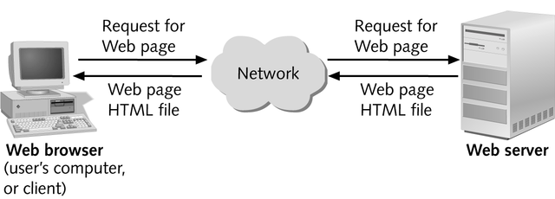
Basic Web Architecture
The web is a two-tiered architecture.
  A web browser displays information content,
  A Web server that transfers information to the client.
›

Slide 4
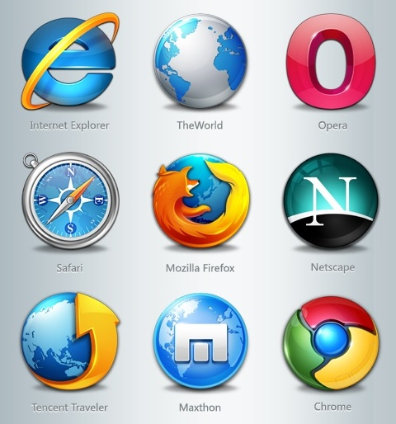
Web Browser
The primary purpose is to bring information resources to the user.
An application for retrieving, presenting, and traversing information resources

Slide 5

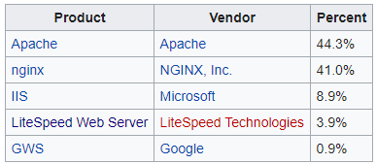

Web Server
The term web server can mean one of two things:
  A computer program that accepts HTTP requests and returns HTTP responses with optional data content.
  A computer that runs a computer program as described above.
Notes:
Web Server Data (Feb 2019) https://en.wikipedia.org/wiki/Web_server

Slide 6
REST Overview
The REST architecture was designed around a few key principles:
  Use HTTP Methods (and Response Codes)
  Be Stateless and Cacheable
  Use Addressable Resources
  Support the transfer of Representations

Slide 7
REST Overview
REST-style architectures consist of clients and servers
Requests and responses are built around the transfer of "representations" of "resources"
A resource is any entity that can be addressed in a Uniform Resource Identifier (an account, an employee, a physical file)
A representation of a resource is any information that captures the current or intended state of a resource. All information necessary to process and complete a request is contained within it

Slide 8
URI’s and URL’s
Requests for resources are identified by URL or URI
URL – Uniform Resource Locator
scheme:[//authority]path[?query][#fragment]
where the authority component divides into three subcomponents:
authority = [userinfo@]host[:port]
  Popular Schemes: http, https, ftp, mailto, file, data, and irc
  Example: https://en.wikipedia.org/wiki/COVID-19_pandemic
URN – Uniform Resource Name
  Example : urn:isbn:0451450523
URI – Uniform Resource Identifier
  Can be either a URL or a URN

Slide 9
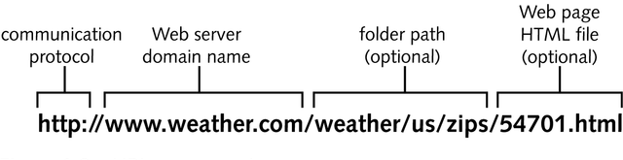
Uniform Resource Locator - URL
URL’s are location dependent
They contains four distinct parts:
  protocol type (Scheme)
  server/machine name (Authority)
  path which can be broken into two parts:
    the directory path
    the file name

Slide 10
HTTP Requests
Request Line
  GET index.jsp HTTP/1.1
  POST myApp/book/update HTTP/1.1
Headers (Zero or more header fields followed by CRLF)
  Content-type: text/plain
  Content-length: 19
Empty Line with CRLF (Indicates end of header fields)
Optional Body
  GET has none.

Slide 11
HTTP GET - Example
Request Line
GET /myApp/insert?name=paul&address=athlone
User-agent:Chrome/3.0.195.38
Host:Host
Accept:application/xml,application/xhtml+xml,text/html;q=0.9,text/plain;q=0.8,image/png,*/*;q=0.5
Header Fields

Slide 12
HTTP POST - Example
Request Line
POST /myApp/insert
User-agent:Chrome/3.0.195.38
Host:Host
Accept:application/xml,application/xhtml+xml,text/html;q=0.9,text/plain;q=0.8,image/png,*/*;q=0.5
Content-length:25
name=paul&address=athlone
Header Fields
Empty Line
Body

Slide 13
HTTP Responses
Status Line
  HTTP/1.1 200 OK
Headers (Zero or more header fields followed by CRLF)
  Content-type: text/plain
  Content-length: 19
Empty Line with CRLF (Indicates end of header fields)
  CRLF refers to the special character elements "Carriage Return" and "Line Feed." These elements are embedded in HTTP headers and other software code to signify an End of Line (EOL) marker
Optional Body
  Usually the content (HTML/XML/JSON/Image etc.)

Slide 14
HTTP Response - Example
Status Line
HTTP/1.1 200 OK
User-agent:Chrome/3.0.195.38
Host:Host
Accept:application/xml,application/xhtml+xml,text/html;q=0.9,text/plain;q=0.8,image/png,*/*;q=0.5
Content-length:25
<html><body><h1>Hello World</h1></body></html>
Header Fields
Empty Line
Body

Slide 15
HTTP Request Methods
HTTP defines methods (sometimes referred to as "verbs") indicating the desired action to be performed on the identified resource
  HEAD – similar to GET , but without the response body
  GET - should only retrieve data
  POST - submit an entity to the specified resource
  PUT - replaces all current representations of the target resource with the request payload
  DELETE - deletes the specified resource
  TRACE - performs a message loop-back test along the path to the target resource
  OPTIONS - used to describe the communication options for the target resource
  CONNECT - establishes a tunnel to the server identified by the target resource
  See https://developer.mozilla.org/en-US/docs/Web/HTTP

Slide 16
HTTP Request – Safe Methods
HEAD, GET, OPTIONS and TRACE are defined as safe (no side effects)
POST, PUT and DELETE are intended for actions which may cause side effects either on the server, and therefore defined as unsafe

Slide 17
HTTP Status Codes
The first line of the HTTP response is called the status line
The way the client handles the response primarily depends on the code and secondarily on the response headers
Success: 2xx
Redirection: 3xx
Client-Side Error: 4xx
Server-Side Error: 5xx

Slide 18
HTTP Session State
HTTP is a stateless protocol
Hosts do not need to retain information about users between requests
Statelessness is a scalability property
For example, when a host needs to customize the content of a website for a user, popular solutions:
  Cookies
  Sessions
  Hidden variables (when the current page is a form)
  URL encoded parameters e.g. /index.php?session_id=some_unique_session_code

Slide 19
Traditional uses of JavaScript
JavaScript is a scripting language designed for creating dynamic, interactive Web applications that link together objects and resources on both clients and servers
  Getting your Web page to respond or react directly to user interaction with form elements and hypertext links
  Preprocessing data on the client before submission to a server
  Changing content and styles

Slide 20
Traditional Server-Side Processing
In server-side processing, the Web server:
  Receives the dynamic Web page request
  Performs all the processing necessary to create the dynamic Web page
  Sends the finished Web page to the client for display in the client’s browser

Slide 21
Traditional Client-Side Processing
Client-side processing
  Some processing needs to be “executed” by the browser, either to form the request for the dynamic Web page or to create or display the dynamic Web page.
  Eg. Javascript code to validate user input

Slide 22
Rich Internet Applications
More Processing on the client
The server can return data (instead of a finished HTML page)
The client will use Javascript (with libraries like jQuery and jQueryUI ) to update the User Interface in the browser
Ajax allows for HTTPRequests to be sent asynchronously

Slide 23
Server and Client Side processing
Server-side processing
  PHP
  ASP
  ASP.NET
  JavaScript, e.g. node.js
  Jakarta EE/J2EE (JSP/Servlets)
  Python, e.g. Django
  Ruby, e.g. Ruby on Rails
  ColdFusion
Client-side processing
  CSS
  HTML
  JavaScript
  Angular
  Ember
  JavaFX
See https://en.wikipedia.org/wiki/List_of_rich_Internet_application_frameworks

Slide 24
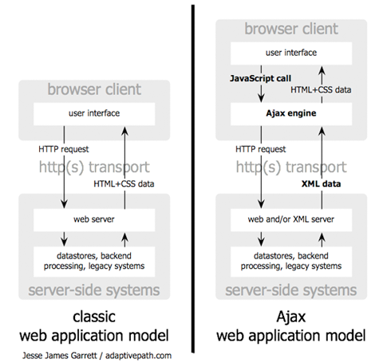
Classic vs. AJAX web application
Classic application:
  Client receives HTML and CSS directly from Server
AXAJ application:
  Server sends Data (XML/JSON) to client side AJAX Engine
  Client receives HTML and CSS from AJAX Engine once its finished processing on client

Slide 25
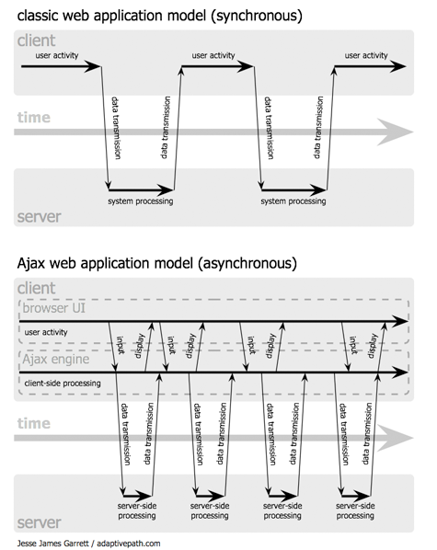
Classic vs. AJAX web application
Classic application:
  Communication completely synchronous.
  Client must wait for server to finish processing
AXAJ application:
  Communication asynchronous
  Client can continue to interact with user and receive callback when server processing finished

Slide 26
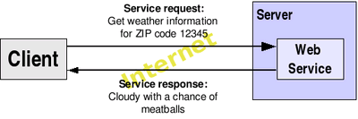
Web Services
A Web Service is a software system designed to support machine-to-machine interaction over a network
Web services are frequently just Internet Application Programming Interfaces (API’s) that can be accessed over a network

Slide 27
Web Services
Web Services are platform-independent and language-independent, since they use standard XML languages
Most Web Services use HTTP for transmitting messages (such as the service request and response)
Style of Use
  RPC – Corba, Remote Method Invocation (RMI)
  SOAP – Simple Object Access Protocol (XML based)
  REST - Representational State Transfer (XML or more commonly JSON)

Slide 28
CRUD, HTTP, SQL Mappings
Action | SQL | HTTP Method
Create | Insert | Post
Read | Select | Get
Update | Update | Put
Delete | Delete | Delete

Slide 29
REST URI Examples
GET | http://www.example.com/v1/employees | Get all Employees
GET | http://www.example.com/v1/employees/1824 | Get Employee with id 1824
POST | http://www.example.com/v1/employees | Create employee from data in HTTP Body
PUT | http://www.example.com/v1/employees/1513 | Update Employee 1513 data in HTTP Body
DELETE | http://www.example.com/v1/employees/1222 | Remove Employee 1222

Slide 30
REST – Identifying Resources
Any THING – person, concept, artifact
Anything you can point to
Explicit Request and Response – No State
Use nouns and NOT the verbs:
  Common mistake. Developers forget that we have HTTP methods to describe the APIs, instead they end up using verbs in the API URLs.
  For instance, API to get all products should be:
  not
GOOD REST API
http://www.example.com/v1/employees
BAD
REST API
http://www.example.com/v1/getAllEmployees

Slide 31
REST – Representations of Resources
A serializable description of a Resource
Resources are modifiable through Representations
Common Candidates
  XML – traditional (support schema validation)
  JSON – widely used (possible to support schema validation with additional libraries)
  Binary Formats (jpg, gif, mpeg etc.)

Slide 32
REST – JSON
JSON provides an easy way to create and store data structures for use with JavaScript
Data encoded with JSON can be read into a JavaScript variable which creates an object.
www.json.org/js.htm

Slide 33
REST – JSON Syntax
Data is represented in name/value pairs
Curly braces hold objects
Each name is followed by ':‘ (colon)
Name/value pairs are separated by , (comma).
Arrays are represented by []

Slide 34
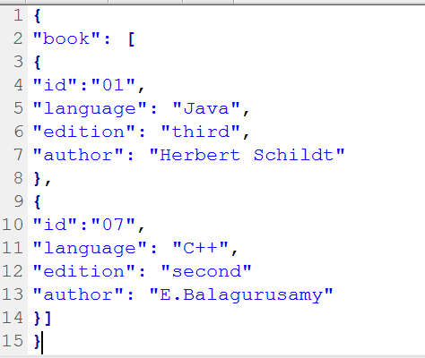
REST – JSON Example
Array of book objects
Object representing a book
Root Object

Slide 35
REST – JSON Objects Another Example

Slide 36
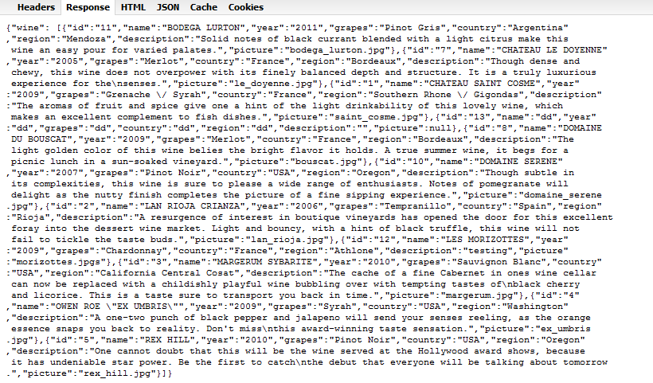
REST – JSON Collection of Objects

Slide 37
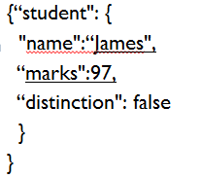
REST – JSON DataTypes
Number – no quotes
String - quotes
Boolean – true or false

Slide 38
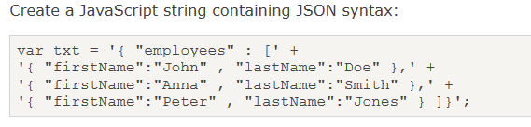
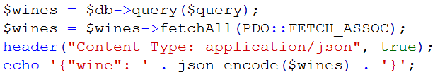
REST – JSON Collection of Objects in PHP

Slide 39
REST and PHP
Use the Slim Framework
Routes URI to a PHP function and therefore enables RESTful applications with PHP
Download and extract the Slim Framework into your project directory
The framework is in api.zip available on Moodle. It also contains the .htaccess file

Slide 40
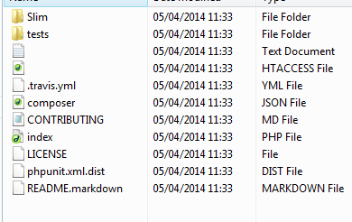
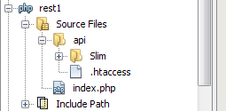
REST and PHP
When you open the unzipped folder you should see
Make a new folder called api (in your project)
Copy in the ‘Slim’ folder and the .htaccess file.

Slide 41
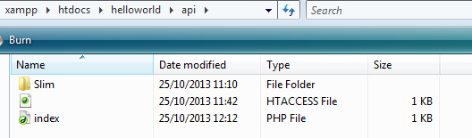
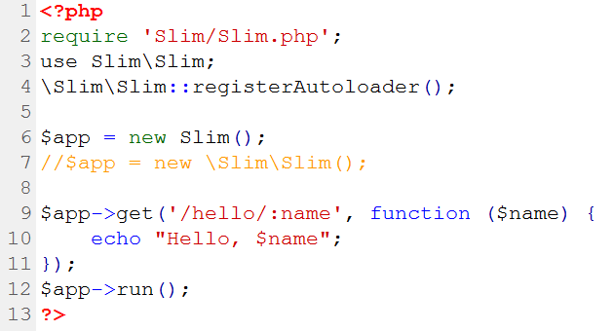

REST and PHP
Now create a file called index.php in the api folder
Slim uses namespaces
Let Slim handle internal dependencies
Anonymous PHP function
Namespaces begin with the vendor namespace (“\Slim”) and
end with the namespace path to the desired class name.
PHP namespaces may be compared to
an imaginary directory structure for PHP classes.
in Slim.php

Slide 42
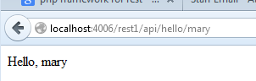

REST and PHP
GET Method call
Routed URI
Parameter
PHP Function
https://www.slimframework.com/docs/v4/objects/routing.html

Slide 43
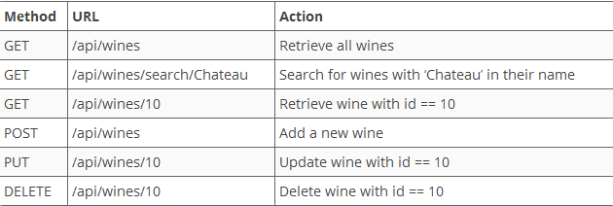
REST and PHP Wine App

