Slide 1
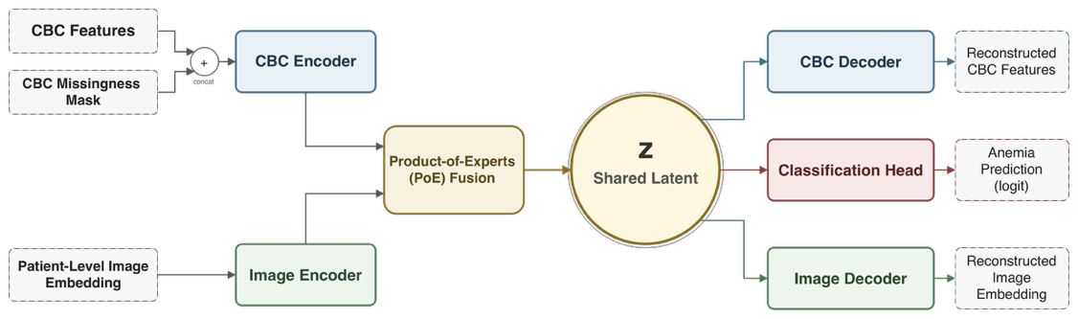
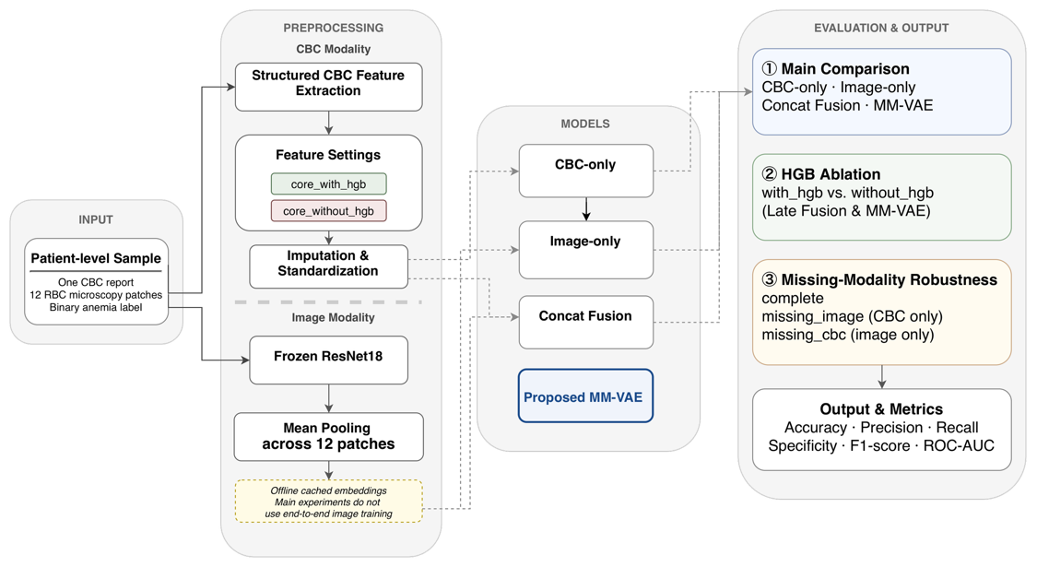
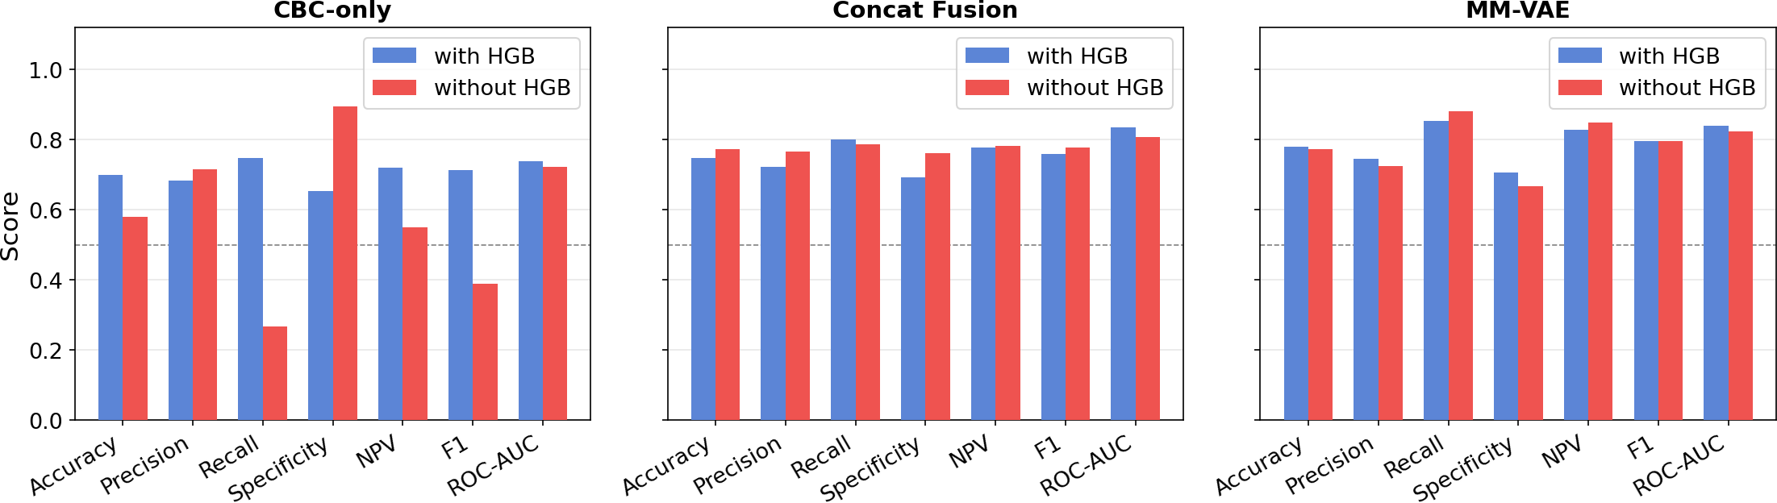
A Multimodal Variational Autoencoder
for Anemia Screening via CBC Indicators
and Blood Smear Imagery
FIVE-SEED MEAN
F1 0.786 ± 0.007
ROC-AUC 0.856 ± 0.021
Fengxun Liu · Yuxuan Huang · Zeyuan Li · Xiaolin Li*
MM-VAE · five random seeds · AneRBC
Xiamen University Malaysia | The Second Affiliated Hospital of Nanchang University
WHY MULTIMODAL SCREENING?
PoE MM-VAE: PROBABILISTIC
FUSION
CBC
Strong quantitative signal → may over-rely on HGB
Blood smear
Morphological evidence → weak alone in this representation
Existing fusion
Simple concatenation → no explicit uncertainty modelling
CBC + missingness mask and image embeddings form two Gaussian experts. PoE produces a 16-D shared latent representation for reconstruction and anemia classification.
Can probabilistic fusion combine both sources more robustly?
PATIENT-LEVEL PIPELINE
Why PoE instead of concatenation?
Precision-weighted fusion lets each modality contribute according to estimated uncertainty.
EXPERIMENTAL SETUP
AneRBC • 1 CBC report + 12 RBC patches per case
700 / 150 / 150 patient-level split • frozen ResNet-18
Adam 0.001 • batch 32 • KL warm-up • early stopping
KEY FINDING: MM-VAE REMAINS STABLE WITHOUT HGB
HGB ABLATION • REPRESENTATIVE RUN
FIVE-SEED MEAN PERFORMANCE
CBC-only collapses when HGB is removed; MM-VAE remains stable.
MM-VAE consistently exceeded Concat Fusion; no formal significance test is claimed.
CBC-only F1
MM-VAE F1
Metric
Concat Fusion
MM-VAE
0.713 → 0.388
0.795 → 0.795
F1
ROC-AUC
NPV
0.763 ± 0.020
0.836 ± 0.009
0.781 ± 0.037
0.786 ± 0.007
0.856 ± 0.021
0.801 ± 0.016
MM-VAE ROC-AUC: 0.839 → 0.823
MISSING-MODALITY EVALUATION • REPRESENTATIVE RUN
IMAGE MISSING
ROC-AUC 0.726
CBC MISSING
ROC-AUC 0.589
Smear embeddings are weak alone, but provide complementary evidence in multimodal fusion.
CBC is the stronger modality; smear images provide complementary evidence when available.
POTENTIAL CLINICAL ROLE
LIMITATIONS & NEXT STEPS
QR
PROJECT / PAPER
LINK
Potential auxiliary screening / decision support: reuse routine CBC, add smear embeddings when microscopy is available, and route model probabilities to clinician-led triage. The method complements clinical judgment; it does not replace diagnosis.
Single public dataset
Frozen image encoder
No prospective clinical validation
Next: multi-center validation · stronger image encoder · threshold calibration
Data: AneRBC. Figures and metrics are from the supplied manuscript and project results. Replace QR placeholder before submission.
*Corresponding author: ndefy21158@ncu.edu.cn

