Slide 1
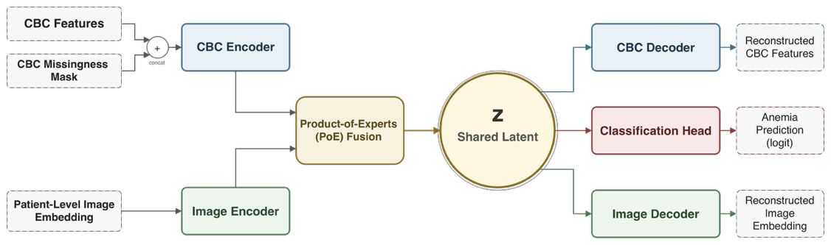
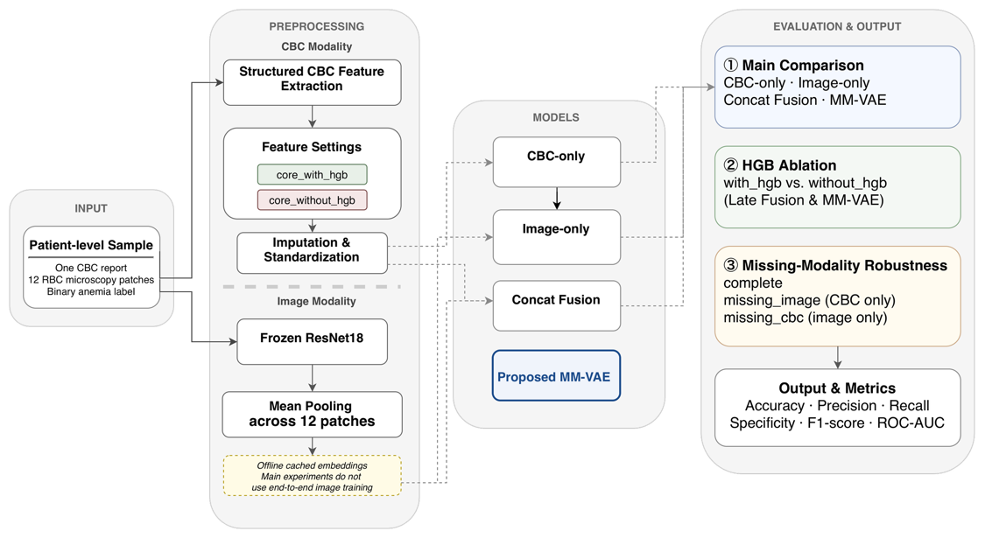
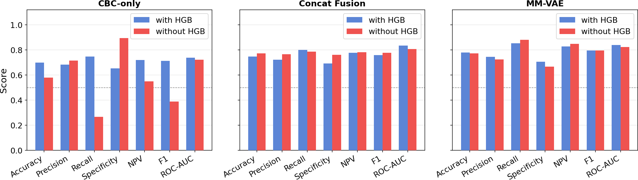
PoE fusion preserves
anemia screening without HGB
FIVE-SEED MEAN
F1 0.786 ± 0.007
ROC-AUC 0.856 ± 0.021
Fengxun Liu · Yuxuan Huang · Zeyuan Li · Xiaolin Li*
MM-VAE · AneRBC · 5 random seeds
Xiamen University Malaysia | The Second Affiliated Hospital of Nanchang University
1 WHY MULTIMODAL SCREENING?
FIG. 2 PoE MM-VAE: PROBABILISTIC FUSION
CBC: strong quantitative signal, but may over-rely on HGB.
Blood smear: complementary morphology, but weak alone in the current embedding.
Direct concatenation: combines features without explicit uncertainty.
CBC features + missingness mask and pooled smear embeddings form two Gaussian experts. Product-of-Experts fusion creates a 16-D shared latent space for reconstruction and anemia classification.
Question: can uncertainty-aware fusion remain useful when HGB is withheld?
FIG. 1 PATIENT-LEVEL PIPELINE
Why PoE instead of concatenation?
Precision-weighted fusion lets each modality contribute according to estimated uncertainty.
EXPERIMENTAL SETUP
AneRBC · 700 / 150 / 150 patient-level split · frozen ResNet-18
Adam 0.001 · batch 32 · KL warm-up · early stopping
KEY RESULT: MM-VAE STAYS STABLE WHEN HGB IS REMOVED
FIG. 3 HGB ABLATION · REPRESENTATIVE RUN
FIVE-SEED MEAN PERFORMANCE
Removing HGB sharply reduces CBC-only performance, while MM-VAE is stable.
MM-VAE exceeds direct concatenation on F1, ROC-AUC and NPV; no formal significance test is claimed.
CBC-only F1
MM-VAE F1
Metric
Concat Fusion
MM-VAE
0.713 → 0.388
0.795 → 0.795
F1
ROC-AUC
NPV
0.763 ± 0.020
0.836 ± 0.009
0.781 ± 0.037
0.786 ± 0.007
0.856 ± 0.021
0.801 ± 0.016
MM-VAE ROC-AUC: 0.839 → 0.823
MISSING-MODALITY EVALUATION · REPRESENTATIVE RUN
IMAGE MISSING
ROC-AUC 0.726
CBC MISSING
ROC-AUC 0.589
Fig. 3. Across the representative ablation, non-HGB CBC indicators and smear morphology preserve MM-VAE discrimination.
CBC is the stronger expert; smear images provide complementary evidence when available.
POTENTIAL CLINICAL ROLE
LIMITATIONS & NEXT STEPS
QR
PROJECT / PAPER
LINK
Auxiliary screening only
• Reuse routine CBC from the laboratory information system
• Add smear embeddings when microscopy is available
• Route probabilities to clinician-led triage
• Complements—not replaces—clinical diagnosis
• Single public dataset
• Frozen image encoder
• No prospective clinical validation
Next: multi-center validation · stronger image encoder · threshold calibration
Data: AneRBC. Figures and metrics: supplied manuscript and project results. Replace QR placeholder before submission.
*Corresponding author: ndefy21158@ncu.edu.cn
Notes:
[Sources]
Study claims, metrics and figures: local project sources recorded in .tmp_poster_rebuild/source-notes.txt.
Design guidance consulted: Karolinska Institutet poster design; RMIT Learning Lab poster presentations.

