Slide 1
Doing Physics with Random Numbers
Andrew J. Schultz
Department of Chemical and Biological Engineering
University at Buffalo
The State University of New York

Slide 2
Concepts
Random numbers can be used to measure things that aren’t so random
Uncertainty in averages can be estimated from the measurements themselves
A Markov process can be used to sample from a probability distribution
Physical properties can be computed using a Markov process

Slide 3
Monte Carlo Simulation: Buffon’s Needle
Consider a grid of equally spaced lines, separated by a distance d
Take a needle of length l, and repeatedly toss it at random on the grid
Record the number of “hits”, times that the needle touches a line, and “misses”, times that it doesn’t
OK, do it! (Buffon’s toothpick)

Slide 4
Monte Carlo Simulation: Buffon’s Needle
Consider a grid of equally spaced lines, separated by a distance d
Take a needle of length l, and repeatedly toss it at random on the grid
Record the number of “hits”, times that the needle touches a line, and “misses”, times that it doesn’t
Buffon showed that the probability of a “hit” is
This experiment provides a means to evaluate π

Slide 5
Quantifying Uncertainty
p(<m>)
Averages <m> obtained by a stochastic process are known to follow a Gaussian distribution
Any given <m> will represent a sample from this distribution
The width of the distribution is related to the standard deviation of the same set of numbers used to compute <m>
Use this to quantify uncertainty in <m>
<m>

Slide 6
The Weather
Model the weather as having three states:
Sunny, Cloudy, Rainy
The weather tomorrow is related to the weather today
For example, Cloudy today:
10% chance it will be Cloudy again tomorrow
50% chance it will be Sunny tomorrow
40% chance it will be Rainy tomorrow
Transition probabilities define the likelihood of the state of the weather tomorrow given the state of the weather today
We might ask, knowing all (9) transition probabilities, what are the fraction of days that are Sunny, Cloudy, and Rainy?

Slide 7
Markov Processes
Random walk
movement through a series of well-defined states in a way that involves some element of randomness (“stochastic”)
Markov process
random walk that has no “memory”
selection of next state depends only on current state, and not on prior states
process is fully defined by a set of transition probabilities π_{ij}
π_{ij} = probability of selecting state j next, given that presently in state i.

Slide 8
Transition-Probability Matrix
Example
system with three states
Requirements of transition-probability matrix
all probabilities non-negative, and no greater than unity
sum of each row is unity
probability of staying in present state may be non-zero
If Cloudy, will stay Cloudy tomorrow, with probability 0.1
If Cloudy, will be Rainy tomorrow with probability 0.4
1 = Cloudy
2 = Sunny
3 = Rainy
Never Rainy tomorrow if Sunny today

Slide 9
Distribution of State Occupancies
Consider process of repeatedly moving from one state to the next, choosing each subsequent state according to Π
1→ 2 → 2 → 1→3 → 2 → 2 → 3 → 3 → 1 → 2 → 3 → etc.
Histogram the occupancy number for each state
n₁ = 3 p₁ = 0.33 (Cloudy)
n₂ = 5 p₂ = 0.42 (Sunny)
n₃ = 4 p₃ = 0.25 (Rainy)
After very many steps, a limiting distribution emerges
Click here for an applet that demonstrates a Markov process and its approach to a limiting distribution
2
1
3

Slide 10
Some Uses of Markov Processes
Physics (molecular simulation)
Chemistry (modeling kinetics)
Designing tests
Speech recognition
Information science
Queuing theory
Google PageRank
Economics and Finance
Social sciences
Mathematical biology
Genetics
Games
Algorithmic music composition
Text generators
http://en.wikipedia.org/wiki/Markov_chain

Slide 11
Designer Transition Probabilities
Say we want to sample states with a desired probability distribution (p_{i} are given), using a Markov process
How do we design transition probabilities p_{ij}?
Many choices are possible for a given distribution
Metropolis algorithm provides a good choice

Slide 12
In-class Markov Process
Three groups
Group 1: p₁ = 0.3
Group 2: p₂ = 0.1
Group 3: p₃ = 0.6
For state at group n, perform trial:
Select one of the other states (m) with equal probability
Compare state probabilities
If p_{m} > p_{n}, let new state be m; done with trial
Otherwise, select a random number r in (0, 1)
If p_{m} / p_{n} > r, let new state be m; done with trial
Otherwise, let new state be n (again); done with trial
Repeat

Slide 13
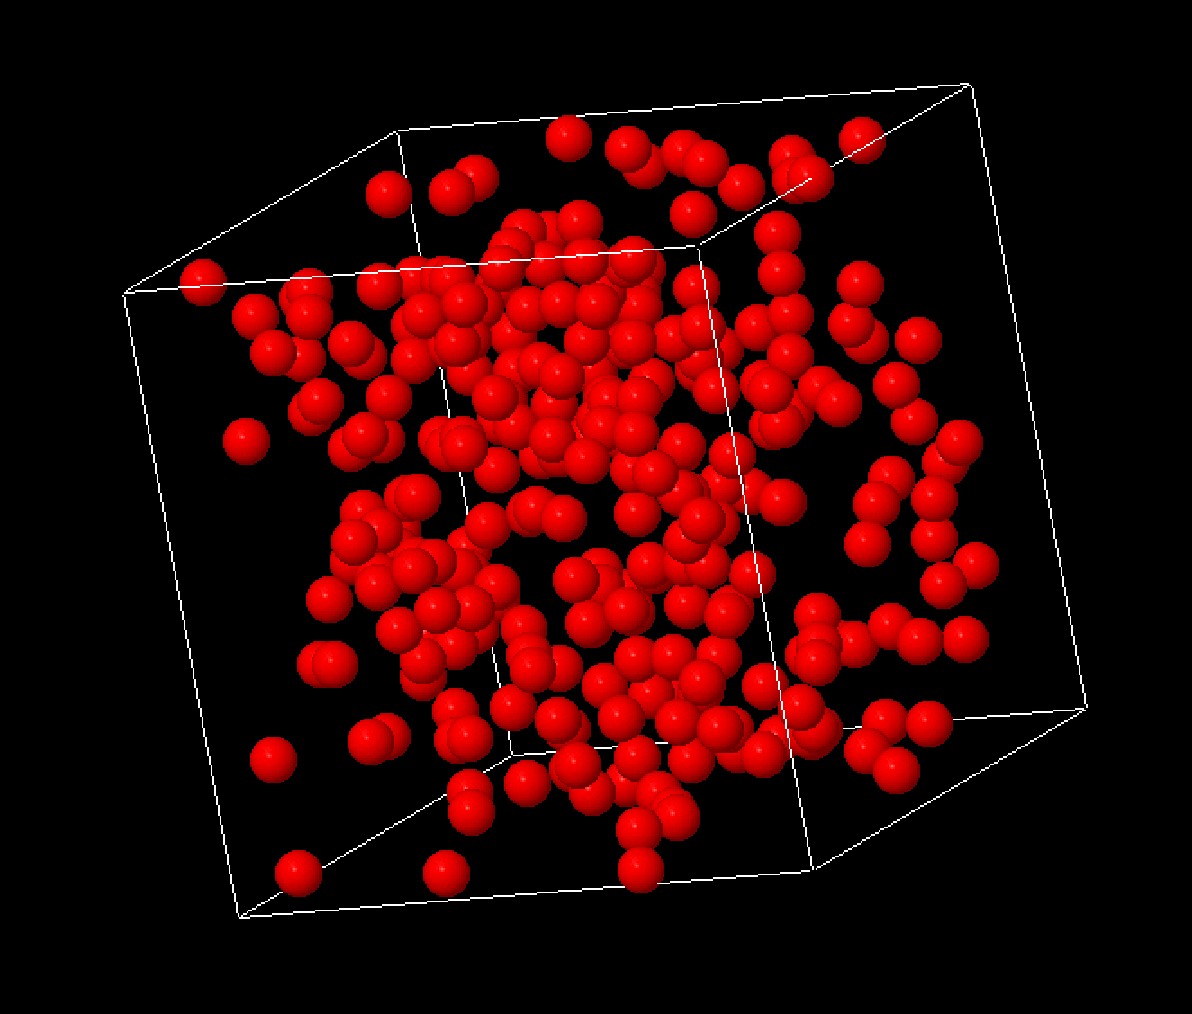
Calculating Physical Properties
Molecular simulation
Generate box of atoms/molecules
Postulate a model for how they interact
Generate configurations appropriate to postulated model
Record averages over generated configurations

Slide 14
Generating Configurations
Monte Carlo
Sample configurations using a Markov process
Atoms move around randomly, but in a controlled way
Movements aren’t physically meaningful, but the sampled distribution of configurations are
Molecular dynamics
Sample configurations according to Newton’s laws
F = ma
Move/accelerate all atoms at once
Direction and amount depends on current velocities and forces
Movements looks realistic, like a movie
Let’s see some demos…

Slide 15
An Application of Molecular Simulation

Slide 16
Concepts
Random numbers can be used to measure things that aren’t so random
Uncertainty in averages can be estimated from the measurements themselves
A Markov process can be used to sample from a probability distribution
Physical properties can be computed using a Markov process

