Slide 1

Welcome !!
Genome-wide association study and candidate gene search, in an F2 Duroc x Pietrain population for meat quality traits.
Casiro Sebastian¹, Deborah Velez¹, Ronald O. Bates¹, Catherine W. Ernst¹, Juan P. Steibel^{1,2}
¹Department of Animal Science, Michigan State University, East Lansing, MI
²Department of Fisheries and Wildlife, Michigan State University. East Lansing, MI
Animal Science Graduate Research Forum
Michigan State University
October 15th 2015
1

Slide 2

Introduction
Breeds used as sire
Duroc: ?
Pietrain: ?
Undesirable correlated response:
Increased lean growth leads to lower meat quality
Consequences
2

Slide 3
Introduction
Importance for the industry
Consumers preference (fresh meat)
Processed meat
GWAS
SNP
Linkage disequilibrium
3

Slide 4
Objective
Map regions in the pig associated with pork quality traits and to propose candidate genes
4

Slide 5

Population
F0 Duroc 4 + Pietrain 16
F1 6 + 50
F2
38 Traits Related to meat quality
948
5
Edwards et al. 2008 J ANIM SCI 86:254-266

Slide 6
Data
Illumina Porcine 60K chip
20 F0, 56 F1, 336 F2
9K tagSNP chip
612 F2
62163 SNPs
8836
Imputation
R² 0.97
Missing Data
Mendelian Inconsistencies
Unknown position
53039 SNPs
1015 Animals
45329 SNPs
MAF<1%
45329 SNPs
6

Slide 7
Model
random
Breeding Values
G=ZZ’
a ~ N (0,Gσ²A)
y= X β + a + e
Phenotype vector
e ~ N (0,Iσ²e)
Fixed effects
Group 1
Group 2
Group 3
sex + slg. group
sex + slg. group + car weight
sex + slg. group + Slg.Age
WBS, dressing percentage, Num Ribs, cook yield, Juiciness, Tenderness ,Overall tenderness
ultimate pH, Last Lumbar BF,10th Rib BF, Loin,Belly, Protein
Drip loss
7
Gualdron Duarte et al.BMC Bioinformatics 2014, 15:246

Slide 8
gwaR
R package gwaR
a=Zg
GBLUP (Genomic Best Linear Unbiased Prediction )
ˆ
ˆ
g= Z’ G⁻¹ â
t=g/sd(g)
ˆ
ˆ
var(g)= Z’ G⁻¹ Z σ²A - Z’ G⁻¹ C^{aa} G⁻¹ Z
H0: There is no Association
8
Gualdron Duarte et al.BMC Bioinformatics 2014, 15:246

Slide 9
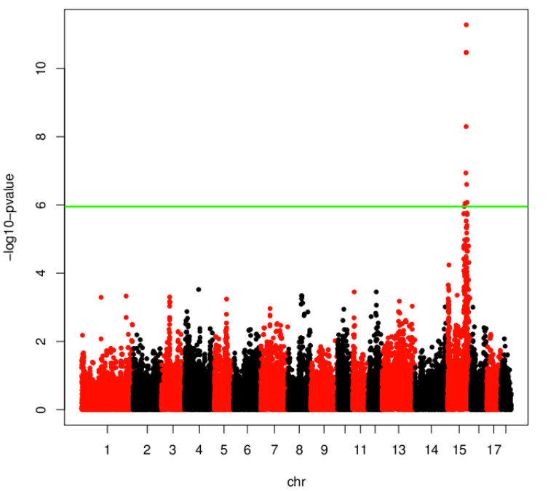
Manhattan Plot Ultimate pH
p-value
Candidate Genes
0.0000000001
0.00000001
α=0.05/N Markers
0.000001
Region
0.0001
0.01
1
ENSMBL
Chromosome
9

Slide 10
QTLs
Trait | Chromosome | Peak | p-value | Genes | Candidate genes
WBS | 2 | 28 Mb | 2.94e-8
Tenderness/ Overall Tenderness | 2 | 58 Mb | <2.60e-8 | 116 | 14
Driploss | 4 | 75 Mb | 4.53e-8 | 37 | 6
10th Rib Backfat Thickness Loin | 6 | 133 Mb | <2.49e-8 | 104 | 11
Last Lumbar Backfat thickness | 6 | 136 Mb | 1.32e-7
Dressing % | 7 | 35 Mb | 1.084e-6 | 3 | 1
Nº of Ribs | 7 | 102 Mb | 1.75e-25 | 153 | 15
Belly | 11 | 84 Mb | 1.4e-7 | 11 | 2
Protein Percentage/cook yield/U. pH /WBS/Tenderness/Overall tenderness/Juiciness | 15 | 135 Mb | <1.62e-7 | 206 | 23
10th Rib Backfat Thickness | 15 | 156 Mb | 3.33e-7
CALP CAST
Ribosomal protein S10
PRKAG3
10

Slide 11
Conclusion
7 QTL regions found
Along 6 chromosomes
14 meat quality traits associated with these QTLs
630 genes in those QTL regions
72 functional candidate genes
Work in progress
11

Slide 12

Thanks for your attention
Any Questions?
12

