Slide 1

BiFrost Games
A presentation by Devan, Curtis, Evan, and Pat
Notes:
PAT: Hello there, my name is Pat, and this is Curtis, Evan, and Devan. We here to present our website, BiFrost Games.

Slide 2
Agenda
Project Overview
Demo
Code Segments
Problems and Challenges
Skills Learned
Proposed Changes
Notes:
PAT: In just a moment we will break down the Project Overview, Demo our website’s functionality, present and explain some code segments, list some challenges we faces and how we solved them, the skills we picked up on the way, and some things we would do differently in the future.

Slide 3
Project Overview
We created a retail website that is able to have video games added, posted, and sold to it. A shopping cart was implemented so customers can add multiple games and buy them in one transaction. The games are able to be sorted by console and genre simultaneously for ease of search. Customers are also able to make an account to save their order history and to place orders.
Notes:
PAT: -read what’s on screen dummy-

Slide 4
DEMO
Notes:
EVAN:

Slide 5
Php loaded YouTube player
Notes:
CURTIS: This php generates a YouTube player if a video id is inserted into the DB. The video id is retrieved from the database and is inserted into the iframe.

Slide 6
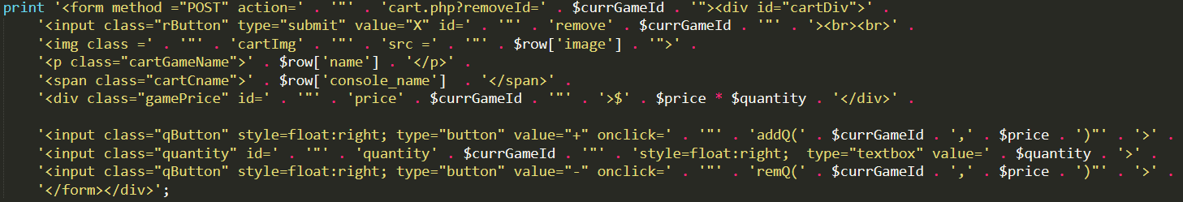
Update Quantity
Notes:
CURTIS: Using dynamic naming with php variables for fields that need to be change made it easy to keep track of and pass variables. Input buttons for quantity call to a JavaScript function as seen below. It passes the game Id and price to the function.

Slide 7
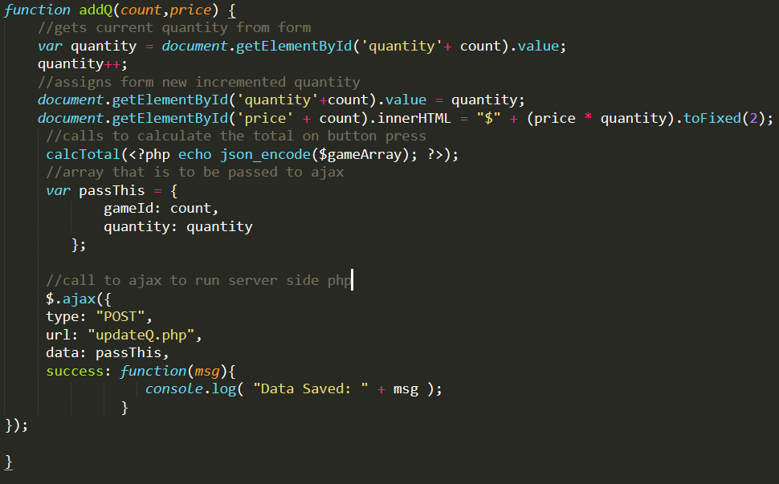
Update Quantity
Notes:
CURTIS: This function uses the game ID and DOM elements to retrieve the current quantity, then it increments the quantity. The price for that item is updated and then a calcTotal() function is called to loop through and add item prices to update the total price. Finally, an ajax function is called that runs a server sided script to update the database.

Slide 8
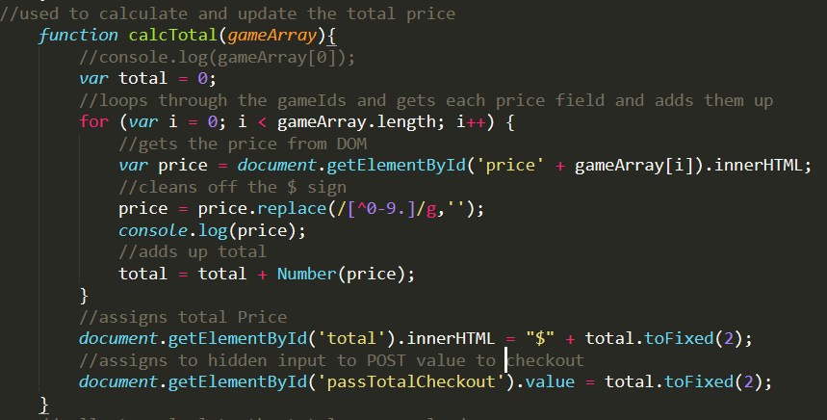
Update Quantity
Notes:
CURTIS: This function loops through the carts price elements and adds them up to get the total to be updated on the page and passed to a hidden input for POST to cart.

Slide 9
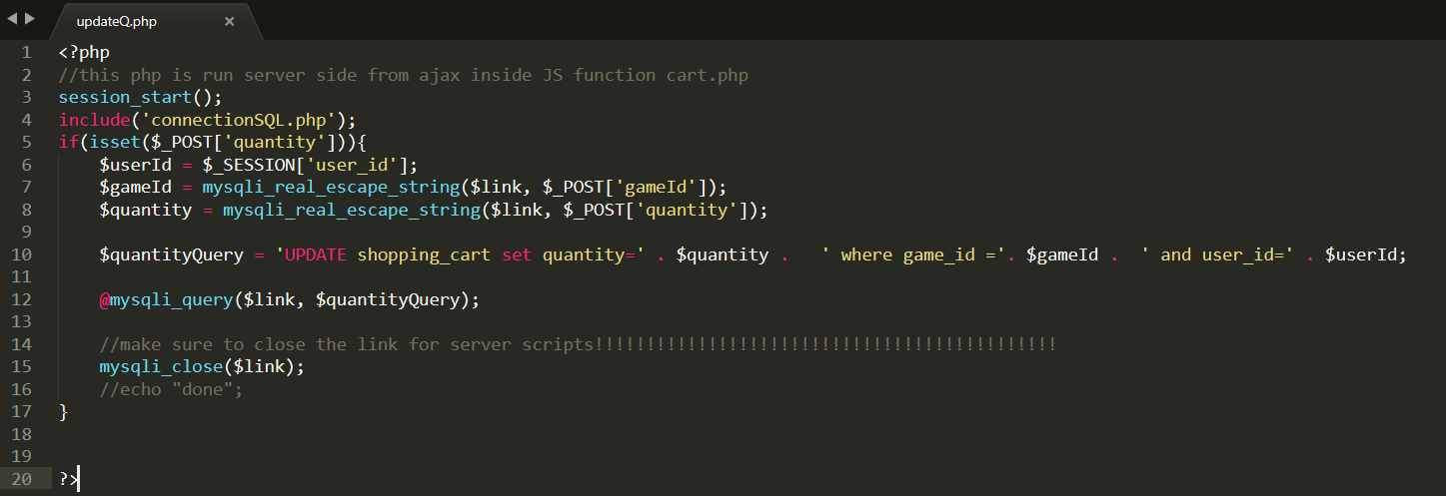
Update Quantity
Notes:
CURTIS: This is the server sided script that is called by the ajax function. This is updating the quantity dynamically in the database without reloading the users page.

Slide 10
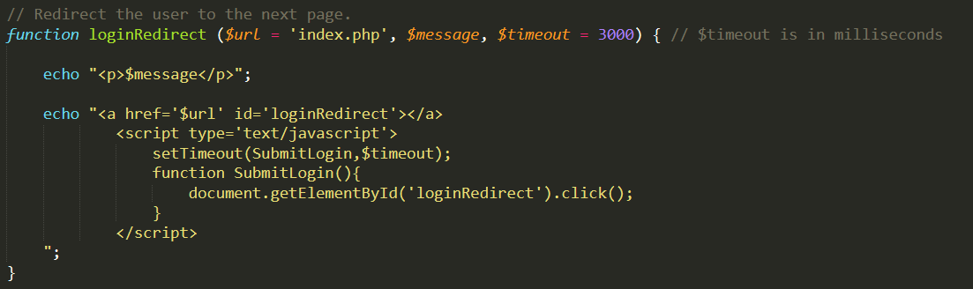
Log in Redirect
Notes:
EVAN: This is a function used on our login page. It is setup to take a URL to direct to, a message to print to the screen, and a value of time, in milliseconds, to wait before redirecting. Different conditions are programmed to call this function with different values. For instance, if a user just created an account, they already have an automatic confirmation and redirection to the login page, so we don't want them delayed for a second time.

Slide 11
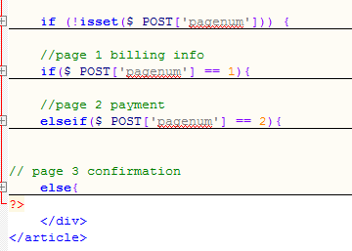
Checkout Structure
Notes:
DEVAN: I’m proud of this code because the checkout is actually only 1 “page” but it acts like 3! Using pagenum which is set to 1 at first, the if statement checks to see what number it is, since it starts at 1 it will display the first page. When you click submit on the first page, pagenum becomes set to 2 and the page refreshes, the if statement then goes to the elseif checking to see if pagenum is 2 which it is, it then displays page 2. After you pay with stripe pagenum is set to 3 which means the else statement at the end comes into effect showing the confirmation page.

Slide 12
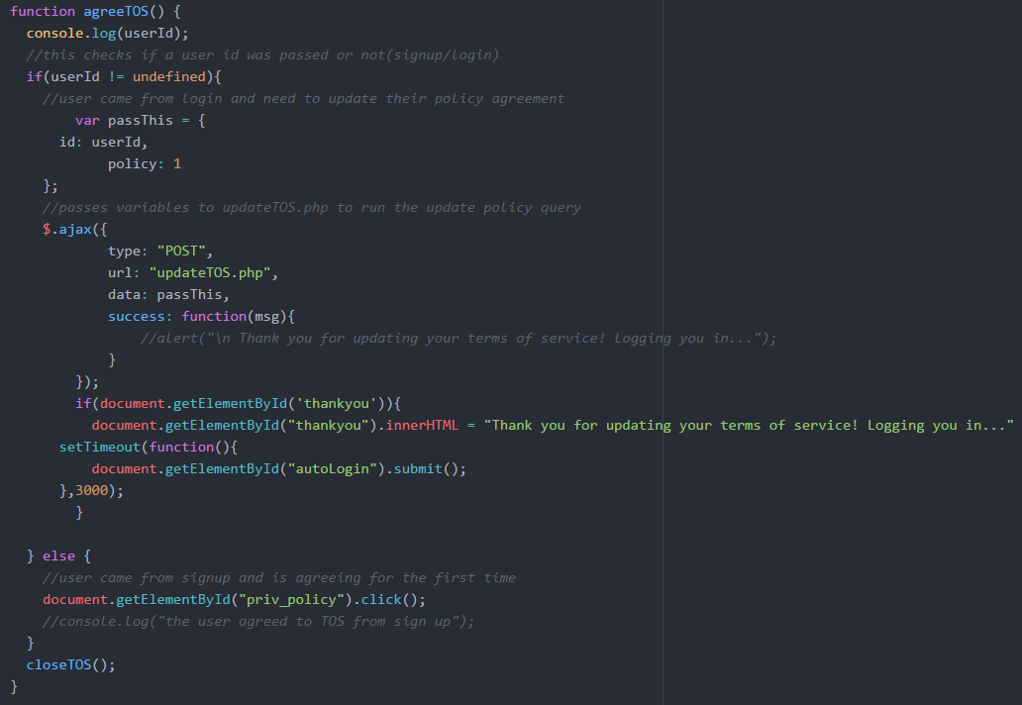
Terms of Service
Notes:
PAT: This function is for the terms of service/privacy policy, which we decided to put into the side navigation for a cleaner look. If accessed via the signup page, the agree function will auto click the TOS checkbox for users. The agree function also updates the policy attribute on the back-end using ajax.
CURTIS: I ajax on YOUR back-end!

Slide 13
Problems & Challenges
Problem: Changing the cart quantities without reloading the page
Solution: Learned to use ajax to change quantity with server-side script.
Notes:
DEVAN:

Slide 14
Problems & Challenges
Problem: Git conflicts when pushing your work
Solution: Ensuring that the most recent version of master was pulled and rebased in branch before work begins
Notes:
DEVAN:

Slide 15
Problems & Challenges
Problem: Git problems with temp files made by Microsoft when file is open
Solution: Close all windows before pushing to Git
Notes:
DEVAN:

Slide 16
Problems & Challenges
Problem: Adopting change requests into "completed" code
Solution: Re-think the code logic to effectively accommodate new and existing functionality
Notes:
DEVAN:

Slide 17
Skills Learned
Learned how to use ajax with jQuery to run server sided scripts
Learned how to use git properly and how to coordinate the team using it
Planning and time management
Re-using code to make tasks easier
How to work on code together with another teammate.
Notes:
DEVAN:

Slide 18
Skills Learned
How to organize project tasks with MS Project.
How to design code to be more modular (i.e. using header/footer.php files).
How to integrate external code (i.e. Stripe).
How to use php to create dynamic web pages.
How to use php to interact with a database.
Notes:
DEVAN:

Slide 19
Proposed Changes
Plan out the design/pages needed more carefully.
Next time I would make cleaner code from the beginning and put comments explaining what the code does as I do it rather than later.
Switch roles more systematically to gain experience with every role.
Notes:
DEVAN:

Slide 20
Concluding remarks
Notes:
PAT: To recall, BiFrost Games, is a fully functional video game retail website with a working products list, cart, payment system, and owner account privileges. With a clean and consistent feel and theme, this website has over 2,500 lines of code, some of which we presented earlier. There has been a few issues and challenges along the way, but I know we’ve also grown as developers because of it.

Slide 21
Questions?
Notes:
PAT: Are there any questions?

