Slide 1
Bring old videos back to life -- Customized video colorization
Yifan WU 119010341 Yulong DAI 119010054 Yifan WANG 119010317

Slide 2
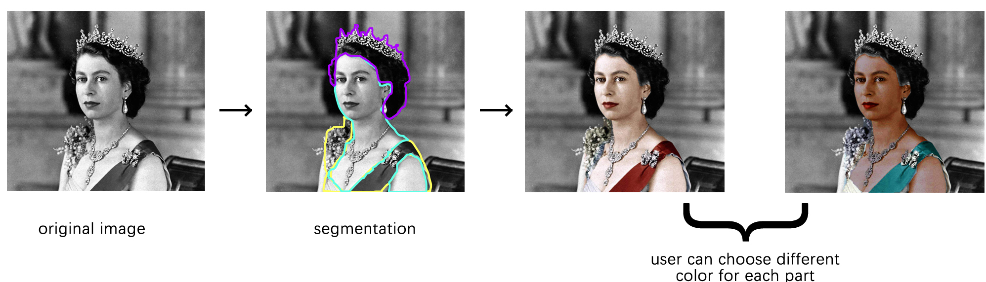
Goal and Dataset
Goal: raise a user guided colorization method for portrait video, which has an interactive interface to allow users to color hair, skin, clothes, and background for portrait.
Data set: Hollywood2 dataset used in Bo, Zhang’s paper. [1]
[1] Zhang, B., He, M., Liao, J., Sander, P. V., Yuan, L., Bermak, A., & Chen, D. (2019). Deep exemplar-based video colorization. In Proceedings of the IEEE/CVF Conference on Computer Vision and Pattern Recognition (pp. 8052-8061)

Slide 3
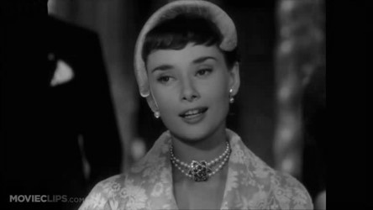
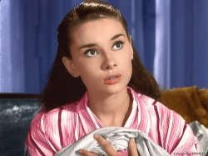
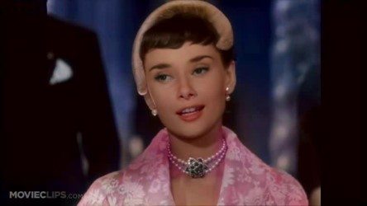
Methodology and Initial Result
Plan of Action
Extract features of the original image and the reference using VGG
Build a semantic correspondence map measuring the correspondence reliability and generate the warped color reference
Use convolution neural network as our colorization network to combine the confidence map, warped color reference along with the last frame to colorize the next frame
Segment the portrait video into four layers: hair, skin, clothes and background, and combine them at last
Sample Result
+
=
Original image
Exemplar
Initial Result (No segmentation)
Evaluation Method: PSNR, SSIM, Mean opion score

Slide 4
Tentative Timeline/To-do lists:
Nov 14 – Nov 17: Investigation
Yifan, WU: investigation about running environment as well as external libraries
Yulong, Dai: investigation about evaluation method
Yifan, WANG: investigation about dataset requirements and preprocessing methods
Nov 17 – Nov 20: Build up codebase and get down to datasets
Yifan, WU: build up code base
Yifan, WANG & Yulong, Dai: prepare datasets
Nov 21 – Dec 01: Develop segmentation and colorization idea
Yifan, WU & Yulong, Dai: design and implement colorization method
Yifan, WANG: design and implement segmentation method
Dec 02 – Dec 09: Experiments
Yifan, WU & Yifan, WANG: test colorization method on the datasets and record performance
Yulong, Dai: colorization method evaluating
Dec 10 – Dec 15: Develop the interactive interface
Yifan, WU & Yulong, Dai & Yifan, WANG: develop the interactive interface

