Slide 1
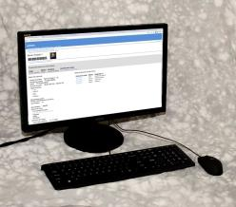
The piClinic Console
Its past, present, and future
Notes:
Photo: Bob Watson

Slide 2
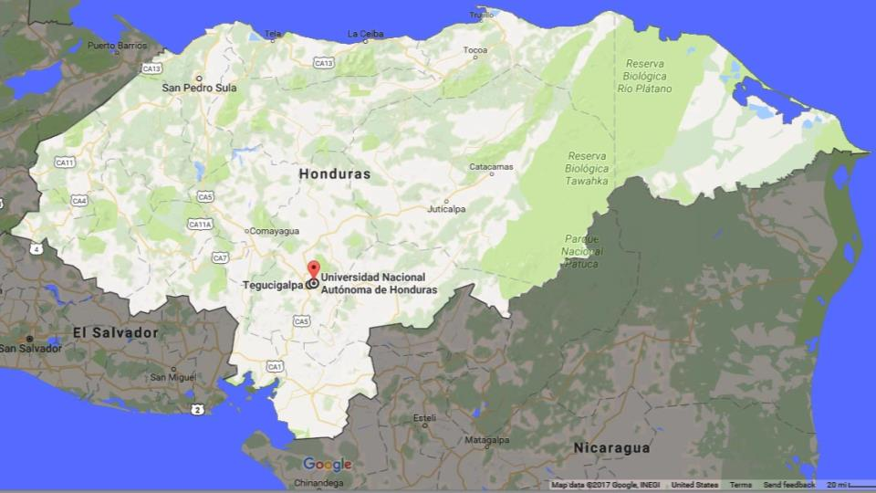

2014
Rus Rus
Notes:
Photo: Google Maps 2017

Slide 3
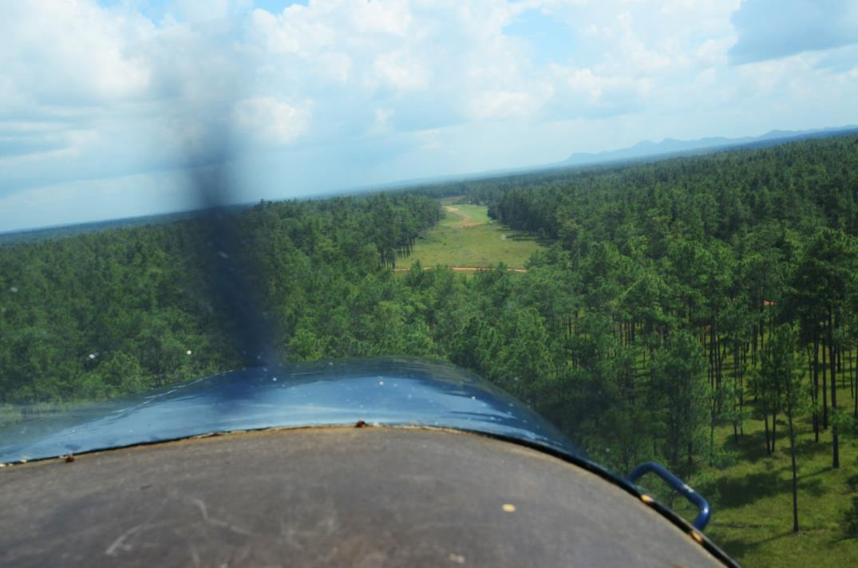
Notes:
Photo: Bob Watson

Slide 4
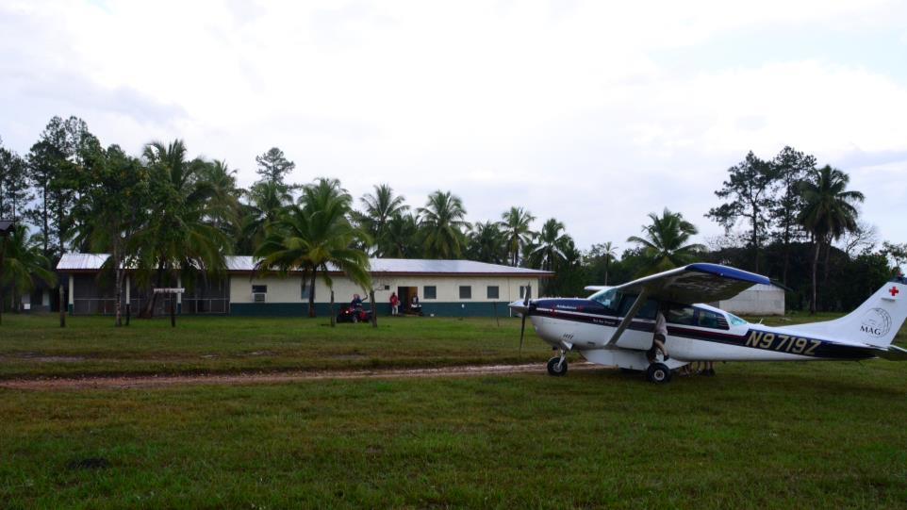
Notes:
Photo: Bob Watson

Slide 5
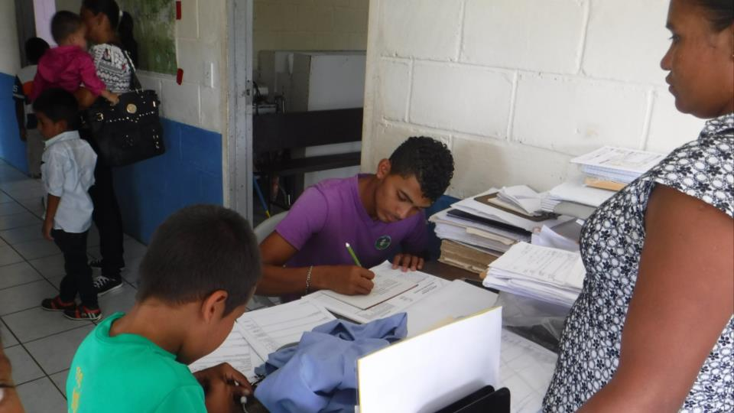
Notes:
Photo: Bob Watson

Slide 6
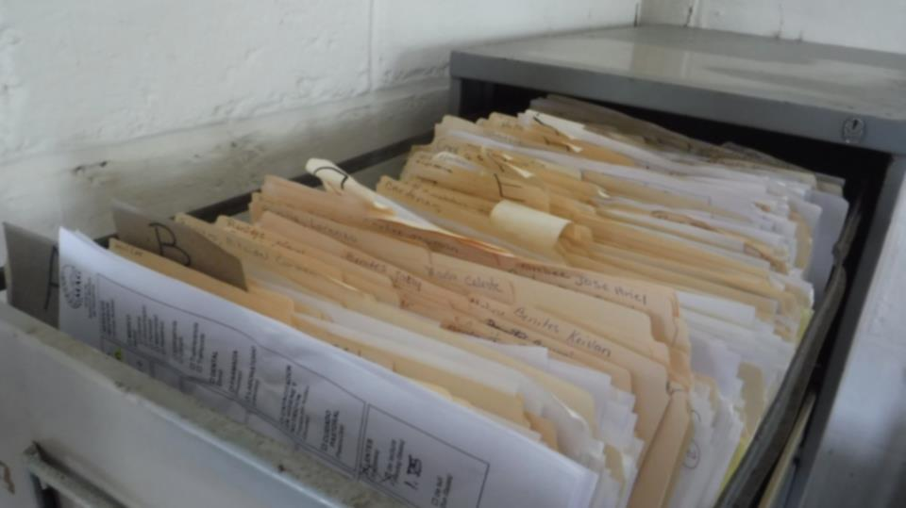
Notes:
Photo: Bob Watson

Slide 7
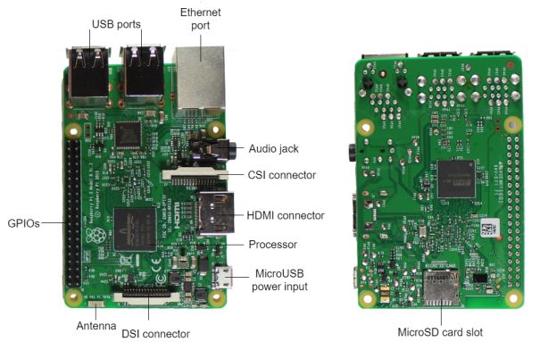
2016: Raspberry Pi 3 introduced Small, economical, and powerful.
Desde arriba
Desde abajo
https://randomnerdtutorials.com/getting-started-with-raspberry-pi/

Slide 8

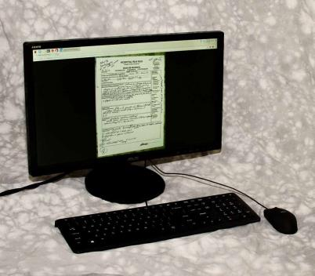

Spring 2017
Notes:
https://upload.wikimedia.org/wikipedia/commons/a/ac/Green_tick.svg

Slide 9
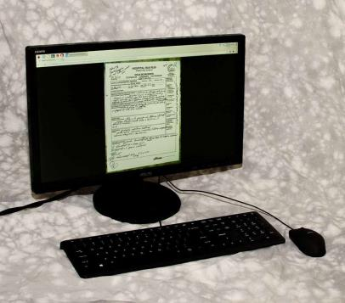
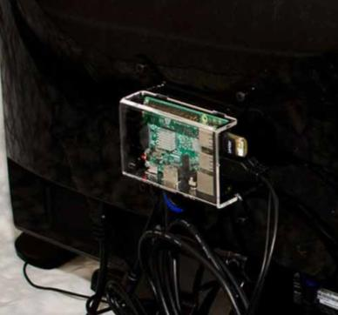
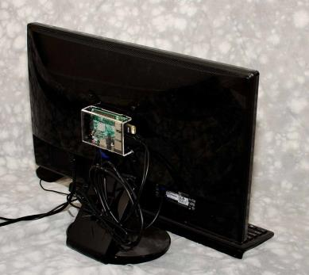
The piClinic Console was born piClinic Console

Slide 10
2017
Roatán
Rus Rus
Notes:
Map: Google Maps, 2017

Slide 11
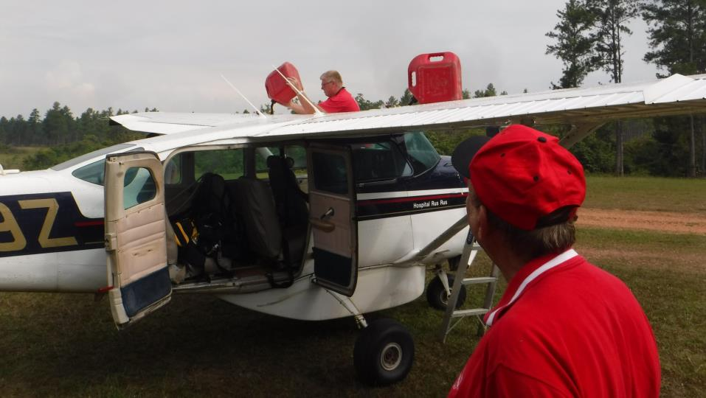
Notes:
Photo: Bob Watson

Slide 12
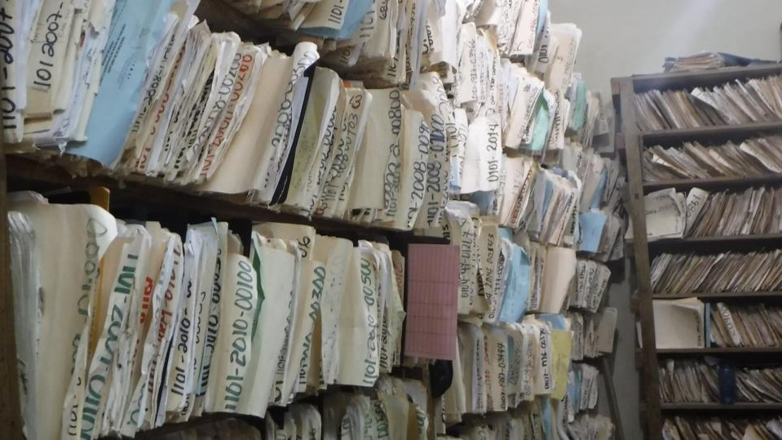
Notes:
Photo: Bob Watson

Slide 13
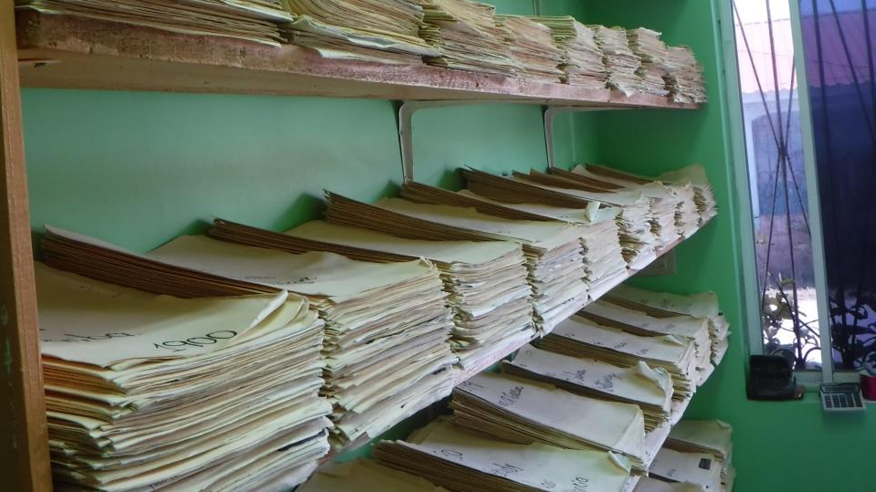
Notes:
Photo: Bob Watson

Slide 14
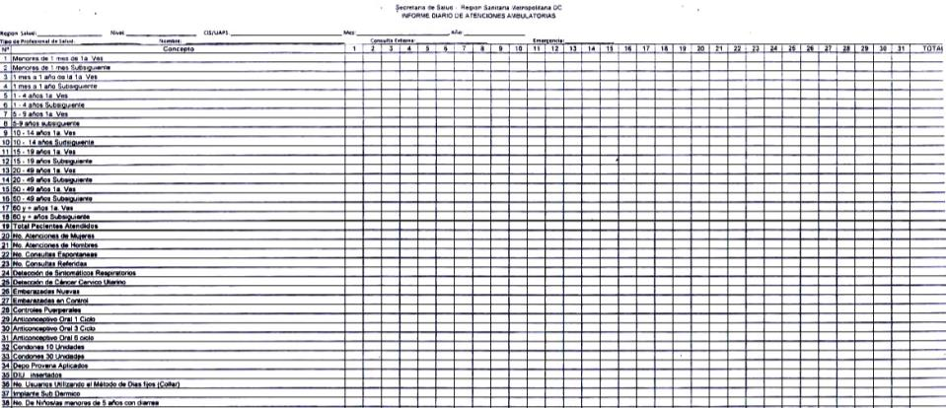
One monthly report takes 2-3 days to fill in its 1,664 fields

Slide 15



2017 Collaboration

Slide 16






Reviewed existing options

Slide 17

Reviewed existing options

Slide 18
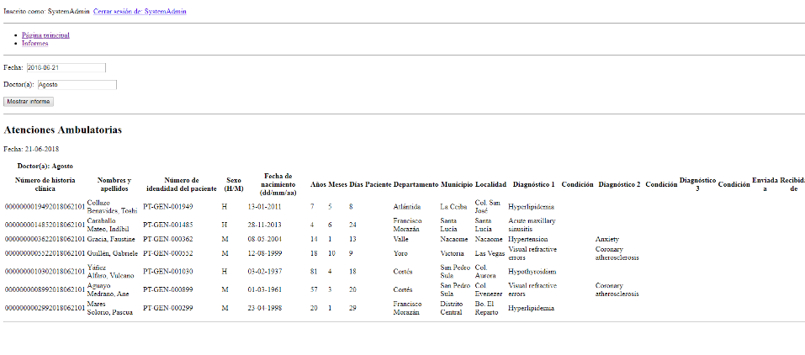

Tested functions on Raspberry Pi

Slide 19
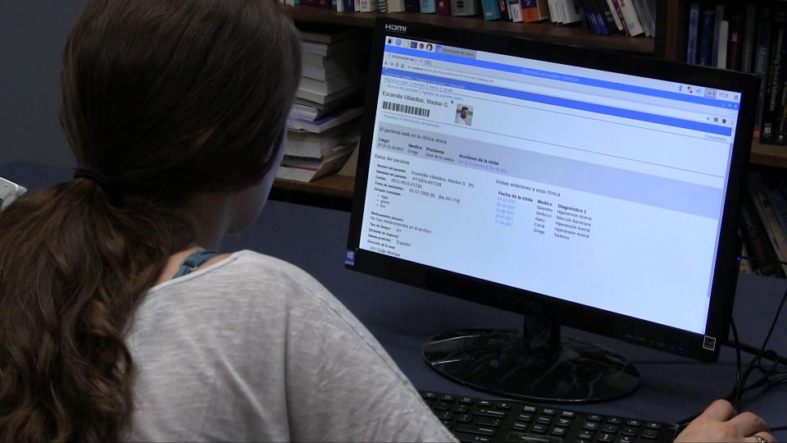
Notes:
Photo: Bob Watson

Slide 20
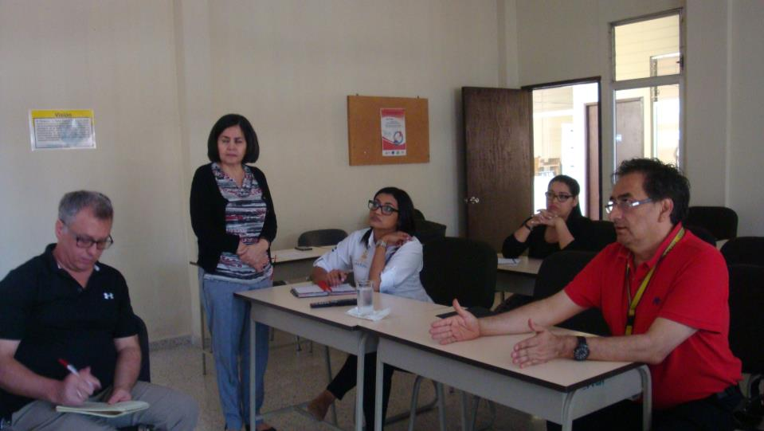
Reviewed functions with SMEs in Honduras

Slide 21
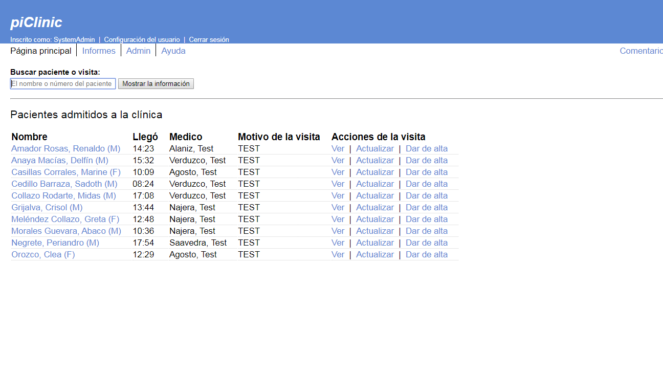
Notes:
Photo: Bob Watson

Slide 22
2018 plans
Find clinics to field test the piClinic console
Review and update the console’s functions
Prepare for 2019 field test
Review and prepare the console for field test
Update the documentation
Test, Test, and Test!

Slide 23

2019 plans
Test the console in three clinics on Roatán
Finish the study funded by the Fulbright grant
Prepare for broader deployment
Develop additional configurations
Mercer On Mission

Slide 24
Los beneficios
Para las clínicas
Más información sobre los pacientes
Menos tiempo coleccionándola
Para la Secretaría de Salud
Mejores datos
Menos errores

Slide 25
How can you contribute?
System development
Secure data storage
Secure LAN, & WAN access
Integration of peripherals
printer, barcode scanner, camera, etc.
Cell-phone interface (text/email).
Alternative hardware platforms

Slide 26
How can you contribute?
Application development
New features
Front-end/UI
Back-end
Image processing and storage
Paper-form integration
Automated testing of app software
Development tool support

Slide 27



piclinic.org
docsbydesign.com
Bob Watson, PhD
@bobwatsonphd
Notes:
You can follow the progress of the project at piClinic dot org, on my blog at docs-by-design dot com, and on Twitter.

Slide 28
Demo

Slide 29
Software architecture
User interface
UI/Form interface
REST API interface
System service & database access

