Slide 1
Mercer University Pre-Medical Track Canvas Course
Soni Allen, Evan Gambill, & Davis Perkins

Slide 2

Roadmap
Summary
Background
Report Analysis:
Needs Assessment
Learner Analysis
Context Analysis
Content Analysis
Instructional Objectives
Checkpoint
Instructional Strategies
Instructional Materials
Our Recommendations
Instructional Evaluation Plan
Conclusion
Notes:
Davis
Analysis follows steps of our work

Slide 3
Background and Purpose
Pre-Medical students need guidance and resources for their time at Mercer for a variety of reasons
In the past, this has taken the form of a print book and advisor meetings
Recently changed to an online format on Canvas
However, the material can be modified in order to be more effective and useful for the students
Notes:
Evan
Pre-med students need guidance, resources
Online recently
Can be changed to be more effective, useful

Slide 4
Summary
Using the research and data we have collected, we have come to these general findings throughout the semester:
Canvas provides a variety of options for the pre-medical track that can greatly help students.
However, at the moment, some of these are not yet fully utilized.
With re-structuring of content, and a redesign of the home page, the Canvas course can help students achieve their goals even better than before.
Notes:
Soni
The course is a great tool for students, but from what we learned from interviews these tools aren’t utilized from to their full potential

Slide 5
Needs Assessment Description
Goal of Needs Assessment: Find what specifically the learners need to succeed
Often works to find what the current and ideal states are, and then what is needed to reach the ideal state.
Methods of uncovering needs (Carliner):
Interviews
Focus Groups
Student Experience
Read literature about similar situations and experiences
Our needs assessment focused largely on interviews
Notes:
Evan
What are the needs of the students?
Describe “states” -- current & ideal of the learners
How to find needs? Interviews, student experience, etc

Slide 6
Needs Assessment Results
Students’ Current State | Students’ Ideal State | Type of Gap
Students unsure about reference materials | Students able to easily reference materials in order to assess their progress and advance in their career | Knowledge
Students unclear about their goals and motivations | Students will be able to better evaluate their goals and motivations | Attitudinal
Students have difficulty progressing through the track and their time at Mercer | Students are able to progress through the course and know what to do during their college career | Skill
Notes:
Evan
Our current vs ideal state chart
Reference materials: Unsure how to use currently
Goals and motivations: Students unsure about their own motivations etc
Progression: Difficulty in progression through course -- often feel unguided

Slide 7
Recommendations from Needs Assessment
For reference materials:
Clearer organization
Explanation of purpose / reason for providing each
For motivation-seeking activities:
Engaging and thought-provoking materials
Explanation of purpose and benefits of materials
For course and college career progression:
Set due dates for modules with a focus on end-of-academic year checkpoints and advising meetings
Highly visible “What’s next” section on home page, highlighting upcoming due dates, events, etc
Notes:
Davis
3 areas for recommendations from the Needs Assessment

Slide 8
Learner Analysis
A Learner Analysis is an overview of the course’s potential learners. Different details like age, gender, year-in-college, and more, are looked at in order to see commonalities between the learners.
In using this data, designers can personalize their content for that audience.
Conducted interviews with students to learn more about the motivational levels and all-around knowledge of students.
Majority of students we interviewed felt good about the overall experience of the program, however we found that some felt unprepared and confused on how to proceed within the track.
Notes:
Davis
First step in the design process
Leads into Context Analysis

Slide 9
Context Analysis
A Context Analysis is a detailed look at different contexts involved with a site. There are three different contexts we considered while looking through the course: the orienting, transfer, and instructional contexts.
Orienting: What the conditions the learners bring to the course already, like prior knowledge or previous experiences.
Transfer: The environment where what is learned from the course is applied in real life.
Instructional: The environment in which the learner gains the information.
Notes:
Soni
Even though the online course is self guided, there should be more guidance in order to help the user achieve their goals

Slide 10
Context Analysis Findings
Orienting Context: Relates to the learners’ background. Each learner is expected to have completed high school (or similar) and have interest in a health or medical field.
Instructional Context: The environment. Due to being online, partially dependent on the learner.
Transfer Contexts: Has to do with how the information and training will be applied.
registration for classes
applications for med-school
in class work
Notes:
Soni
Even though the online course is self guided, there should be more guidance in order to help the user achieve their goals

Slide 11
Content Analysis
A Content Analysis is a high-level overview at all of the content provided on the course. Within the analysis, we:
Looked at the structure of the course in order to analyze what things that were needed and potentially could be rearranged for the course
Made a general outline of the course and all of the materials that are on each page.
Notes:
Soni

Slide 12
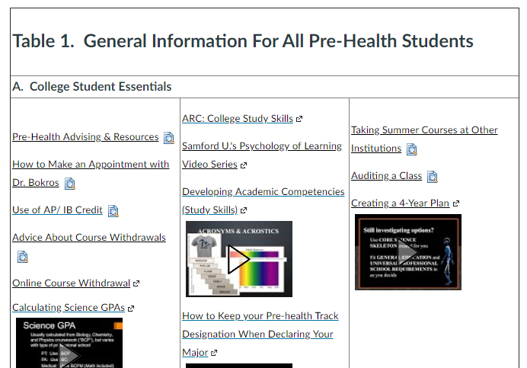
Findings from Content Analysis
With an extensive amount of content considered, we noted the following:
Information on the home page could be reorganized to increase the digestion of information
No way for students to measure their own progress
Notes:
Soni

Slide 13
Instructional Objective Description
Instructional Objectives are the specific goals of the learner over the course of the instruction.
These help with content creation, organization, and evaluation.
There are four parts to every objective: the condition, the “who,” the action, and the criterion.
In the case of the Canvas course, our objectives include objectives for the course overall, along with those for each specific module.
Notes:
Davis

Slide 14
Instructional Objective Examples
For the course overall:
After completing the Pre-Health Canvas course, students will be able to determine whether or not a career in a Pre-Health profession is suitable for them.
For specific modules:
After completing a specific module, students will be able to adequately express their motivations to further their learning and career path.
Notes:
Davis
Condition: After completion
The “who”: Students
Action: Determine
Criterion: “is suitable”

Slide 15
Checkpoint
Summary
Background
Report Analysis:
Needs Assessment
Learner Analysis
Context Analysis
Content Analysis
Instructional Objectives
Checkpoint ← You are here.
Instructional Strategies
Instructional Materials
Our Recommendations
Instructional Evaluation Plan
Conclusion
Notes:
Davis

Slide 16
Instructional Strategies
Determining how best to present information based on the organization’s background and learner’s needs, to create the materials needed to deliver the training.
3 Different strategies to present what the learners need:
Motivational
Presentation
Generative
Notes:
Evan
Based on prior data, we wanted to look at the instructional strategies in use, and what might be best for each piece of content
Motivational : attitudinal stuff
Presentation: policy / memorization stuff
Generative: Writing / creating stuff

Slide 17
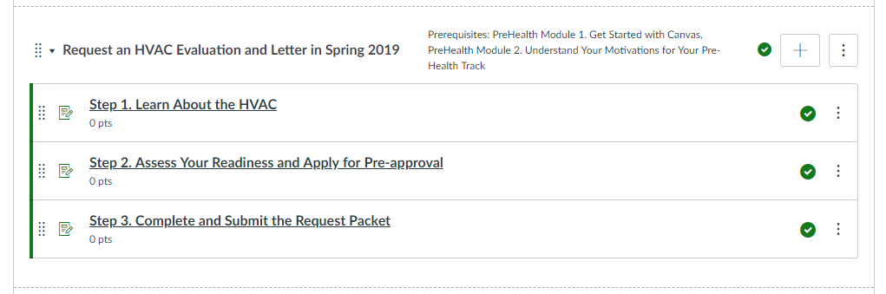
Instructional Materials Description
The Instructional Materials are a catch-all term for all of the content needed for the instruction.
This includes content used by instructors as well as that used by learners.
In the case of the Canvas, this is mostly composed of the home page content and the content in the modules
Notes:
Evan
Next comes all of the materials creation.
In a new course, this would mean generation of content
In our case, it involved largely organization of existing content

Slide 18
Home page improvement
We believe the home page is the most important part of the website. Because it is the first page that students will see, we think there are some slight alterations that could be made in order to improve the experience of the users:
Showing upcoming modules on the home page.
Creating a “schedule” that shows a rough flow of what modules students should complete and when to complete them.
Moving the “General Information” table to a page dedicated to resources.
Notes:
Davis

Slide 19
Home page improvement (cont’d)
Module Name | Begin Period | End Period
Module 1: Getting Started | 1st Semester | 1st Semester
Module 2: Understand your Motivations | 1st Semester | 3rd Semester
Notes:
Davis

Slide 20
Module changes
As they are, the modules are a great tool with organized information for the learners. However, we believe that some shuffling could be done to maximize effectiveness:
Moving the last two modules, the ARC and and CCPD modules, to an accompanying “Resource” page.
Creating and scheduling an HVAC evaluation / letter request to be due shortly before students are recommended to complete these tasks. (Similar to currently numbered pre-health modules)
Notes:
Soni

Slide 21
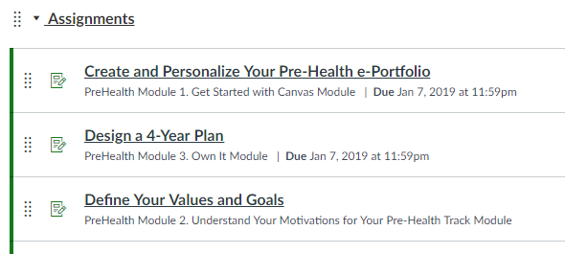
Canvas Course Scheduling
To better encourage students to use their time wisely, we recommend a clearer and more concrete scheduling of module due dates.
For example, a module or modules due shortly before advising ensures the student is ready to discuss that module’s topic during advising.
Consistent scheduling also helps students to be aware of and work towards short-term goals on the track.
Notes:
Evan
One feature of Canvas that would help users: scheduling and a directed path through the track
Could have due before advising to be able to discuss better
Consistent scheduling great for helping students keep up with track

Slide 22
Instructional Evaluation Plan
An evaluation plan is vital to gaining useful feedback from the student’s reaction to the course. This feedback can be used to further improve the course and offer a better reference to the design of future courses.
There isn't currently a way to evaluate the Canvas course based on the course objectives.
With these recommendations, the evaluation of the course becomes easier to measure with quantitative and qualitative data:
Module quizzes: Are the modules effective, if so, how much?
End of academic year online surveys: What are the students’ reactions to the course?
Exit survey: If a student leaves, why? (graduation, major switch, etc.) What are their final thoughts on the course?
Notes:
Evan
After implementation, how can we tell how effective the course is? (For further
Need to create evaluation plan.
We recommend using student performance on the module quizzes as well as surveys to determine student reaction
See: academic year surveys, exit surveys

Slide 23
Conclusions
Thank you again for this opportunity to work with this website.
We believe that with our recommended changes, the Canvas course will be easier to use and students will have a clearer understanding as to what is expected of them to progress in their college careers and beyond.
Notes:
Soni

Slide 24
Conclusions
Thank you again for this opportunity to work with this website.
We believe that with our recommended changes, the Canvas course will be easier to use and students will have a clearer understanding as to what is expected of them to progress in their college careers and beyond.
Questions?
Notes:
Soni

