Slide 1
Lab 1 – Introduction to gRPC
BAI Dongbin
dong-bin.bai@connect.polyu.hk

Slide 2
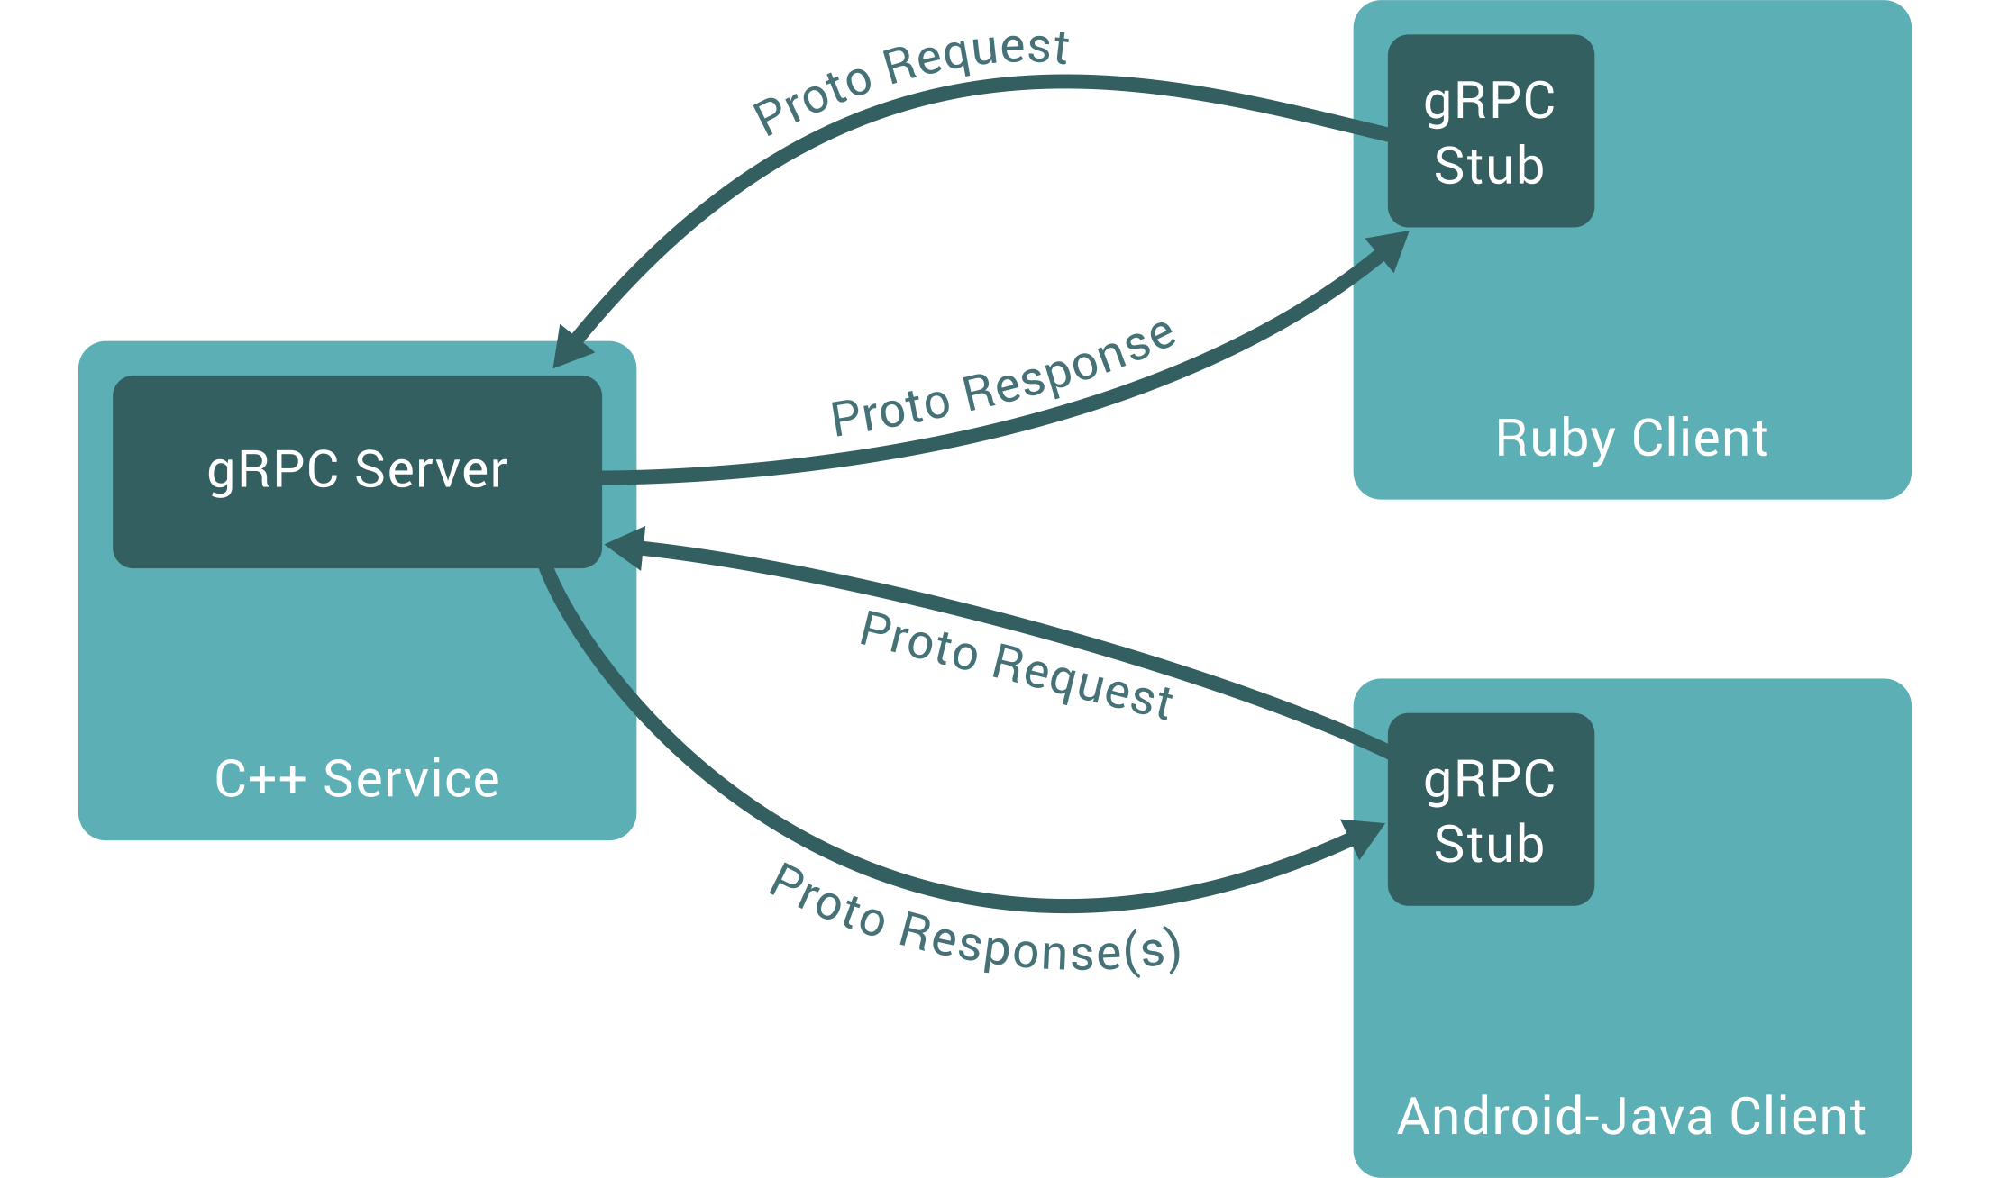
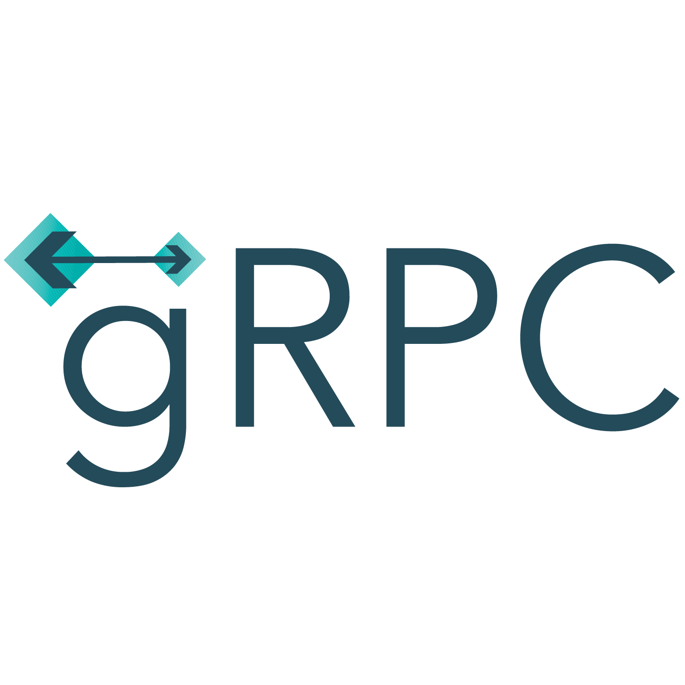
What is gRPC?
gRPC (gRPC Remote Procedure Calls) is a cross-platform open source high performance remote procedure call (RPC) framework. gRPC was initially created by Google, which used a single general-purpose RPC infrastructure called Stubby to connect the large number of microservices running within and across its data centers from about 2001.

Slide 3
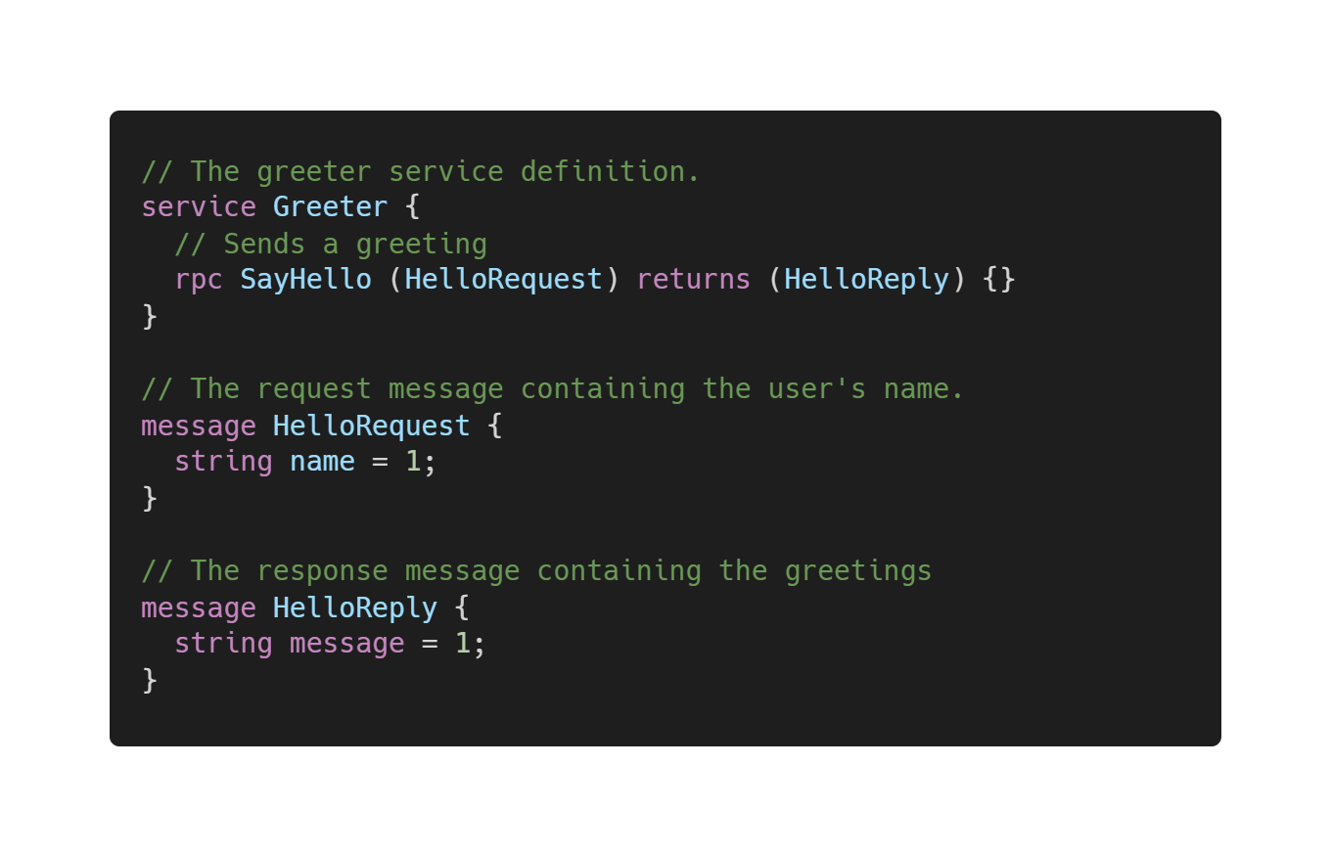
What is gRPC?
In gRPC, a client application can directly call a method on a server application on a different machine as if it were a local object, making it easier for you to create distributed applications and services.
By default, gRPC uses Protocol Buffers, Google’s mature open source mechanism for serializing structured messages.

Slide 4
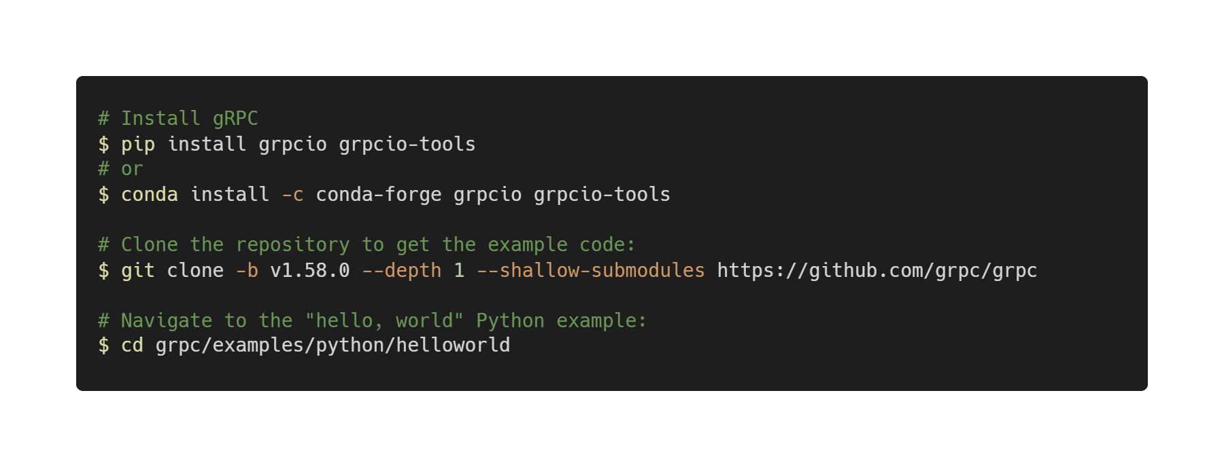
Prerequisites
Python 3.7 or higher
pip version 9.0.1 or higher
https://grpc.io/docs/languages/python/quickstart/

