Slide 1


Rona Cards
Ironic, Interactive, and Informational
“Collect cards, instead of the real thing!”
Copyright © 2020 Rona Cards (http://www.rona.cards)

Slide 2
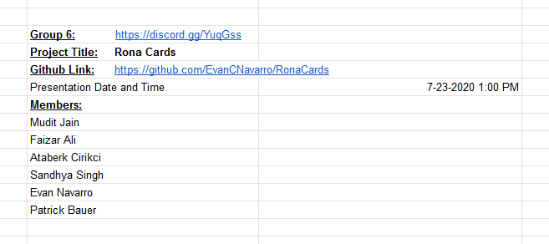
Group 6:
Sandhya Singh (Project Manager)
Evan Navarro (Database, API, Web App)
Ataberk Cirikci (Database, Email Verification, Password Reset)
Faizar Ali (Web App, Unit Testing)
Mudit Jain (Web App)
Patrick Bauer (Mobile App)
GROUP 6:

Slide 3


Project Overview:
. . . . . . . . . . . . . .
Ironic / Interactive / Informational
Rona Cards is a purposefully ironic application, where users can collect cards that represent different symptoms associated with COVID-19.
GROUP 6:
While collecting a card, users can view a 3D Model (AR) over the card.
After collecting a Symptom Card™, users can visit a website to view more information on symptoms.
The overall mission: is to incentivize people into learning about the symptoms of the novel Coronavirus, to reduce misinformation and “spread” awareness.

Slide 4



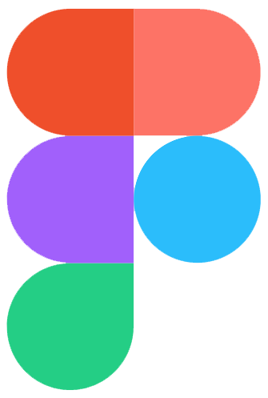



Technologies/Tools Used: #1
(Internal Management)

Slide 5








Technologies/Tools Used: #2
(Web Application)

Slide 6

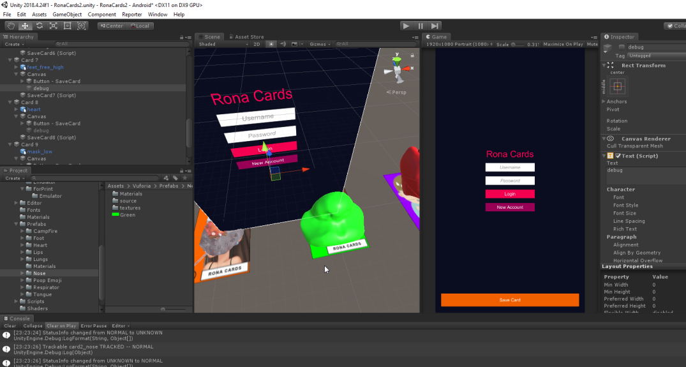

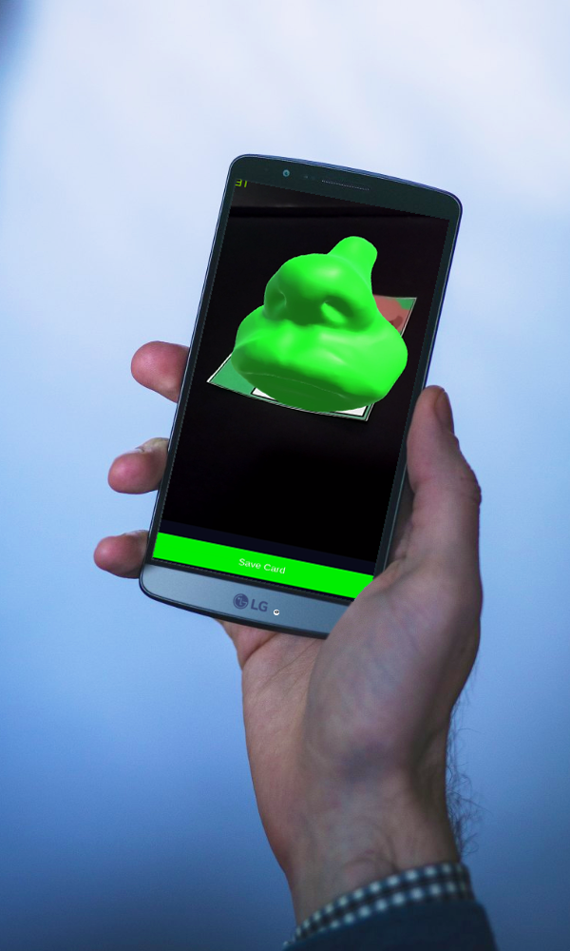
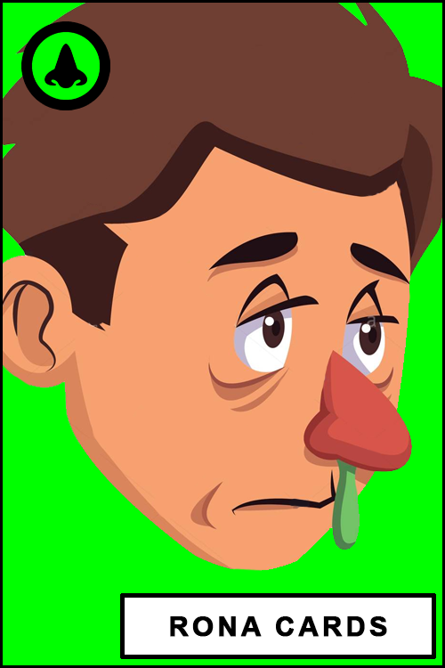


Technologies/Tools Used: #3
(Mobile Application)

Slide 7
What went well? What didn’t?
The Good:
The Bad:
Communication
No ghosting
Pairs programming
Completion of work
Relaxed mentality
Laughing
Time Management
Learning Curves
Wasted efforts
Inexperience
GROUP 6:

Slide 8
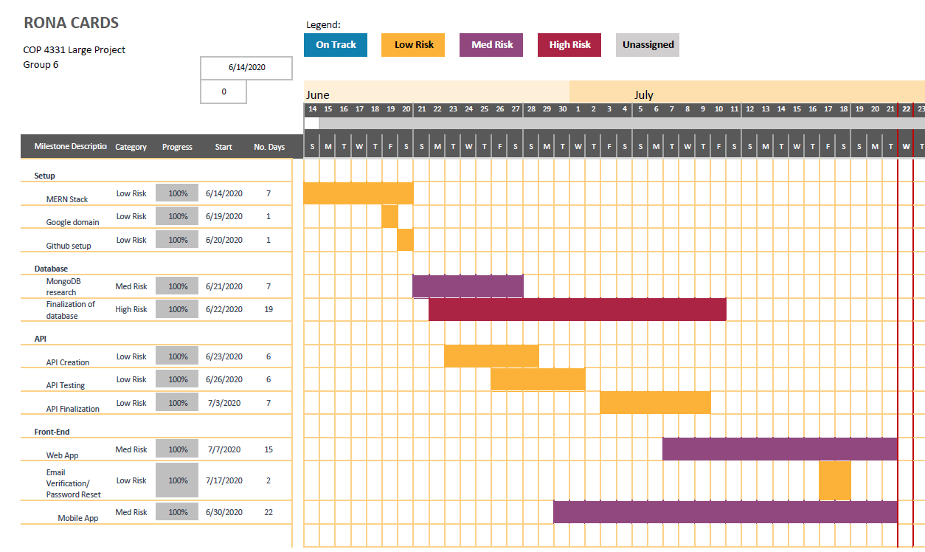
Gantt Chart

Slide 9
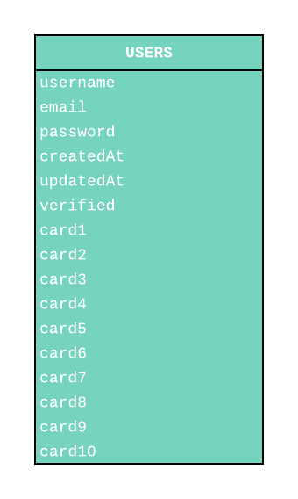
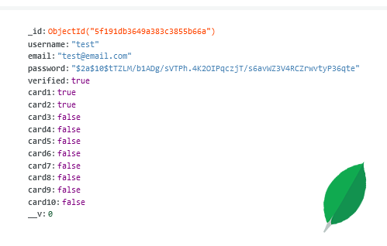
Entity Relationship Diagram (ERD):
FOR EXAMPLE:

Slide 10
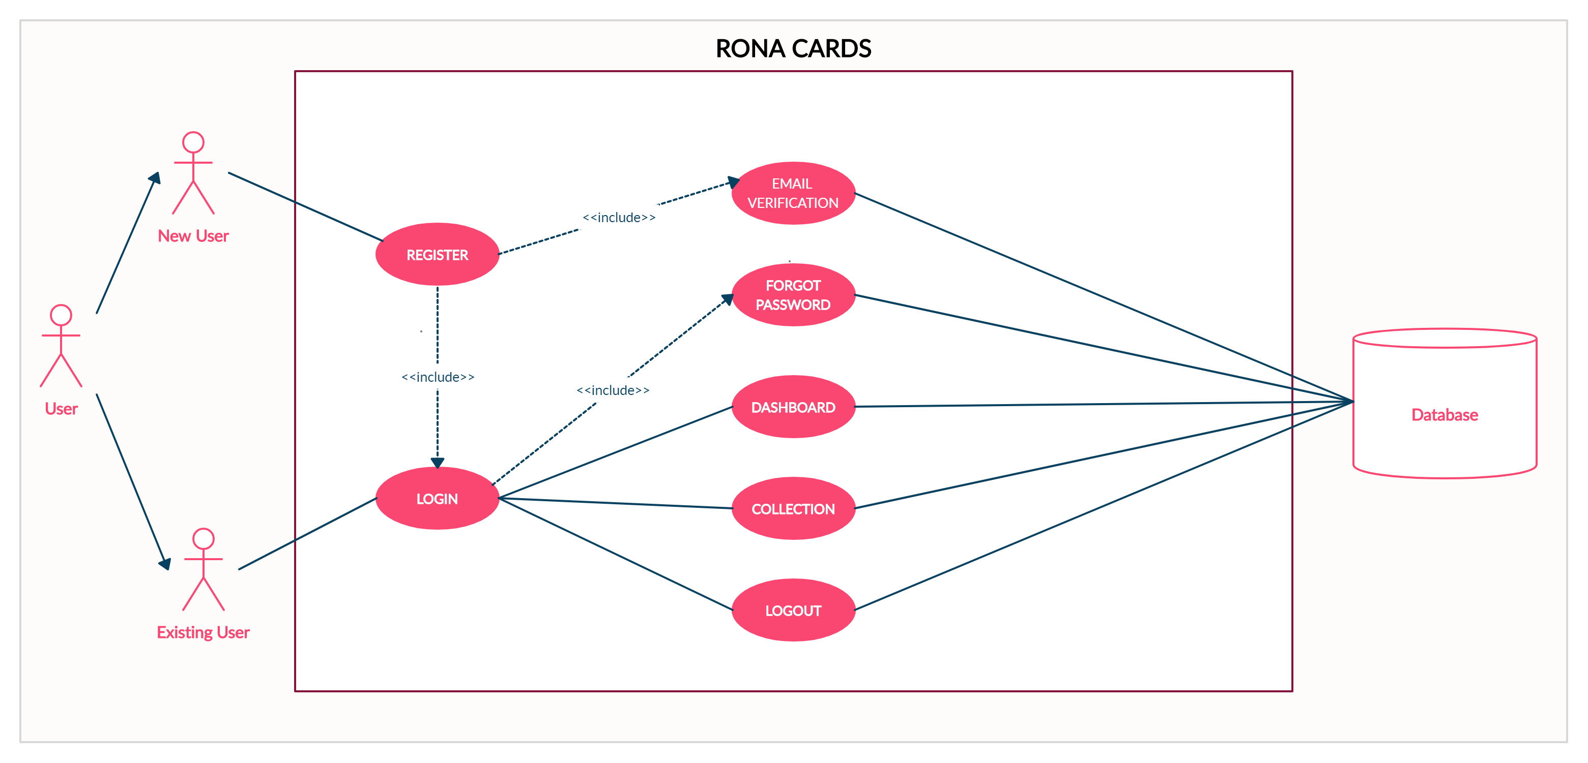
Use Case Diagram:

Slide 11
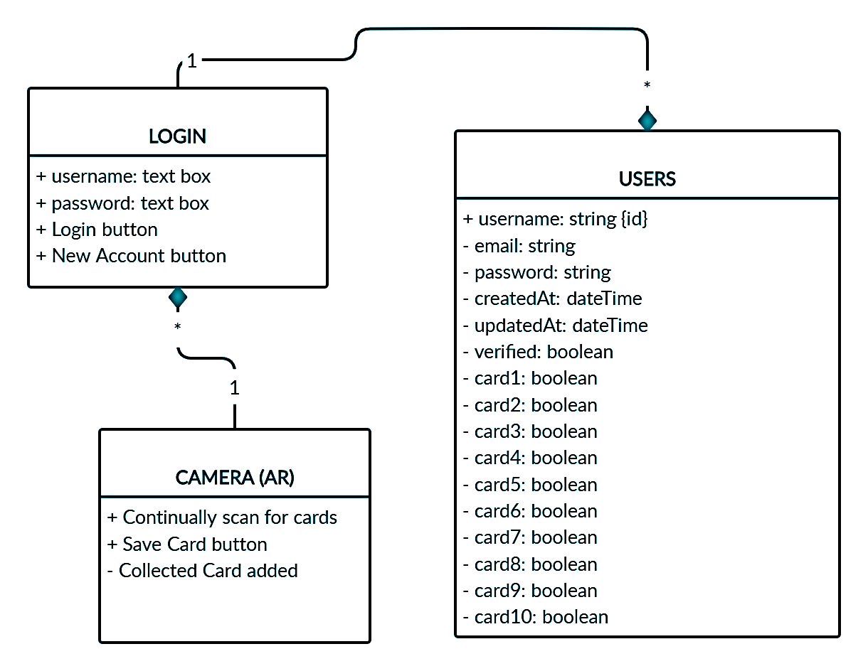
Class Diagram (Mobile Application):

Slide 12
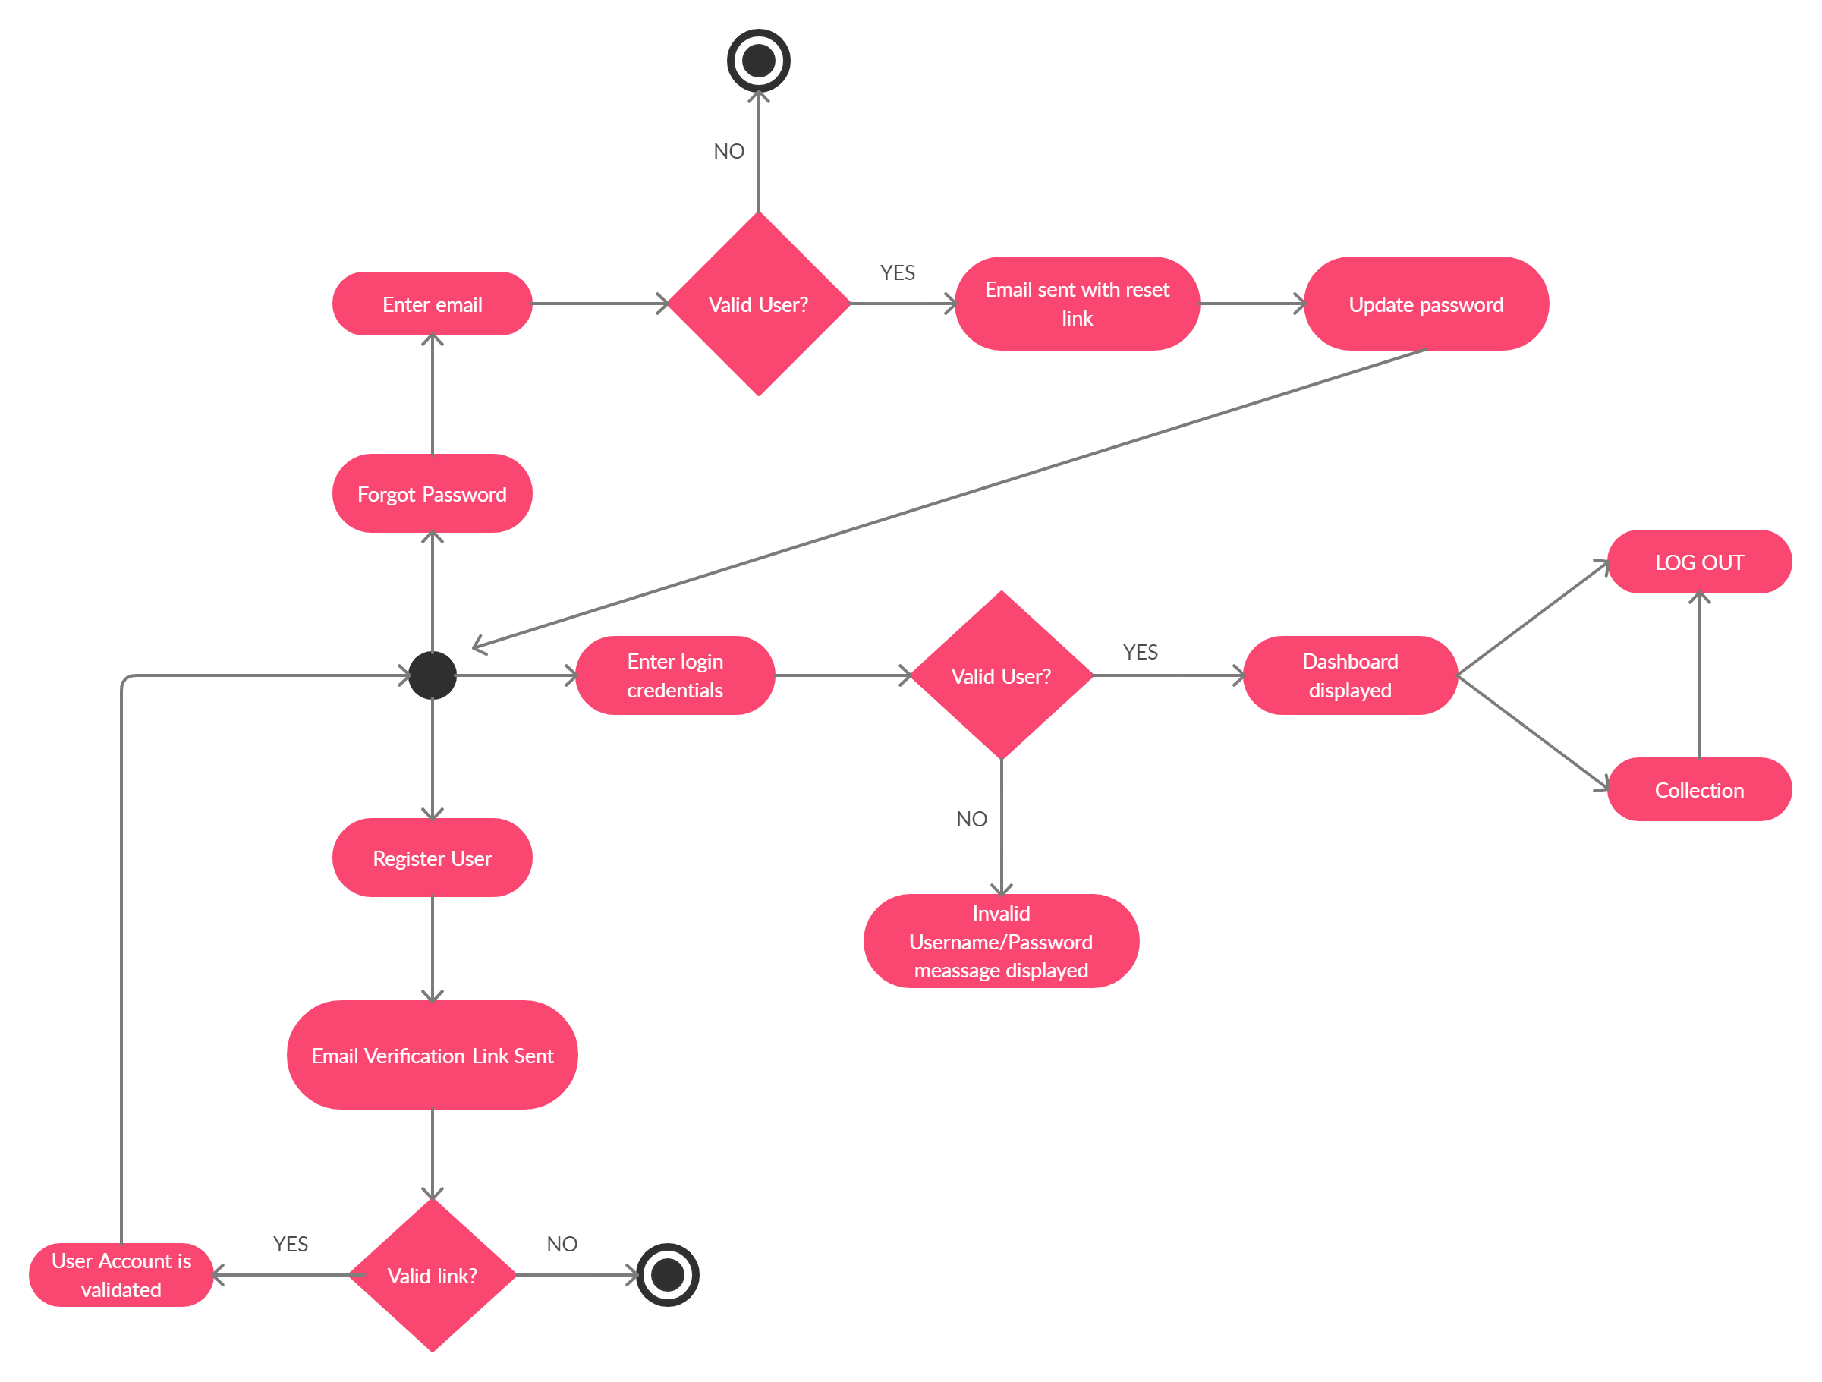
Activity Diagram

Slide 13
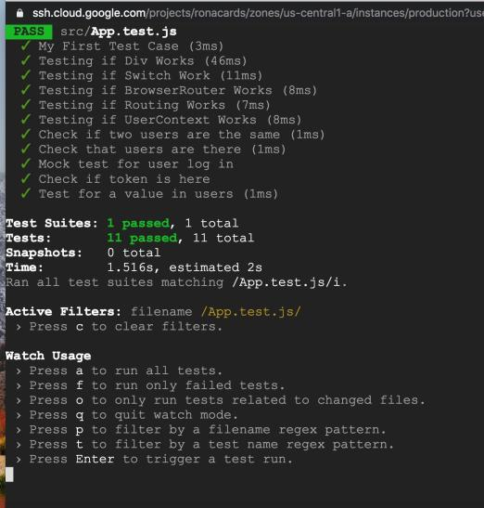
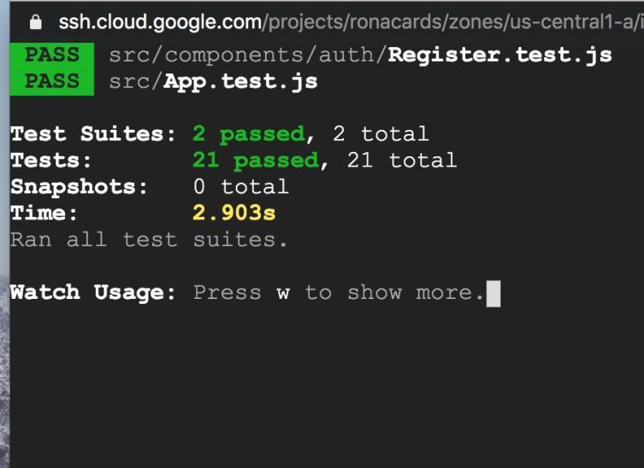
Unit Testing: #1

Slide 14
Unit Testing: #2
Function Name | Description | Input | Result
test('Mock test for an array of users', () | This function is a mock test of an array of users send to the database. | expect(users).toEqual(expect.arrayContaining(['Mudit', 'Evan'])); | True
test('Mock test for user log in', () | This function is a mock test of a user logging into the website. | expect(login.username).not.toBeUndefined; | True
test('Check if two users are the same', () | This function is a mock test where two users are the same. | expect(firstUser).toEqual(secondUser); | True
test('Check if token is here ', function () | This function is to check if the token is found. | expect(hasToken.token).not.toBeUndefined; | True

Slide 15
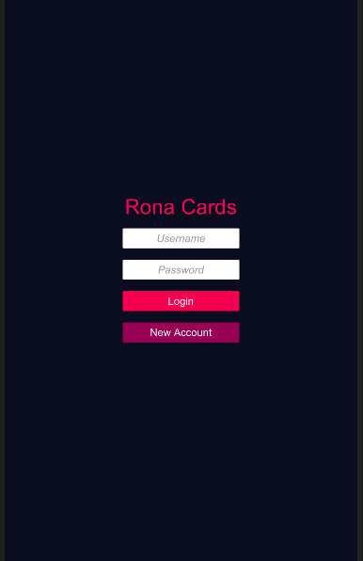
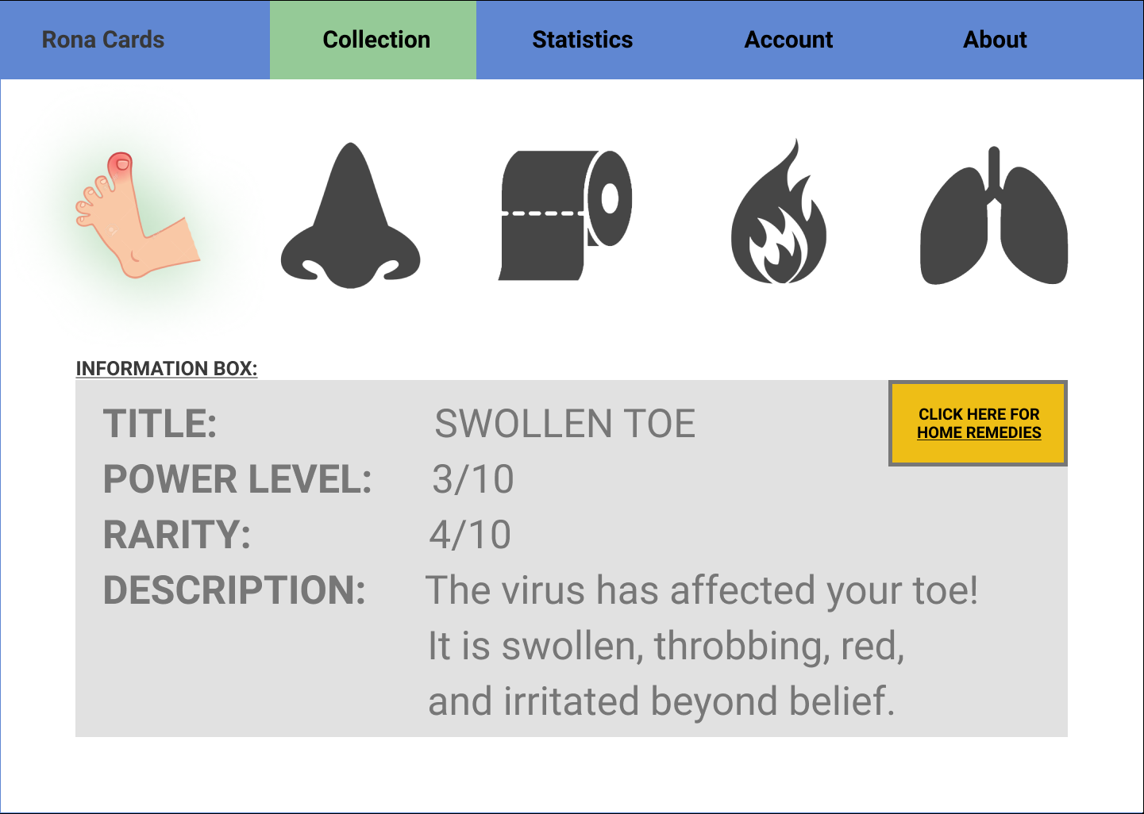
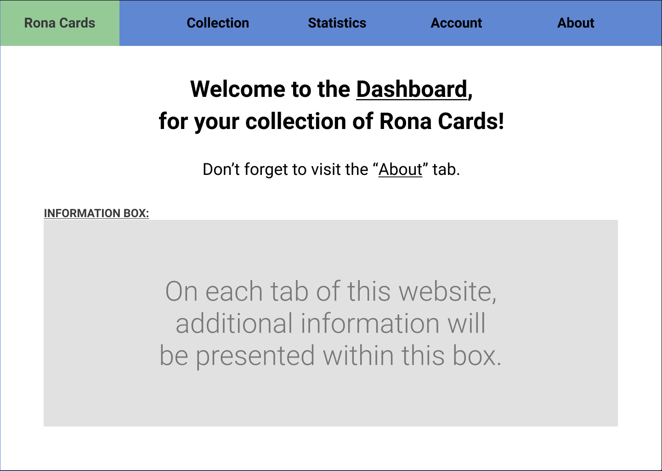
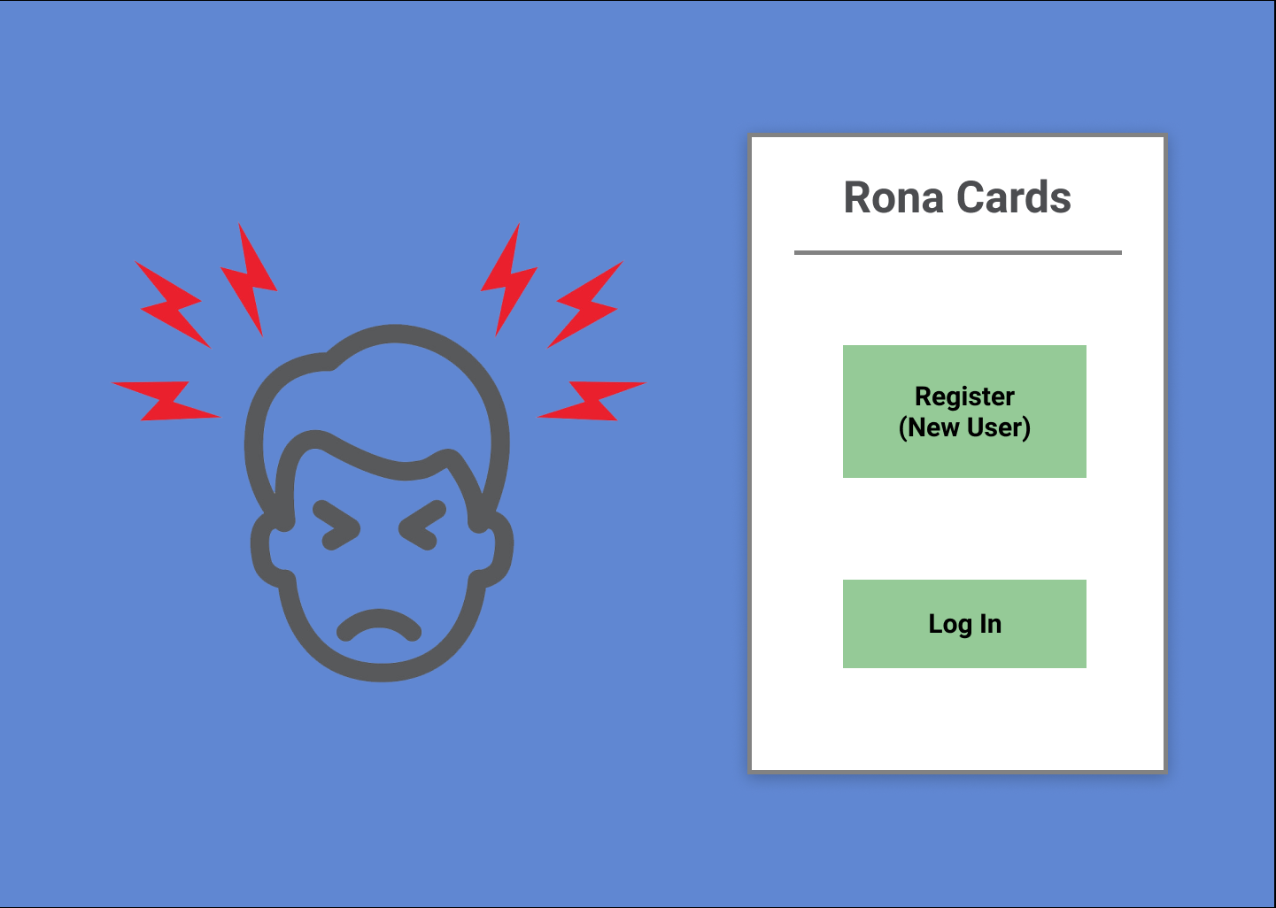
Wireframes / Prototypes:

Slide 16
Demonstration of:
Web Application
API Test (Update)
Mobile Application

