Slide 1
Existing without Google Maps:
Open Source Navigating and Mapping with your community
in blue, and yellow,

Slide 2
Introducing a new term: GIS
Geographic Information System
Basically create a coordinate system. Wrap some kind of shape in it. Pin that shape to earth.
Come back to learn more! PostGIS, QGIS, GeoJSON, etc. etc.

Slide 3
Stupid history snore quote
"Ask not what your country can do for you — ask what you can do for your country."
- Some Guy
Correction: ask both questions. Questions are good.

Slide 4
What I want you to know
What the current GIS projects can do for you
What you can do for them

Slide 5
Our binaries
Two personas...
Users - Don't care how it works.
Developers - Willing to learn how it works.
Comparing...
Security
Functionality

Slide 6
Problem with Security and Functionality
Doesn't make sense when comparing your service or produce or Google.
In the context of a sales pitch this division is arbitrary:
  it's a feature to be able to able to control your data.
  it's a security problem to have other people control your data.
  Now I can cut this show in half!

Slide 7
Users
Correct data
The ability to correct incorrect data
The ability to make use of correct data
ie., ecosystem

Slide 8
Case Study:
Shit Data; Superb Pide: Star Pizzeria

Slide 9
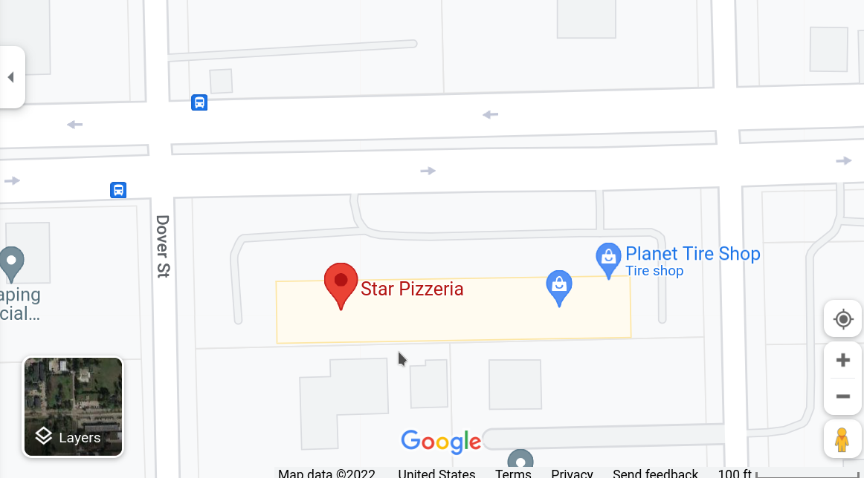
Google has bad data
Open a browser right now.
Google for "Star Pizzeria, Houston"
What street is it on?

Slide 10
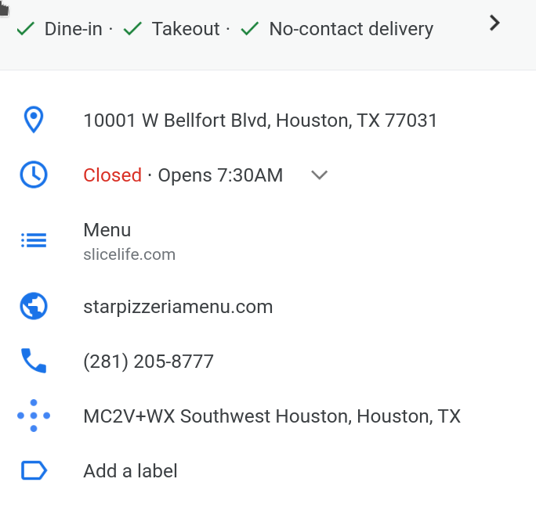
Google Maps
That's it.
Not much data.
Hours are wrong.
Clearly Google says "Bellfort Blvd"

Slide 11

Store Website:
Right on the home page
and, in the footer...
W. Bellfort Ave.

Slide 12
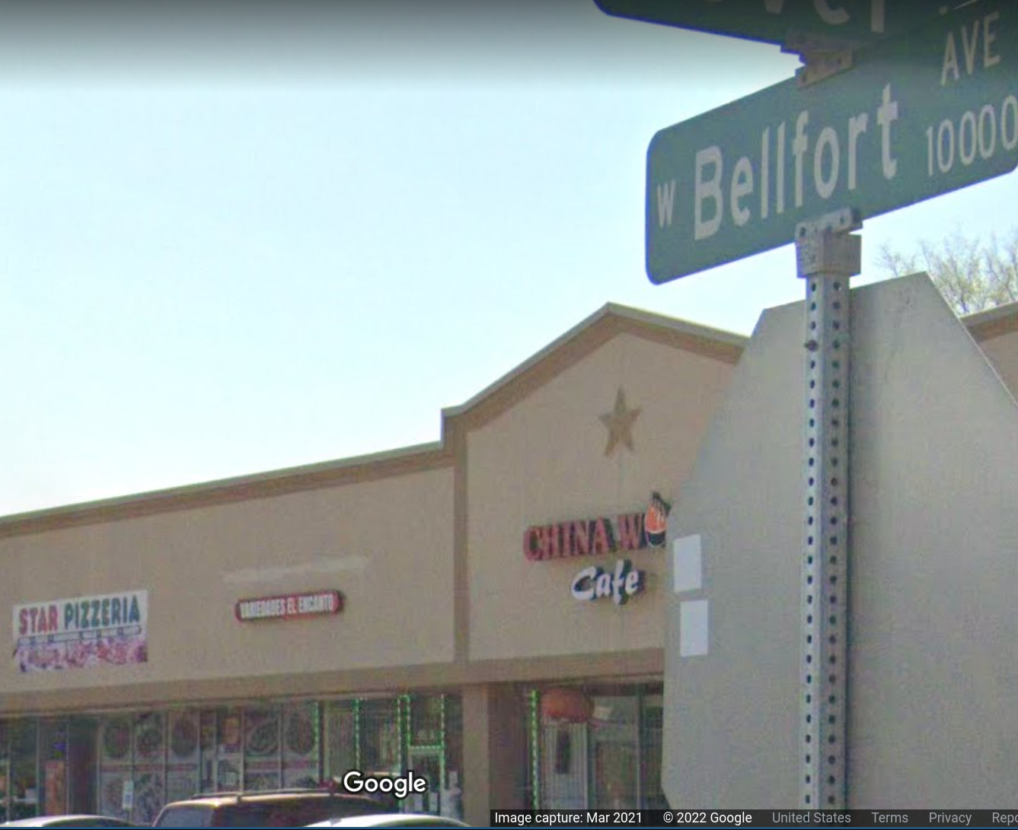
Google: Street View

Slide 13
Case closed.
It's an Avenue
Not a Street.
Not a Boulevard.

Slide 14
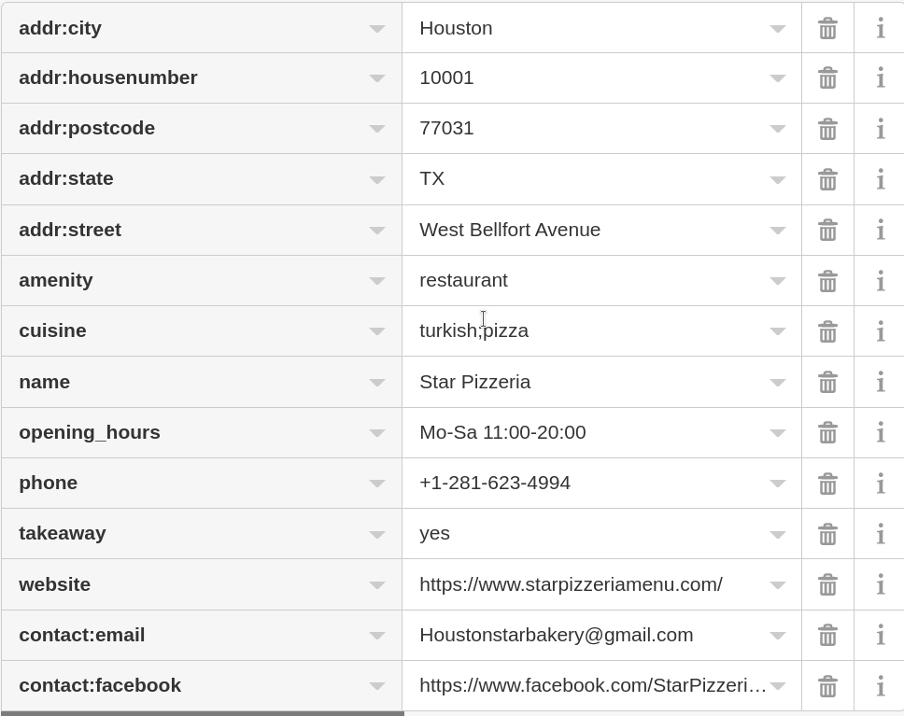
What does OSM say?
Yes, I cheated. So what?
More info!
It's right! Street address AND hours.
Adds more contact info (email/FB)
Mentions "TURKISH CUISINE"

Slide 15
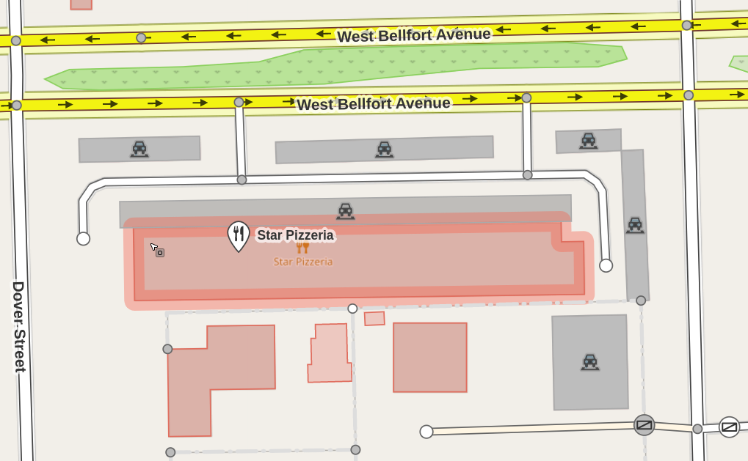
OSM View

Slide 16
Side by Side

Slide 17
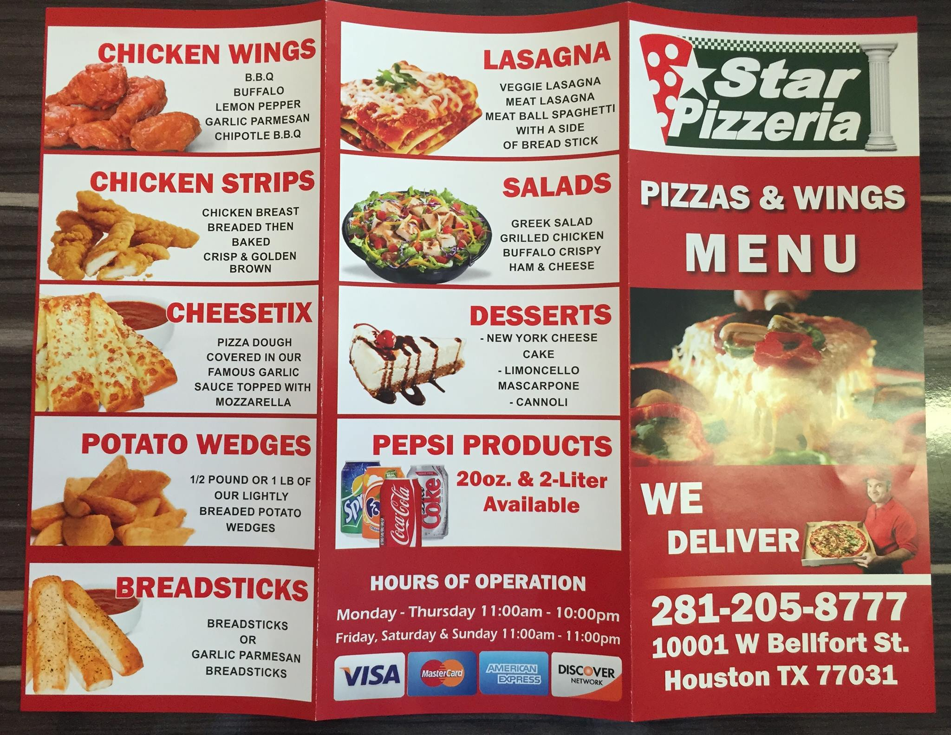

Alas...
Bottom. Right.
Street Address?
WTF?

Slide 18
Summary
There is a pizza shop I like.
The street name has reptilian characteristics.
I can play detective and solve it.
This makes the data better for you.

Slide 19
Street Views?
100% Free.
Creative Commons Licensed Data
Unfortunately, the app is closed source
https://www.mapillary.com/

Slide 20
Navigation?
Maps are a means to an end, usually
Aesthetics meet functionality
Enter OSMAnd
10M Downloads
https://osmand.net/

Slide 21
Navigate Cotd.
https://www.openstreetmap.org/
Also works.

Slide 22
Giving Back On the Go
OSMAnd
  Traces
  Edits on the go
Vespucci
  Powerful
  A bit too complex for my liking

Slide 23
Giving Back On the Go (cotd.)
Street Complete
  Gamification of Data Holes
  Quests, Badges, etc etc.
  Bridge height, building numbers, hours of operation, stories, road pavement type
  Easy, I do it while walking

Slide 24
Giving Back On the Go (cotd.)
Mapillary
  Point clouds
  Street Views
  Beware app not open source.

Slide 25
King of Ease: OSM iD
JavaScript enabled WebApp
https://wiki.openstreetmap.org/wiki/ID
https://www.openstreetmap.org/

Slide 26
Ideological Motivated
Excellent.
Small local business?
Geek stores. EPO and TX/RX are done. ;)
Community places. Set the hours. Find us here, at Improving HLUG.

Slide 27
Things you can do
Flag sidewalks for repair, making them dangerous
Flag fruit trees, or edible plants.
Catalog building colors or landmarks
Learn more about the ecosystem, propose automated edits

Slide 28
Now it begins!
Watch me first.
  Android
  Add a location
Then...
  Go create an account https://www.openstreetmap.org/
  Find one place that's not on the map, think small business.
  Add it!

