Slide 1
Chapter 14 JavaFX Basics

Slide 2
Motivations
JavaFX is a new framework for developing Java GUI programs. The JavaFX API is an excellent example of how the object-oriented principle is applied. This chapter serves two purposes. First, it presents the basics of JavaFX programming. Second, it uses JavaFX to demonstrate OOP. Specifically, this chapter introduces the framework of JavaFX and discusses JavaFX GUI components and their relationships.

Slide 3
Objectives
To distinguish between JavaFX, Swing, and AWT (§14.2).
To write a simple JavaFX program and understand the relationship among stages, scenes, and nodes (§14.3).
To create user interfaces using panes, UI controls, and shapes (§14.4).
To use binding properties to synchronize property values (§14.5).
To use the common properties style and rotate for nodes (§14.6).
To create colors using the Color class (§14.7).
To create fonts using the Font class (§14.8).
To create images using the Image class and to create image views using the ImageView class (§14.9).
To layout nodes using Pane, StackPane, FlowPane, GridPane, BorderPane, HBox, and VBox (§14.10).
To display text using the Text class and create shapes using Line, Circle, Rectangle, Ellipse, Arc, Polygon, and Polyline (§14.11).
To develop the reusable GUI components ClockPane for displaying an analog clock (§14.12).

Slide 4
JavaFX vs Swing and AWT
Swing and AWT are replaced by the JavaFX platform for developing rich Internet applications.
When Java was introduced, the GUI classes were bundled in a library known as the Abstract Windows Toolkit (AWT). AWT is fine for developing simple graphical user interfaces, but not for developing comprehensive GUI projects. In addition, AWT is prone to platform-specific bugs. The AWT user-interface components were replaced by a more robust, versatile, and flexible library known as Swing components. Swing components are painted directly on canvases using Java code. Swing components depend less on the target platform and use less of the native GUI resource. With the release of Java 8, Swing is replaced by a completely new GUI platform known as JavaFX.

Slide 5
Basic Structure of JavaFX
Application
Override the start(Stage) method
Stage, Scene, and Nodes
MyJavaFX
MultipleStageDemo

Slide 6
Running JavaFX
Running JavaFX on command prompt:
https://liveexample.pearsoncmg.com/liang/intro12e/supplement/InstallJavaFX11.pdf
Running JavaFX on NetBeans 11 or higher:
https://liveexample.pearsoncmg.com/liang/intro12e/supplement/NetBeansJavaFX11.pdf
Running Eclipse 4.9 or higher:
https://liveexample.pearsoncmg.com/liang/intro12e/supplement/EclipseJavaFX11.pdf

Slide 7
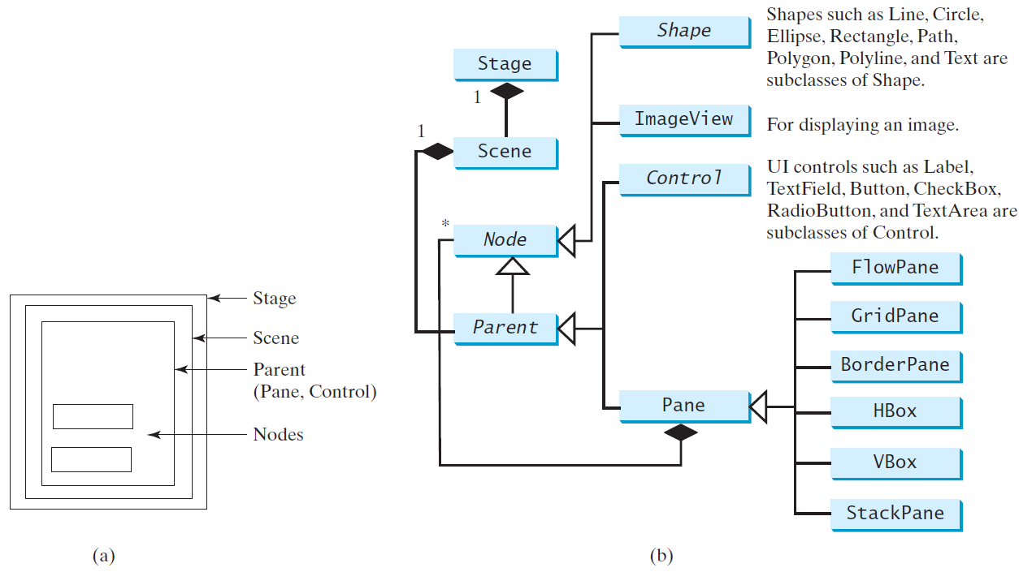
Panes, UI Controls, and Shapes
ButtonInPane

Slide 8
Display a Shape
This example displays a circle in the center of the pane.
ShowCircle

Slide 9
Binding Properties
JavaFX introduces a new concept called binding property that enables a target object to be bound to a source object. If the value in the source object changes, the target property is also changed automatically. The target object is simply called a binding object or a binding property.
ShowCircleCentered

Slide 10
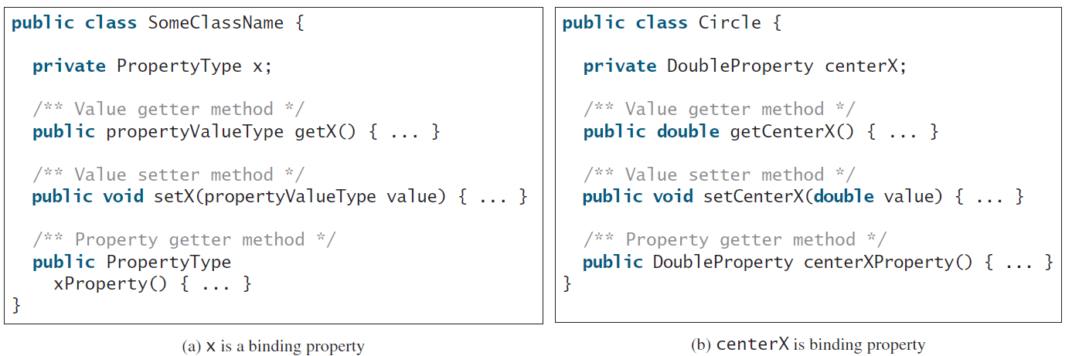
Binding Property: getter, setter, and property getter

Slide 11
Uni/Bidirectional Binding
BindingDemo
BidirectionalBindingDemo

Slide 12
Common Properties and Methods for Nodes
style: set a JavaFX CSS style
rotate: Rotate a node
NodeStyleRotateDemo

Slide 13
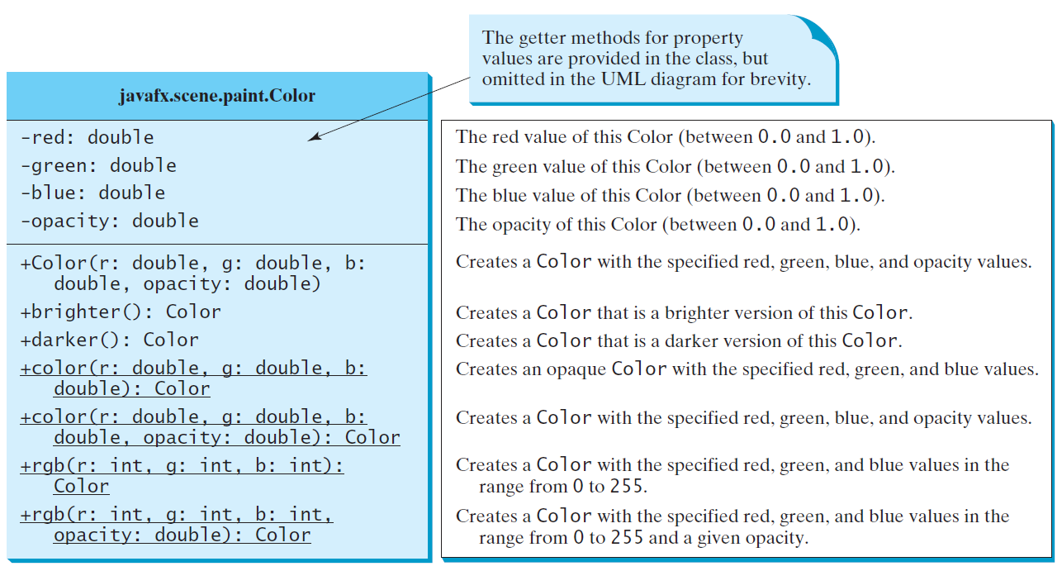
The Color Class

Slide 14
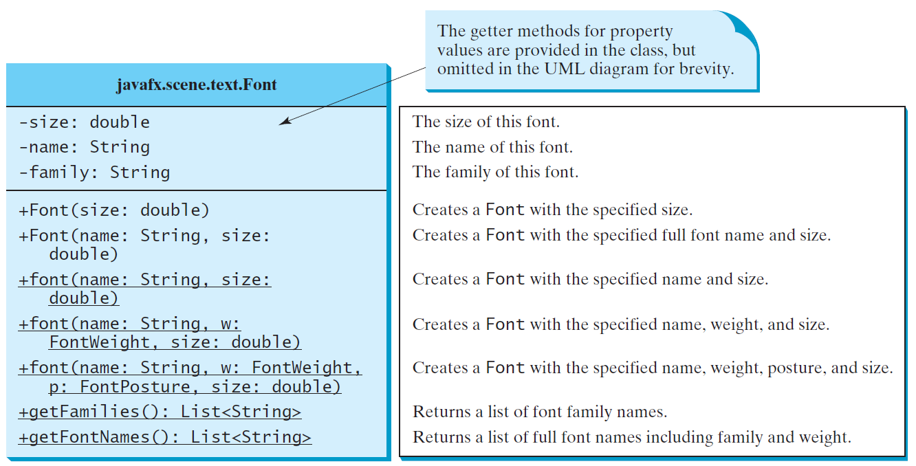
The Font Class
FontDemo

Slide 15
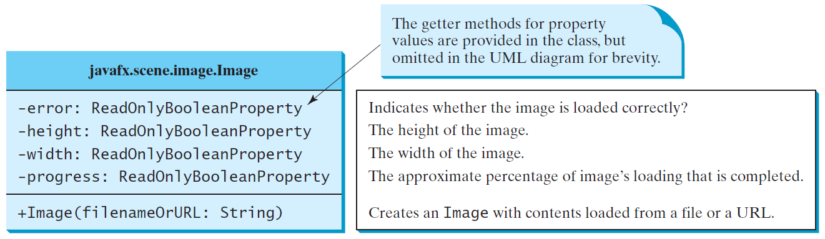
The Image Class

Slide 16
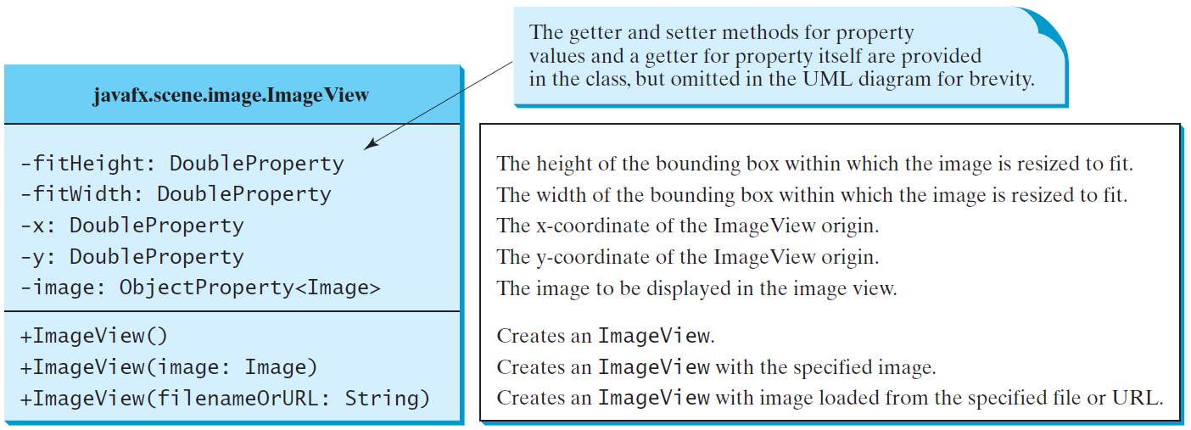
The ImageView Class
ShowImage

Slide 17
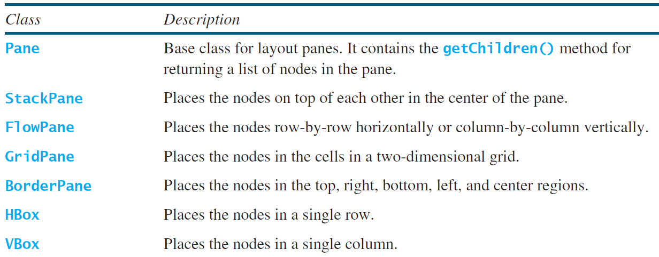
Layout Panes
JavaFX provides many types of panes for organizing nodes in a container.

Slide 18
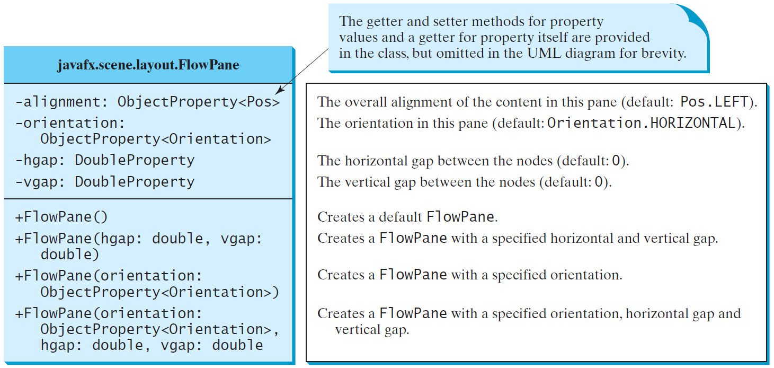
FlowPane
MultipleStageDemo

Slide 19
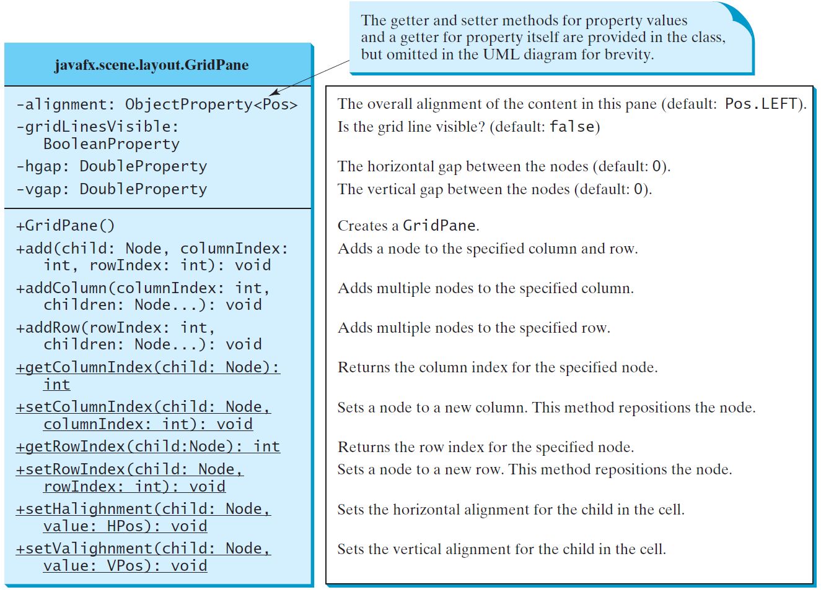
GridPane
ShowGridPane

Slide 20
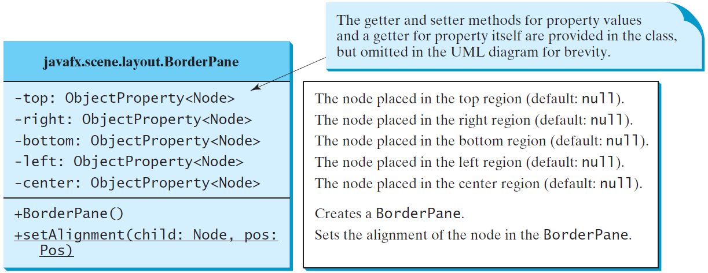
BorderPane
ShowBorderPane

Slide 21
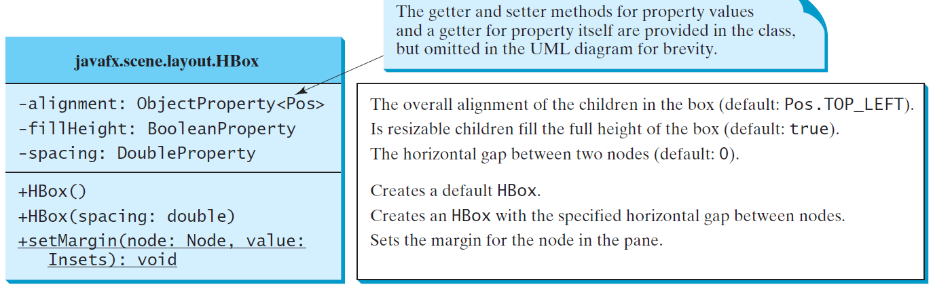
HBox

Slide 22
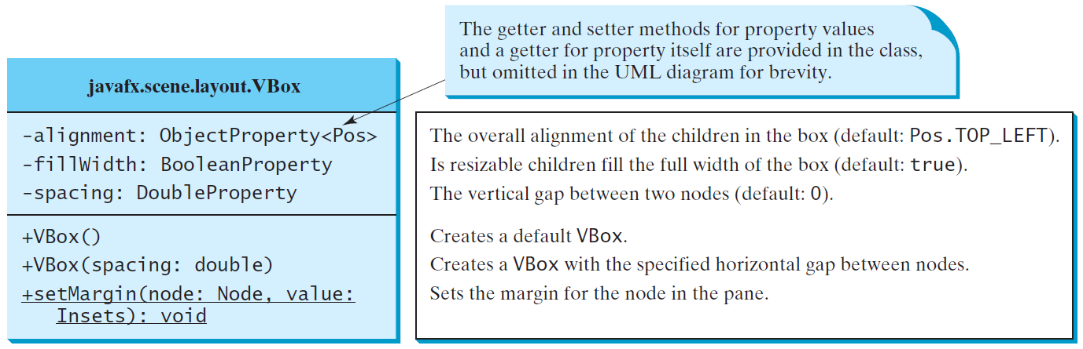
VBox
ShowHBoxVBox

Slide 23
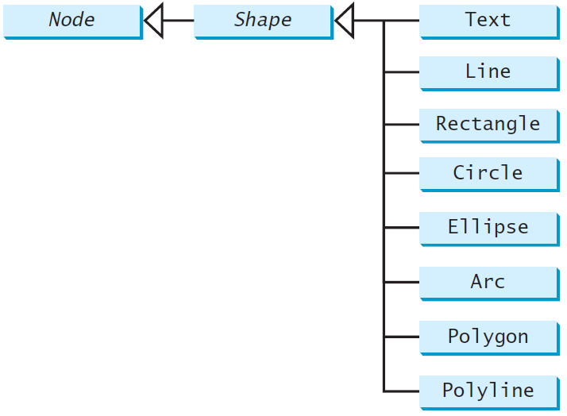
Shapes
JavaFX provides many shape classes for drawing texts, lines, circles, rectangles, ellipses, arcs, polygons, and polylines.

Slide 24
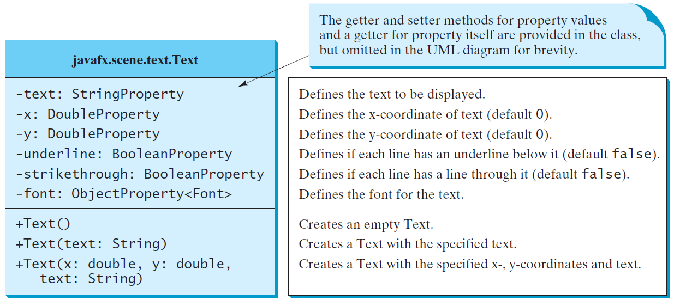
Text

Slide 25
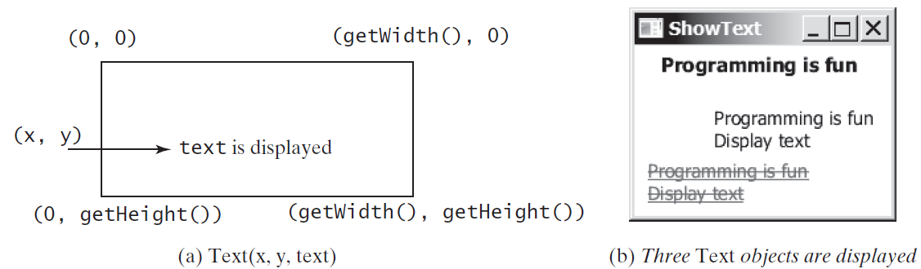
Text Example
ShowText

Slide 26
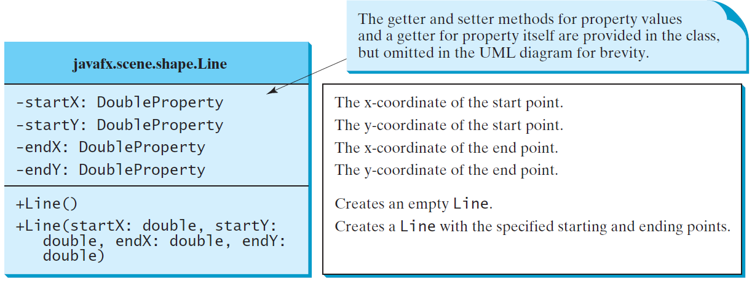
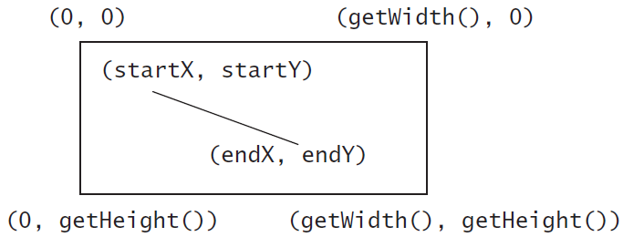
Line
ShowLine

Slide 27
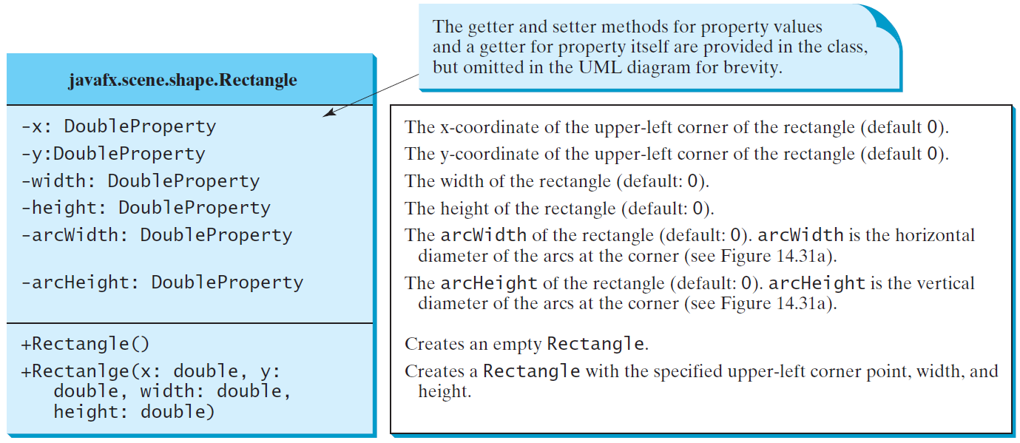
Rectangle

Slide 28
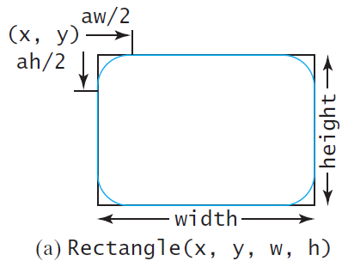
Rectangle Example
ShowRectangle

Slide 29
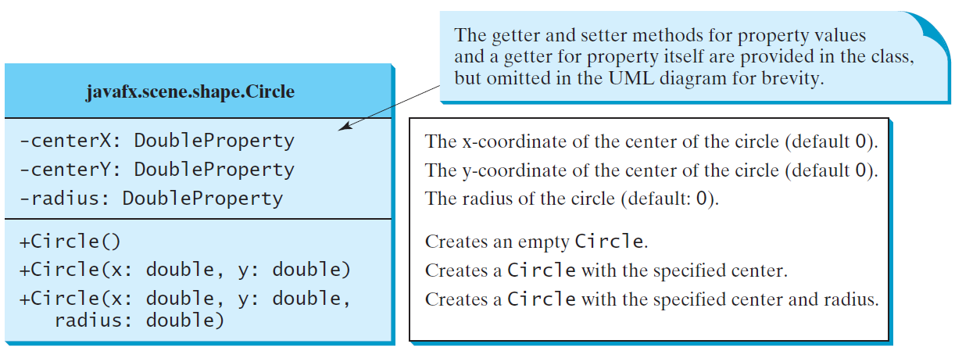
Circle

Slide 30
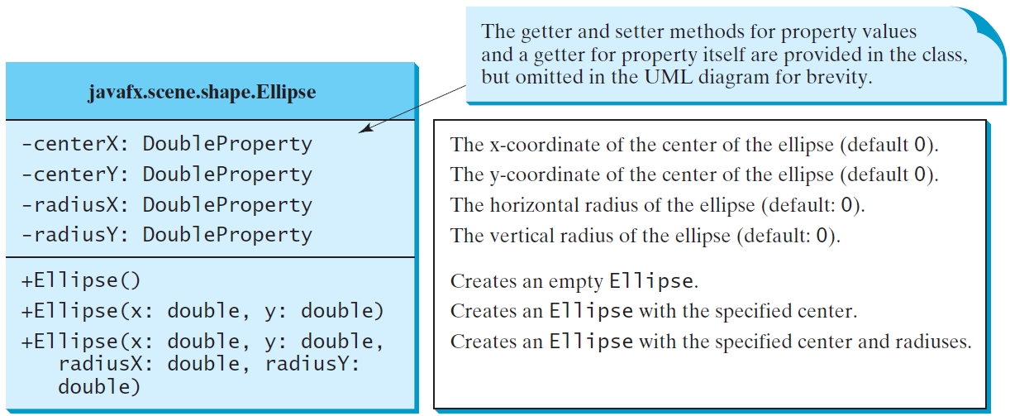
Ellipse
ShowEllipse

Slide 31
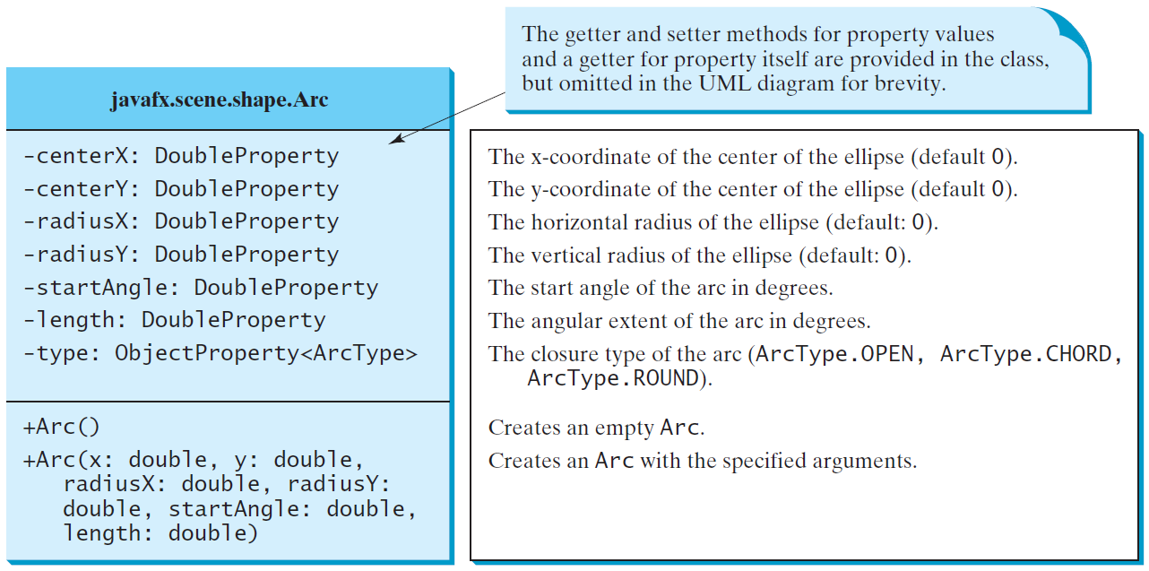
Arc

Slide 32
Arc Examples
ShowArc

Slide 33
Polygon and Polyline

Slide 34
Polygon
ShowPolygon

Slide 35
Case Study: The ClockPane Class
This case study develops a class that displays a clock on a pane.
ClockPane

Slide 36
Use the ClockPane Class
DisplayClock

