Slide 1
Chapter 28 Graphs and Applications

Slide 2
Objectives
To model real-world problems using graphs and explain the Seven Bridges of Königsberg problem (§28.1).
To describe the graph terminologies: vertices, edges, simple graphs, weighted/unweighted graphs, and directed/undirected graphs (§28.2).
To represent vertices and edges using lists, edge arrays, edge objects, adjacency matrices, and adjacency lists (§28.3).
To model graphs using the Graph interface, the AbstractGraph class, and the UnweightedGraph class (§28.4).
To display graphs visually (§28.5).
To represent the traversal of a graph using the AbstractGraph.Tree class (§28.6).
To design and implement depth-first search (§28.7).
To solve the connected-circle problem using depth-first search (§28.8).
To design and implement breadth-first search (§28.9).
To solve the nine-tail problem using breadth-first search (§28.10).

Slide 3
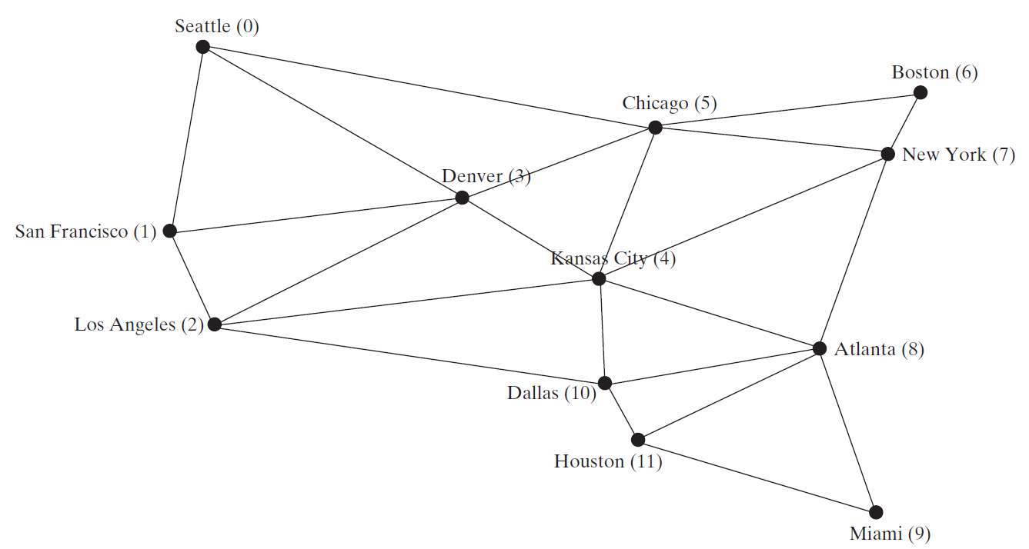
Modeling Using Graphs

Slide 4
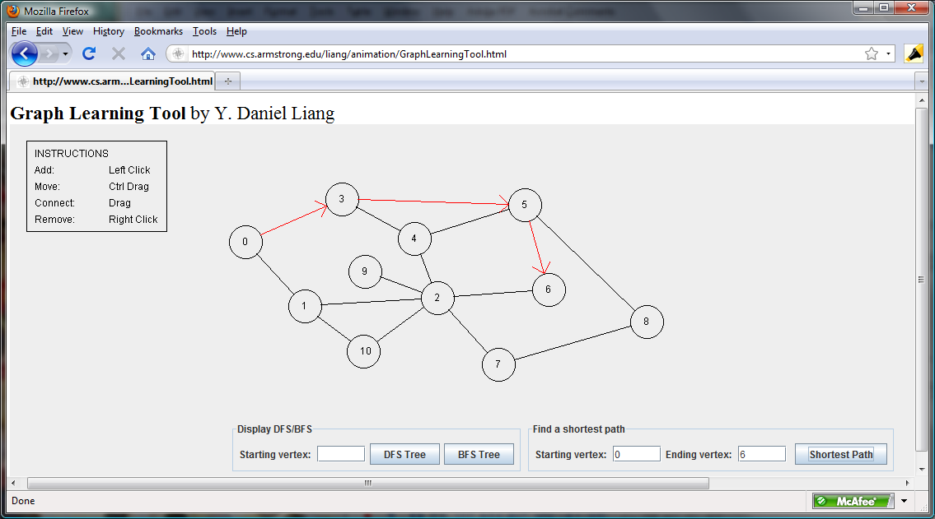
Graph Animation
https://liveexample.pearsoncmg.com/dsanimation/GraphLearningTooleBook.html

Slide 5
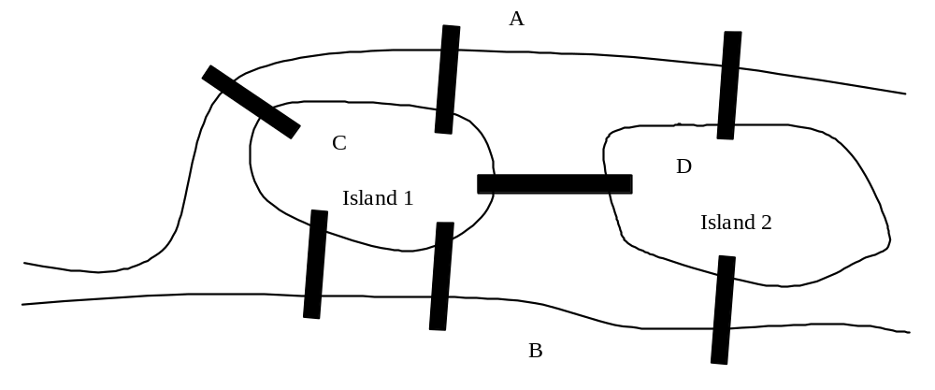
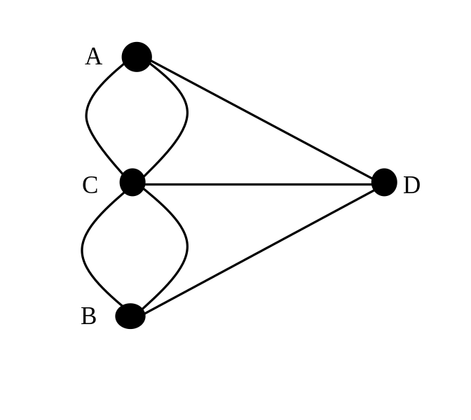
Seven Bridges of Königsberg

Slide 6
Basic Graph Terminologies
What is a graph? G=(V, E)
Define a graph
Directed vs. undirected graphs
Weighted vs. unweighted graphs
Adjacent vertices
Incident
Degree
Neighbor
loop

Slide 7
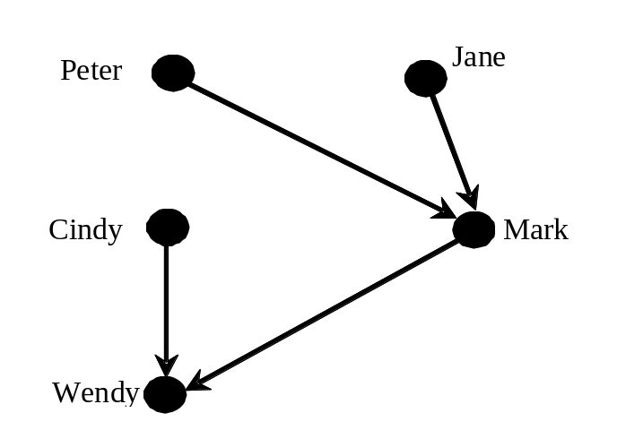
Directed vs Undirected Graph

Slide 8
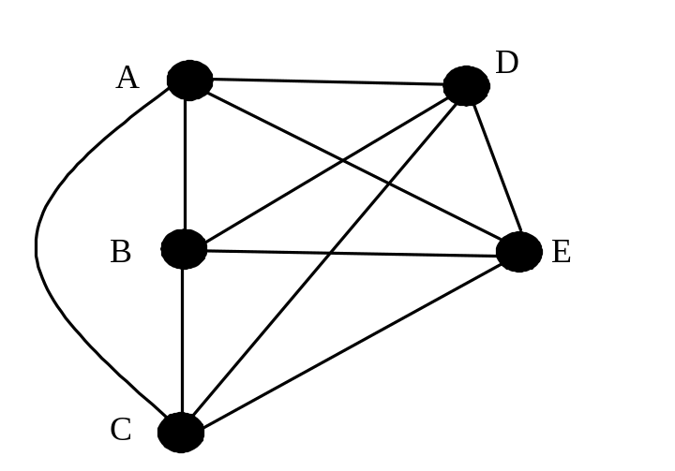
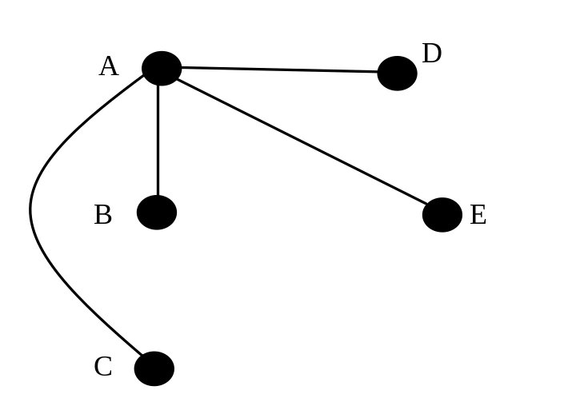
Basic Graph Terminologies
Parallel edge
Simple graph
Complete graph
Spanning tree

Slide 9
Representing Graphs
Representing Vertices
Representing Edges: Edge Array
Representing Edges: Edge Objects
Representing Edges: Adjacency Matrices
Representing Edges: Adjacency Lists

Slide 10
Representing Vertices
String[] vertices = {“Seattle“, “San Francisco“, “Los Angles”, “Denver”, “Kansas City”, “Chicago”, … };
City[] vertices = {city0, city1, … };
public class City {
}
List<String> vertices;

Slide 11
Representing Edges: Edge Array
int[][] edges = {{0, 1}, {0, 3} {0, 5}, {1, 0}, {1, 2}, … };

Slide 12
Representing Edges: Edge Object
public class Edge {
int u, v;
public Edge(int u, int v) {
this.u = u;
this.v = v;
}
List<Edge> list = new ArrayList<>();
list.add(new Edge(0, 1)); list.add(new Edge(0, 3)); …

Slide 13
Representing Edges: Adjacency Matrix
int[][] adjacencyMatrix = {
{0, 1, 0, 1, 0, 1, 0, 0, 0, 0, 0, 0}, // Seattle
{1, 0, 1, 1, 0, 0, 0, 0, 0, 0, 0, 0}, // San Francisco
{0, 1, 0, 1, 1, 1, 0, 0, 0, 0, 0, 0}, // Los Angeles
{1, 1, 1, 0, 1, 1, 0, 0, 0, 0, 0, 0}, // Denver
{0, 0, 1, 1, 0, 1, 0, 1, 1, 0, 1, 0}, // Kansas City
{1, 0, 0, 1, 1, 0, 1, 1, 0, 0, 0, 0}, // Chicago
{0, 0, 0, 0, 0, 1, 0, 1, 0, 0, 0, 0}, // Boston
{0, 0, 0, 0, 1, 1, 1, 0, 1, 0, 0, 0}, // New York
{0, 0, 0, 1, 1, 0, 0, 1, 0, 1, 1, 1}, // Atlanta
{0, 0, 0, 0, 0, 0, 0, 0, 1, 0, 0, 1}, // Miami
{0, 0, 1, 0, 1, 0, 0, 0, 1, 0, 0, 1}, // Dallas
{0, 0, 0, 0, 0, 0, 0, 0, 1, 1, 1, 0} // Houston
};

Slide 14
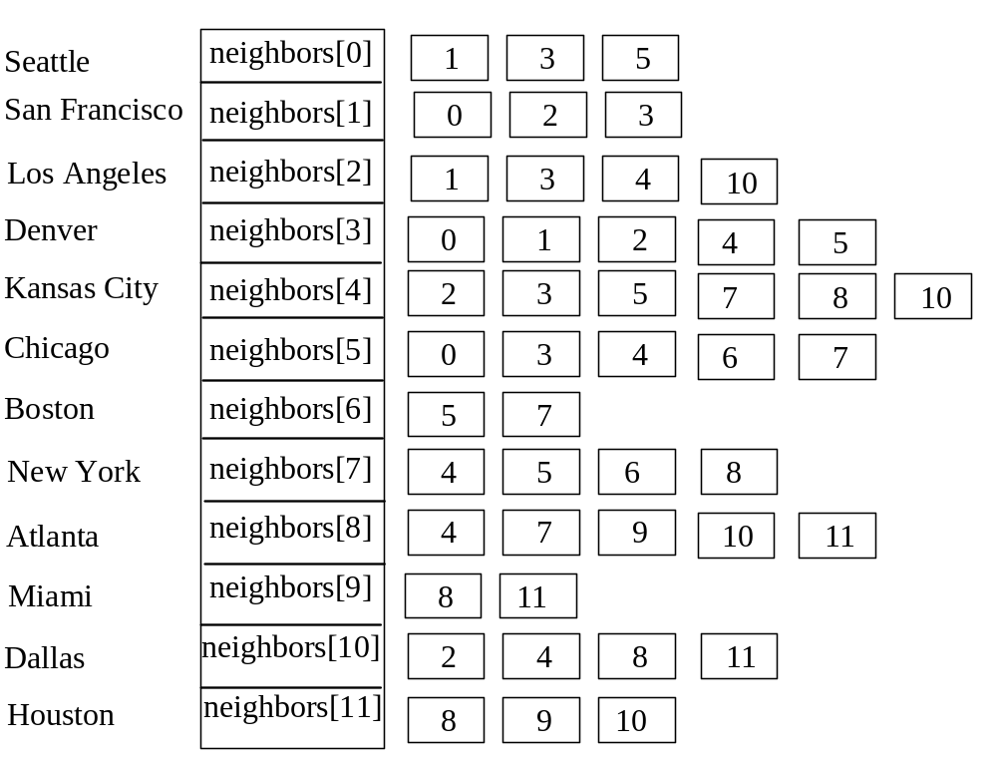
Representing Edges: Adjacency Vertex List
List<Integer>[] neighbors = new List[12];
List<List<Integer>> neighbors = new ArrayList<>();

Slide 15
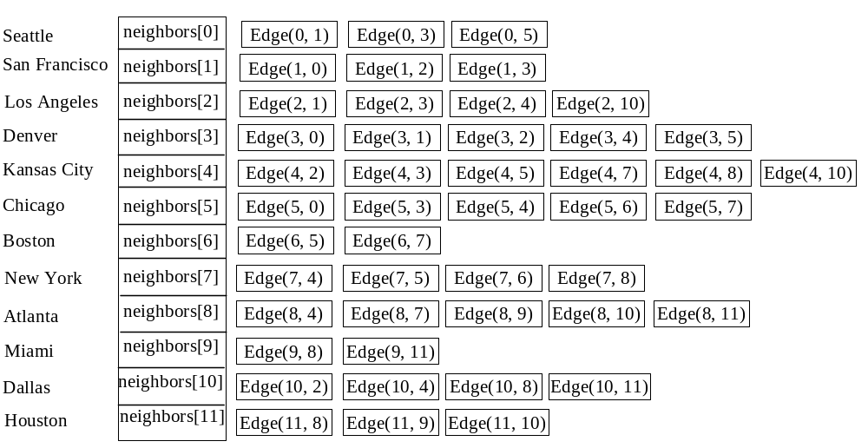
Representing Edges: Adjacency Edge List
List<Edge>[] neighbors = new List[12];

Slide 16
Representing Adjacency Edge List Using ArrayList
List<ArrayList<Edge>> neighbors = new ArrayList<>();
neighbors.add(new ArrayList<Edge>());
neighbors.get(0).add(new Edge(0, 1));
neighbors.get(0).add(new Edge(0, 3));
neighbors.get(0).add(new Edge(0, 5));
neighbors.add(new ArrayList<Edge>());
neighbors.get(1).add(new Edge(1, 0));
neighbors.get(1).add(new Edge(1, 2));
neighbors.get(1).add(new Edge(1, 3));
...
...
neighbors.get(11).add(new Edge(11, 8));
neighbors.get(11).add(new Edge(11, 9));
neighbors.get(11).add(new Edge(11, 10));

Slide 17
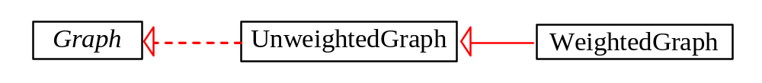
Modeling Graphs

Slide 18
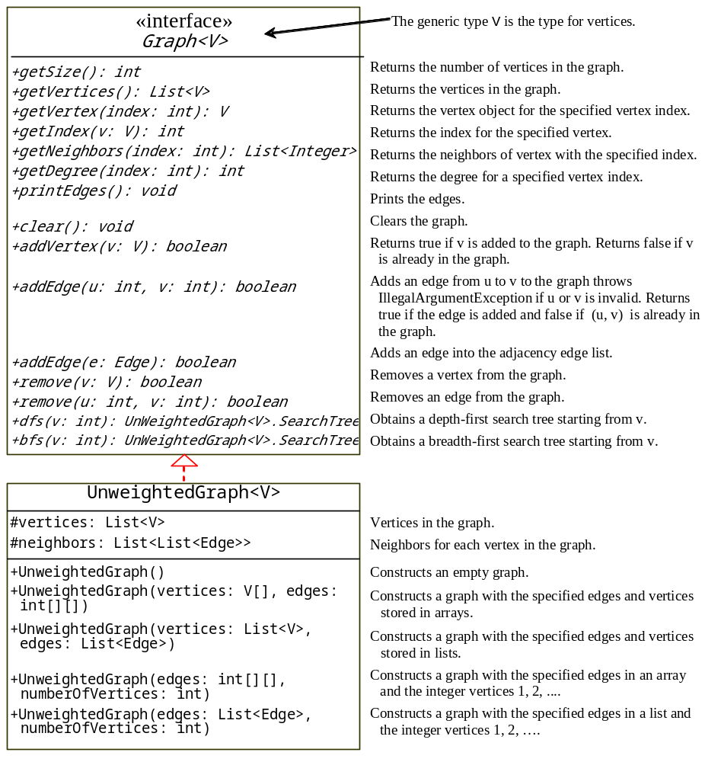
Graph
UnweightedGraph
TestGraph

Slide 19
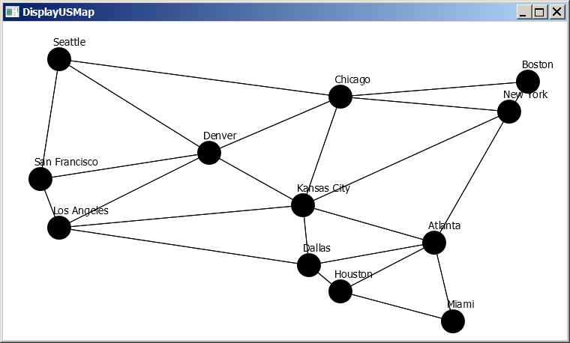
Graph Visualization
GraphView
Displayable
DisplayUSMap

Slide 20
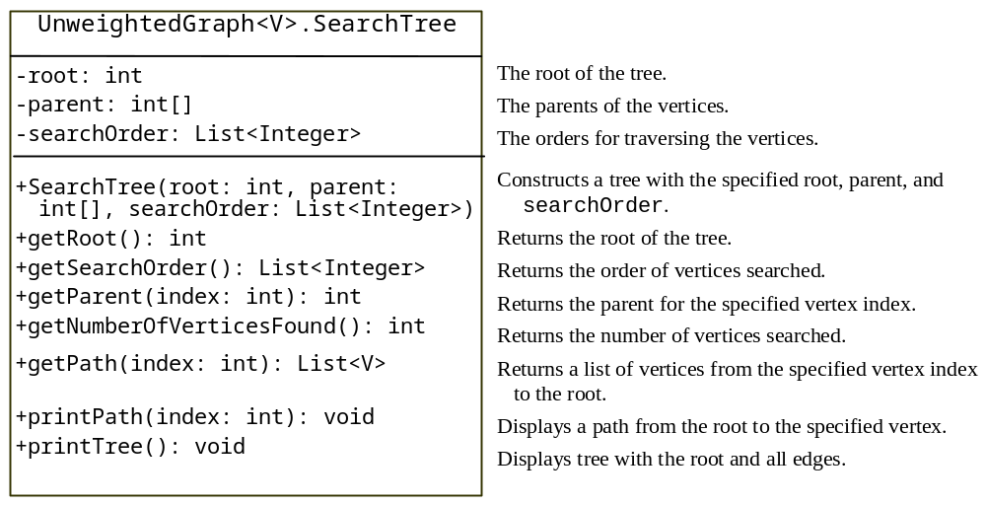
Graph Traversals
Depth-first search and breadth-first search
Both traversals result in a spanning tree, which can be modeled using a class.

Slide 21
Depth-First Search
The depth-first search of a graph is like the depth-first search of a tree discussed in §25.2.3, “Tree Traversal.” In the case of a tree, the search starts from the root. In a graph, the search can start from any vertex.
Input: G = (V, E) and a starting vertex v
Output: a DFS tree rooted at v
Tree dfs(vertex v) {
visit v;
for each neighbor w of v
if (w has not been visited) {
set v as the parent for w;
dfs(w);
}
}

Slide 22
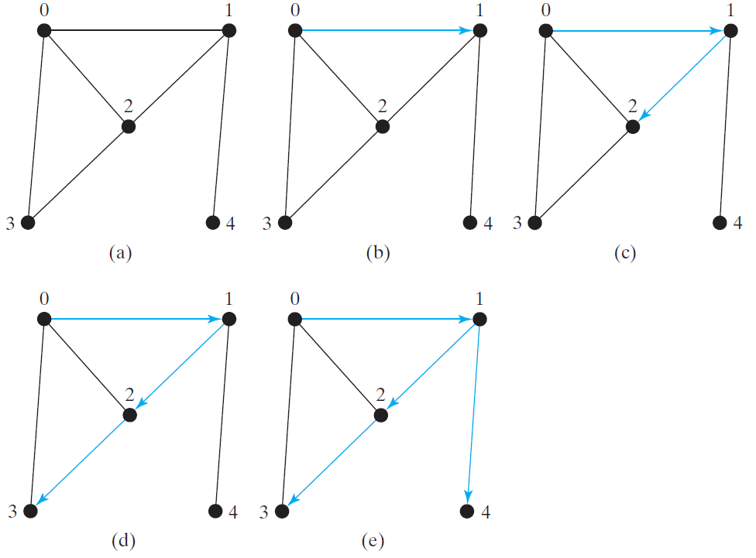
Depth-First Search Example

Slide 23
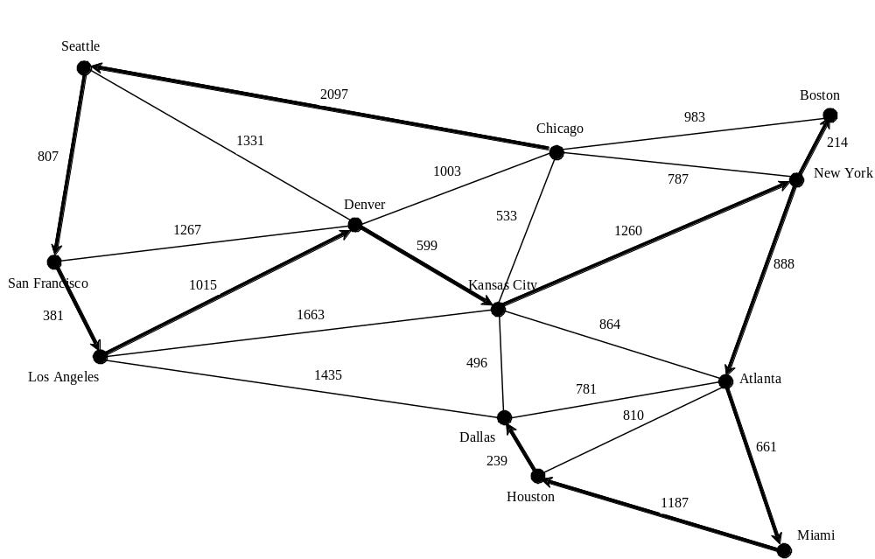
Depth-First Search Example
TestDFS

Slide 24
Applications of the DFS
Detecting whether a graph is connected. Search the graph starting from any vertex. If the number of vertices searched is the same as the number of vertices in the graph, the graph is connected. Otherwise, the graph is not connected.
Detecting whether there is a path between two vertices.
Finding a path between two vertices.
Finding all connected components. A connected component is a maximal connected subgraph in which every pair of vertices are connected by a path.
Detecting whether there is a cycle in the graph.
Finding a cycle in the graph.

Slide 25
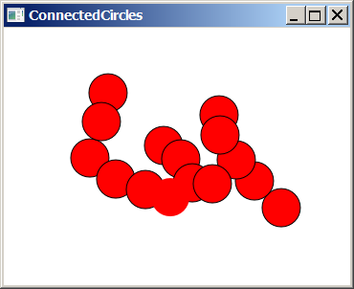
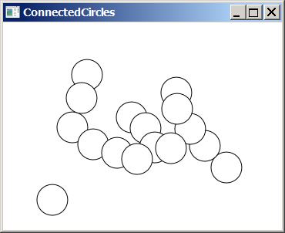
The Connected Circles Problem
ConnectedCircles

Slide 26
Breadth-First Search
The breadth-first traversal of a graph is like the breadth-first traversal of a tree discussed in §25.2.3, “Tree Traversal.” With breadth-first traversal of a tree, the nodes are visited level by level. First the root is visited, then all the children of the root, then the grandchildren of the root from left to right, and so on.

Slide 27
Breadth-First Search Algorithm
Input: G = (V, E) and a starting vertex v
Output: a BFS tree rooted at v
bfs(vertex v) {
create an empty queue for storing vertices to be visited;
add v into the queue;
mark v visited;
while the queue is not empty {
dequeue a vertex, say u, from the queue
process u;
for each neighbor w of u
if w has not been visited {
add w into the queue;
set u as the parent for w;
mark w visited;
}
}
}

Slide 28
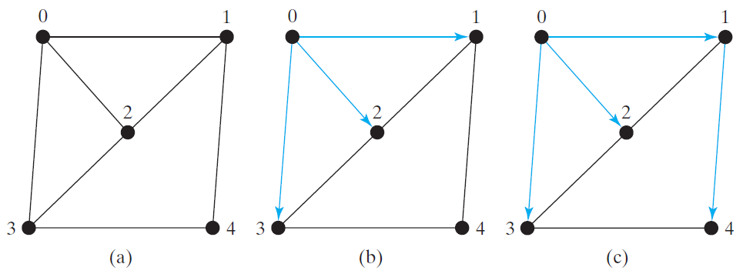
Breadth-First Search Example
Queue: 0
isVisited[0] = true
Queue: 1 2 3
isVisited[1] = true, isVisited[2] = true, isVisited[3] = true
Queue: 2 3 4
isVisited[4] = true

Slide 29
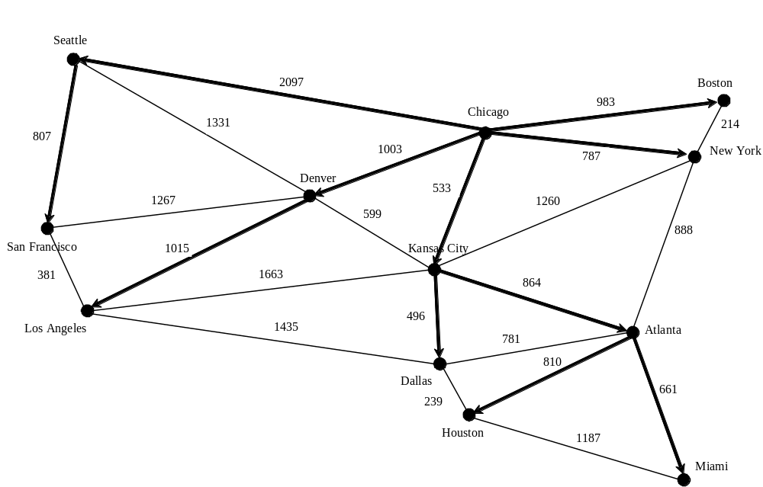
Breadth-First Search Example
TestBFS

Slide 30
Applications of the BFS
Detecting whether a graph is connected. A graph is connected if there is a path between any two vertices in the graph.
Detecting whether there is a path between two vertices.
Finding a shortest path between two vertices. You can prove that the path between the root and any node in the BFS tree is the shortest path between the root and the node.
Finding all connected components. A connected component is a maximal connected subgraph in which every pair of vertices are connected by a path.
Detecting whether there is a cycle in the graph.
Finding a cycle in the graph.
Testing whether a graph is bipartite. A graph is bipartite if the vertices of the graph can be divided into two disjoint sets such that no edges exist between vertices in the same set.

Slide 31
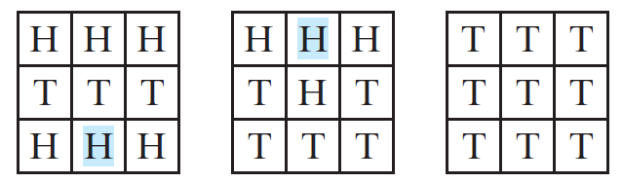
The Nine Tail Problem
The problem is stated as follows. Nine coins are placed in a three by three matrix with some face up and some face down. A legal move is to take any coin that is face up and reverse it, together with the coins adjacent to it (this does not include coins that are diagonally adjacent). Your task is to find the minimum number of the moves that lead to all coins face down.

Slide 32
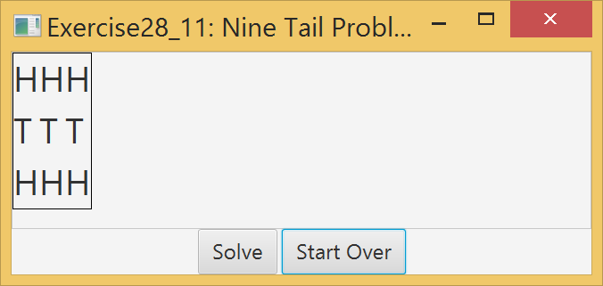
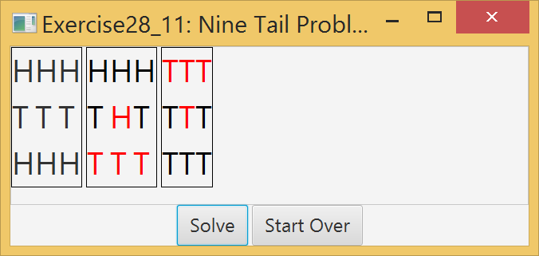
Nine Tail GUI Demo

Slide 33
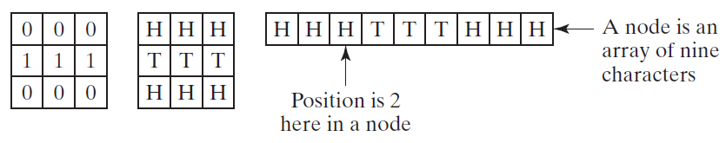
Representing Nine Coins

Slide 34
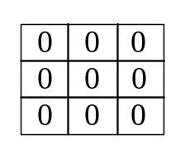
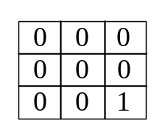
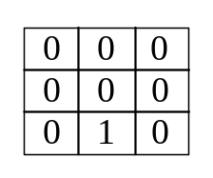
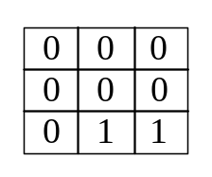

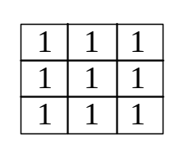
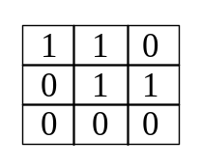
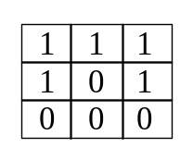
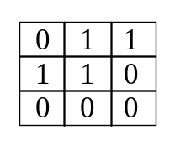
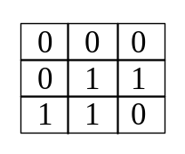
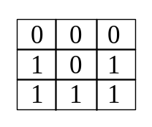
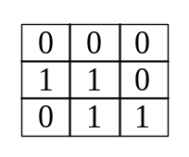
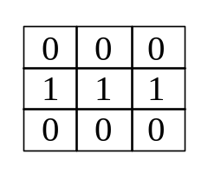
Model the Nine Tail Problem
0
1
2
3
511
408
488
240
30
47
51
56

Slide 35
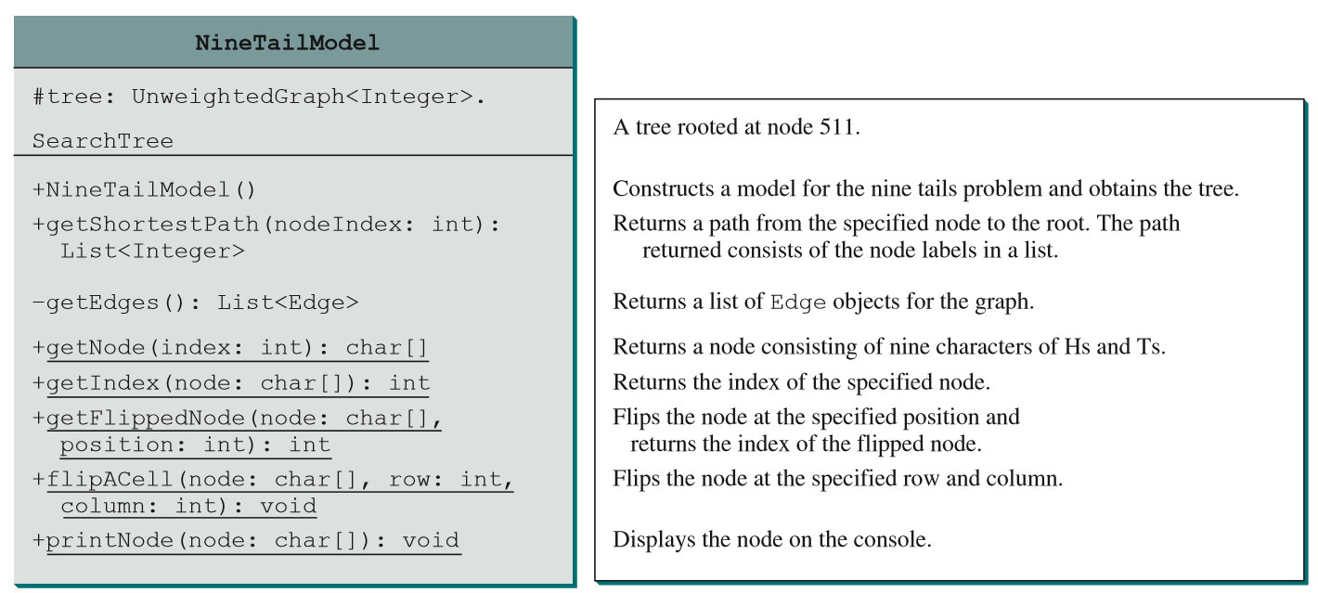
NineTailModel
NineTailModel
NineTail

