Slide 1
YouTube Data Analyzer
Sowmya Kudva
Evan Grill

Slide 2

Background
YouTube is the number one video sharing site on the internet.
Over 1 Billion unique visitors each month.
Big audience means big data
All of this data is in unstructured format and can be analyzed with the help of Bigdata frameworks such as MR or Apache Spark
The PageRank algorithm can be applied to YouTube videos to determine the highest quality videos.
300 hours of videos uploaded every minute.

Slide 3
Implementation
Analysis on the Youtube dataset is done using Apache spark .
Performed the data processing locally with the small subset of data.

Slide 4
steps we followed
Installed java and pyspark using HomeBrew
Homebrew can be used to install technologies like Apache Spark. Apache Spark is not the easiest to install, but Homebrew makes it easier.
Set JAVA_HOME and SPARK_HOME env variables
Downloaded youtube dataset in a text file
Created spark context ,
It is the entry point to the services of Apache Spark (execution engine) and so the heart of a Spark application
data processing through pyspark shell using python and tested on local machines
Develop methods for each of the use cases
Visualize the results

Slide 5
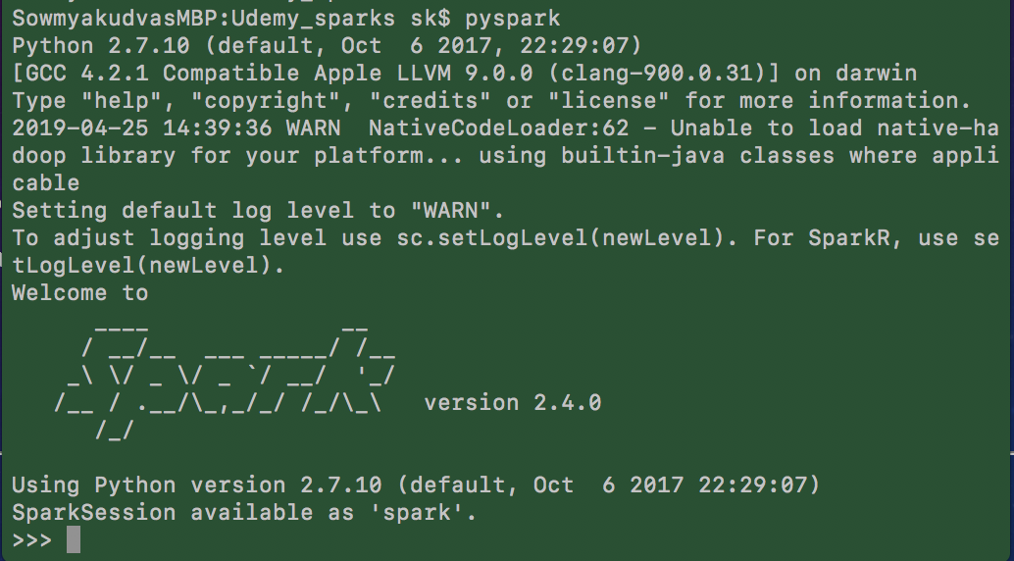
Apache Spark
Apache Spark was built on top of Hadoop MapReduce framework.
It extends MapReduce model to efficiently use it for more type of computations using interactive queries and stream processing
Resilient Distributed Datasets are the fundamental data structures of Spark.
Spark automatically distributes the data contained in RDDs across cluster and parallelizes the data.
Written in Scala Language
To support Python with Spark, community released a Pyspark shell
Can be connected using pyspark command.
Using pyspark we can work on RDD’s and datasets in python programming language.

Slide 6
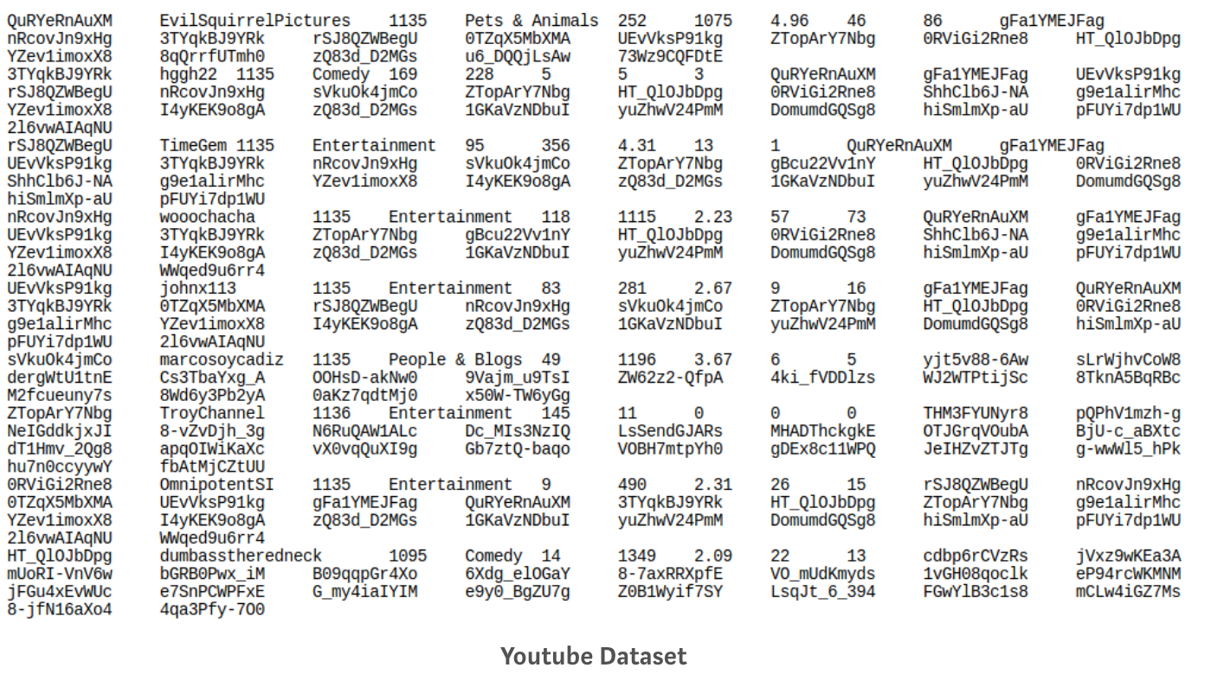
Sample Dataset
The dataset includes a series of scrapes of YouTube data from 2007/2008. It was compiled by researchers at Simon Fraser University. It can be found at http://netsg.cs.sfu.ca/youtubedata/

Slide 7
Understanding The Dataset We Recognize That The Above Displayed Data Is In the below format
Column no. 1: Video id.
Column no. 2: Video uploader.
Column no. 3: Interval between the day of establishment of YouTube and the date of uploading of the video.
Column no. 4: Category of the video.
Column no. 5: Length of the video.
Column no. 6: Number of views for the video.
Column no. 7: Rating on the video.
Column no. 8: Number of ratings given for the video
Column no. 9: Number of comments on the videos.
Column no. 10: Related video ids of the uploaded video.

Slide 8
Constraints/Issues
Not all data rows are of same length.
We recognized that some of the rows have just 2 or 3 data points
In such cases we faced issues while retrieving the needed column
We needed to use some specific techniques to extract specific attributes from the this data.

Slide 9
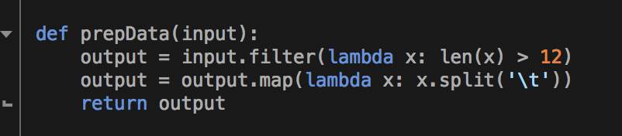
Resilient Distributed Data Sets
Spark solves this problem for us with its RDD feature
RDD filter transformation helps us to eliminate all the columns with lesser length than needed.
Function below which filters the data based on length and splits it based on tab separator.

Slide 10
Using This Dataset, We Performed Some Analysis And have Drawn Out Some Insights..
Find out Highest Ranked Related Video using Page rank algorithm
Top 5 video Categories By number of videos uploaded
Top 10 Highly Rated Videos (Sort based on ratings)
Top 10 Videos with Highest Comments
Top 5 video Categories By number of Views uploaded
Top 10 users with highest number of uploads

Slide 11
Usecase-1 - Page Rank Of Highly Related Video Id’s

Slide 12
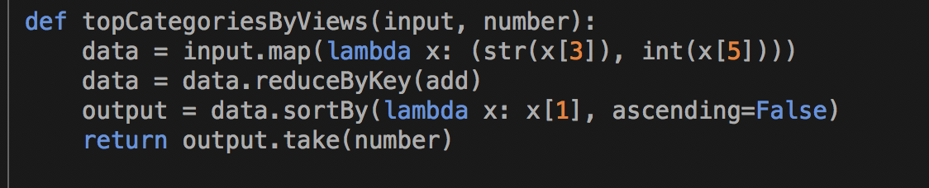
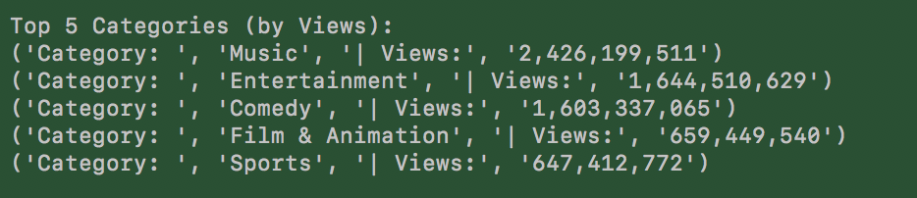
Use Case 2- Top 5 Categories By Views
Ran on the data for one entire month
Steps:
we are creating an RDD with the existing dataset, which is saved locally
Filter out the data with only valid data points (filter based on column length)
Line 1 :Pass the valid data set , ie, input into the topCategories ByVideos function
Line 2: we are taking each record as input using the map method and extracting the 3rd column, which is the category of the video.
we are creating a pair of category_name,1(count)
In line 4, we are using the reduceByKey method so that all the values of that key are aggregated.
Then we are sorting by descending order

Slide 13

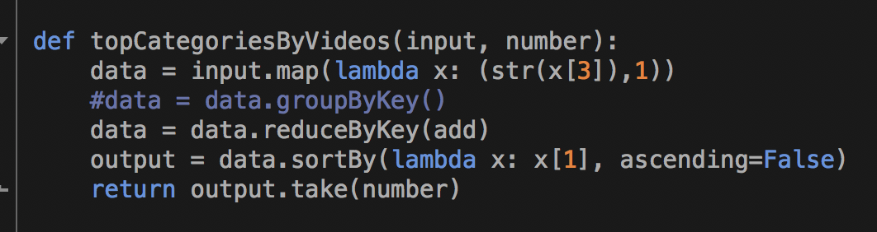
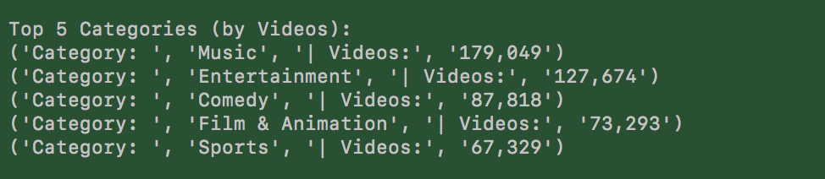
Use Case 3- Top 5 Categories By Videos
Ran on the data for one entire month
Steps:
we are creating an RDD with the existing dataset, which is saved locally
Filter out the data with only valid data points (filter based on column length)
Line 1 :Pass the valid data set , ie, input into the topCategories ByVideos function
Line 2: we are taking each record as input using the map method and extracting the 3rd column, which is the category of the video.
we are creating a pair of category_name,1(count)
In line 4, we are using the reduceByKey method so that all the values of that key are aggregated.
Then we are sorting by descending order

Slide 14
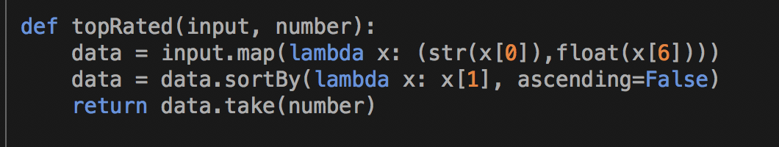
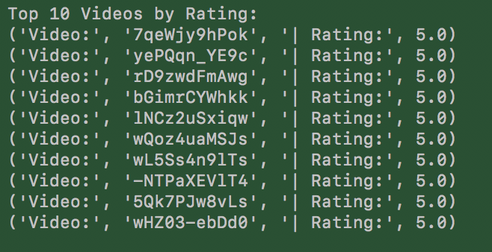
Use Case 4- Top 10 Highly Rated Videos
Ran on the data for one entire month
Steps:
we are creating an RDD with the existing dataset, which is saved locally
Filter out the data with only valid data points (filter based on column length)
Line 1 :Pass the valid data set , ie, input into the topRated function
Fetch the columns video Id’s and their corresponding rating from column 6
In line 2, we are using the SortBy method so that all the values we are sorting by descending order.

Slide 15
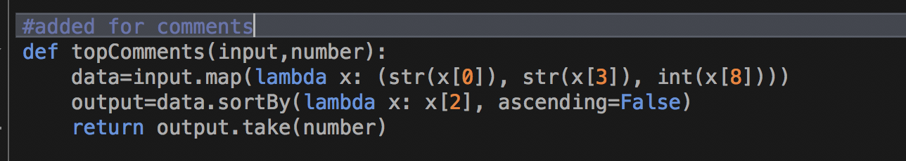
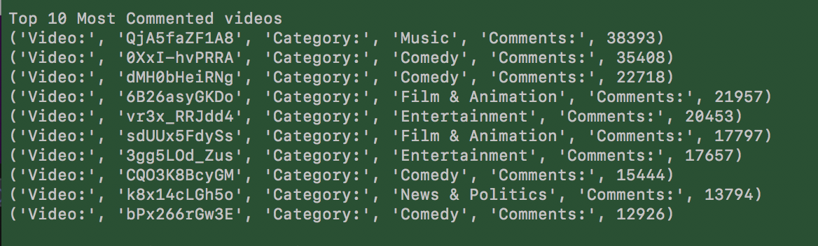
Use Case 5- Top 10 Highly commented Videos
Ran on the data for one entire month
Steps:
we are creating an RDD with the existing dataset, which is saved locally
Filter out the data with only valid data points (filter based on column length)
Line 1 :Pass the valid data set , ie, input into the topComments function
Line 2: we are taking each record as input using the map method and extracting the column 0,3,8 which is the video id, category, no of comments column of the video. we are creating a pair of category_name,1(count)
In line 3, we are using the sortBy method so that all records are sorted by descending order

Slide 16
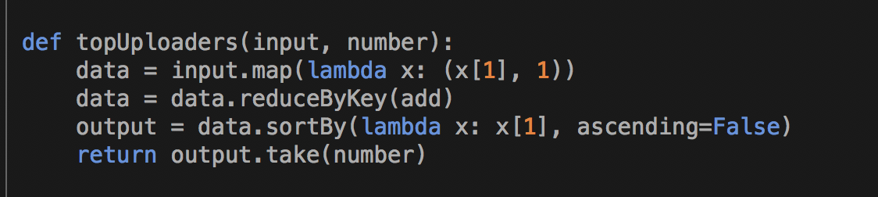
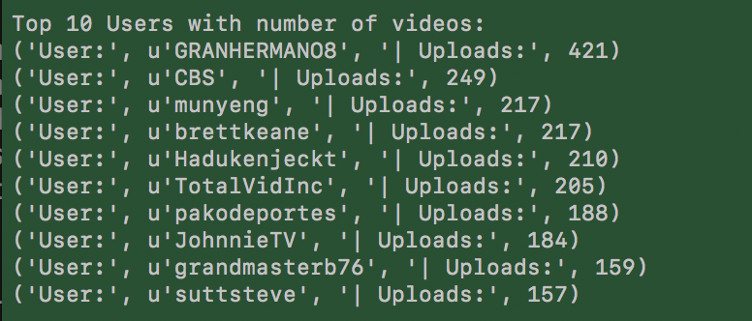
Use Case 6- Top Video Uploaders
Ran on the data for one entire month
Steps:
we are creating an RDD with the existing dataset, which is saved locally
Filter out the data with only valid data points (filter based on column length)
Line 1 :Pass the valid data set , ie, input into the topUploads function
Line 2: we are taking each record as input using the map method and extracting the 1st column, which is the category of the video.
In line 3, we are using the reduceBy method to aggregate all keys
In line 4 , we are sorting by descending order

Slide 17




Tools and software
This project uses following
concepts and tools throughout
its lifecycle

Slide 18
Questions?

