Slide 1
YouTube Data Analyzer
Author
Sowmya Kudva
Evan Grill

Slide 2
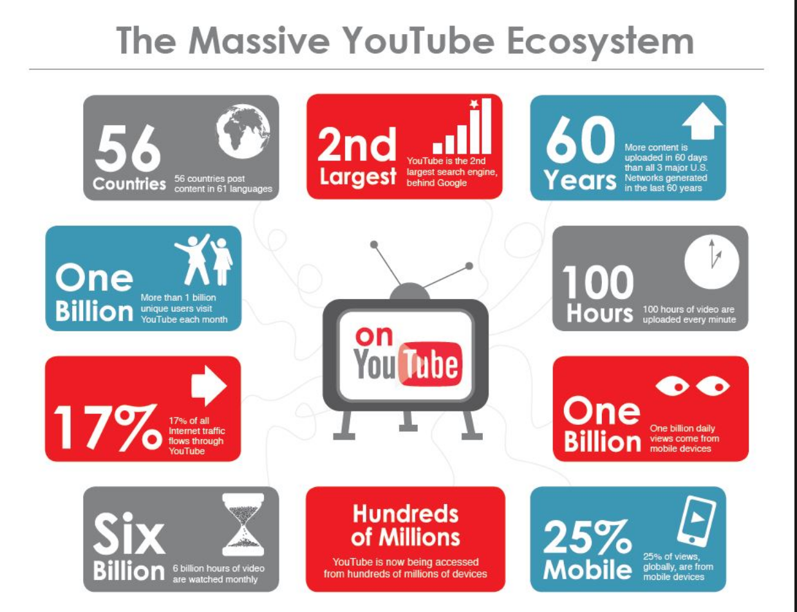

Slide 3

Background
YouTube is the number one video sharing site on the internet.
Over 1 Billion unique visitors each month.
Big audience means big data
Huge opportunity to improve the recommendation engine to increase viewing time.
The PageRank algorithm can be applied to YouTube videos to determine the highest quality videos.

Slide 4
Related Work
Search Analytics
Air Traffic Analytics
Weather Analytics
Twitter Sentiment Analysis
Stock Market Analytics
IMDb Data Analytics

Slide 5
Dataset description and columns that are under scope for our project
Data set can be found at http://netsg.cs.sfu.ca/youtubedata/
Column1
Video id
Column4
Category
Column6
No of Views
Column10
Related video Ids

Slide 6
Our Objective
Highly influential video
Top K most influential videos
Highest Views
Top category

Slide 7
Overview of Approach
YouTube Dataset Loaded into HDFS
Processing data PySpark
Output
Data extraction from the Data source

Slide 8
Why Sparks??
MapReduce
More lines of code
Performance is slow due to R/W from the disk
Spark
Rapid Development
Fewer lines of code
High performance due to in-memory processing

Slide 9
Tools and software
JDK 1.8.0_202
Python
2.7.10
PySpark Shell
HDFS
This project uses following
concepts and tools throughout
its lifecycle

Slide 10
Challenges
Distributing Huge data set over clusters
Availability of commodity computer clusters

Slide 11

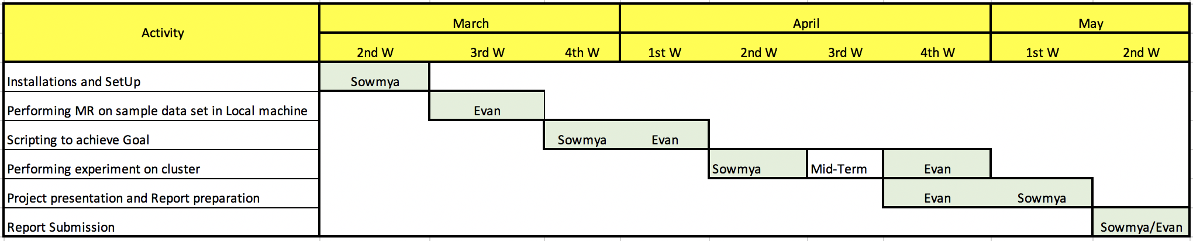
Timelines Milestones And Task Owners

Slide 12
Thank you

