Slide 1
YouTube Data Analyzer
Author
Sowmya Kudva
Evan Grill

Slide 2
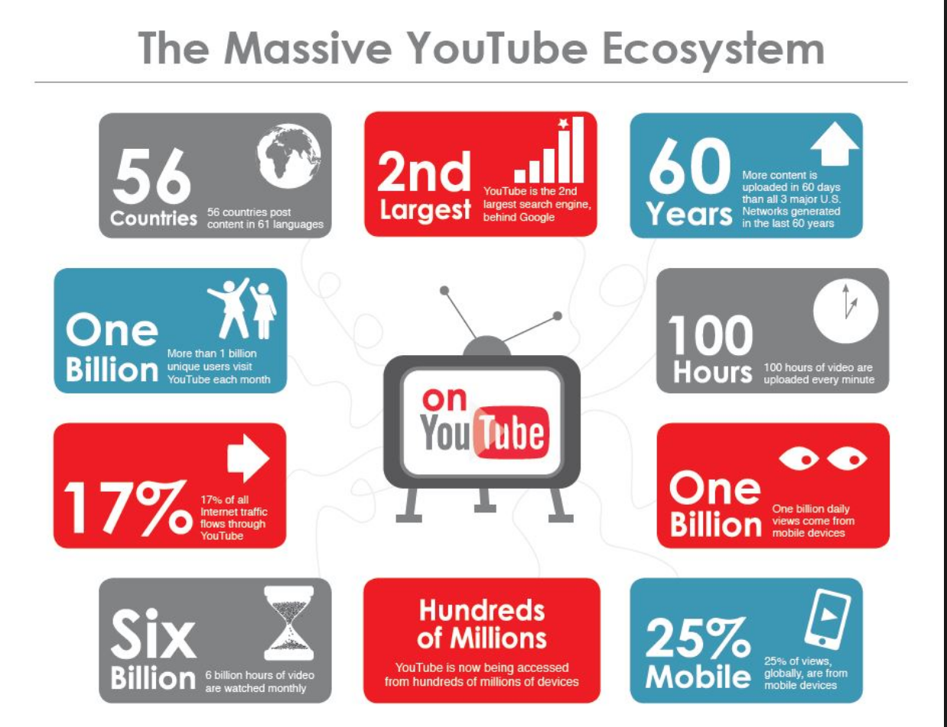

Slide 3

Background
Past few years youTube has become quiet popular
Millions of visits per day
Huge web crawl dataset
Lot of analytics can be done which makes it easier to find and discover great video content
Accelerate research on large scale video understanding

Slide 4
Related Work
Search YouTube Data
Airline data Analysis
Weather data Analysis
Sentiment Analysis on Twitter
Analyzing Stock Market data
Movies dataset Analysis on IMDB

Slide 5
Dataset description and columns that are under scope for our project
Data set can be found at http://netsg.cs.sfu.ca/youtubedata/
Column1
Video id
Column4
Category
Column6
No of Views
Column10
Related video Ids

Slide 6
Our Objective
Highly influential video
Top K most influential videos
Highest Views
Top category

Slide 7
Overview of Approach
YouTube Dataset Loaded into HDFS
Processing data PySpark
Output
Data extraction from the Data source

Slide 8
Why Sparks??
MapReduce
More lines of code
Performance is slow due to R/W from the disk
Spark
Rapid Development
Fewer lines of code
High performance due to in-memory processing

Slide 9
Tools and software
JDK 1.8.0_202
Python
2.7.10
PySpark Shell
HDFS
This project uses following
concepts and tools throughout
its lifecycle

Slide 10
Challenges
Distributing Huge data set over clusters
Availability of commodity computer clusters

Slide 11

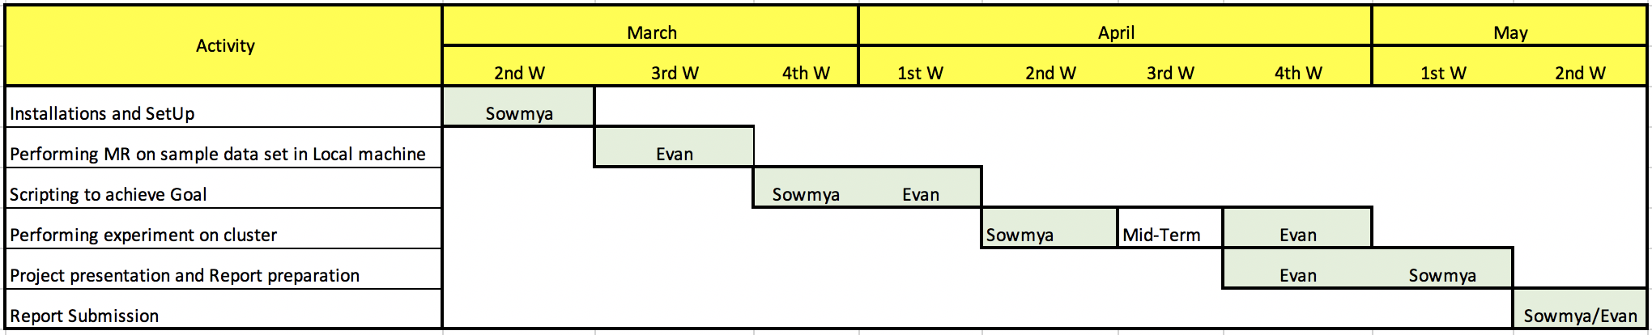
Timelines Milestones And Task Owners

Slide 12
Thank you

