Slide 1
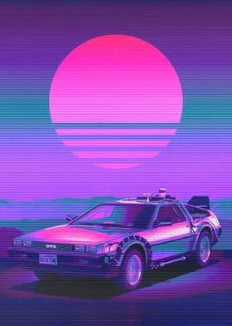
Back to the Fashion
By: Bella Griffith, John Griffith Raziel Cisneros & Citlali Aldama

Slide 2
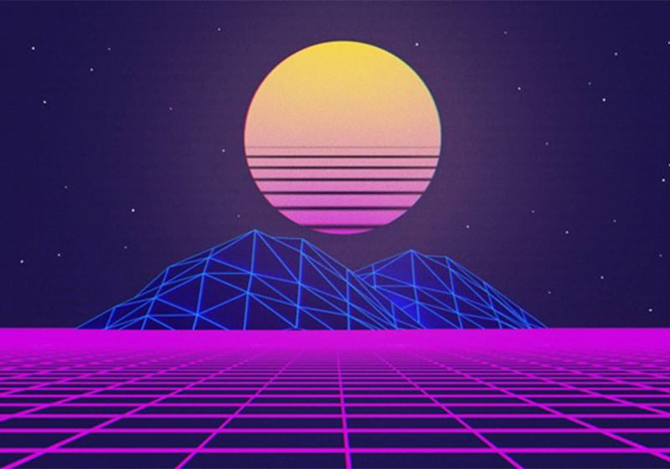
What is our project?
A simple web interactive timeline depicting the evolution of Western fashion from the year 1000 to 3000
The timeline allows users to scroll thorough the years and view pictures with respect on each period.

Slide 3
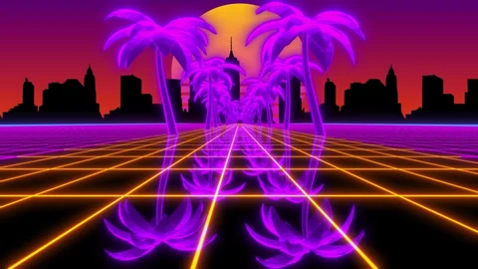
How did we build it?
Java
JavaScript
HTML
CSS
AI Image Generation

Slide 4
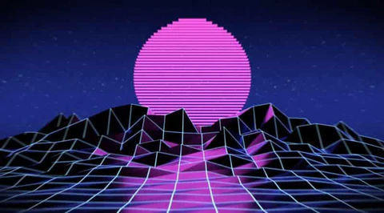
What did we learn?
Macs are difficult to use in GitHub but help of mentors we were able to overcome that hurdle.
Most of use where back-end users, but gained an understanding for front end languages

