Slide 1

United States Olympic & Paralympic Committee Practicum Final Presentation
Evan Jones
April 27th, 2022

Slide 2
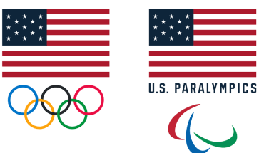

Project Motivation
The United States Olympic & Paralympic Committee (USOPC) is a non-profit corporation with limited capital resources. It is the committee’s mission to utilize these funds as effectively as possible to maximize Team USA’s medal achievement.
The USOPC must decide when, how, and by what amount to fund promising athletes to maximize the athlete’s and Team USA’s potential for success

Slide 3
Project Purpose
The USOPC given their limited capital must decide when, how, and by what amount to fund promising athletes to maximize both the athlete’s and Team USA’s potential for medal achievement.
In achieving this the USOPC aims to gain understanding with respect to the role athlete age impacts medaling achievement in various sports/events.
Such an analysis would improve the USOPC’s ability to:
More effectively gauge their competitive potential
Better understand drivers of medal achievement both from both an aggregate and event specific view
Make better informed funding decisions to ensure athletes are funded at the right time
Identify weak and strong areas in Team USA’s pipeline

Slide 4
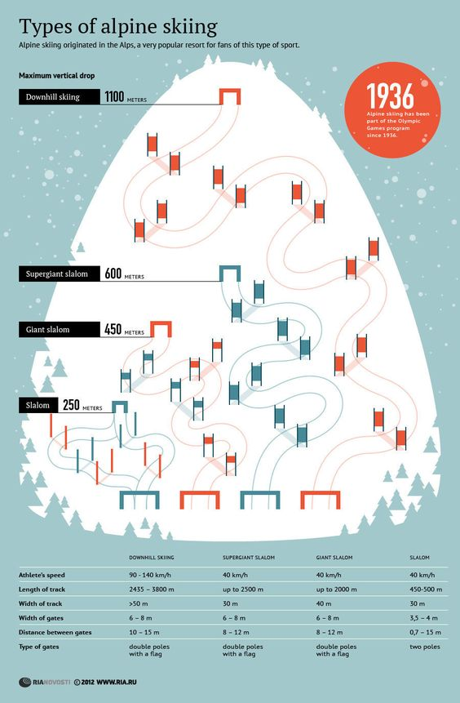
Project Focus
For this project, we will be focusing on the Winter Olympic solo disciplines of Alpine Skiing which includes 5 events for both male & female athletes
Slalom
Giant Slalom
Super Giant Slalom (Super G)
Downhill
Super Combined (1x Downhill + 2x Slalom)

Slide 5
Alpine Skiing Background
All sports have unique characteristics that define them. Alpine skiing is no different, and because our analysis recognizes these unique aspects here are some important considerations about alpine skiing to keep in mind:
The five alpine events can be loosely ordered by course length & density of technical elements with Slalom being the shortest but most precise and Downhill being the longest, but with a greater flexibility in precision.
Alpine skiing especially in events like Downhill is hard on knees and is generally injury prone.
Alpine skiing solo races are run sequentially one after the other
Weather and snow condition vary over the event and can play crucial roles in given run
Ski slope change in composition year to year so times may not be directly comparable over time
In events with multiple runs, inability to make a “gate” results in immediate disqualification
The International Ski Federation (FIS) is the regulatory body and host of alpine events (outside Olympic games)

Slide 6
Central Questions
1) How does the health of Team USA’s pipeline compare to other top medal winning countries through the primary lens of age?
2) Can a country’s percentage of athletes competing at an Olympic games while in their peak age ranges in their respective sports predict medal success?
3) Which athletes who competed in Beijing 2022 will be hitting their peak age in their respective sports in Milan 2026?
4) Can the number of young, ”pre-peak” athletes that competed in Beijing predict medal success for their countries in Milan 2026?
5) How many promising athletes who did not compete in Beijing, but will reach peak age in Milan does Team USA and other countries have in their pipeline?

Slide 7
Project Overview
Evaluate the impact of age from an individual perspective considering what age the athlete “peaks” by event.
Evaluate the impact of age at the event level considering if different events have different age
Using prior insights about age, evaluate country athlete pipelines and competitiveness at the event and gender levels through the lens of age
Given information about a country’s pipeline composition and relative strength, create a model to predict medal achievement
Present our findings and relevant visualizations via web application

Slide 8
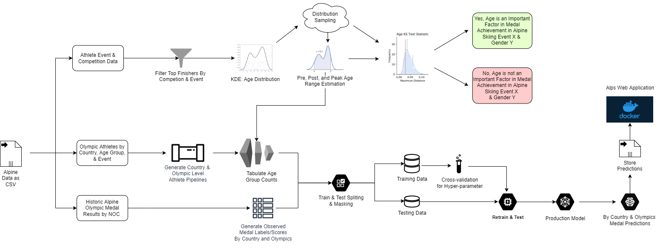
Modeling Overview

Slide 9
Individual Perspective Age Modeling
Modeling medal achievement at the individual level is equivalent to asking when does the athlete reach peak performance?
Different ways to measure peak performance:
Age at athlete’s best all-time finishing position
Age at athlete’s best recorded world ranking
Age at athlete’s maximal smoothed ranking curve
Age at athlete’s peak performance adjusted by competition difficulty

Slide 10
Individual Perspective Age Modeling
Only the approaches of rank and world rank analysis were successful. Both approaches took the following structure:
1) Identify peak age for individuals as the earliest age at which they finished the best for each sport they compete in (scaled or unscaled).
2) Aggregate all these peak ages by event and gender and fit a KDE model
3) Evaluate the distribution shape and identify potential modality
4) If age and peak individual performance not related, we should see uniform distribution otherwise they are related. If related identify potential peak age range.

Slide 11
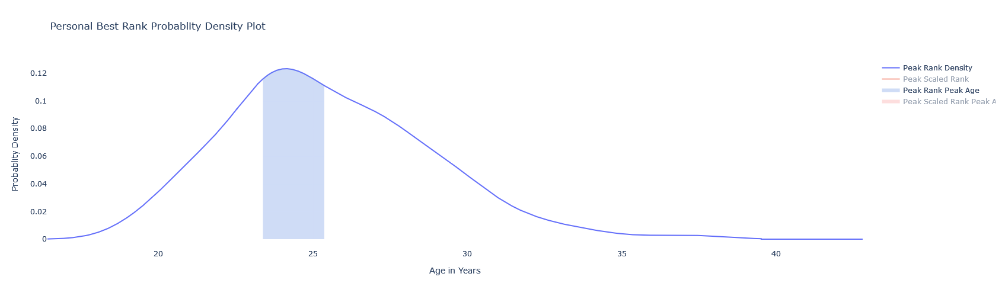
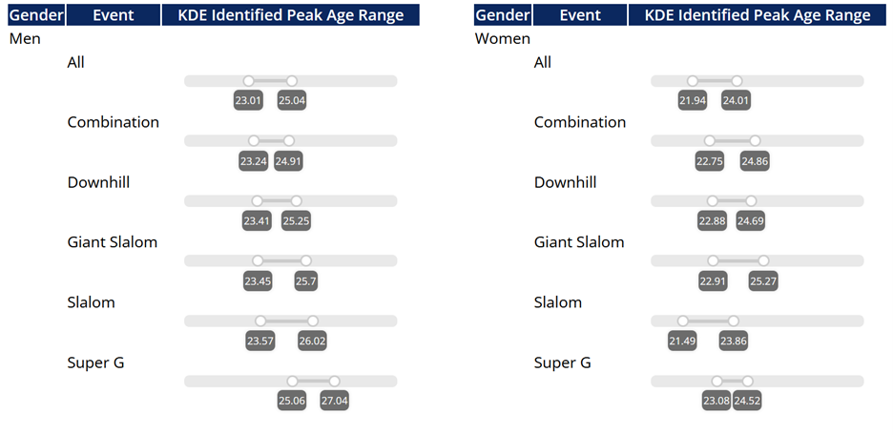
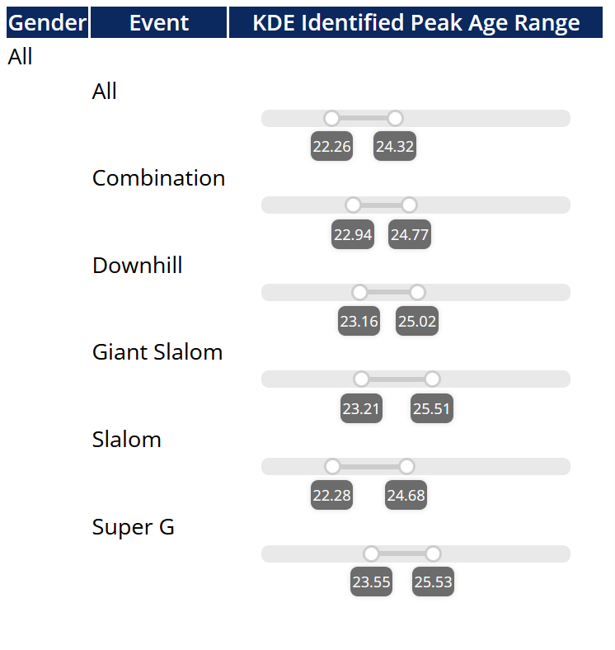
Individual Peak Rank Modeling
Conducted process of KDE modeling and age range identification for all event and gender pairs.
All KDE distributions were clearly non-uniform, age has some relation to when athlete’s “peak”
Example KDE of Individual peak rank for men's’ downhill

Slide 12
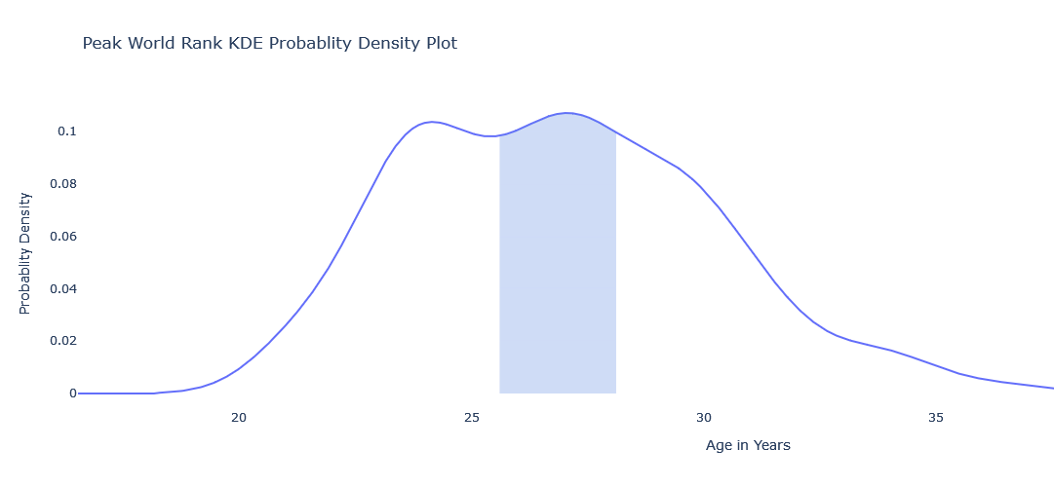
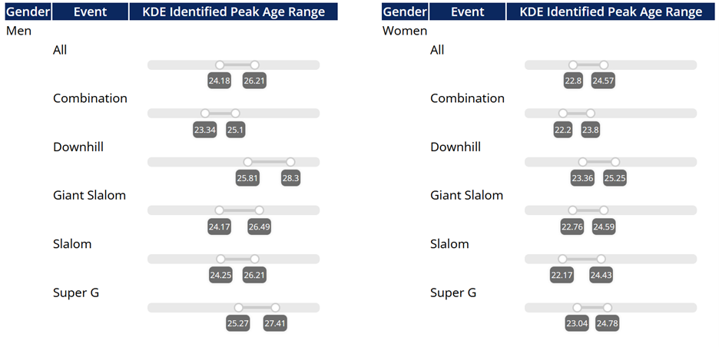
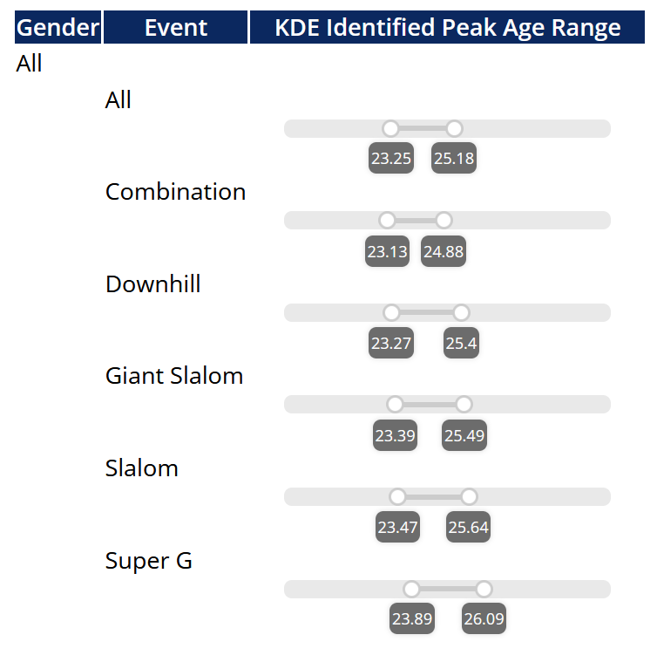
Individual Peak World Rank Modeling
Conducted process of KDE modeling and age range identification for all event and gender pairs.
All KDE distributions were clearly non-uniform, age has some relation to when athlete’s “peak”
Example KDE of Individual peak world rank for men's’ downhill

Slide 13
Event Perspective Modeling
Modeling at the event level we were able to take advantage of the ability to aggregate and compare top finishing athletes vs. all athletes
Fit a KDE model of age on all of a given event gender pairs top finishing athletes and their corresponding ages (ranks 1-3)
Fit a KDE model of age on all of a given event gender pairs non-top finishing athletes excluding DNF
Compare the distribution of age with those that are top finishers and those which are not using 2-sample Kolmogorov-Smirnov test.
If distributions are different age should impact medal achievement.
If age is significant find the potential peak age ranges by gender and sport

Slide 14
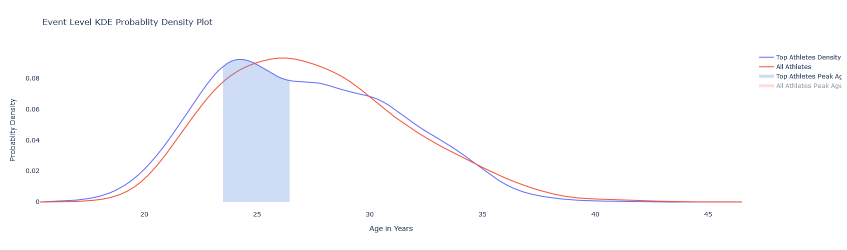
Event Level Modeling
Conducted process of KDE modeling and age range identification for all event and gender pairs.
“Top” medaling distributions when compared to “All” athlete distributions were significantly different in all event gender pairs
This difference is demonstrated in the very small 2-smple Kolmogorov-Smirnov test and corresponding test statistic and p-values
In all cases the test statistic and p-value were statistically significant at the alpha = 0.05 level
Thus, athlete age impacted medal achievement in the case of all event gender pairs.

Slide 15
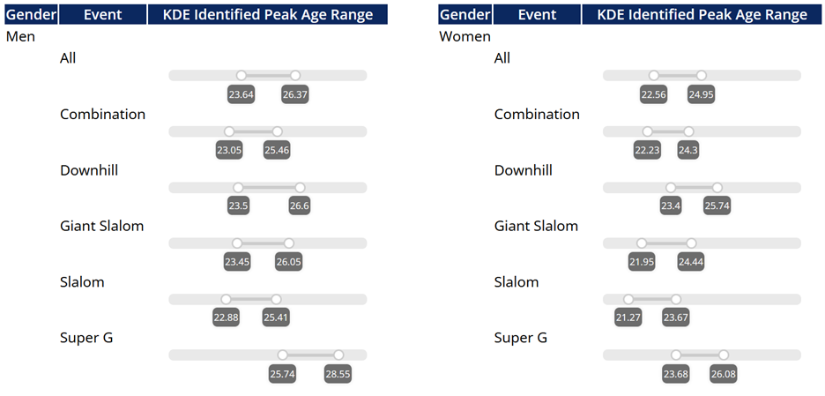
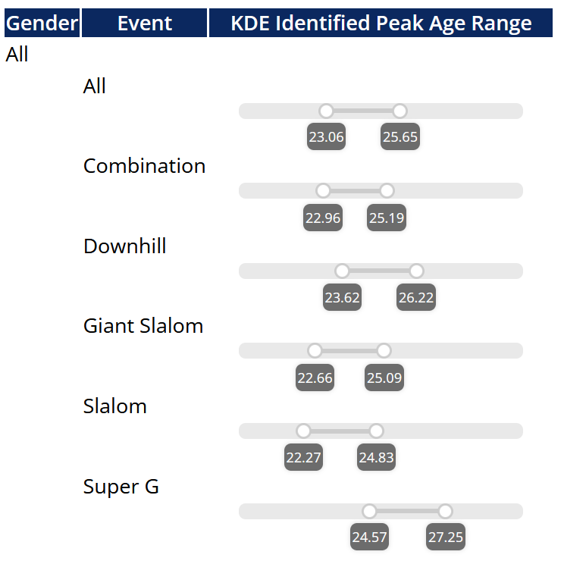
Event Level Modeling
Similar to the individual perspective analysis, we were able to derive potential peak age
ranges from the middle 33% of the distribution (1/6 left and 1/6 right of mode)

Slide 16
Medal Score Prediction Overview
Aggregate medal count and type at the country and Olympic games level
Assign varying points to gold, silver, and bronze medals to adequately differentiate the value of each (6.4, 2.4, 1 respectively)
Use event/gender level identified peak age ranges from event level KDE modeling to identify each countries pre-Olympic pipeline composition for each games (pre/post/peak athlete frequencies)
Fit models with inputs as the known pre/post/peak age frequencies for a given country and Olympic games as our explanatory variables with medal score at our target

Slide 17
Medal Score Prediction: Linear Regression
Fit with varying hyper-parameters for normalization and intercept
Intercept with normalization was the best resulting model

Slide 18
Medal Score Prediction: Ridge Regression
Fit with varying hyper parameters for intercept, normalization, and alpha (l2 regularization)
Intercept with normalization and an alpha of 0.1 was the best fitting model

Slide 19
Medal Score Prediction: Lasso Regression
Fit with varying hyper parameters for intercept, normalization, and alpha (l1 regularization)
Intercept without normalization and an alpha of 1.0 was the best fitting model

Slide 20
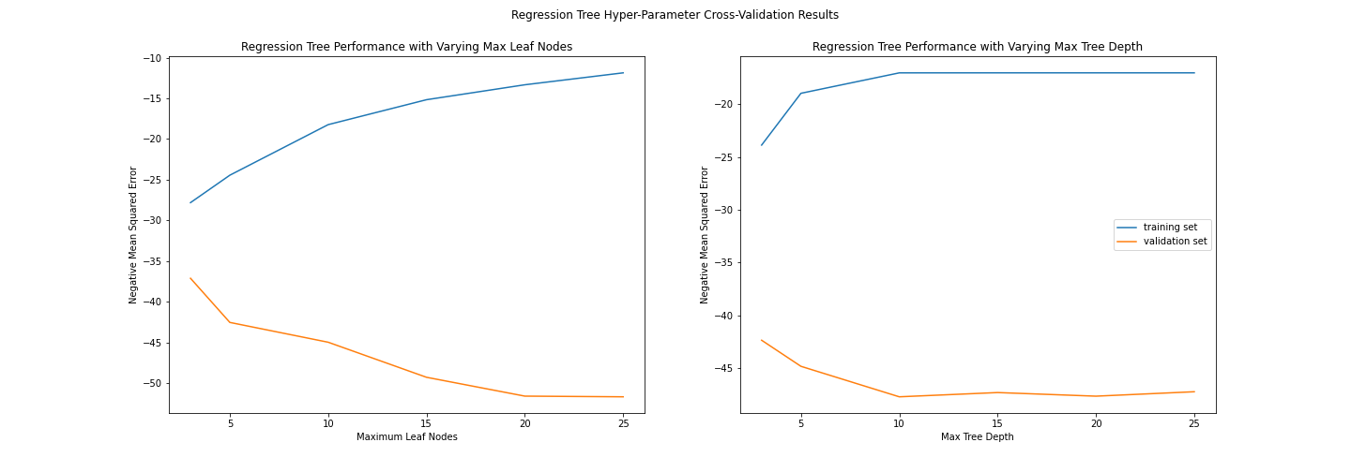
Medal Score Prediction : Regression Trees
Regression Trees were test with varying values for the hyperparameters of maximum depth and maximum leaf nodes
Best performing model combination was identified to be maximum depth = 5 and maximum leaf nodes = 3.

Slide 21
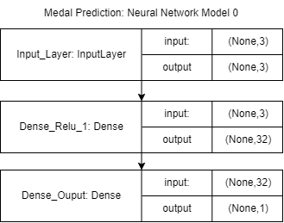
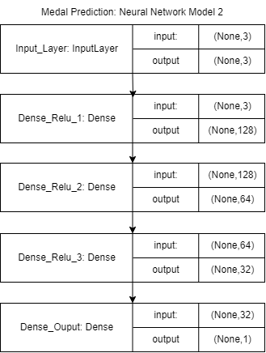
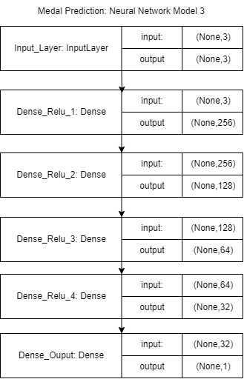
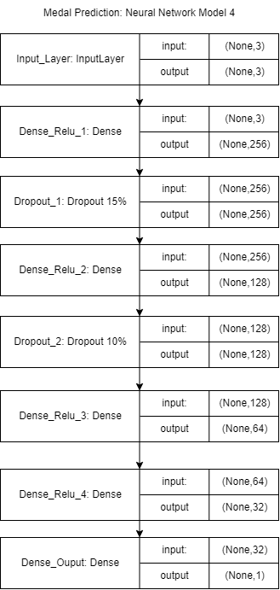
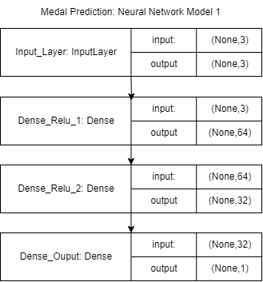
Medal Score Prediction : Neural Networks
Since grid-searching for neural network hyper-parameters would be computationally infeasible, we trained and tested 5 models of varying architecture (increasing in size).

Slide 22
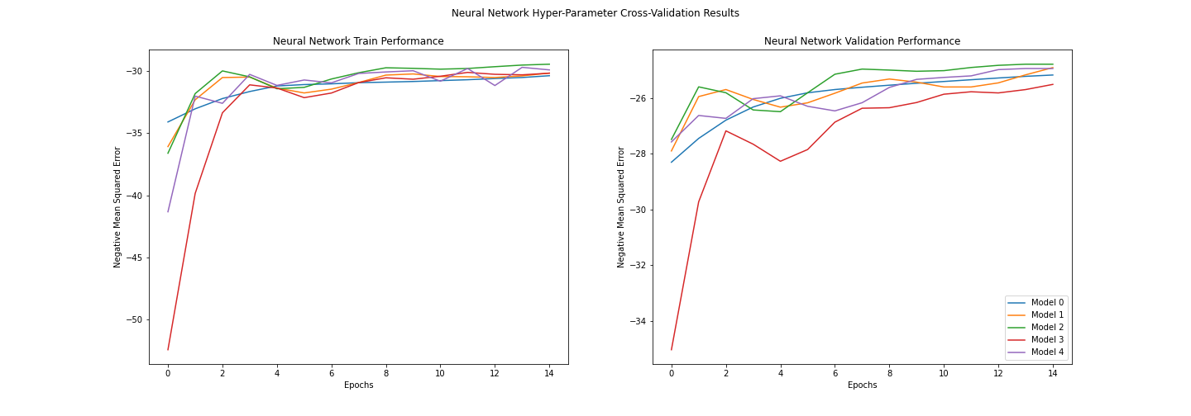
Medal Score Prediction : Neural Networks
Identified Model 2 as our optimal model using 3 intermediate dense layers with sizes [128, 64, 32] and relu activation

Slide 23
Medal Score Prediction : Results
After identifying each models most suitable hyper-parameters, we re-trained each model
We then compared each of their performances on the completely held out test set and scored their errors
In all cases we see Neural Networks perform the best
However, all models are generally similar

Slide 24
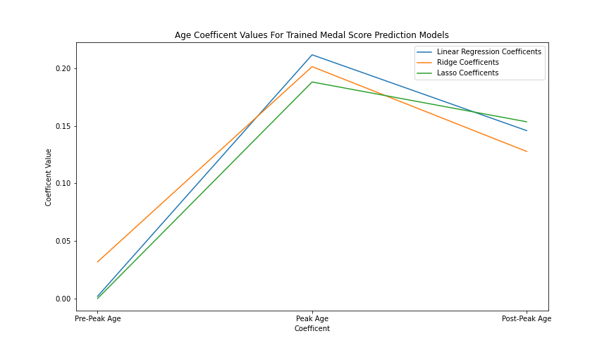
Modeling Conclusions
Despite Neural Networks having the best overall test scores, we selected Ridge Regression as our best model due to higher interpretability
Similar to Ridge, both lasso and linear regression can be directly interpreted at the feature level though evaluation of their coefficients
This added benefit of regression-based approaches allowed us to generalize the coefficient magnitudes into weights within our pipeline strength index
By plotting the regression coefficients, we can see that all models discounted pre-peak aged athletes while putting the most weight on the peak athlete feature.
This matches with our expectations

Slide 25
Key Takeaways
At the individual level, each alpine sport and gender pair demonstrate reasonably strong relations between age and peak athletic achievement
At the event level, each alpine sport and gender pair demonstrate very strong relations between age and peak athletic achievement
Utilizing peak age as a feature we can model and predict Olympic medal scores to some degree
Peak age was able to explain ~1/3 of all variance in Olympic medals scores
Many alternative avenues still remain in explaining the other 2/3 variation

Slide 26
Beyond Modeling
In the preparation of our analysis and modeling results, we also created some additional tools that may be useful for the USOPC going forward.
Athlete Data Scraper: a tool that allows users to augment and reconcile their data with the FIS’s database. Could be applied to other use cases.
Alps: a web application that provides interactive visualizations and increased analysis capabilities of alpine skiing data.

Slide 27
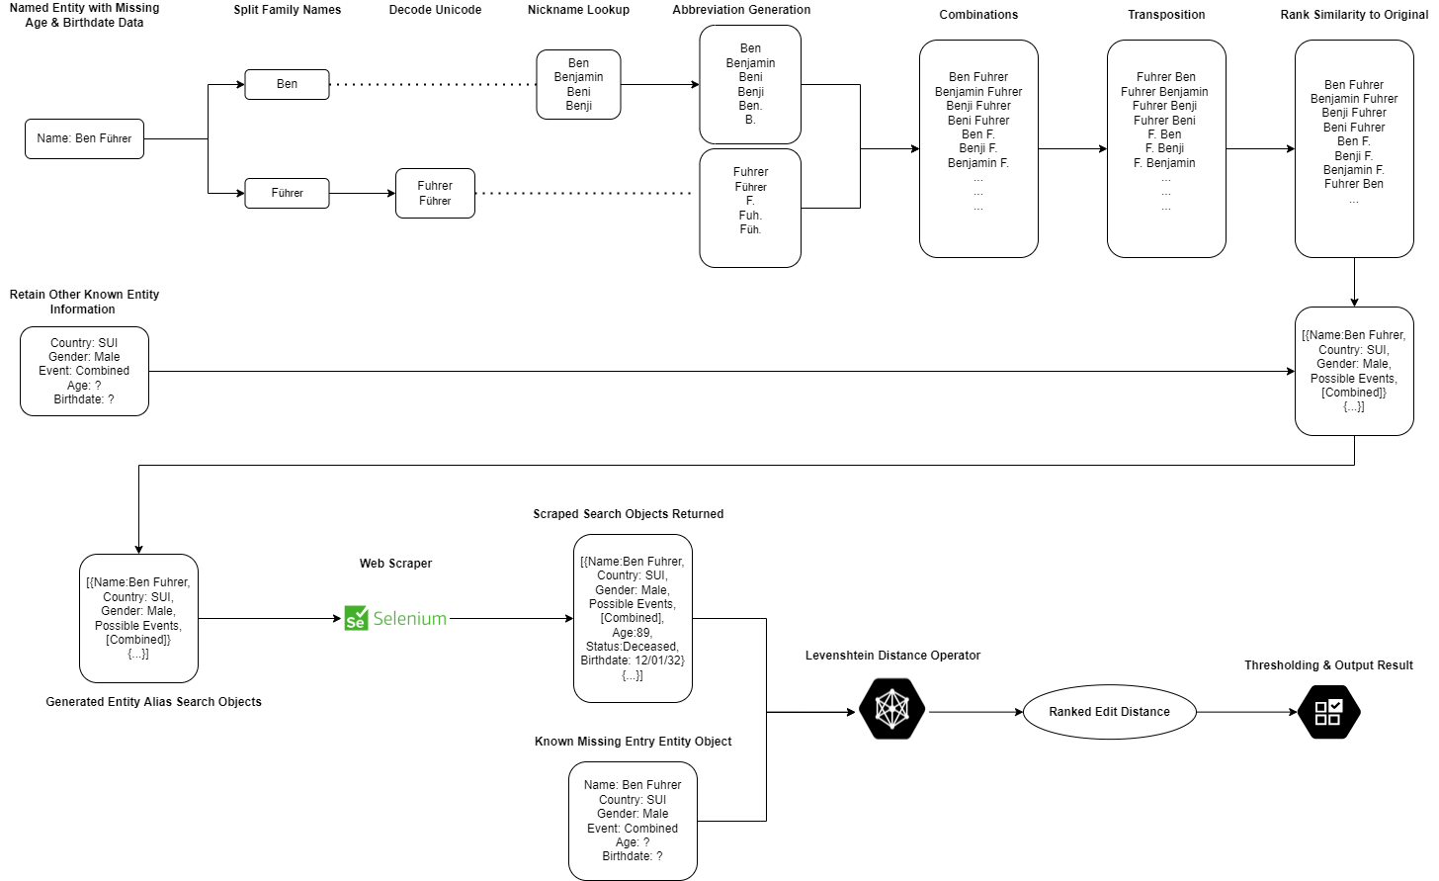
Data Scraper

Slide 28
Alps: Web Application
Alps
Dashboards
Utilities
Individual Dashboard
Methodology Overview
Country Dashboard
Data Uploads
Event Dashboard

Slide 29
Acknowledgements & References Cited
[9] Fionn Murtagh and Pedro Contreras. Algorithms for hierarchical clustering: an overview. WIREs Data Mining and Knowledge Discovery,2(1):86–97, 2012.
[10] Vit Niennattrakul and Chotirat Ann Ratanamahatana. On clustering multimedia time series data using k-means and dynamic time warping. In 2007 International Conference on Multimedia and Ubiquitous Engineering (MUE’07), pages 733–738, 2007.
[11] K.P. Pfeiffer. Stepwise variable selection and maximum likelihood estimation of smoothing factors of kernel functions for nonparametric discriminant functions evaluated by different criteria. Computers and Biomedical Research, 18(1):46–61, 1985.
[12] H. Platzer, Michael Barth, Anton Giger, Peter Schrocksnadel, and Werner Nachbauer. Did injury incidence in alpine ski racing change after equipment regulations? an evaluation based on the injury surveillance system of the austrian ski federation. Journal of Science and Medicine in Sport, 24, 07 2020.
[13] B. W. Silverman. Using kernel density estimates to investigate multi- modality. Journal of the Royal Statistical Society: Series B (Methodological), 43(1):97–99, 1981.
[14] Richard Simard and Pierre L’Ecuyer. Computing the two-sided kolmogorov-smirnov distribution. Journal of Statistical Software, 39(11):1–18, 2011.
[15] Sebastian Sitarz. The medal points’ incenter for rankings in sport. Applied Mathematics Letters, 26(4):408–412, 2013.
[16] Mikael Swar ́en, Caitlin Gallagher, and Glenn Bj ̈orklund. Impact on ski regulation changes on race and gate-to-gate times in world cup giant slalom skiing 2005-2020. 7:668–673, 07 2021.
[1] Rhiannon L. Cowan, Bradley Fawver, Keith R. Lohse, Troy Taylor, Paul R. Ford, and A. Mark Williams. Modeling talent development pathways in alpine ski racers. Psychology of Sport and Exercise, 55:101942, 2021.
[2] Carl d. Boor. A Practical Guide to Splines. Springer Verlag, New York, 1978.
[3] F ́ed ́eration Internationale de Ski. Athlete biographies database, February 2022.
[4] Bora et. al Facebook, Edizel. Misspelling oblivious word embeddings, 2019.
[5] Vivien Goepp, Olivier Bouaziz, and Gr ́egory Nuel. Spline regression with automatic knot selection, 2018.
[6] Bjørnar Haaland, Sophie Steenstrup, Tone Bere, Roald Bahr, and Lars Nordsletten. Injury rate and injury patterns in fis world cup alpine skiing (2006-2015): Have the new ski regulations made an impact? British journal of sports medicine, 50, 11 2015.
[7] V. I. Levenshtein. Binary Codes Capable of Correcting Deletions, Insertions and Reversals. Soviet Physics Doklady, 10:707, February 1966.
[8] Domenico Maisano, Andrea Botta, and Fiorenzo Franceschini. On the rating system in alpine skiing racing: Criticism and new proposals. Proceedings of the Institution of Mechanical Engineers, Part P: Journal of Sports Engineering and Technology, 230(4):253–263, 2016.

