Slide 1

United States Olympic & Paralympic Committee Practicum Midterm Report
Evan Jones
February 20th, 2022

Slide 2


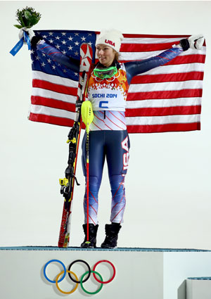
Project Motivation
The United States Olympic & Paralympic Committee (USOPC) is a non-profit corporation with limited capital resources. It is the committee’s mission to utilize these funds as effectively as possible to maximize Team USA’s medal achievement.
The USOPC must decide when, how, and by what amount to fund promising athletes to maximize the athlete’s and Team USA’s potential for success

Slide 3
Project Purpose
The United States Olympic & Paralympic Committee (USOPC) aims to gain understanding with respect to the role athlete age impacts medaling achievement in various sports/events.
A better understanding of this relationship on the discipline, event, and gender levels could allow for more targeted and effective funding decisions by the committee
By more effectively funding athletes at the right time in their career we create an environment that better cultivates athletic potential and maximizes Team USA’s medal output.

Slide 4
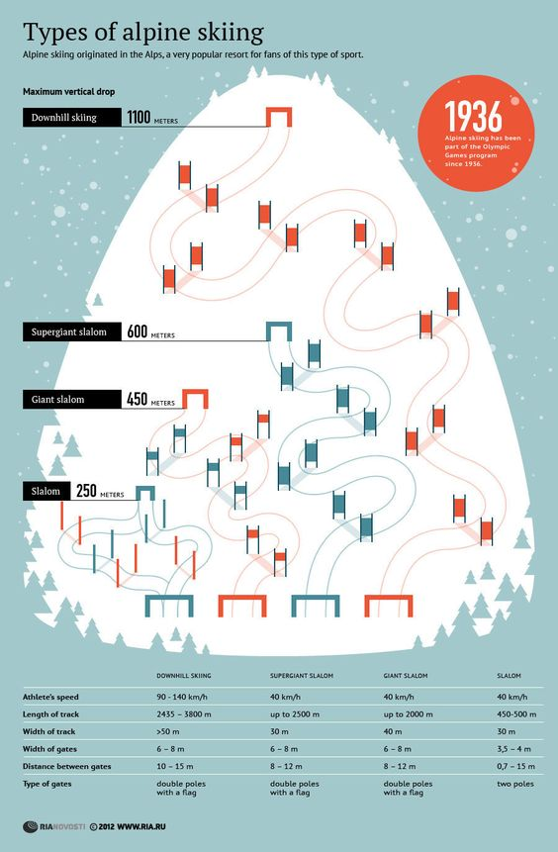
Project Overview
For this project, we will be focusing on the Winter Olympic solo disciplines of Alpine Skiing which includes 5 events for both male & female athletes
Slalom
Giant Slalom
Super Giant Slalom (Super G)
Downhill
Combined (1x Downhill + 2x Slalom)
Although similar each of the event has their own unique qualities and challenges

Slide 5
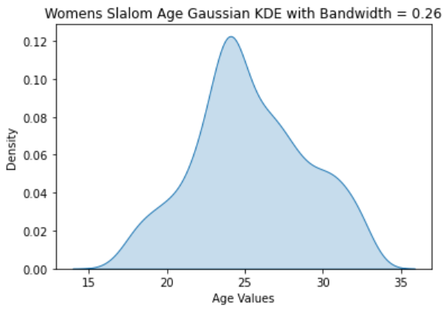
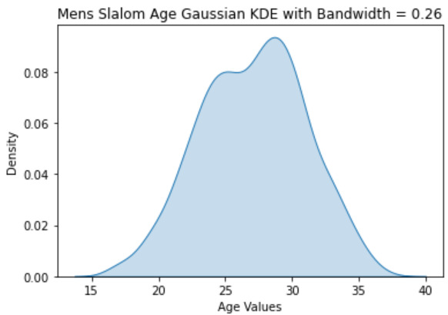
Project Overview
We will utilize internal client data as well as publicly available data to model the unique pre/post peak ages for each event & gender pair
We then apply Kernel Density Estimation to capture the distribution of top 3 event finisher ages for each event & gender pair
This resulting distributional models give us clear insight into peak age ranges via statistical metrics, modality tests and sampling
Pre-Peak
Peak
Post-Peak
Pre-Peak
Peak
Post-Peak

Slide 6




Project Overview
We will then compare past, present, and future athlete pipelines for both Team USA and other Olympic competitors through the lens of our age models
Each country’s number of pre-peak, peak, and post peak athletes prior to each Olympic games will be tabulated and used with known medal outcomes to train models that predict a country’s aggregate medal outcomes in the alpine disciplines
Sochi 2014 Alpine Skiing Athlete Pipelines by Country
(*example data; not representative of final results which are still in progress)
Country | Pre-peak Aged Athletes | Peak Aged Athletes | Post-Peak Aged Athletes | Alpine Bronze Medals Earned/Predicted | Alpine Silver Medals Earned/Predicted | Alpine Gold Medals Earned/Predicted
USA | 5 | 12 | 3 | 2/3 | 1/2 | 1/3
Norway | 3 | 7 | 0 | 2/1 | 1/0 | 1/1
China | 0 | 2 | 0 | 0/0 | 0/0 | 0/0

Slide 7
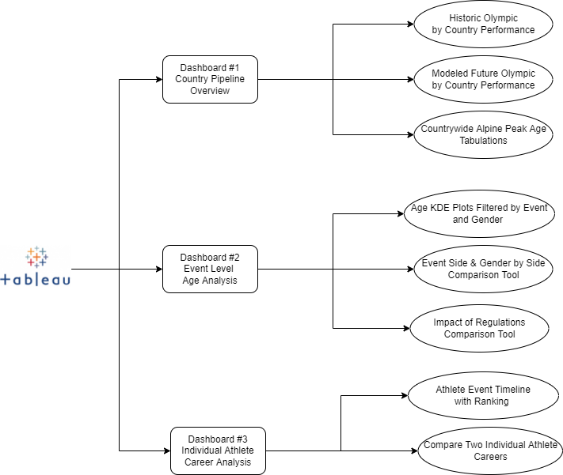
Project Overview
All of this information will be aggregated and visualized for the USOPC in Tableau across three dashboards
Each Dashboard will tackle a unique view of the dataset form country, event, and individual.
Each view will allow user interaction allowing quicker and clearer identification of actionable insights
Additional dashboard or view of model train and testing results is also likely to be contained within the tableau workbook but is not likely to be interactive or dynamic

Slide 8

Project Plan
Generally speaking, our project has been broken down and organized into three primary phases: Data Cleaning & Aggregation, Modeling, and Visualization. Each of these key sections will be broken down into section level tasks in the following slides.
For a full task specific breakdown of our project plan and schedule see the linked document here:

Slide 9
Data Cleaning: Key Challenges
Poor data schema design
Needs a redesign to conform with standard entity-relation modeling conventions
Athletes need to be stored independent of events
Age needs to be a derived feature rather than explicitly stored to prevent data consistency issues
Schema should be “event agnostic” and store all events together with athletes stored elsewhere
Unintuitive and inefficient variable encodings
Many columns contain uninformative or redundant information and need pruning
Encoding conventions for features need refining
Column names need reformatting for clearer descriptions
Non-uniform missing data handling
Large volume of missing & inconsistent data
~17% of all rows have no associated age in days or years
~22% of all athletes have inconsistent ages with multiple possible birthdays.
Duplicated athletes with slight name variations
Unicode non-conforming characters cause identity conflation
~27% of solo athlete data are duplicate rows

Slide 10
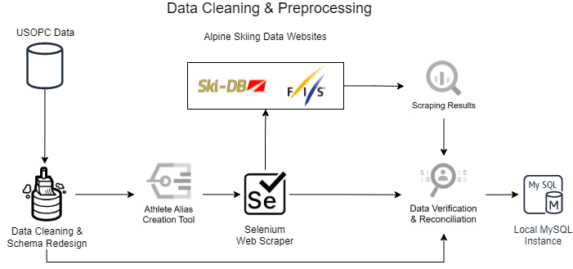
Data Cleaning: Process Overview

Slide 11
Data Cleaning: Fixing the Schema
The existing data was essentially one table with all event and athlete information dumped into it. This representation was converted to a new schema for both efficiency, usability, and compatibility reasons.
Athlete information was moved into a separate table containing only athlete specific information such as name, birthdate, country, etc.
Foreign key of Athlete ID is used to connect this new table to the remaining race level data
Competition related data was also moved into a separate table utilizing the foreign key of Competition ID to relate to the remaining race level data
Team table created to more efficiently represent teams and declutter main table; linked to athlete ids as foreign key
Each race result and related information is still fully recovered through the unique key representation of athlete id, competition id, and event id
Collectively large memory and efficiency gains

Slide 12
Data Cleaning: General Cleaning & Pruning
Although relatively “clean” the dataset still had a small list of changes that would make the data representations more intuitive, approachable, and efficient. A non-exhaustive summary of these alterations includes:
Columns renaming and whitespace removal
Enforce strong data types on each column
Use “None” encoding for missing data
Use “NaN” for inconsistent or non-conforming entries
Use numeric encoding as opposed to strings where possible (ex: Tied, Gender)
Pruned 5 columns which were mostly blank or “NaN”
Pruned 8 columns for data redundance

Slide 13
Data Cleaning: Entity Recognition Tool
Created a customized tool for athlete entity generation, recognition, and reconciliation. One of the key problems we faced in both web scraping for missing data, and in reconciling known existing inconsistent data entries was one of entity recognition. Thus, we needed a tool to solve the following problems:
Given incomplete athlete information how can we find matching entities in other public databases (possibly stored under slightly different names or conventions)?
Given a scale prohibitive semi-supervised scraping process how can we ensure data integrity and accurate entity matching?
What metrics can be used to rank entity similarity?
Can entity knowledge from two different sources be used to reconcile existing data integrity issues?

Slide 14
Entity Recognition Tool : Overview
Two-part framework that together solves our entity generation and recognition problem
Generator
Takes as input an athletes name formatted as a string
Generates multiple athlete aliases using combinations of first, last, and middle (if present) names
Applies Unicode encoding and decoding combinations
Generates possible abbreviated aliases
Utilizes lookup dictionaries of known nicknames to generate additional aliases
Discriminator:
Takes as input a base entity object for comparison and a list of entity objects, we wish to compare the base entry to
Uses a two headed modeling approach to sort and rank entity objects in terms of similarity
Applies learned similarity thresholds to determine if no entity is reasonably similar

Slide 15
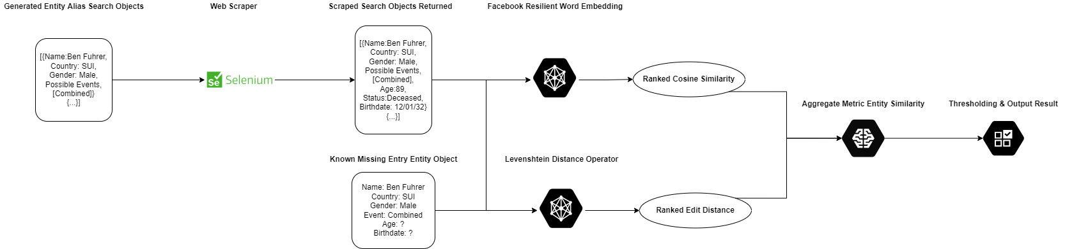
Entity Recognition Tool : Discriminator
Levenshtein distance: string relative distance metric that captures the minimum number of single character edits required to change one word into another
Facebook Resilient Word Embedding: A method developed by the Facebook AI team to train and query word embeddings in a way to make them more robust to OOV tokens, mis-spellings, common nicknames and other related representation problems
Aggregation: Each metric has its own weaknesses. However, when ensembled we arrive at a much more reliable result.

Slide 16



Data Cleaning: Scraping Missing Data
Designed custom web scraping tool to locate and replace missing fields athlete age fields.
Scraper utilizes python & selenium to locate athlete records hosted on three large providers of alpine skiing data (FIS & Ski-DB).
Utilized entity generation tool to query a broad list of possible identities for each athlete and website
Searched over 25K total athlete aliases across three websites in just under 72 hours
Utilized entity recognition tool to sort and rank the similarity of scraping results with the incomplete athlete profile we were looking to augment
Successfully filled ~82% of all missing athlete age entries
Missing Entry Example
Possible Name Aliases
Name: Beni Führer
Country: SUI
Gender: Male
Event: Combined
Age: ?
Birthdate: ?
Beni Führer
Beni Fuhrer
Benjamin Führer
Benjamin Fuhrer
Ben Führer
Ben Fuhrer
B. Führer
…
Entity recognition tool returns closest matching result (if any)
Search each generated name using known country, event, and gender data
Input scraped entities into the entity recognition tool for ranking and sorting

Slide 17
Data Cleaning: Reconciling Inconsistent Data
In addition to merging in the web scraping results generated for the missing data fields, we also realized that we could utilize this scraping and entity recognition framework to reconcile some of the known inconsistencies within the database entries for athlete ages.
For each athlete we derive a birthdate:
birth date = competition date – athlete age (in days)
If the database was consistent, each athlete would only have one birthdate. However, due to incorrect data entry hundreds of athletes had multiple possible birthdates.

Slide 18
Data Cleaning: Reconciling Inconsistent Data
In order to solve this problem, we utilized our web scraper to find highly similar athlete birth dates and ages.
Scraped athlete birth date/age information at the event level was concatenated with the existing data
The frequency of each unique birthdate from the concatenated dataset was utilized to determine the resulting athlete’s reconciled birthdate
If the birth date values showed strong unimodality we determined the reconciled entry via the mode operator
If the values showed no indication of unimodality we determined the reconciled entry via the mean operator clipping outliers
Although non-exact, it is likely better than the data was prior. Additionally, since we are interested in viewing age as a variable in the function of performance, we need only use a non-exact reasonable estimate which an unbiased estimator accomplishes.

Slide 19
Data Cleaning: Summary
To date, all of the data cleaning tasks mentioned have been completed. This process took much longer than anticipated as it was only when working on preliminary modeling that some of these critical data integrity issues were discovered.
Although this is subject to change as additional modeling and visualization is completed, we anticipate little or no future data cleaning in the project workflow.

Slide 20
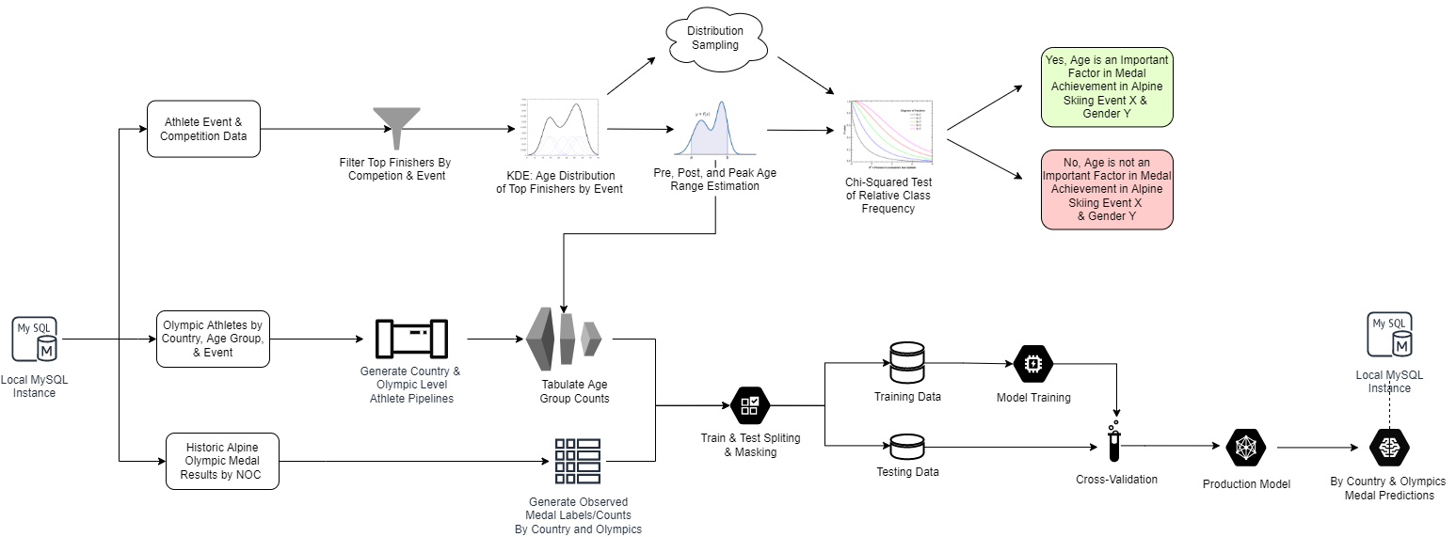
Modeling: Overview

Slide 21
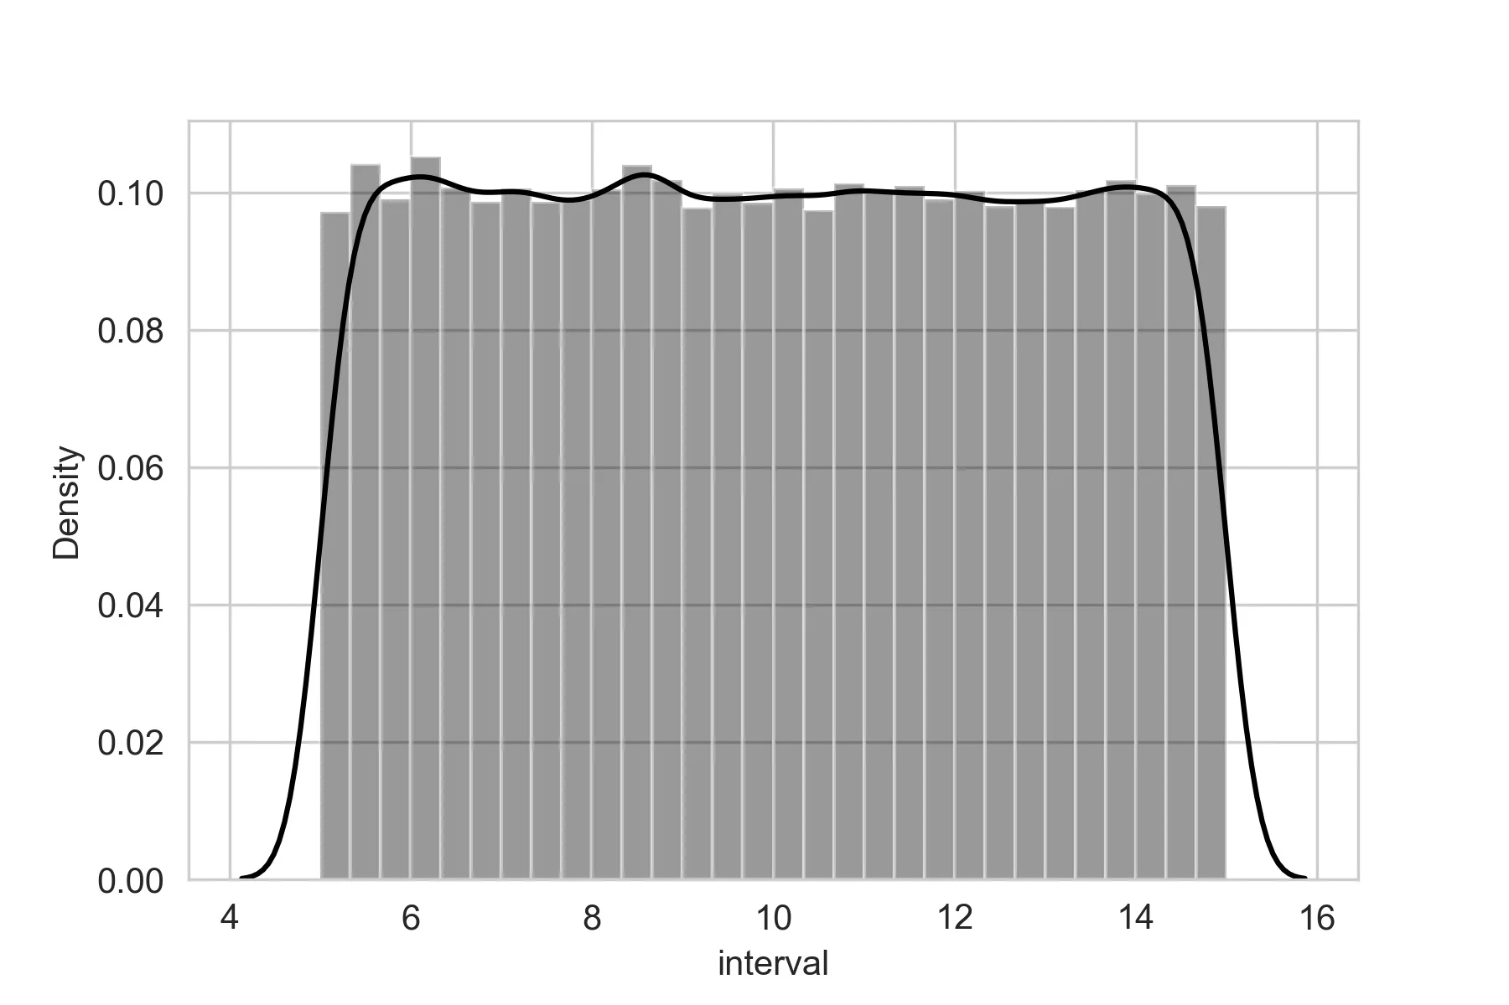
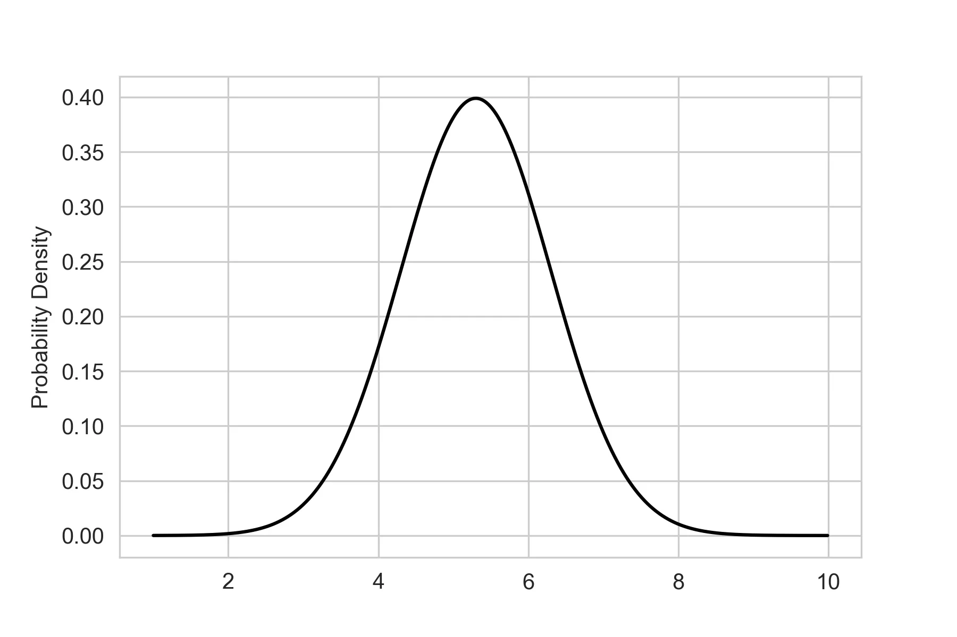
Modeling: Understanding Age
Uniform
In this report, our primary task is to model the impact of age (if any) and nature of this relationship on solo alpine skiing performance. With this task in mind, it makes sense to analyze the distribution of top medaling athletes vs. age.
In the extreme case, if age has no impact, we expect a uniform distribution
If age has impact to equal and constant effect on younger and older athletes, we should expect to see a triangular distribution
If age has as symmetric, but non-constant impact on younger and older adults, we should expect to see a gaussian-like distribution
If age has as non-symmetric and non-constant impact on younger and older adults, we should expect to see a distribution demonstrating skewness or kurtosis
Gaussian

Slide 22
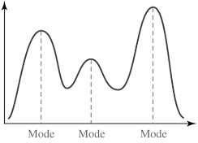
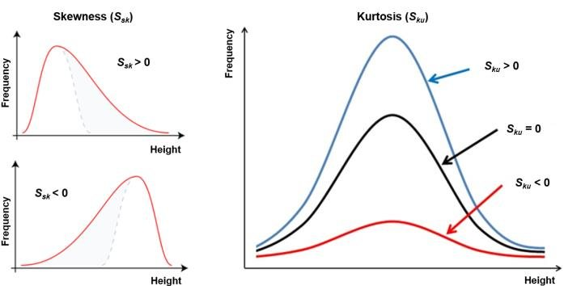
Modeling: Understanding Age
We can use several statistical test along with distributional parameters to recognize pre, post, and peak age segments within the age/achievement distribution.
Modality: Serves as an indicator of peak (or lack thereof) age range
Mean: Serves as our midpoint for peak age estimation
Skewness & Kurtosis: metrics which inform us about the skewness and “tailedness” of the distribution respectively
Standard deviation: metric to inform our spread of observations

Slide 23
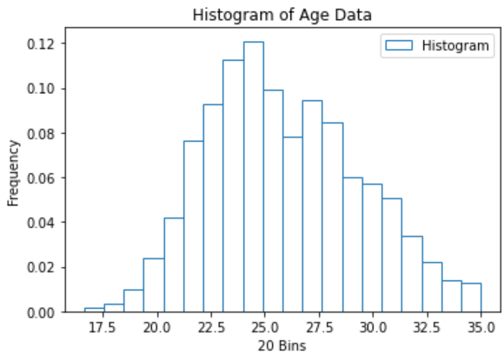
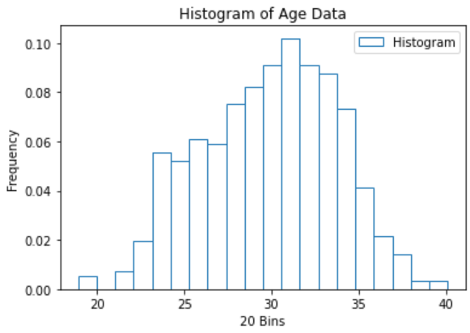
Modeling: Achievement Histograms
Since we do not know the data’s inherent distribution, we must learn it from the data using non-parametric methods. One of the simplest and most effective ways to accomplish this is through the lens of frequency histograms. This simple plotting approach yields a clear distributional approximation, but there are several issues with this simple approach:
Discretization of the continuous variable age is not ideal
Choice of binning hyperparameter introduces complication
Integration and sampling possible, but loses a lot of information depending on the number of bins selected and where starting bin edges are placed
Is there a way we can improve this analysis approach with these problems in mind?
Yes, Kernel density estimation can be thought of as the continuous generalization of these histograms, and gain several advantages to standard histogram modeling and inspection

Slide 24
Modeling: Kernel Density Estimation
Kernel density estimation can be thought of as the continuous generalization of histograms and gain several advantages to standard histogram modeling and inspection.
Continuous age variable can be modeled by continuous distribution
Non-parametric method enables flexible distributional fitting
Bandwidth parameter adds complication, but Silverman’s method is near optimal and will be used to save a hyperparameter search
Easy to generate data samples from the fitted distribution
Can easily integrate with respect to the fitted density function to derive pre, post, and peak ages.
Allows us to conduct statistical tests on the fit distribution.

Slide 25
Modeling: KDE & Statistical Testing (in-progress)
Kernel density estimation alone cannot provide a definitive answer to the question of whether athlete age plays a significant role in Olympic medaling.
However, KDE models can be used to generate representative samples from our population which in turn can be classified into pre, post, and peak age categories derived earlier.
Tracking the relative frequencies of a large number of these generated samples can then be compared to expected categorical frequency via a Chi-Squared test. The results of this Chi-Squared test will inform us about the nature of athlete age and if it is independent from medal achievement
Modality tests such as DIP, MAP, & Saddle can inform the presence or absence of distinct age groups within the achievement distribution
Country event medaling probabilities can be computed as a function of number of competition athletes scaled by their additional qualities relative to peak age

Slide 26
Modeling: Pipeline Creation (in-progress)
With the question of age importance answered we now need to move onto the task of modeling the pipeline strength of various Olympic teams. We will train a variety of models for this task and are currently prototyping several different methods.
Aggregate & filter athletes by event, country, and specific Olympics to get an Olympic athlete pipeline for each NOC
Sochi 2014 Alpine Skiing Athlete Pipelines by Country
(*example data; not representative of final results which are still in progress)
Country | Pre-peak Aged Athletes | Peak Aged Athletes | Post-Peak Aged Athletes
USA | 5 | 12 | 3
Norway | 3 | 7 | 0
China | 0 | 2 | 0

Slide 27
Modeling: Prediction (in-progress)
Now that we have country athletic pipelines created, we can utilize this information to make predictions about past and future Olympic medaling outcomes.
Generate by country & specific Olympics medal results to store as the true label (number of medals a country earned)
Tabulate the number of athletes each country has for each events unique peak age categories
Use these peak age category frequencies as the explanatory modeling variables to predict the number of total country medals earned
If age is indeed helpful in predicting medaling outcomes our model should demonstrate a reasonably sound out of sample accuracy

Slide 28
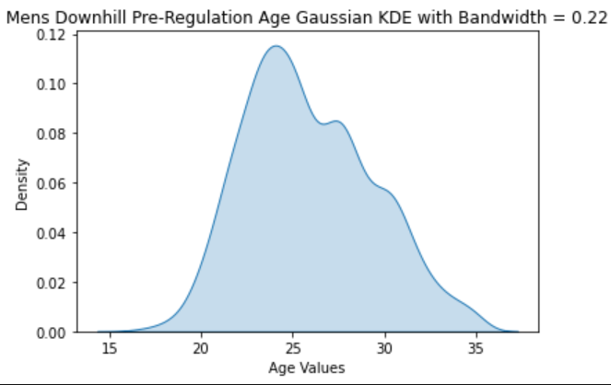
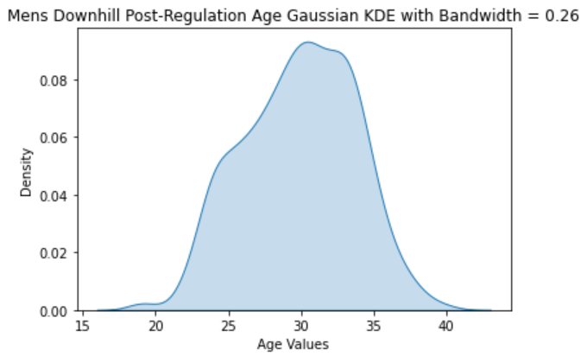
Modeling: Exploratory Analysis & Insights
Throughout the modeling process, a lot of experimentation was done with alternative factors evaluated in their own right as well as with respect to age
One of the most significant insights gleaned from this exploration was the impact of far-reaching alpine ski regulations imposed in 2004, and the resulting impact on peak age
As we can see from the two KDE models of peak age the distributions of pre-regulation skiing show a younger more distinct peak age. Alternatively, we can see that the post-regulation distribution is less skewed and suggests an older peak age
Together these observation which persist across all disciplines and genders show that regulations meant to increase sport safety also led to increased athlete competitiveness with respect to age

Slide 29
Future Modeling
Although we have made significant progress with respect to modeling there are still several areas where more time will be required mostly in the area of hyperparameter tuning and model selection with respect to pipeline modeling
Collectively, we believe that the kernel density analysis and accompanying descriptive statistics paired with the overall pipeline medal expectation modeling will provide the USOPC the necessary information to understand the relationship between age and athlete competitiveness both generally and with respect to Team USA’s own athletic pipeline
We remain on track (slightly ahead of schedule) on the modeling front, and time permitting may create and test additional modeling approaches

Slide 30
Future Visualization
At this point in the project, we have not yet started the process of generating visualization beyond the prototype phase
This is however expected based on the schedule we have set
Overall goals remain creating the three dashboard view in Tableau previewed in slide 7
We remain on track to meet the respective deadlines, and may expand our visualization offering based on available time

Slide 31
Conclusion: Review of Key Questions & Insights
At the beginning of this project the client asked us to answer these three central questions. So far in our progress we are confidently able to answer the first two with respect to alpine skiing. With the third pending further analysis.
Is age significant in predicting medal achievement?
- Yes, age plays a significant factor in an athlete’s competitiveness. Chi-squared tests at the event and gender level show that age ranges have distinct impact on medal outcomes. However, it is still uncertain if it is the most significant factor in medal achievement.
Are there specific peak age ranges? Do they vary by event and gender?
- Yes, although somewhat similar, each event and gender combination have distinctly different distributions of medal achievement by age.
How does Team USA’s athletic pipelines compare to other countries?
- Pending further research…

Slide 32
Acknowledgements & References Cited
Edizel, Bora, et al. Misspelling Oblivious Word Embeddings. 2019. Misspelling Oblivious Word Embeddings. 2019.
Fédération Internationale de Ski, FIS. (February 20, 2022). FIS-Ski, Athlete Biographies Database. https://www.fis-ski.com/DB/general/biographies.html
Fédération Internationale de Ski, FIS. (February 20, 2022). International Ski Competition Rules and Regulations. https://assets.fis-ski.com/image/upload/v1593675483/fis-prod/assets/ICR_02072020.pdf
Novosti, Rio; Sputniknews (February 20, 2020). Types of Alpine Skiing [Computer Graphic] https://sputniknews.com/20120220/171415223.html
O'Neill, Kristy & Cotton, Wayne & Cuadros, Juan & O'Connor, Donna. (2016). An Investigation of the Relative Age Effect amongst Olympic Athletes. Talent Development and Excellence. 8. 27-39. Kaggle Dataset
Pacor, Matteo. SKI-DB: Alpine Skiing Database, (February 20, 2022). SKI-DB: Alpine Skiing Athlete and Event Database. https://ski-db.com/
United States Olympic and Paralympic Committee, USOPC. (February 20, 2022). USOPC Proprietary Database.

