Slide 1
Towards Offline GenAI Fine Tuning Model with LoRA Derivatives for IoT Edge Server
Pujianto Yugopuspito
I Made Murwantara
Evan Kurnia Alim
Wiputra Cendana
Aditya Mitra

Slide 2
Background
The Internet of Things (IoT) has become ubiquitous, collecting and analyzing data from various sources.
Dependence of constant internet connection makes its functionality unreliable, therefore research focused on offline artificial intelligence (AI) systems for IoT is highly needed.
Generative AI (GenAI) has become a trendy topic since late 2022, and is expected to continue at least for the foreseeable future.
Our research will focus on how to optimize GenAI so it will become usable on consumer devices.
One of the possible optimizations is to minimize the memory usage of GenAI, especially during fine tuning.
The most popular method is low-rank adaptation (LoRA), and it has given rise to lots of derivatives, the most popular of it being Quantized LoRA (QLoRA).

Slide 3
LoRA’s core principles
Low-rank adaptation (LoRA) is a popular technique used during GenAI fine-tuning to improve the efficacy.
The core principles include:
Parameter efficiency fine-tuning (PEFT), i.e. by fine-tuning only a small subset of the model’s parameters, thereby greatly increasing efficacy.
Low-rank decomposition, i.e. by decomposing the weight matrices into lower-rank matrices, which are easier to fine-tune.
Modularity, which is useful for transfer learning, by only training specific parts of the model.
Scalability, meaning that a linear increase on model size should result in only a sublinear increase of computational resources.
Regularization, to prevent model overfitting.
Generalization, for adapting to new tasks.

Slide 4
LoRA Derivatives
Quantized LoRA (QLoRA) - most popular
Multi-task LoRA (MTLoRA)
Adaptive LoRA (AdaLoRA)
Accurate LoRA (IR-QLoRA)
Continual LoRA (C-LoRA)
Quantized Dynamic LoRA (QDyLoRA)
Residual LoRA (ResLoRA)
Orthonormal LoRA (OLoRA)
Weight-Decomposed LoRA (DoRA)
High-rank Adaptation (HiRA) - intriguing

Slide 5
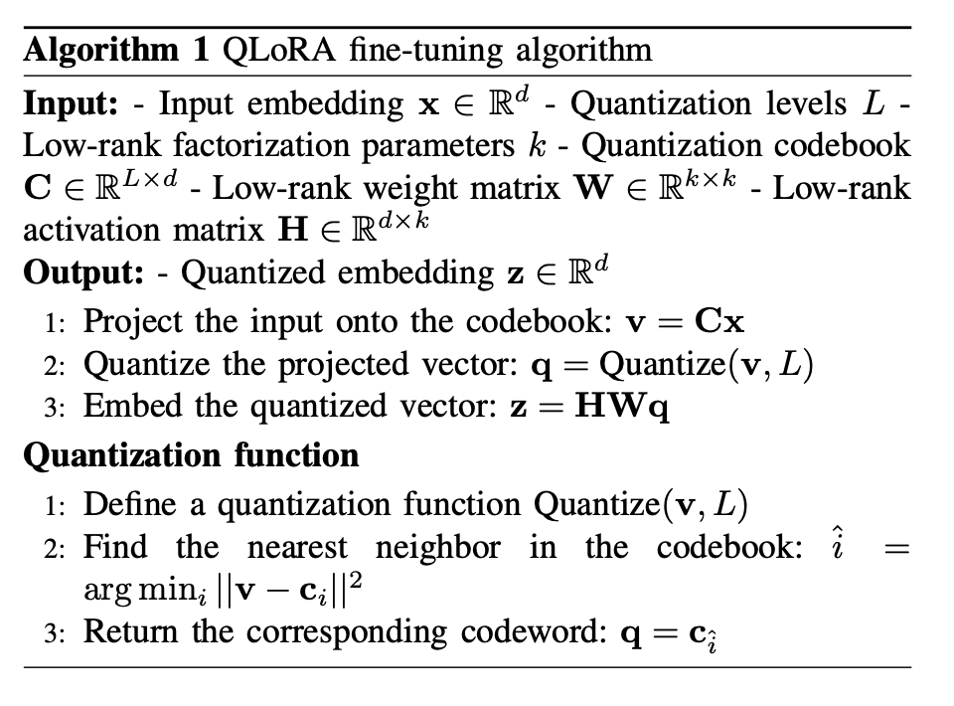
Quantized LoRA (QLoRA)
The most popular LoRA derivative, it includes quantizing the weights used for fine-tuning in order to minimize computational resources while maintaining LLM performance.

Slide 6
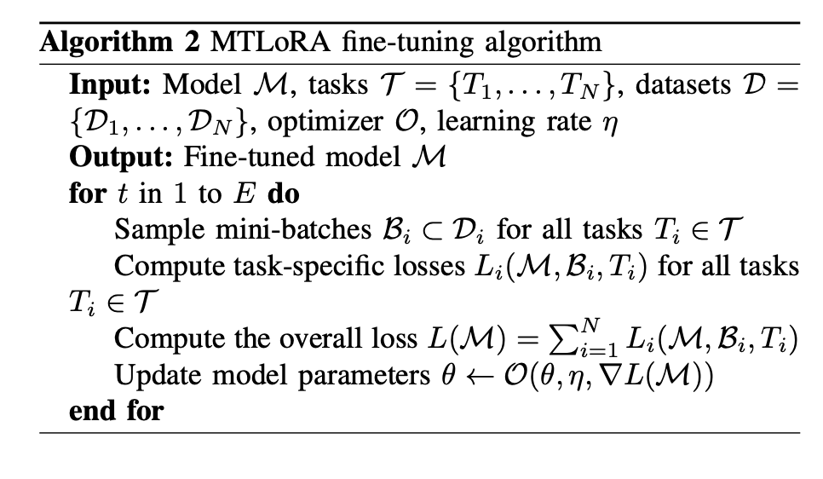
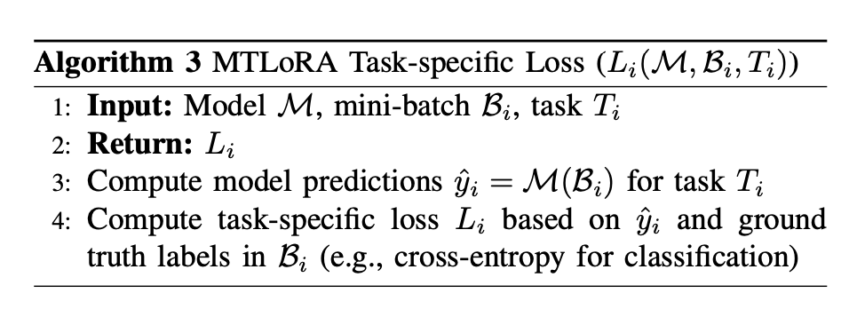
Multi-task LoRA (MTLoRA)
It uses both task-agnostic modules and task-specific modules, in order to adapt from just learning a certain task to learning different but related tasks.

Slide 7
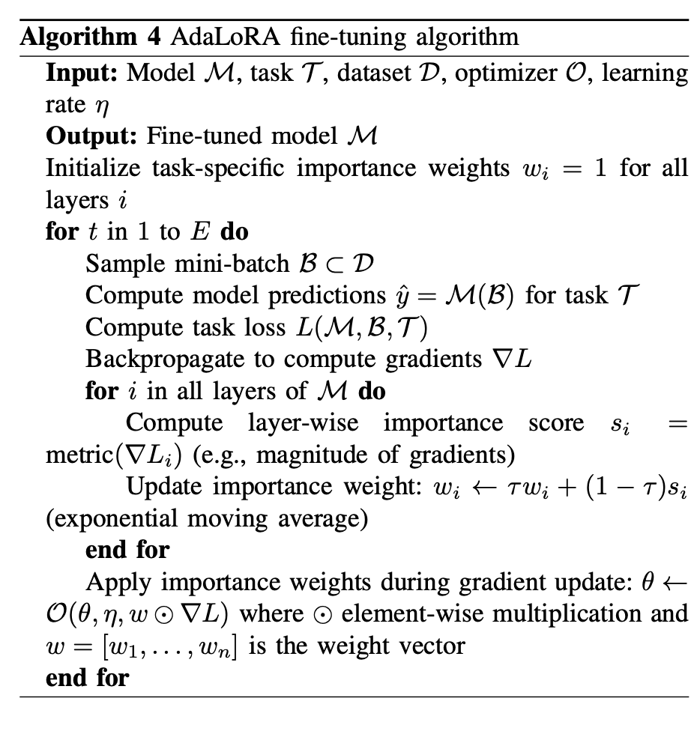
Adaptive LoRA (AdaLoRA)
AdaLoRA dynamically adjust the parameters’ weights and the matrices’ rank based on the model performance to focus only on the parameters that need improvement instead of training a fixed number of parameters on every step.

Slide 8
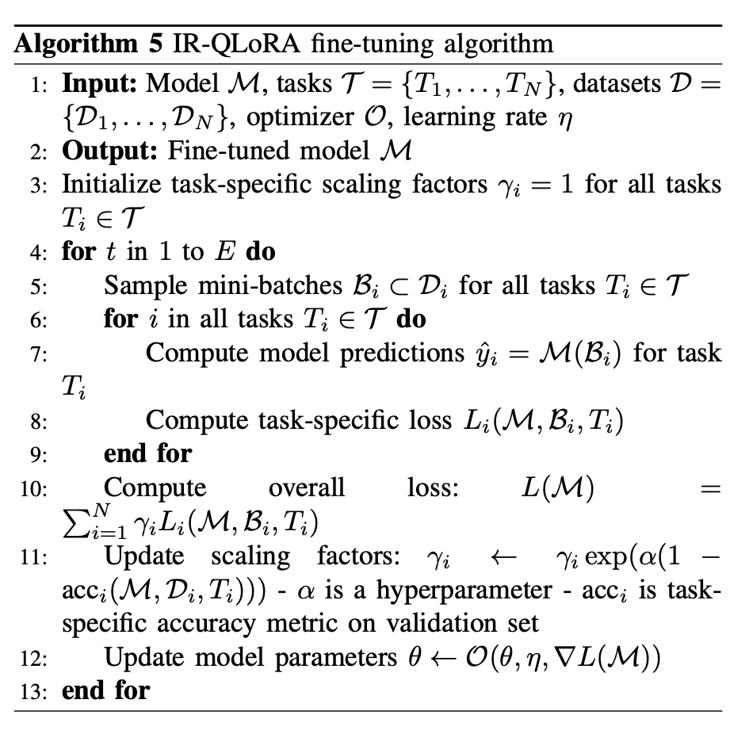
Accurate LoRA (IR-QLoRA)
IR-QLoRA uses the Information Calibration Quantization (ICQ) and Information Elastic Connection (IEC) to preserve information in the quantized parameters while only having a minimum additional training time.

Slide 9
Methodology
LLM to be fine-tuned is the 4-bit quantized version of Llama 3.1.
We’ll fine tune the 8B (smallest) model, followed by the 70B (standard) model.
The dataset used to fine-tune is the cleaned Alpaca dataset.
We’ll use the free Google Colaboratory, which has a single 16GB Nvidia T4 GPU installed. Then, we’ll try to run it on a device with a single laptop 8GB Nvidia Geforce RTX 4070 installed.

Slide 10
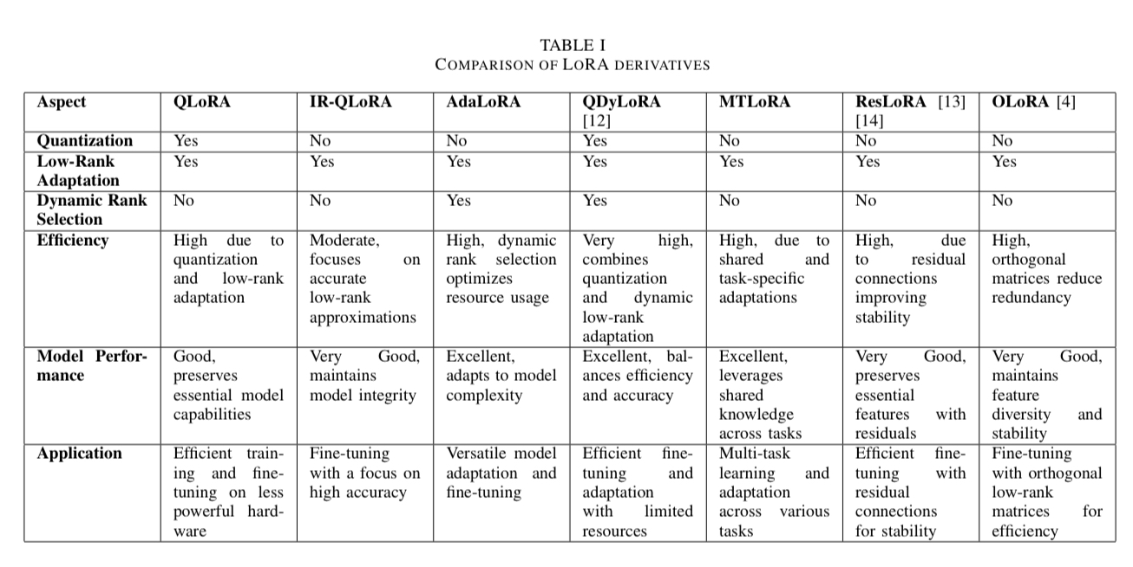
Comparison Table

Slide 11
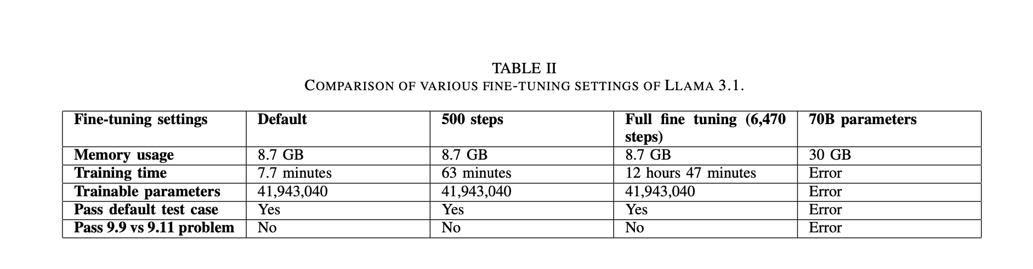
Results

Slide 12
Future Research
Try to run the fine-tuning algorithm locally and compare the performance to the cloud-based, given the same or similar specs.
Try to use other models as the based model and other datasets as the fine-tuning data.
Try to further optimize memory usage to use less than 8 GB (e.g. Nvidia Geforce RTX 4070 laptop GPU) of GPU memory.
Use more test cases for testing the LLM. Especially, try to tinker the fine-tuning parameters until it passes the 9.9 vs 9.11 problem.
Develop a metric that also implements training time, disk usage, and LLM quality (accuracy and non-hallucination)
Implement safety guardrails for ethical AI.
Adapt the code to use accelerated computing alternatives, such as Polars and Mojo.
Consider other PEFT techniques (i.e. non LoRA based), such as DoRA and HiRA.

