Slide 1
Snapshot Seattle: an analytics-based approach
Innovation & Performance team
November 18th, 2019

Slide 2
Introduction

Slide 3
People: Who is Seattle?

Slide 4
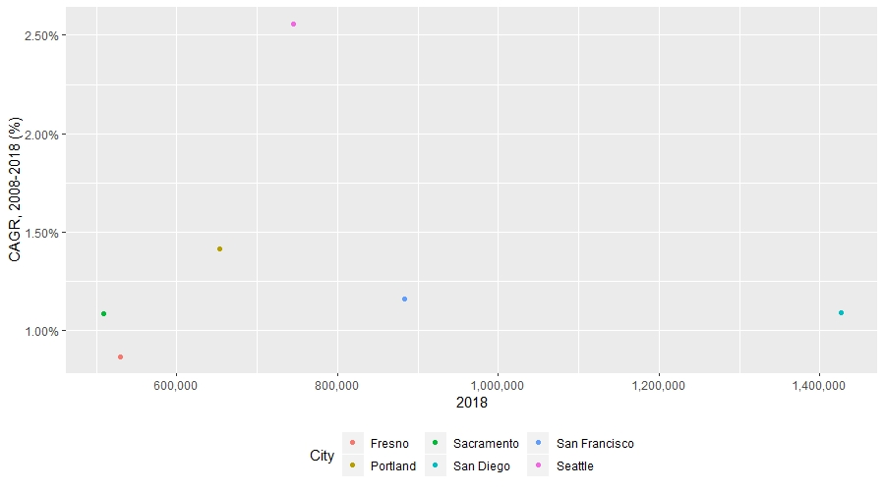
Population and population growth

Slide 5
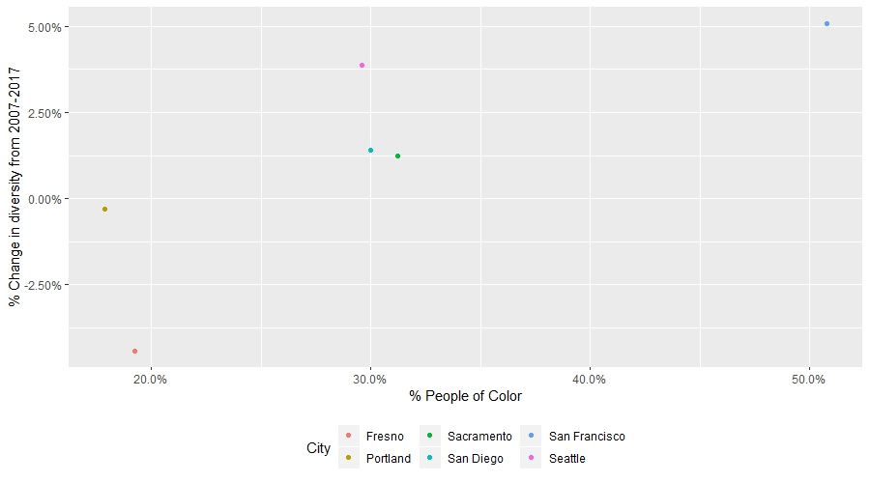
Racial diversity among the west coast seven

Slide 6
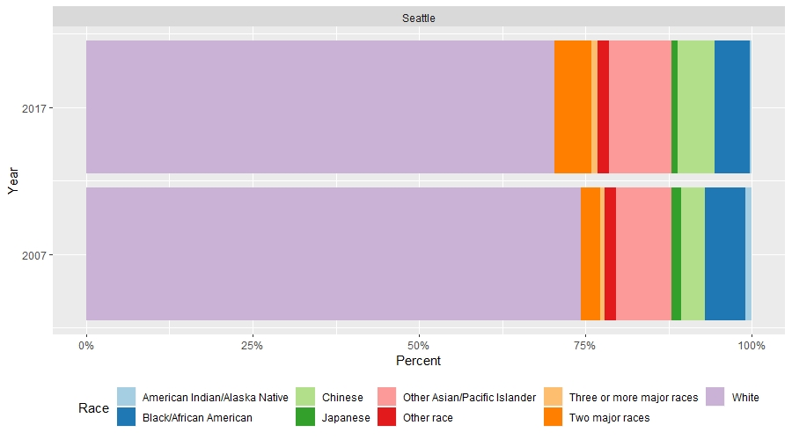
Seattle’s racial diversity

Slide 7
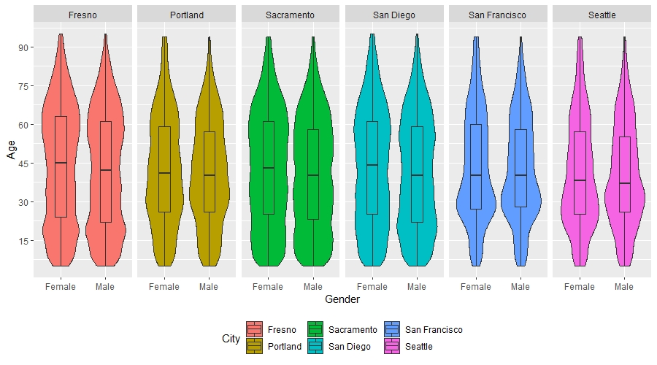
Age Violin (2017)

Slide 8
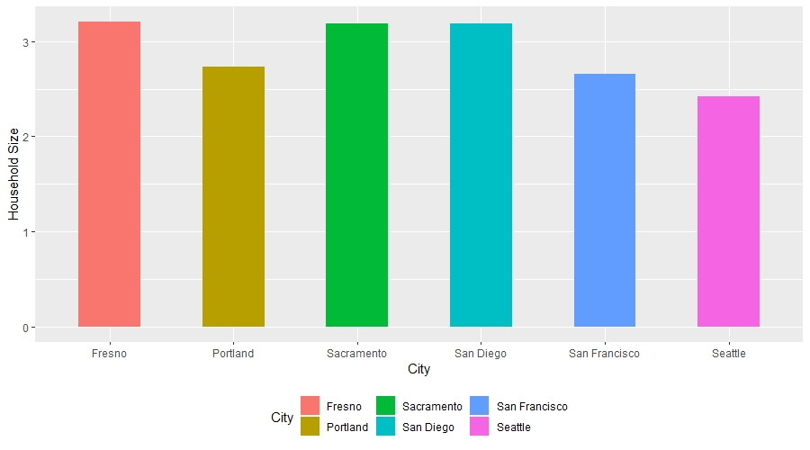
Average household size

Slide 9
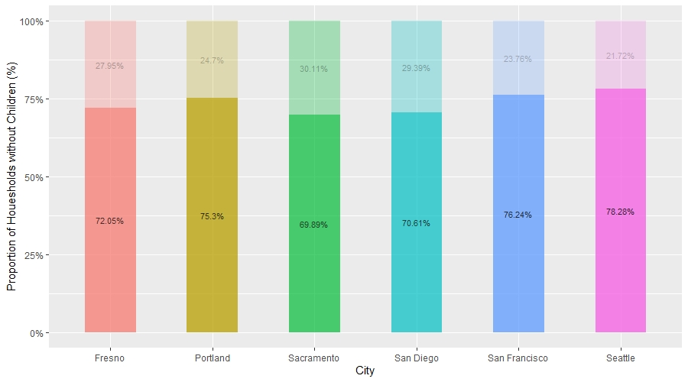
Proportion of households with children

Slide 10
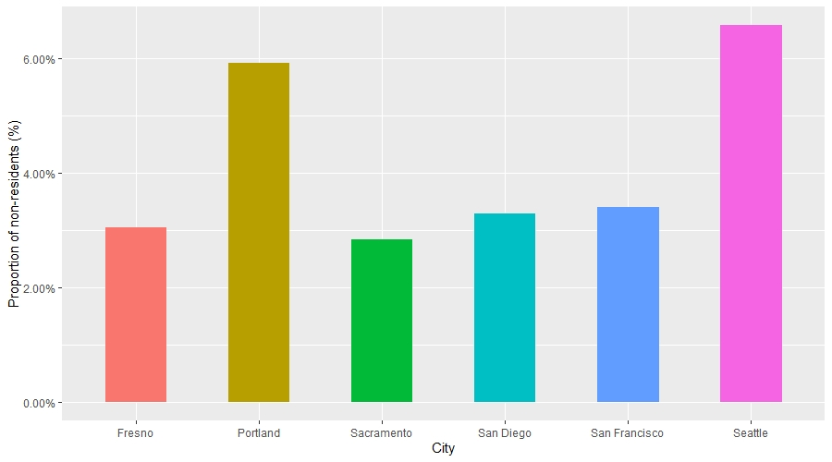
% of non-residents during last year (increase)

Slide 11
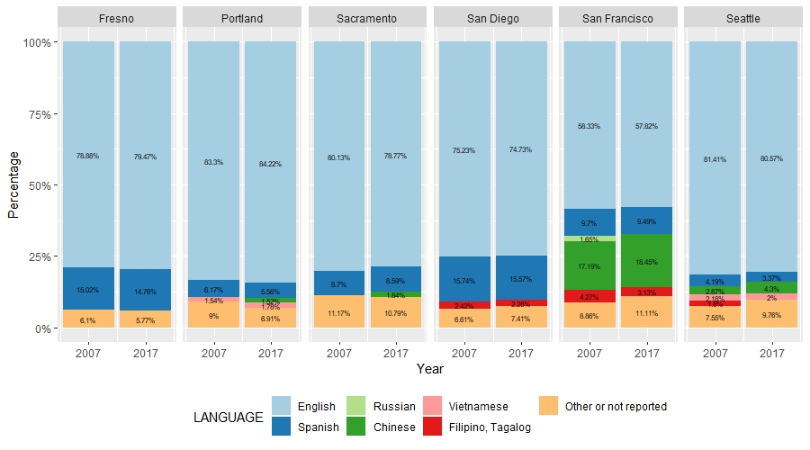
Major languages spoken

Slide 12
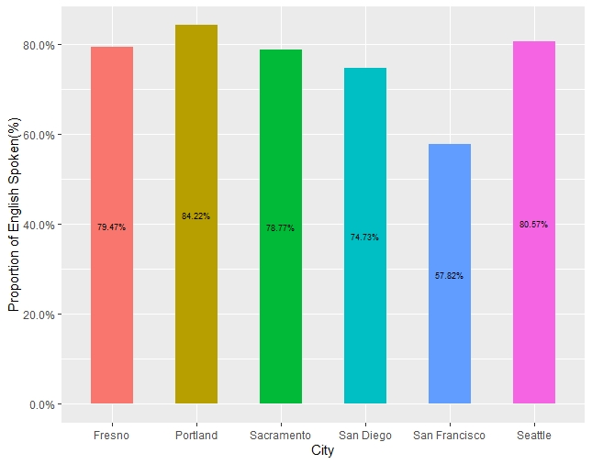
Proportion of English spoken in household

Slide 13
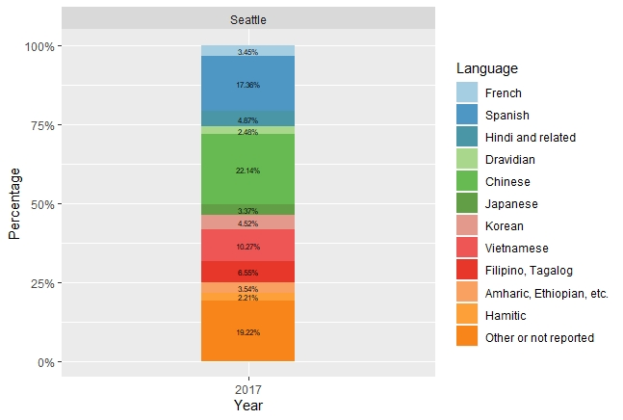
Linguistics Seattle

Slide 14
Economy: What runs Seattle?

Slide 15
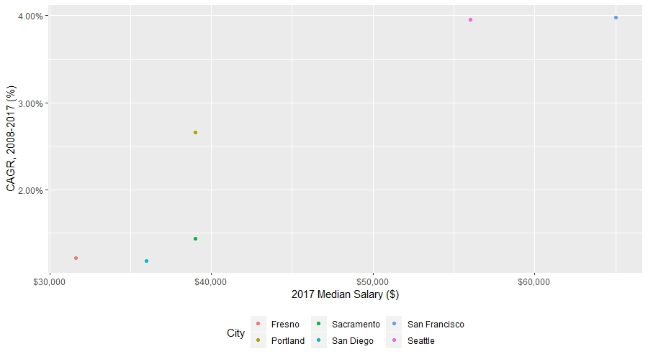
Seattle income CAGR

Slide 16
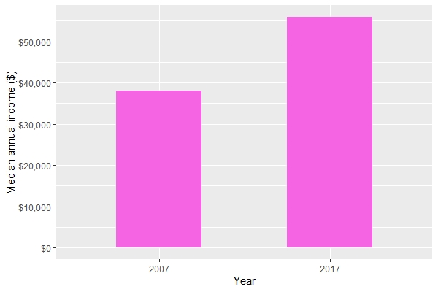
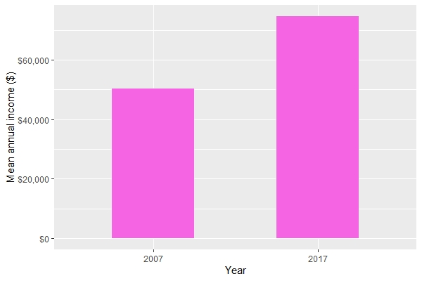
Average salary Seattle

Slide 17
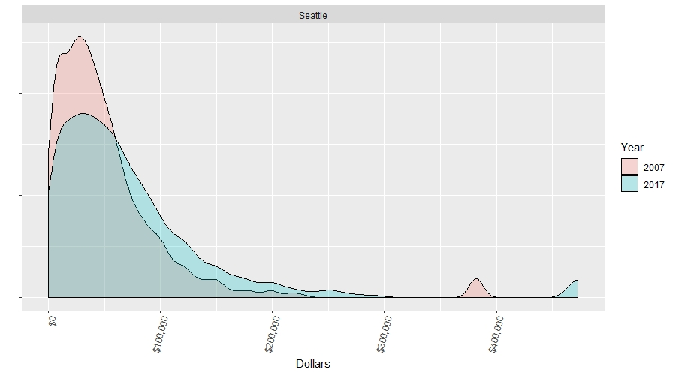
Distribution: Seattle individual salary
Notes:
Filtered by Ages between 20 and 65, making more than 0$ an hour (basically trying to exclude non-earners

Slide 18
Housing: Who Lives in Seattle?

Slide 19
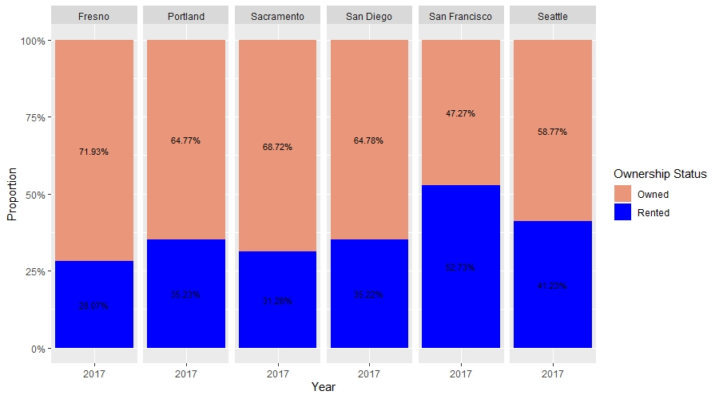
Percent of renters

Slide 20
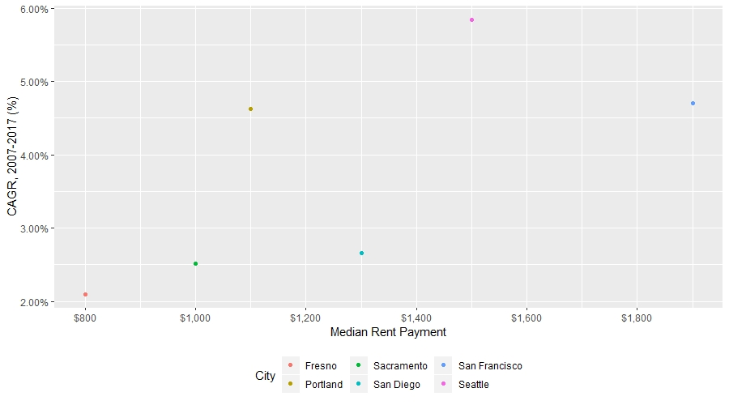
CAGR median rent

Slide 21
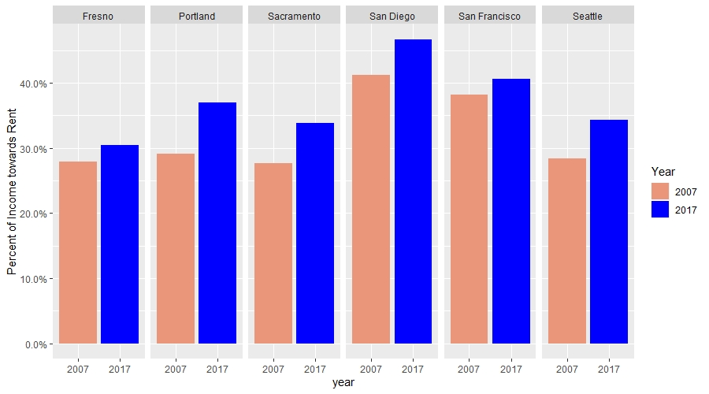
Rent burden

Slide 22
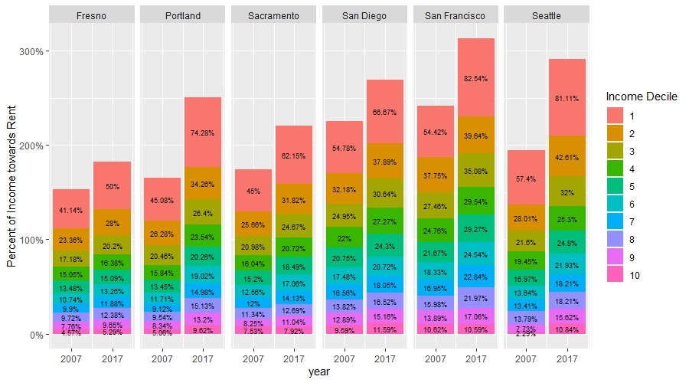
Rent burden by income decile
Percent | Income
0% | 0
10% | 16500
20% | 28100
30% | 40000
40% | 52000
50% | 65200
60% | 80790
70% | 100000
80% | 126400
90% | 175900
100% | 1971000
Notes:
Note: Income table is temporary.

Slide 23
Seattle’s Education

Slide 24
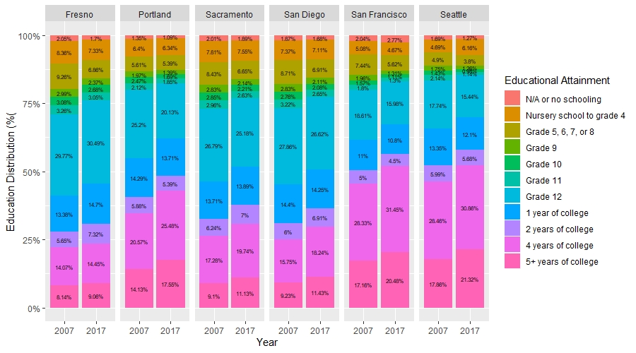
Educational Attainment

Slide 25
Transit: How does Seattle Get to Work?

Slide 26
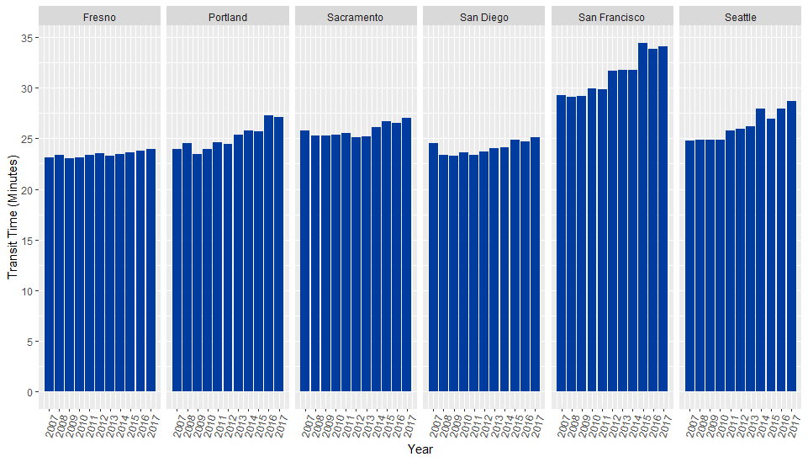
Average Commute Time

Slide 27
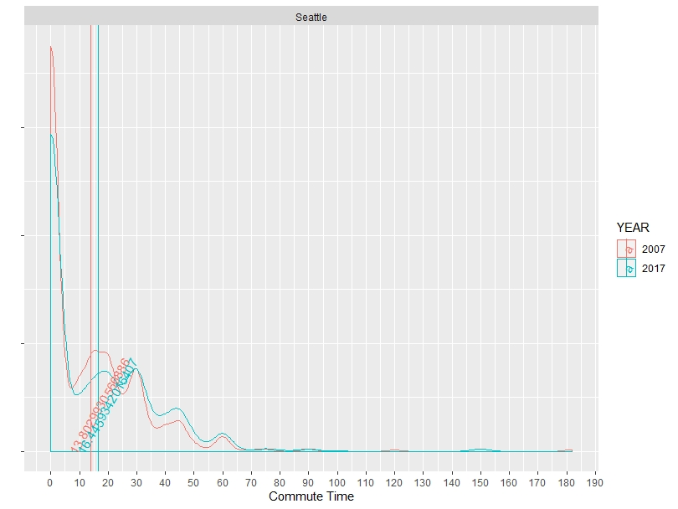
Distribution of commute time
Notes:
Preliminary PLOT! Still working on making it pretty.
Veritcal lines are the mean.

Slide 28
Appendix

Slide 29
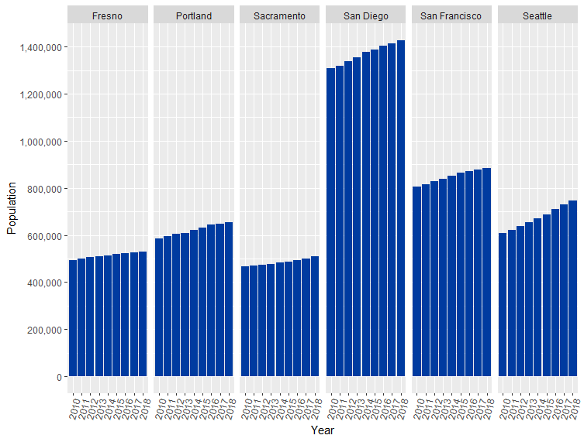
Total population
Sources: US ACS Yearly Estimates,

Slide 30
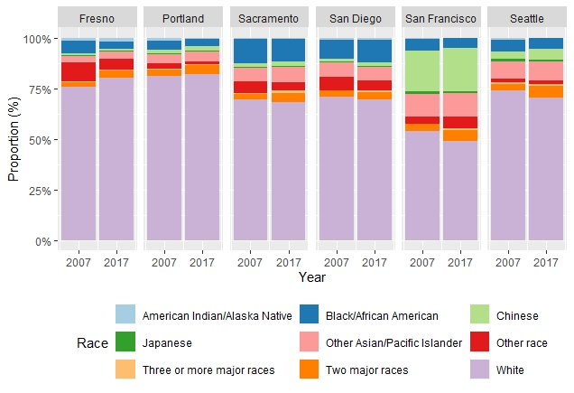
Breakdown of city residents by race

Slide 31
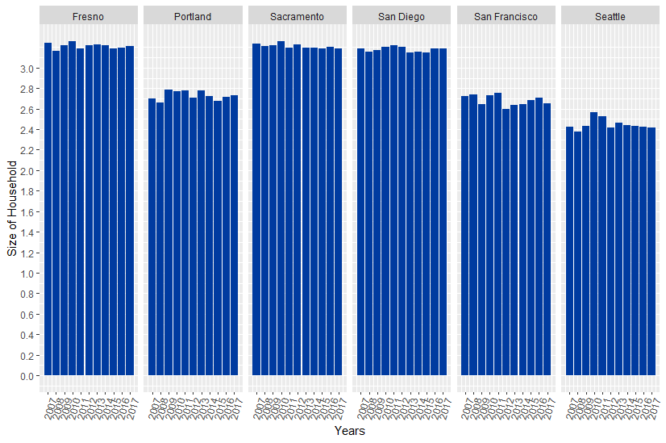
Household Size

Slide 33
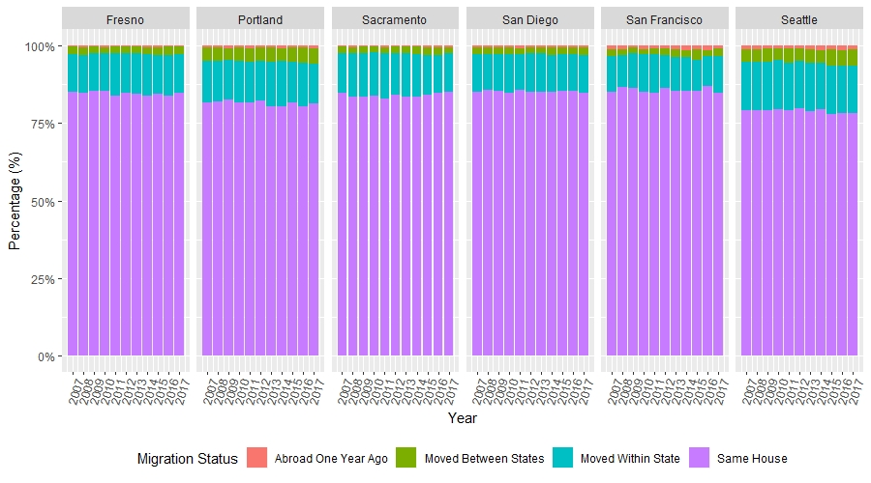
Migrants

Slide 34
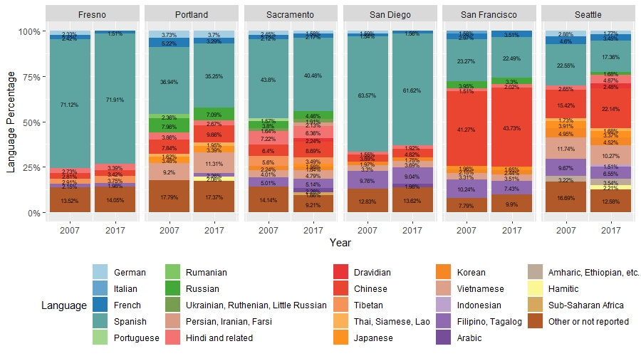
Languages spoken (excluding English)
Notes:
Languages spoken in seattle (excluding English) have remained quite diverse. There has been a large increase in Hindi and Chinese spoken languages
Languages under 3% were excluded.

Slide 35
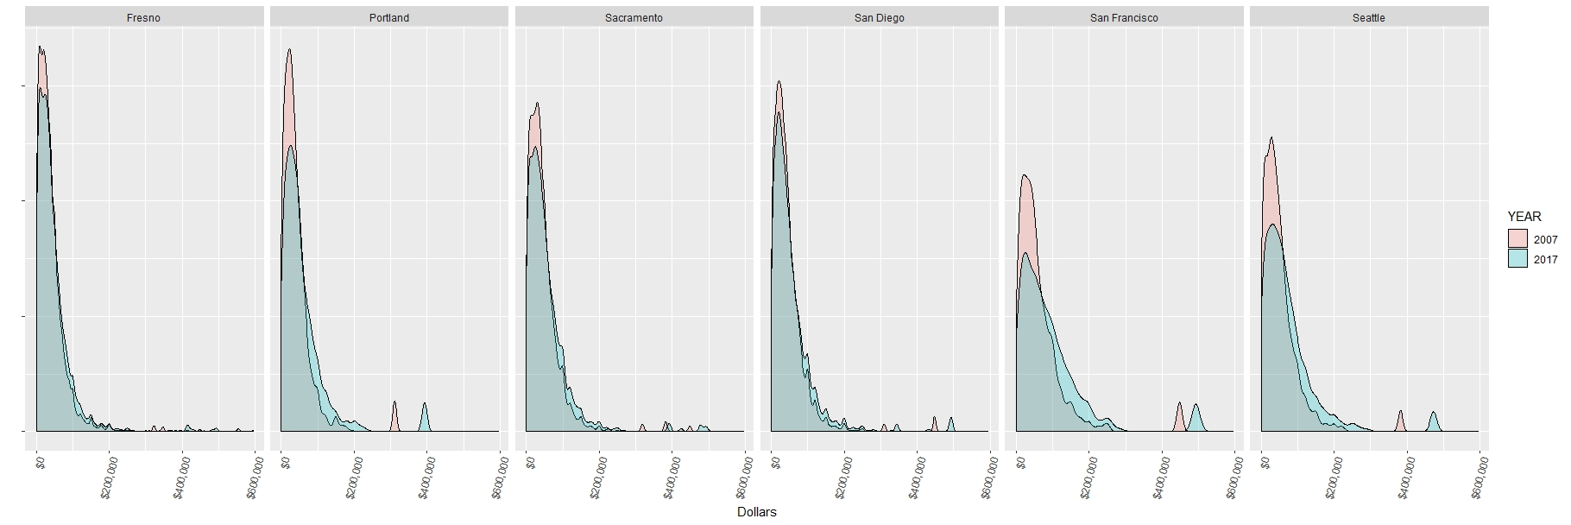
Distribution: individual salary

Slide 36
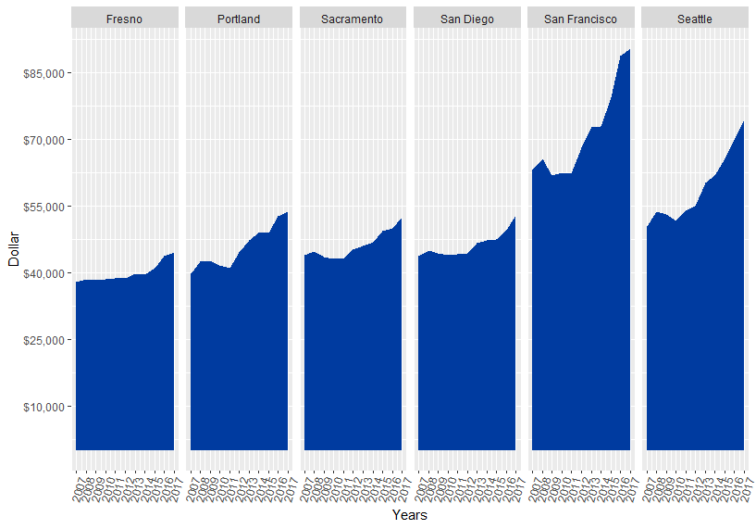
Median individual salary

Slide 37
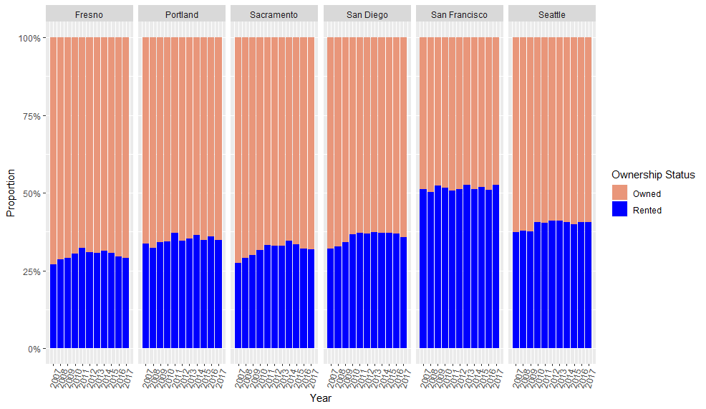
Rented vs. owned

Slide 38
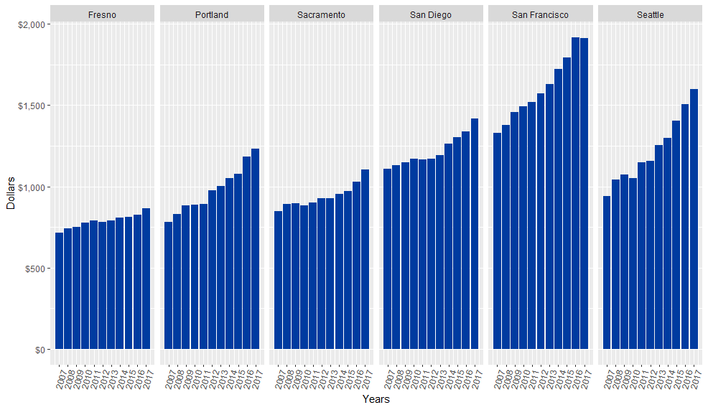
Median rent

