Slide 1
Video System
呂依凡
Github:

Slide 2
System Introduction
host
Main.cpp
kernel
pixel_in 20* 20
PixelIni
Video_2dfilter
3*3 window
filter
video_filter_rescale
1*1 pixel
pixel_out 20* 20
PrintPixel

Slide 3
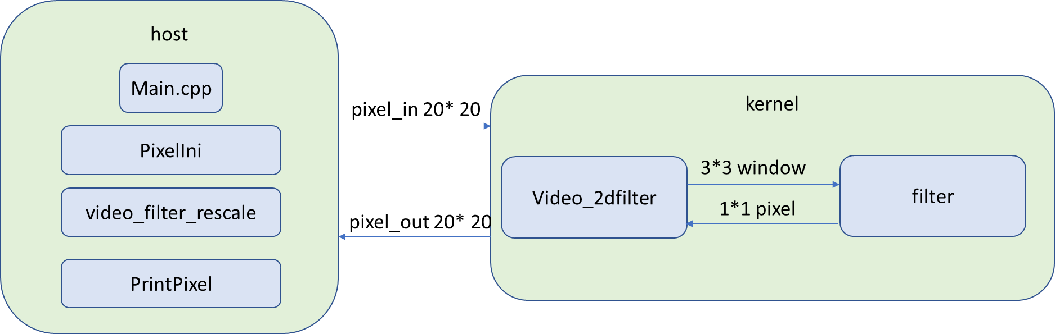
System Introduction
Host
Kernel
Generate pixel_in
Print the pixel_in
Rescale pixel_in
Print the rescaled pixel_in
Pass the pixel_in to kernel
Print the kernel results, pixel_out
Video_2dfilter: prepare 3*3 window for filter
Filter: Do MAC (multiply accumulate)

Slide 4
Introduction to Algorithm filter
window
h
*
=

Slide 5
Introduction to Algorithm video_2dfilter
(0, 0) | (0, 1) | (0, 2) | … | … | (0, 19)
(1, 0) | (1, 1) | (1, 2) | … | … | (1, 19)
(2, 0) | (2, 1) | (2, 2) | … | … | (2, 19)
… | … | … | … | … | …
(19, 0) | (19, 1) | (19, 2) | … | … | (19, 19)
Lots of memory access!

Slide 6
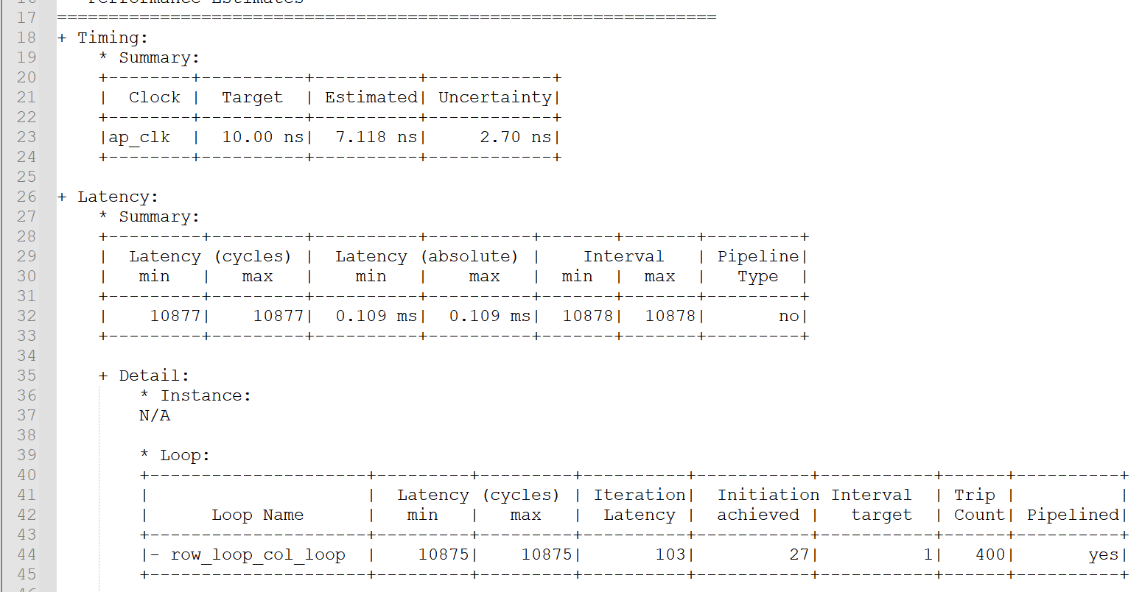
Synthesis Report Timing
The clk frequency 10ns has been met.
Top function spend 10877 cycles to complete write all outputs
Initiation interval is 27 row_loop_col_loop has been pipelined.

Slide 7
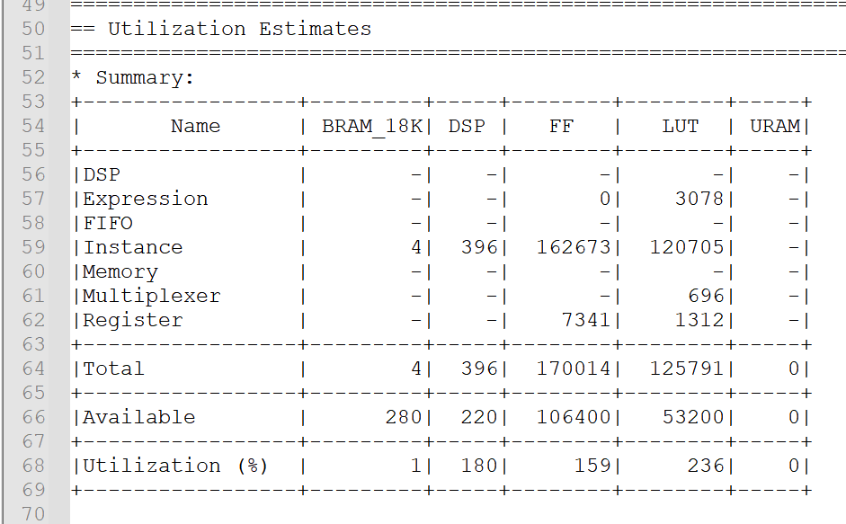
Synthesis Report Utilization

Slide 8
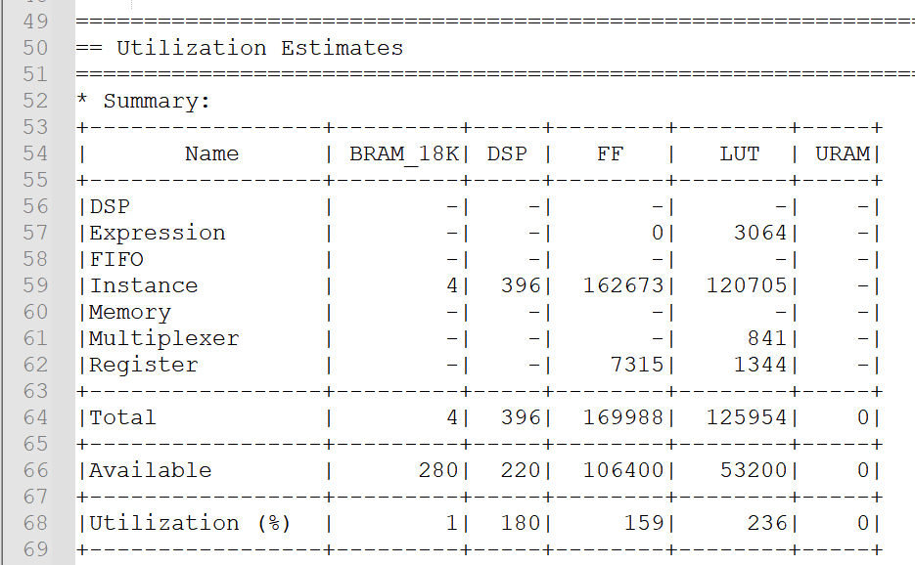
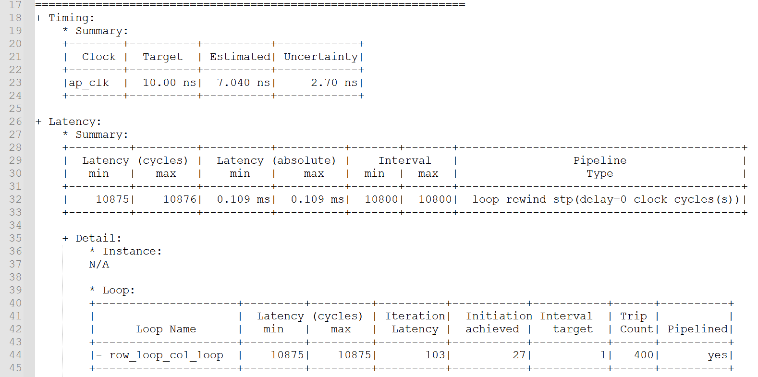
Optimize Design 1 rewind
Top function has prepared for next input after 10800 cycles

Slide 9
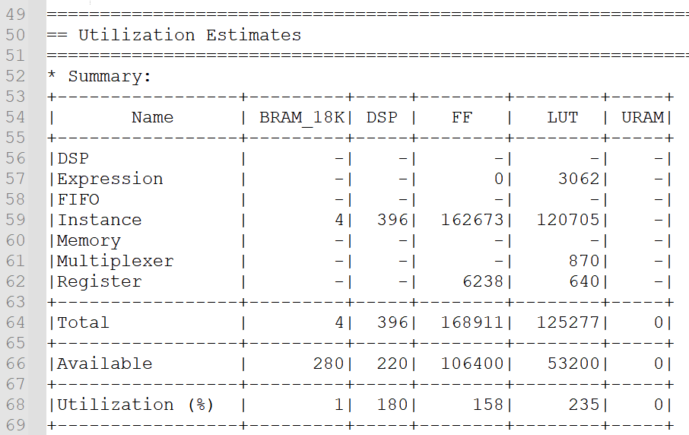
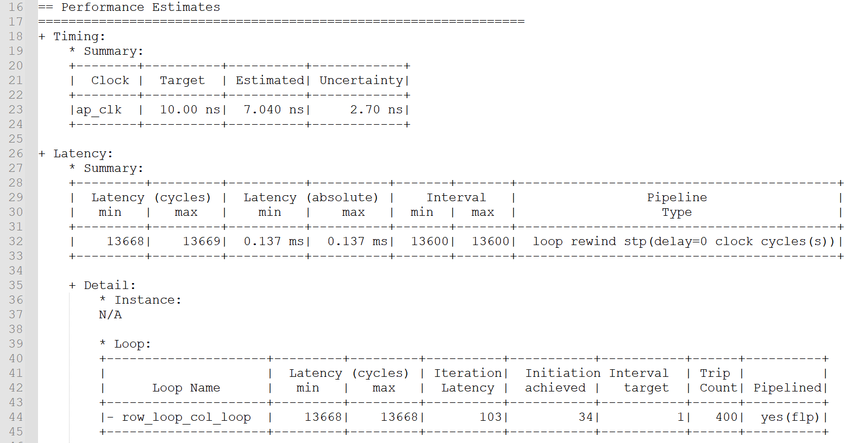
Optimize Design 1 enable_flush
Number of registers decreases about a half for LUT. The pipeline will not stall after adding enable_flush, that is, it do not need to keep the outputs during pipeline stall.

Slide 10
Optimize Design 2 Using Line Buffer
col - 1
col
col + 1
Line buffer
Access only one pixel!
Pixel_in[row][col]

Slide 11
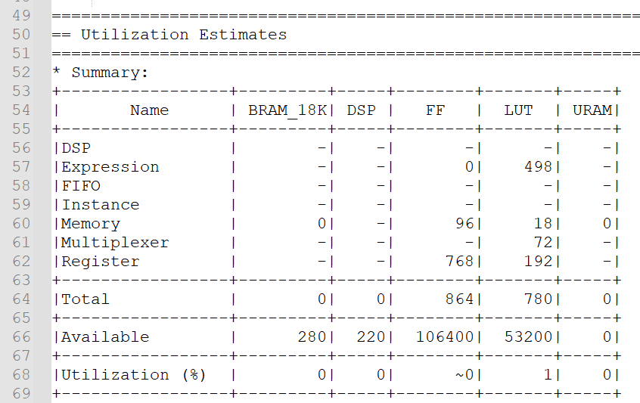
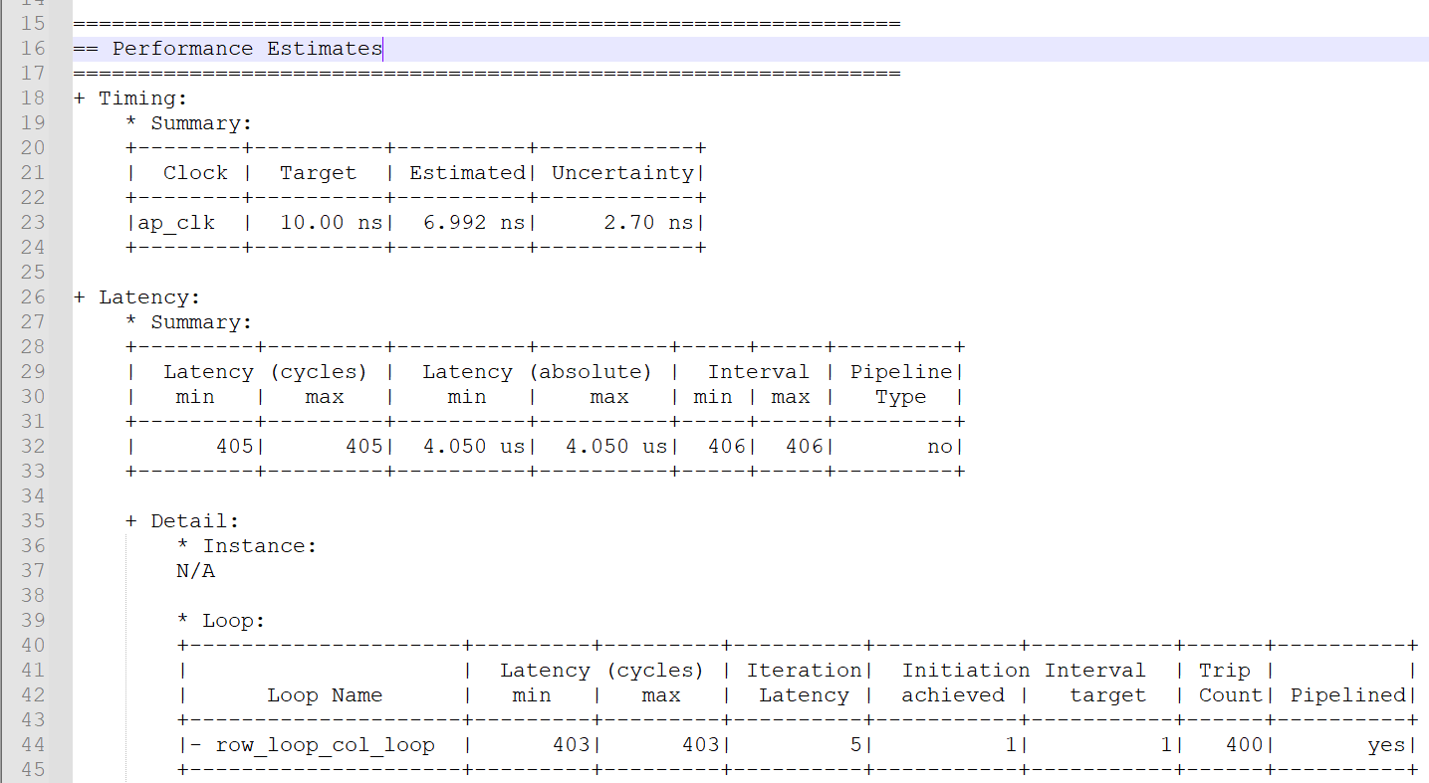
Optimize Design 2 Timing/ Utilization

Slide 12
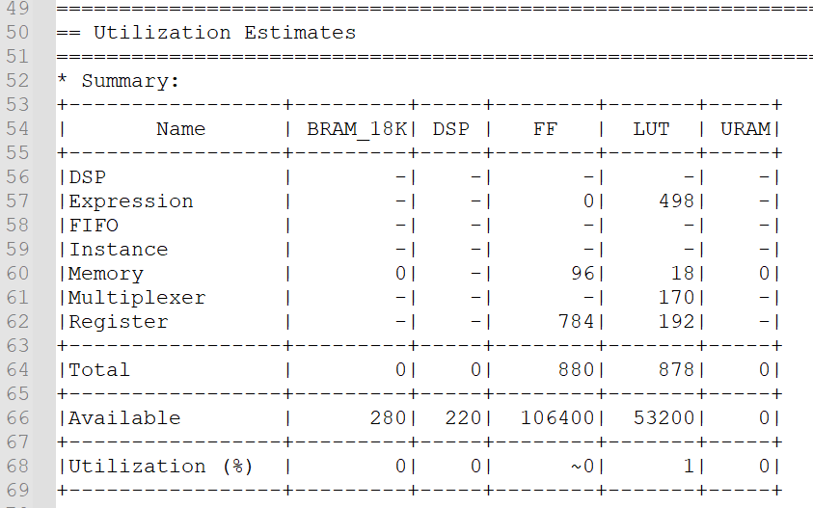
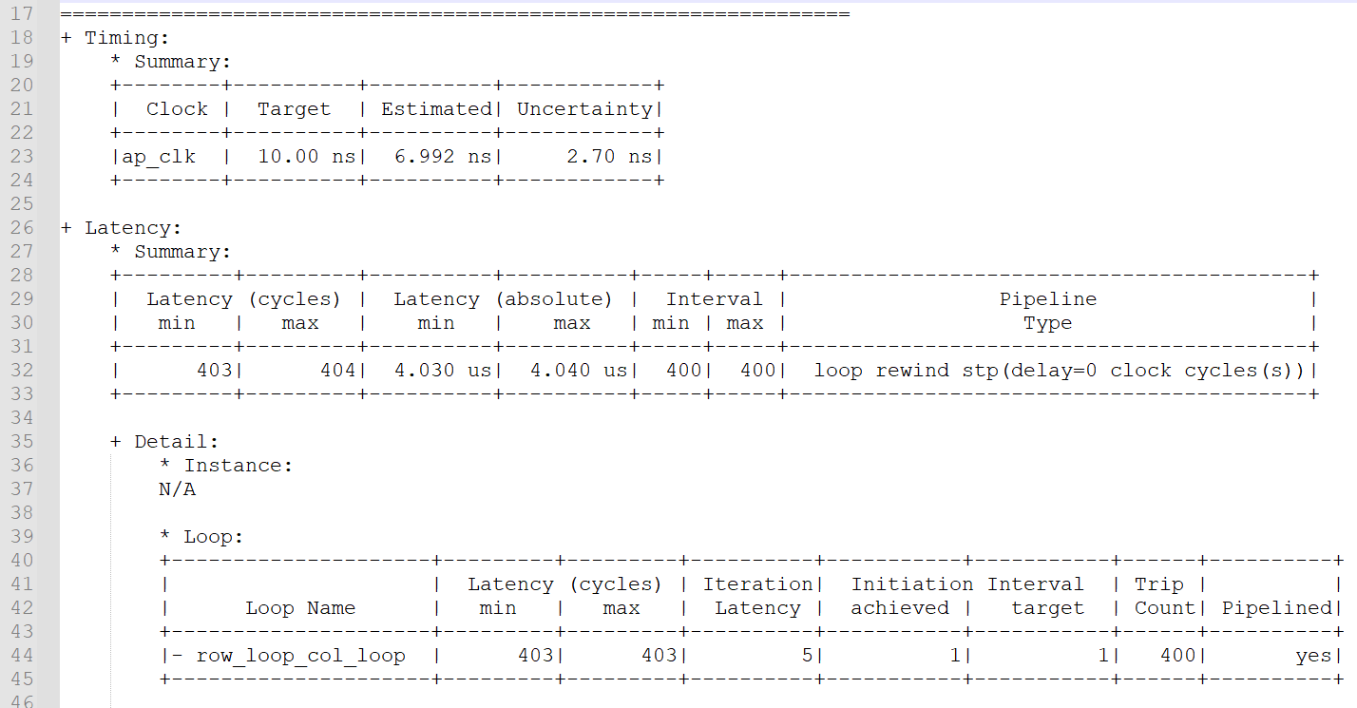
Optimize Design 2 rewind
Top function has prepared for next input after 400 cycles

Slide 13
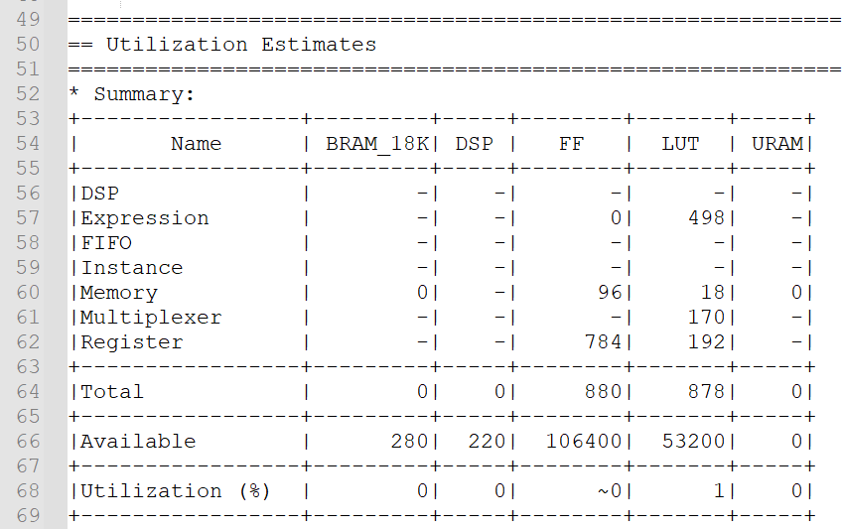
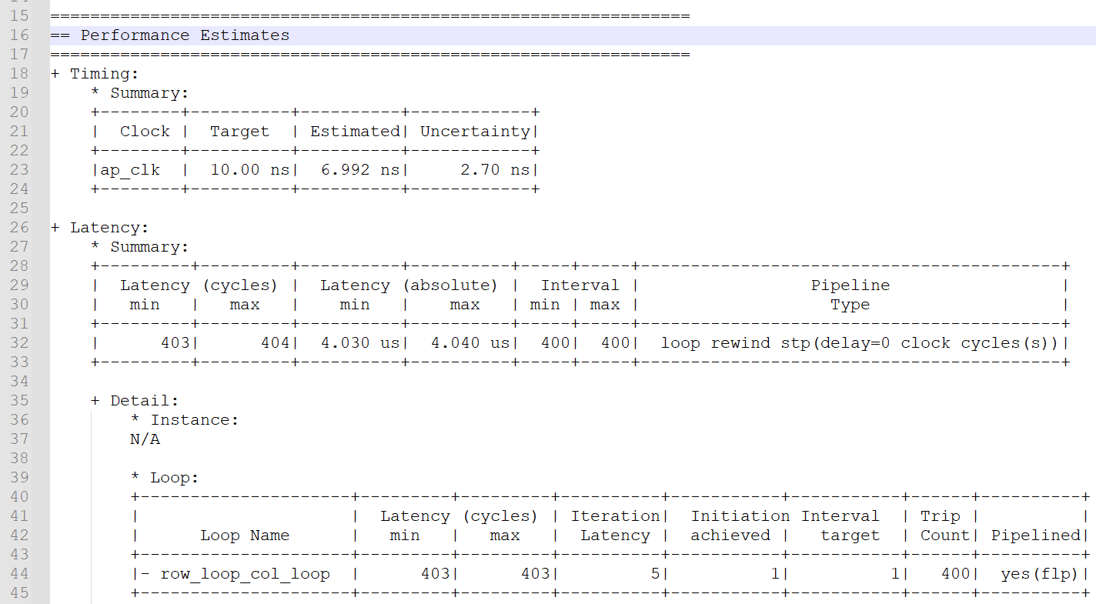
Optimize Design 2 enable_flush
The report remains the same.

Slide 14
Optimize Design 3 Extending the iteration domain
Loop bound is increased by 1 in this case
Read the first pixel in the first iteration, but write the first output in the next iteration.
→ Allow the filter to be implemented without spatial shift.
Prepare window in the previous iteration

Slide 15
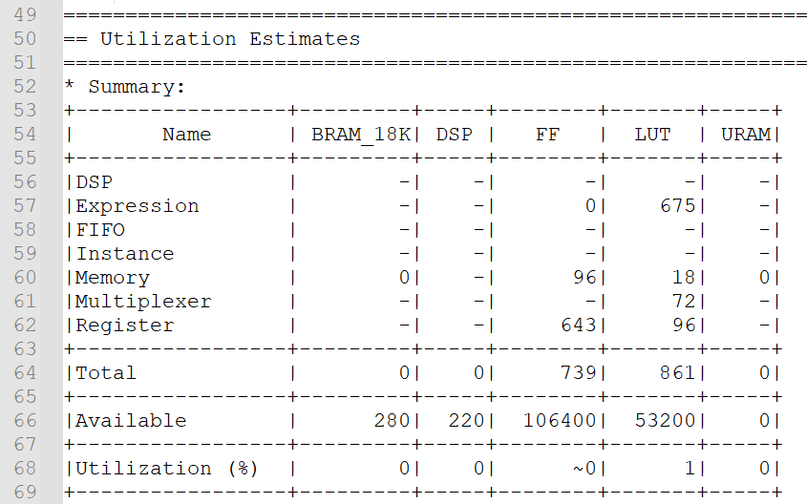
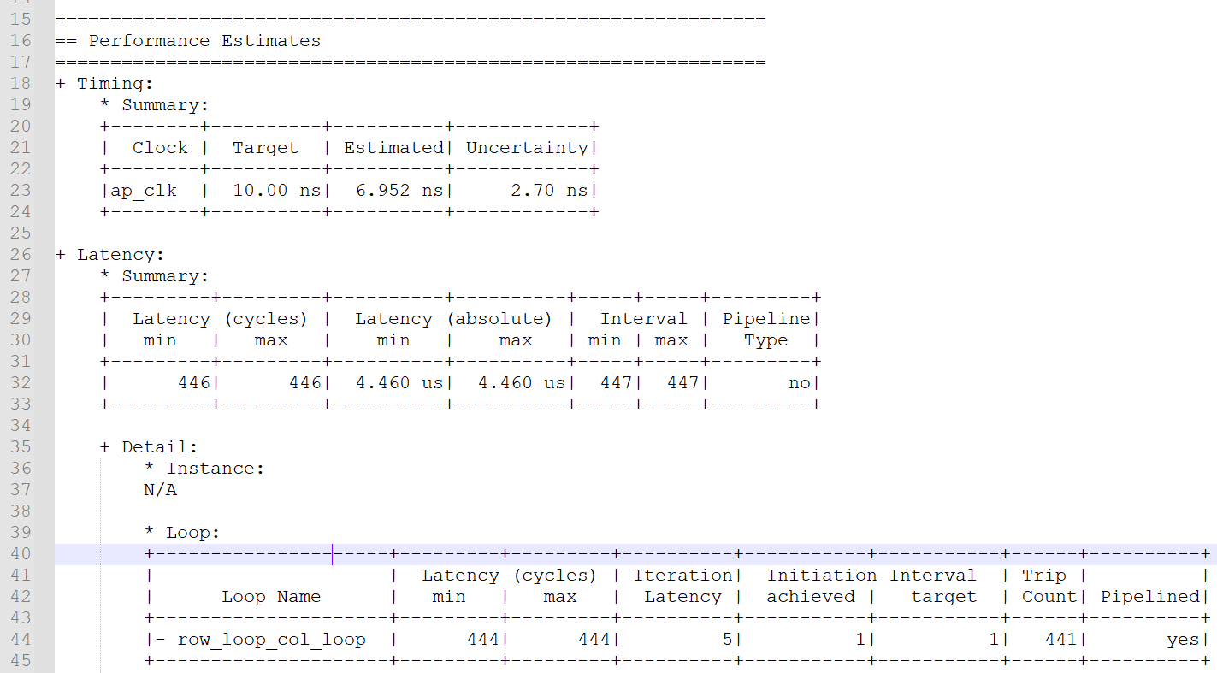
Optimize Design 3 Timing/ Utilization

Slide 16

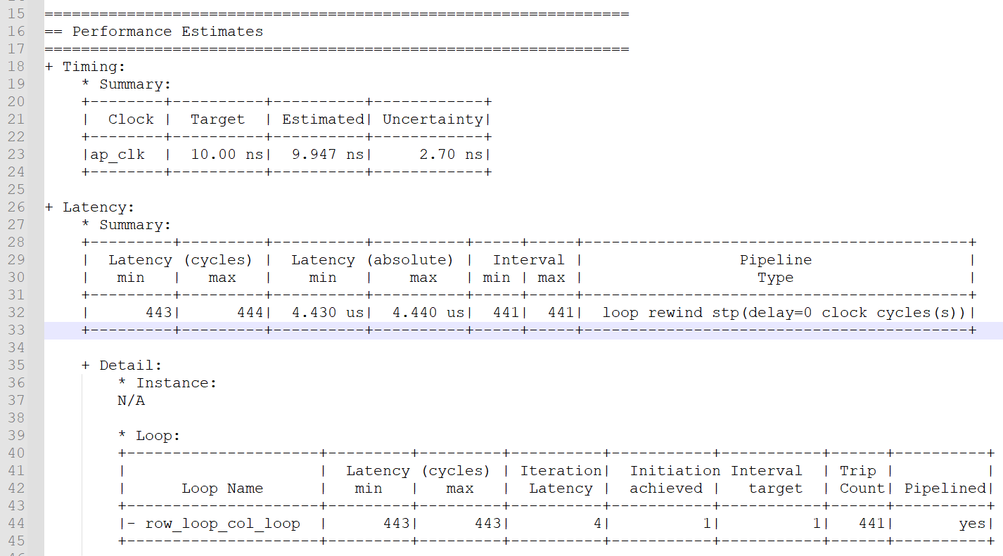
Optimize Design 3 rewind
Timing violation occurs! 9.947 + 2.70 = 12.647 > 10ns

Slide 17
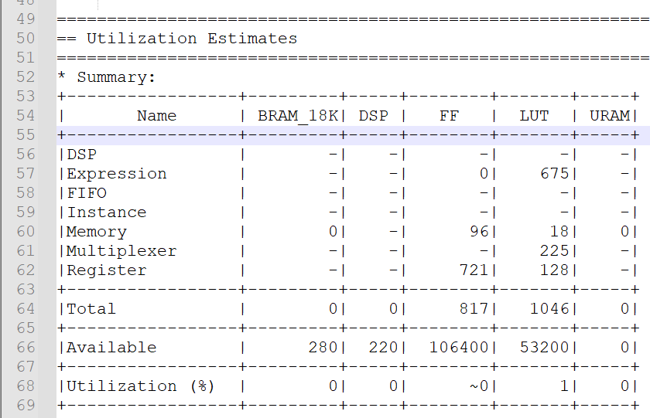
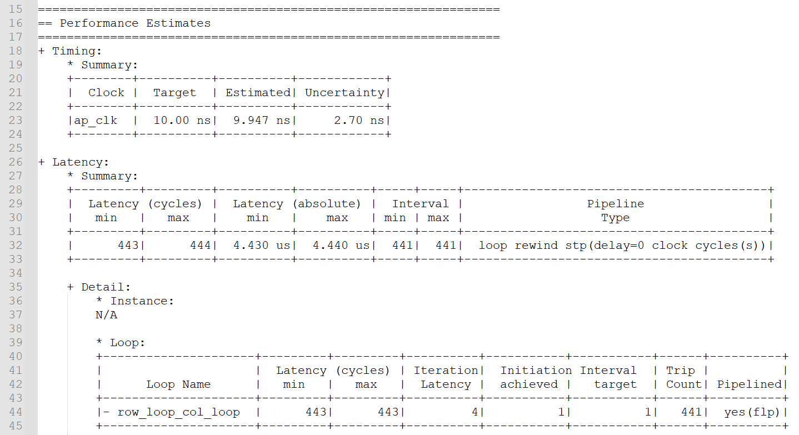
Optimize Design 3 enable_flush
Timing violation remains!
The report remains the same.

Slide 18
Optimize Design 3_2 Adjust the Operation Order
Move the function call of filter() to the beginning of the pipeline body
→ Truly realize avoiding spatial shift

Slide 19
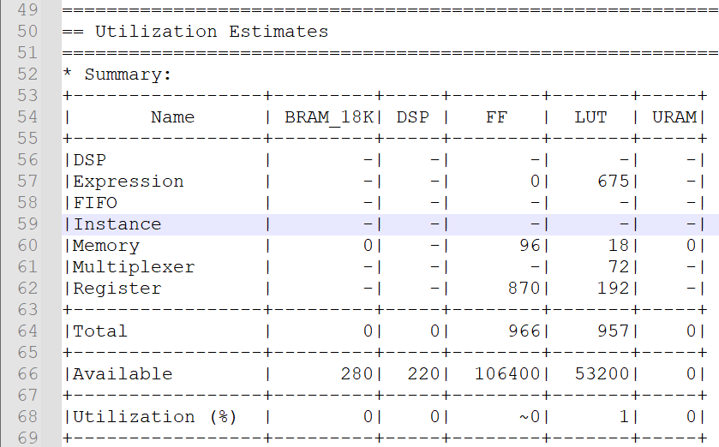
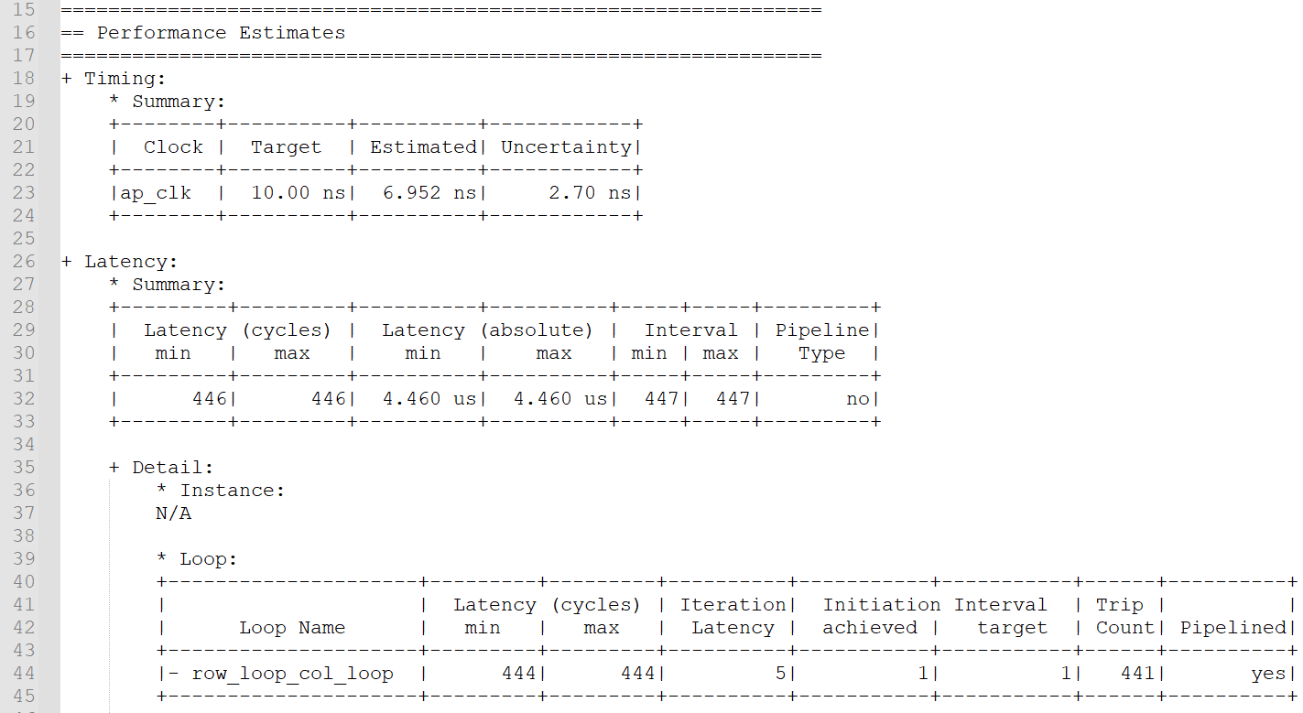
Optimize Design 3_2 Timing/ Utilization

Slide 20
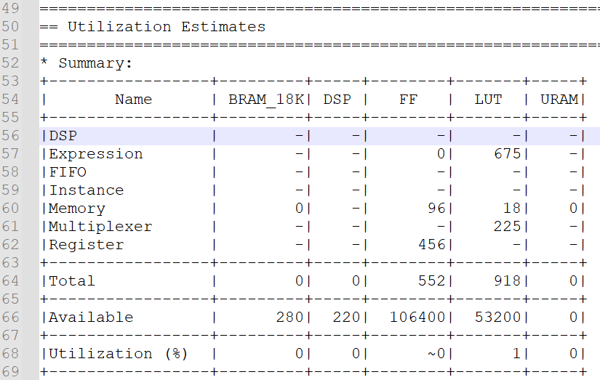
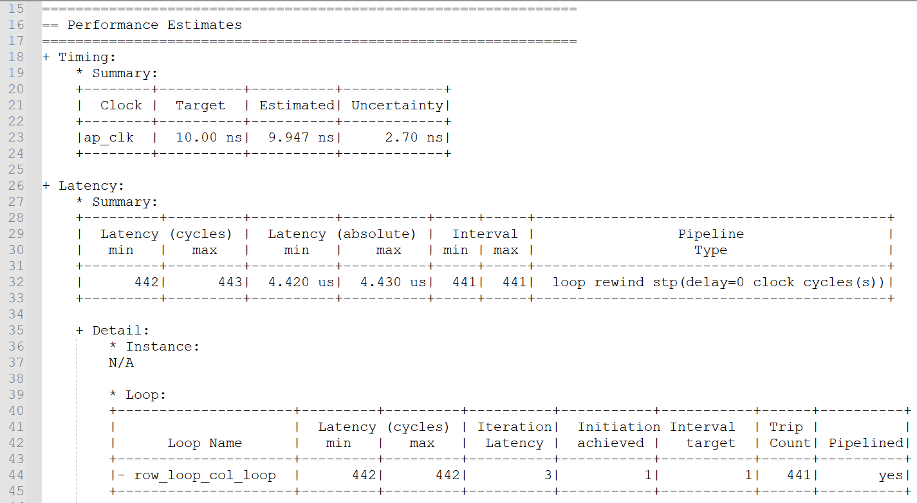
Optimize Design 3_2 rewind

Slide 21
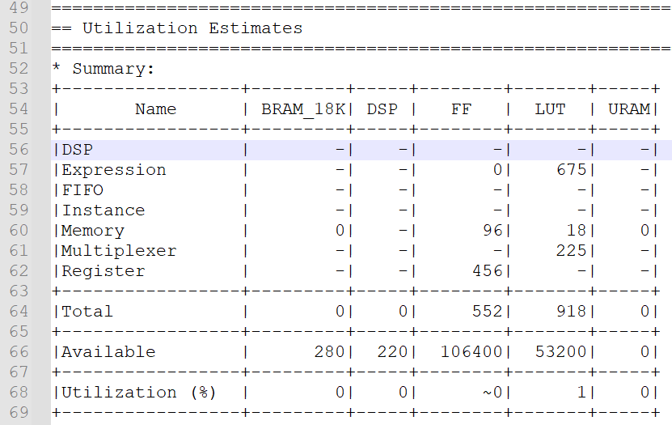
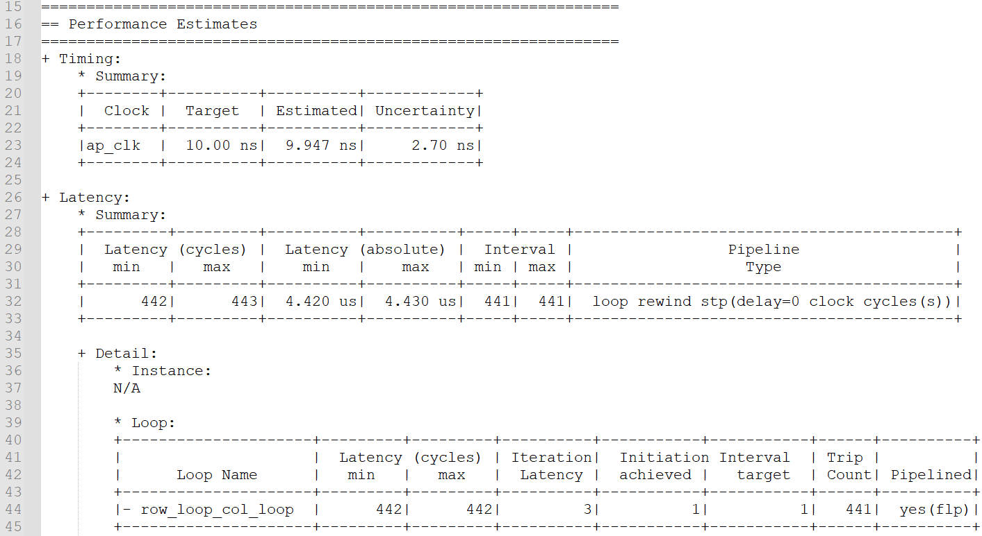
Optimize Design 3_2 enable_flush

Slide 22
Optimize Design 4 Handle Boundary Condition
Avoid the window access beyond boundary

Slide 23
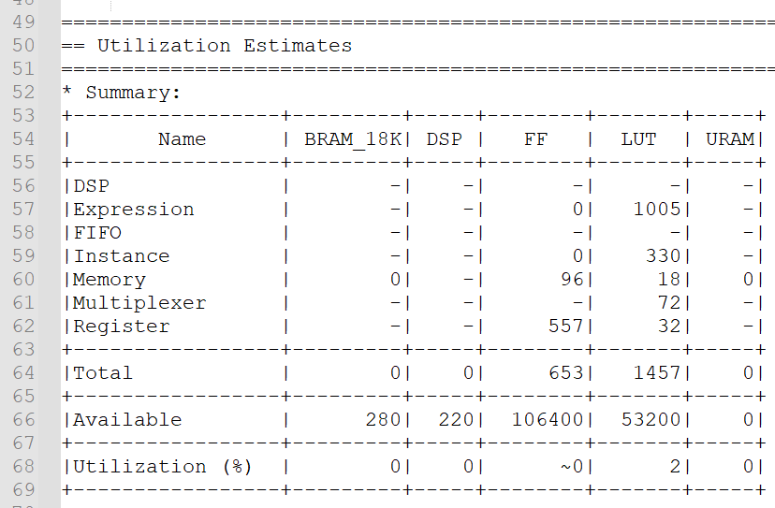

Optimize Design 4 Timing/ Utilization

Slide 24
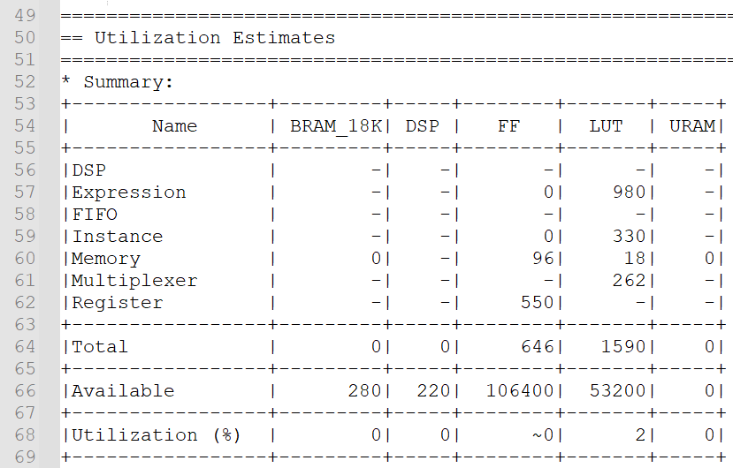
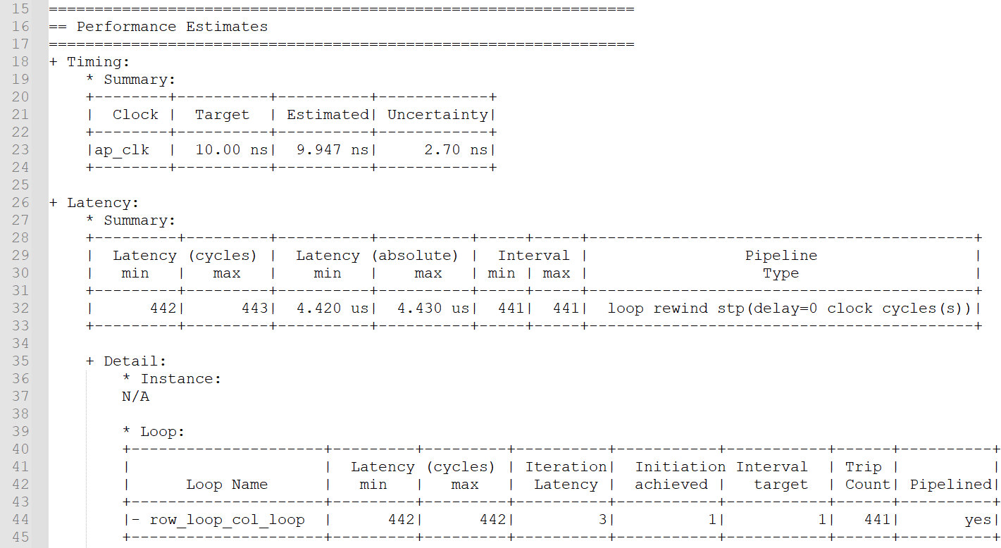
Optimize Design 4 rewind

Slide 25
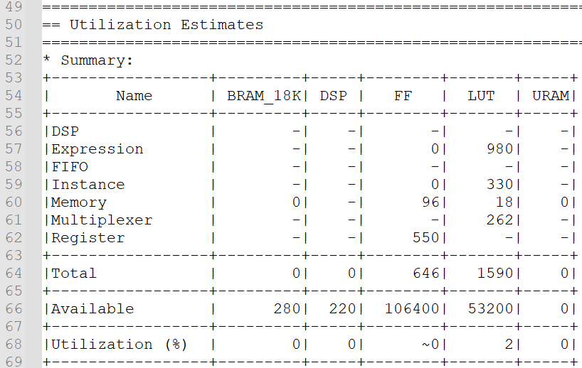
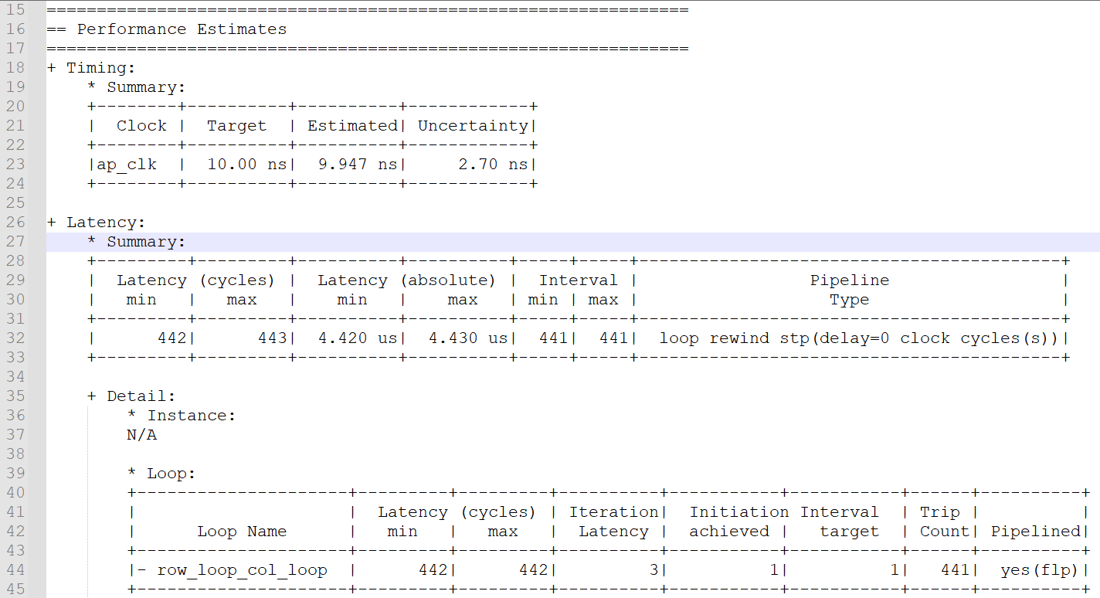
Optimize Design 4 enable_flush

Slide 26
Observation and Learning
Sth about flush and rewind
Spatial shift

Slide 27
Problem

