Slide 1
Linguistic Bias in Crowdsourced Articles and the Aspect of Time
Vangelis Mathioudis - University of Nicosia - COMP-592DL

Slide 2
Objective
To compare if the biographies about females contain more subjective words than biographies about males in Wikipedia

Slide 3
What is linguistic bias?
Beukeboom’s definition [1]
A systematic asymmetry in the way that one uses language, as a function of the social group of the person(s) is being described.
What kinds of linguistic bias exist?
Linguistic Expectancy Bias
Linguistic Intergroup Bias
Both are built on the Linguistic Category Model
[1] C. Beukeboom, Mechanisms of linguistic bias: How words reflect and maintain stereotypic expectancies., 01 2014, pp. 313–330.

Slide 4
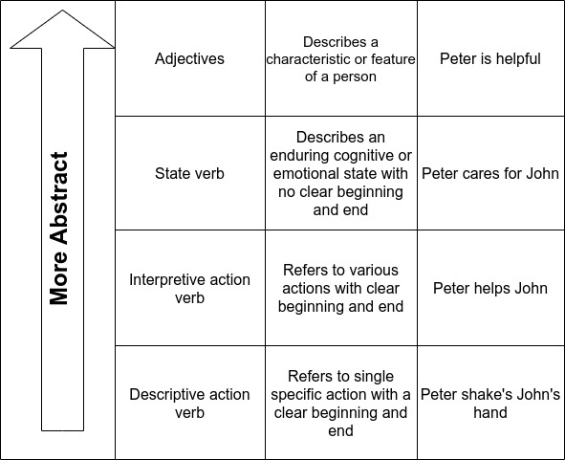
Linguistic Category Model
The four level of abstraction for Linguistic Category Model based on Semin [1]
[1] Gün R. Semin. The Linguistic Category Model. SAGE Publications Ltd, 309–326. https://doi.org/10.4135/9781446249215.n16

Slide 5
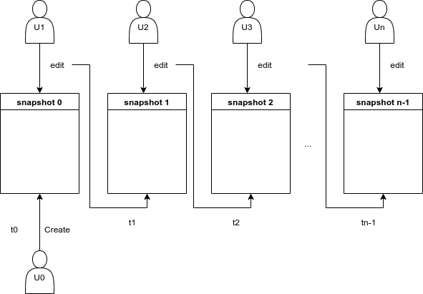
Revisions in Wikipedia

Slide 6
Building our dataset (1)
Steps:
Build our dataset in the form of a python dictionary
We download the history of revisions of biographies of 7 European politicians using the MediaWiki API and the library MWParserFromHell
We keep track of the Revision Id, Users Id, Timestamp, Content and Tags
Drop any entry that doesn’t have content
Plug the dataset in Didaxto¹ to create two domain specific dictionaries (sets) with positive and negative words
1 https://deixto.com/didaxto/

Slide 7
Building our dataset (2)
This is the structure of the dataset:
{
"name": {"revid": {"userid": userid,
"timestamp": timestamp,
"content": biography's snapshot,
"tags": tags that are associated with this revid},
"revid2":{...}, . . . },
"name2": {"revid": {...}, "revid2": {...}, . . .}
}

Slide 8
Building our dataset (3)
Steps:
Build our Pandas dataframes by:
Extracting the number of verbs, adverbs, adjectives, positive, negative words and total words
Extracting ratios for positive, negative words and adjectives
Measuring the Mean Abstract Level
Resample the dataset to daily and weekly periods

Slide 9
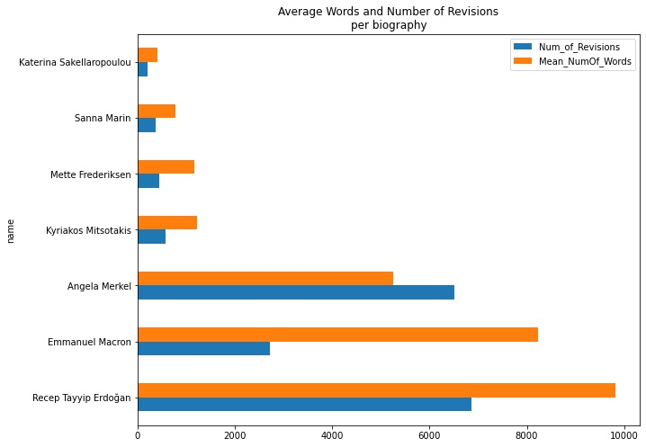
Exploratory Data Analysis (1)

Slide 10
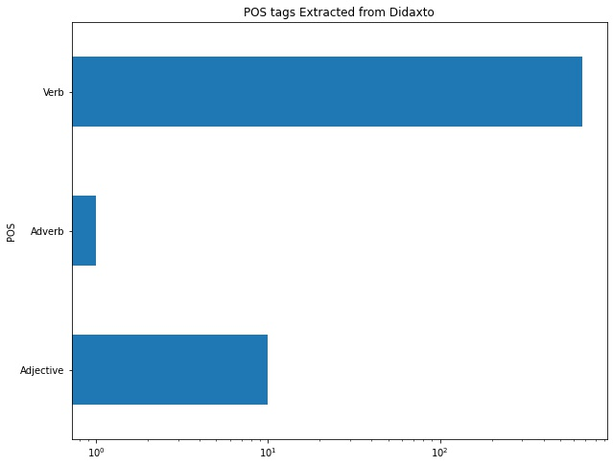
Exploratory Data Analysis (2)

Slide 11
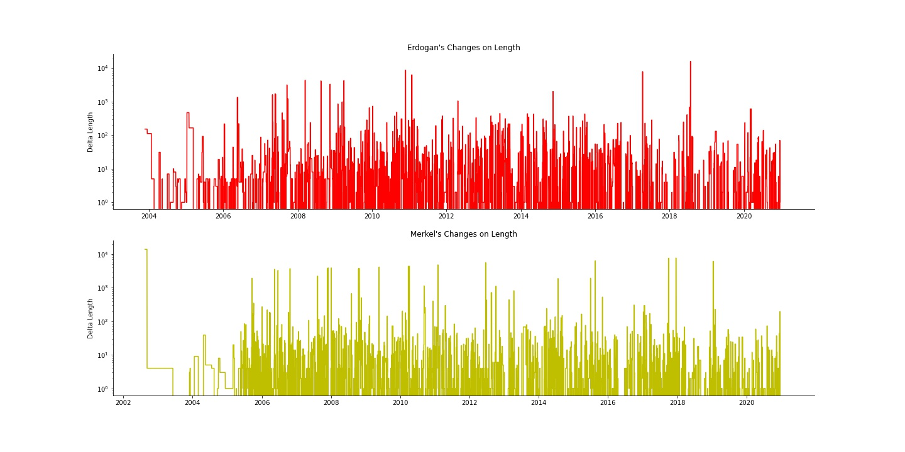
Exploratory Data Analysis (3)

Slide 12
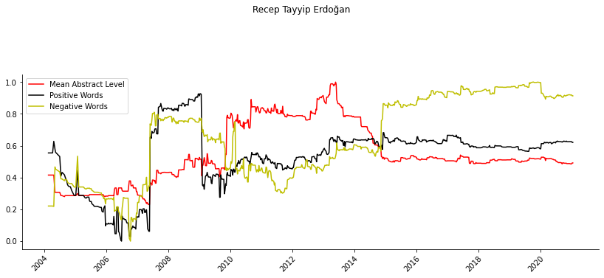
Weekly Changes of MAL, Positive and Negative Ratios
Turkey's Erdogan: Successful leader or 'dictator'? - CNN
Erdogan visited Baghdad
At this period Erdogan meet with the Israeli president on Davos
Elections of 2007

Slide 13
Hypothesis
Null Hypothesis H₀: The average of female MAL score is equal to average of male MAL
Alternative Hypothesis H₁: The average of female MAL score is higher than the average of male MAL
Results:
Confidence level: 95%
T-statistic = 4.06077
p-value = 2*10⁻⁵
We conclude that the average Mean Abstract Level for females is different to the average Mean Abstract Level for males.

Slide 14
Future work
Build a model to categorize verbs as “State”, “Interpretive” and “Descriptive Action Verbs” and use these to calculate MAL scores,
Work with more biographies about people in diverse domains and across the world,
Extend to historical events

