Slide 1
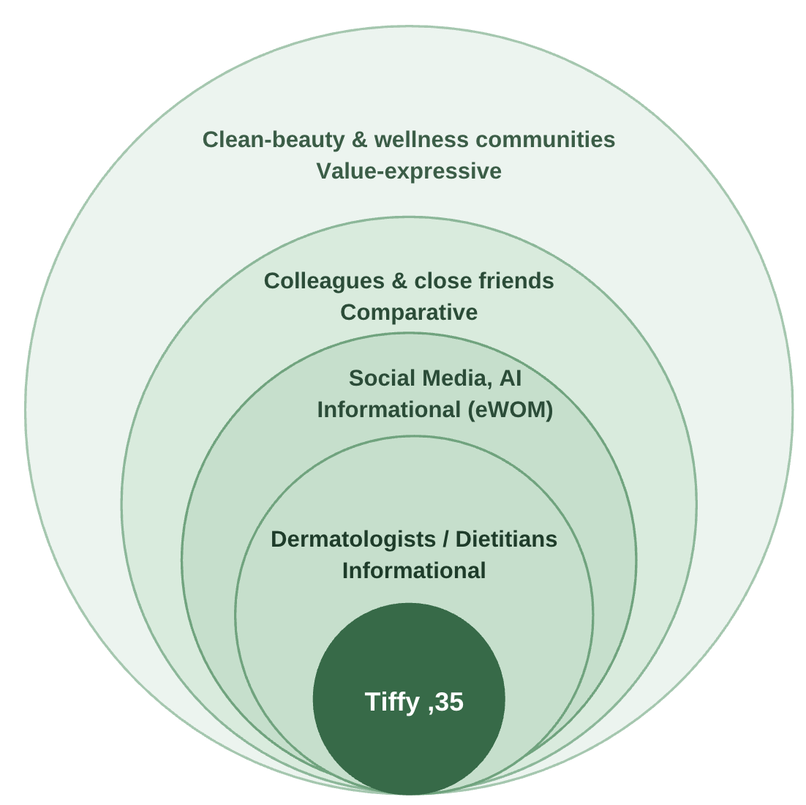
External Influences on Tiffy
Tiffy Han, 35 · Korean-Australian project manager, Melbourne · buys her own supplements
1
Social
Experts, social media/AI, friends and wellness communities shape what she believes.
→ Pair dermatologist proof with real creator results
2
Cultural
Wants glowing, even skin (Korean ideal) but also safe, clean, ethical products.
→ Say "radiance", not "whitening"; show B Corp
3
Family & Class
Decides alone; busy upper-middle-class professional wants affordable luxury.
→ Masstige price, convenient format
Source: developed by authors, adapted from Park & Lessig (1977)
Notes:
[~1 minute, ~150 words]
Tiffy Han is our persona: a 35-year-old Korean-Australian project manager in Melbourne who buys her own beauty supplements.
First, social influence. Using Park and Lessig's reference group theory, dermatologists and dietitians give her trusted information. Social media, influencers and even AI are where she searches first. Friends and colleagues give her a point of comparison, and wellness communities reflect her values.
Second, culture. Tiffy wants bright, even-toned skin, a Korean beauty ideal. But she also cares about safety and ethics. As a migrant she blends both cultures. So Swisse should promise "radiance", not "whitening", and highlight its B Corp status.
Third, family and social class. She decides by herself, and as a busy upper-middle-class professional she wants affordable luxury that is convenient.
So for Swisse: combine expert proof with real creator results, at a masstige price. This fits the "Proven" and "Aspirational" pillars of H&H's PPAE model.

