Slide 1
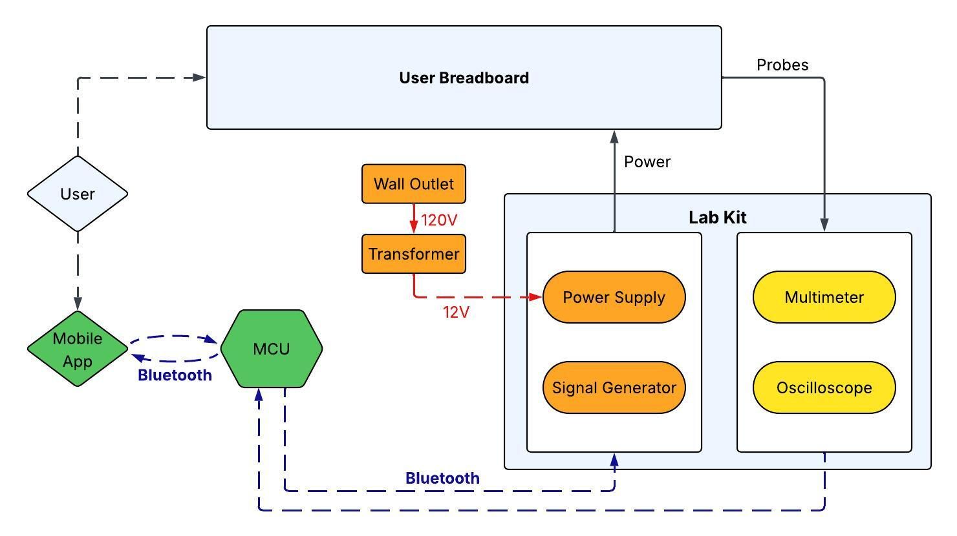
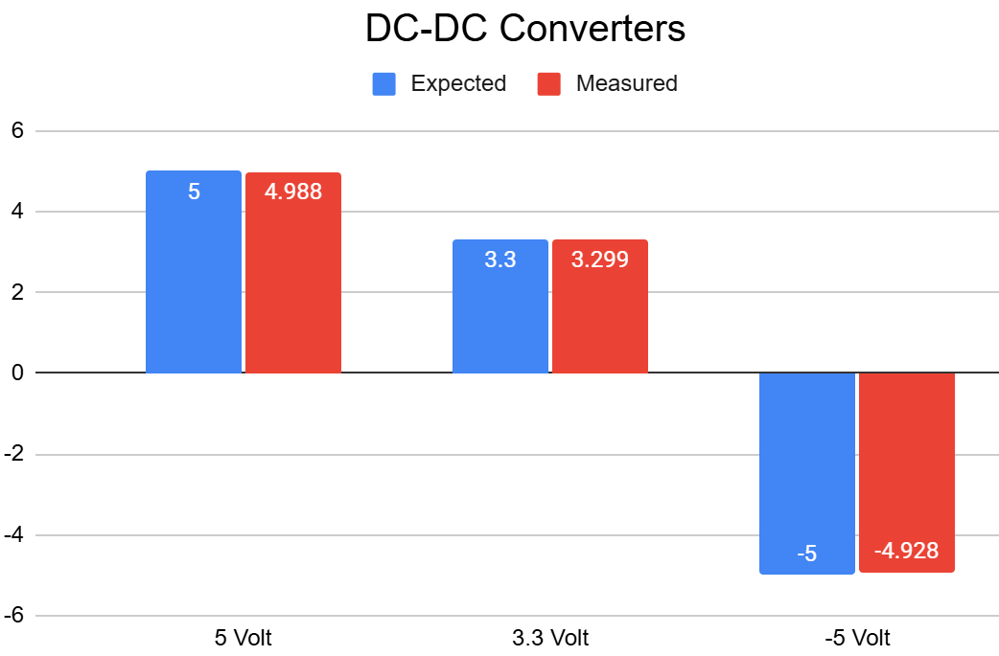
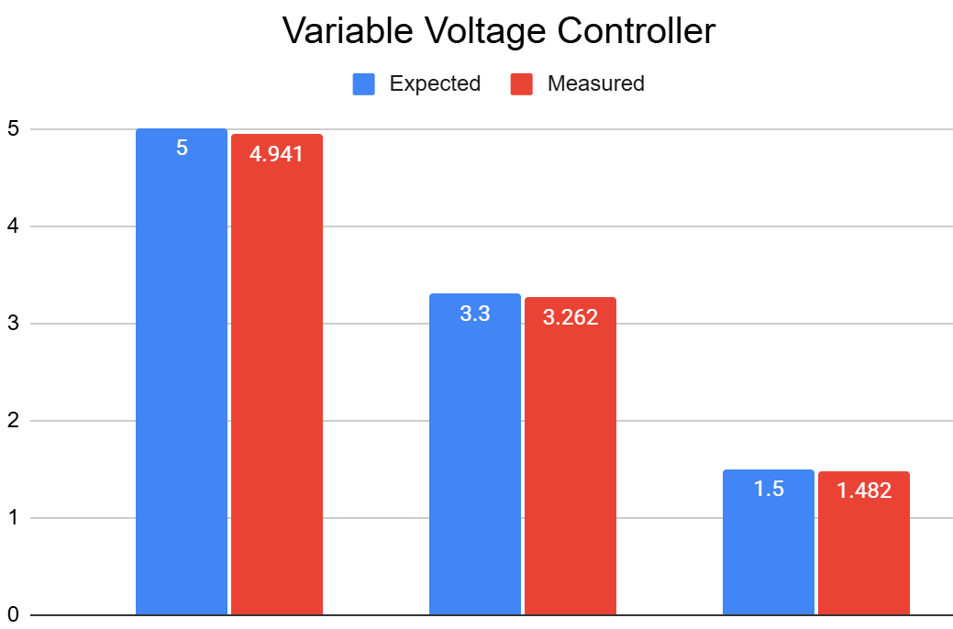
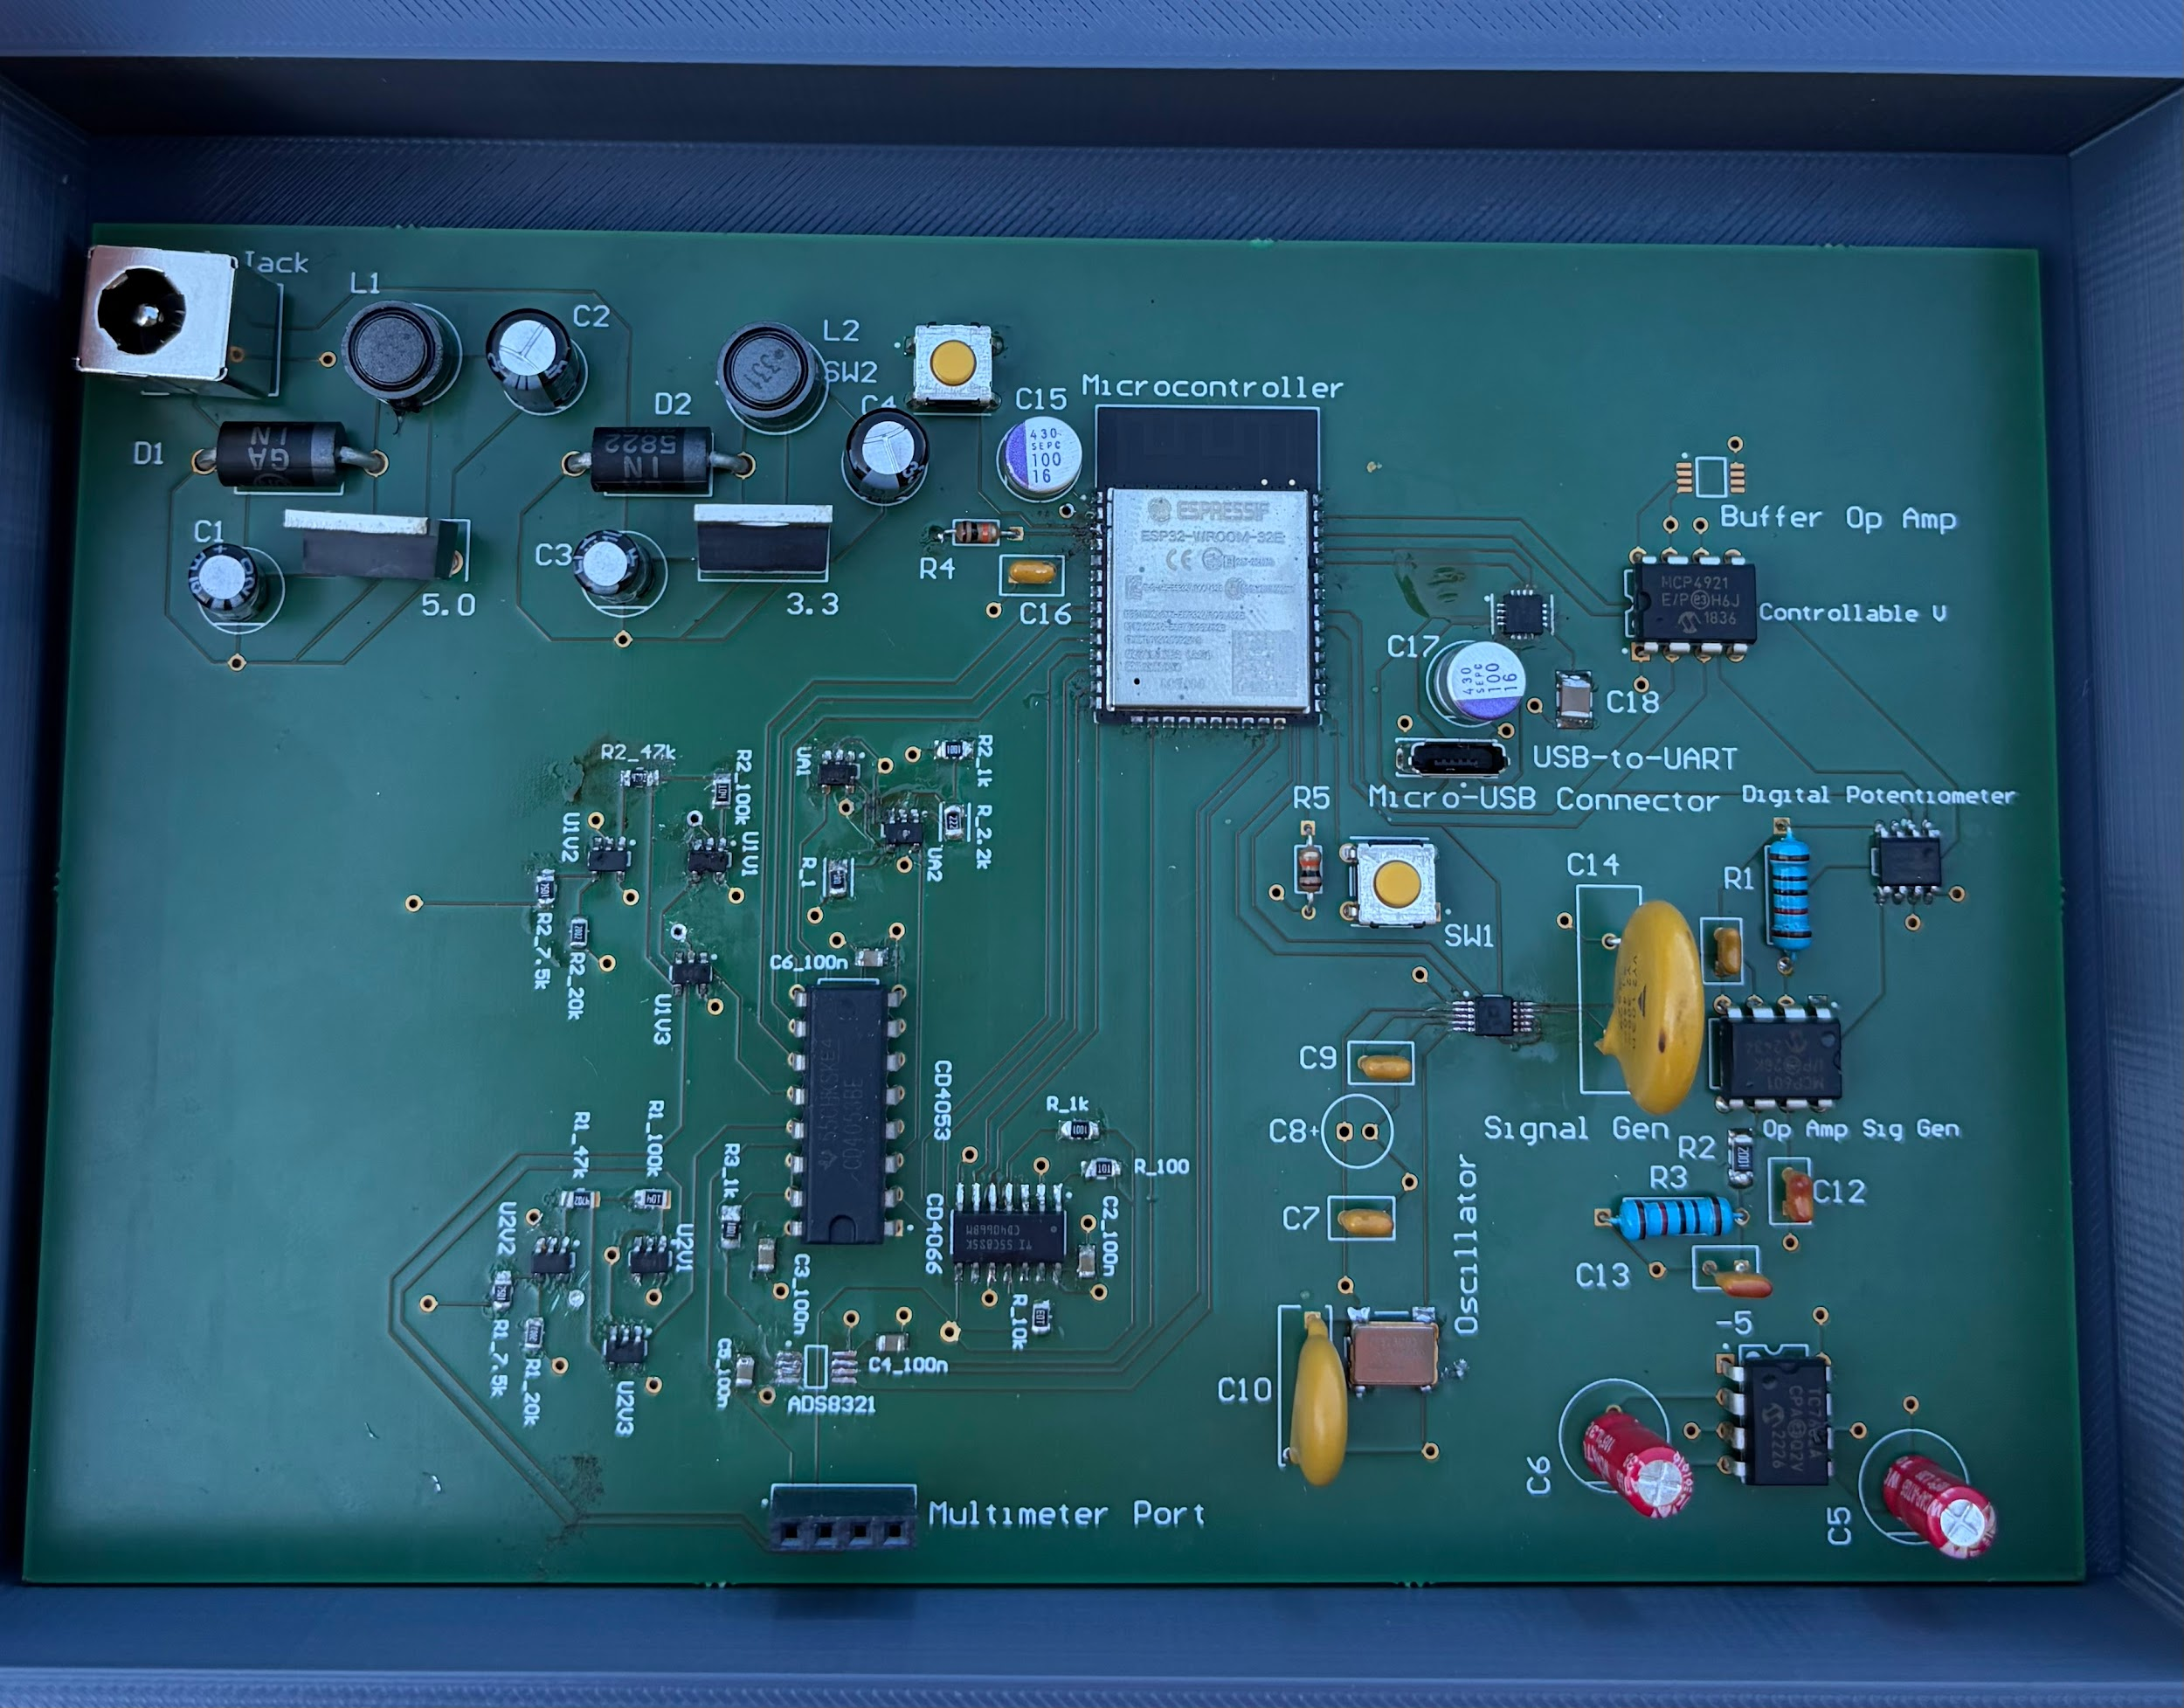
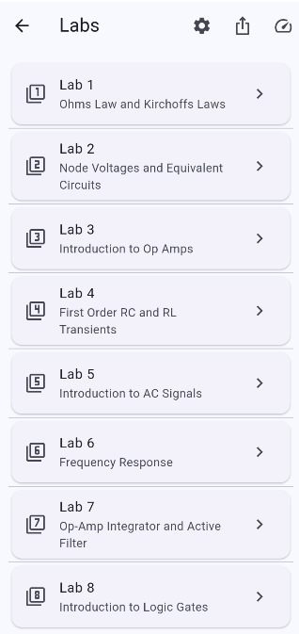
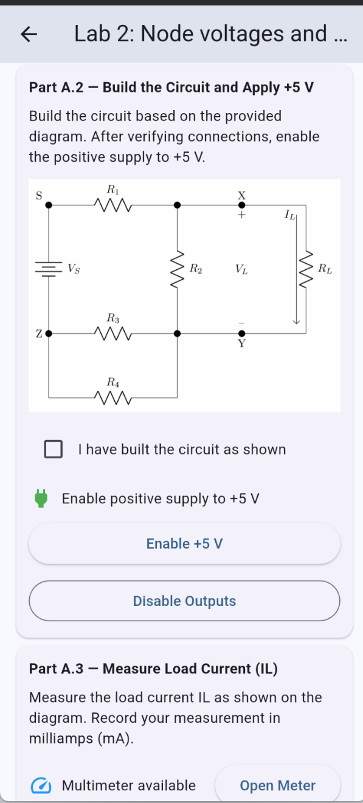
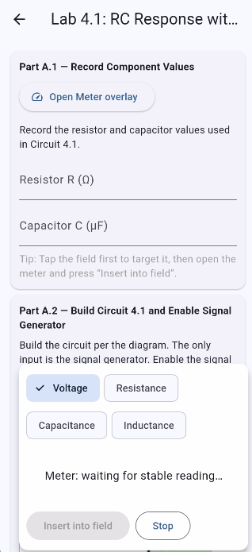
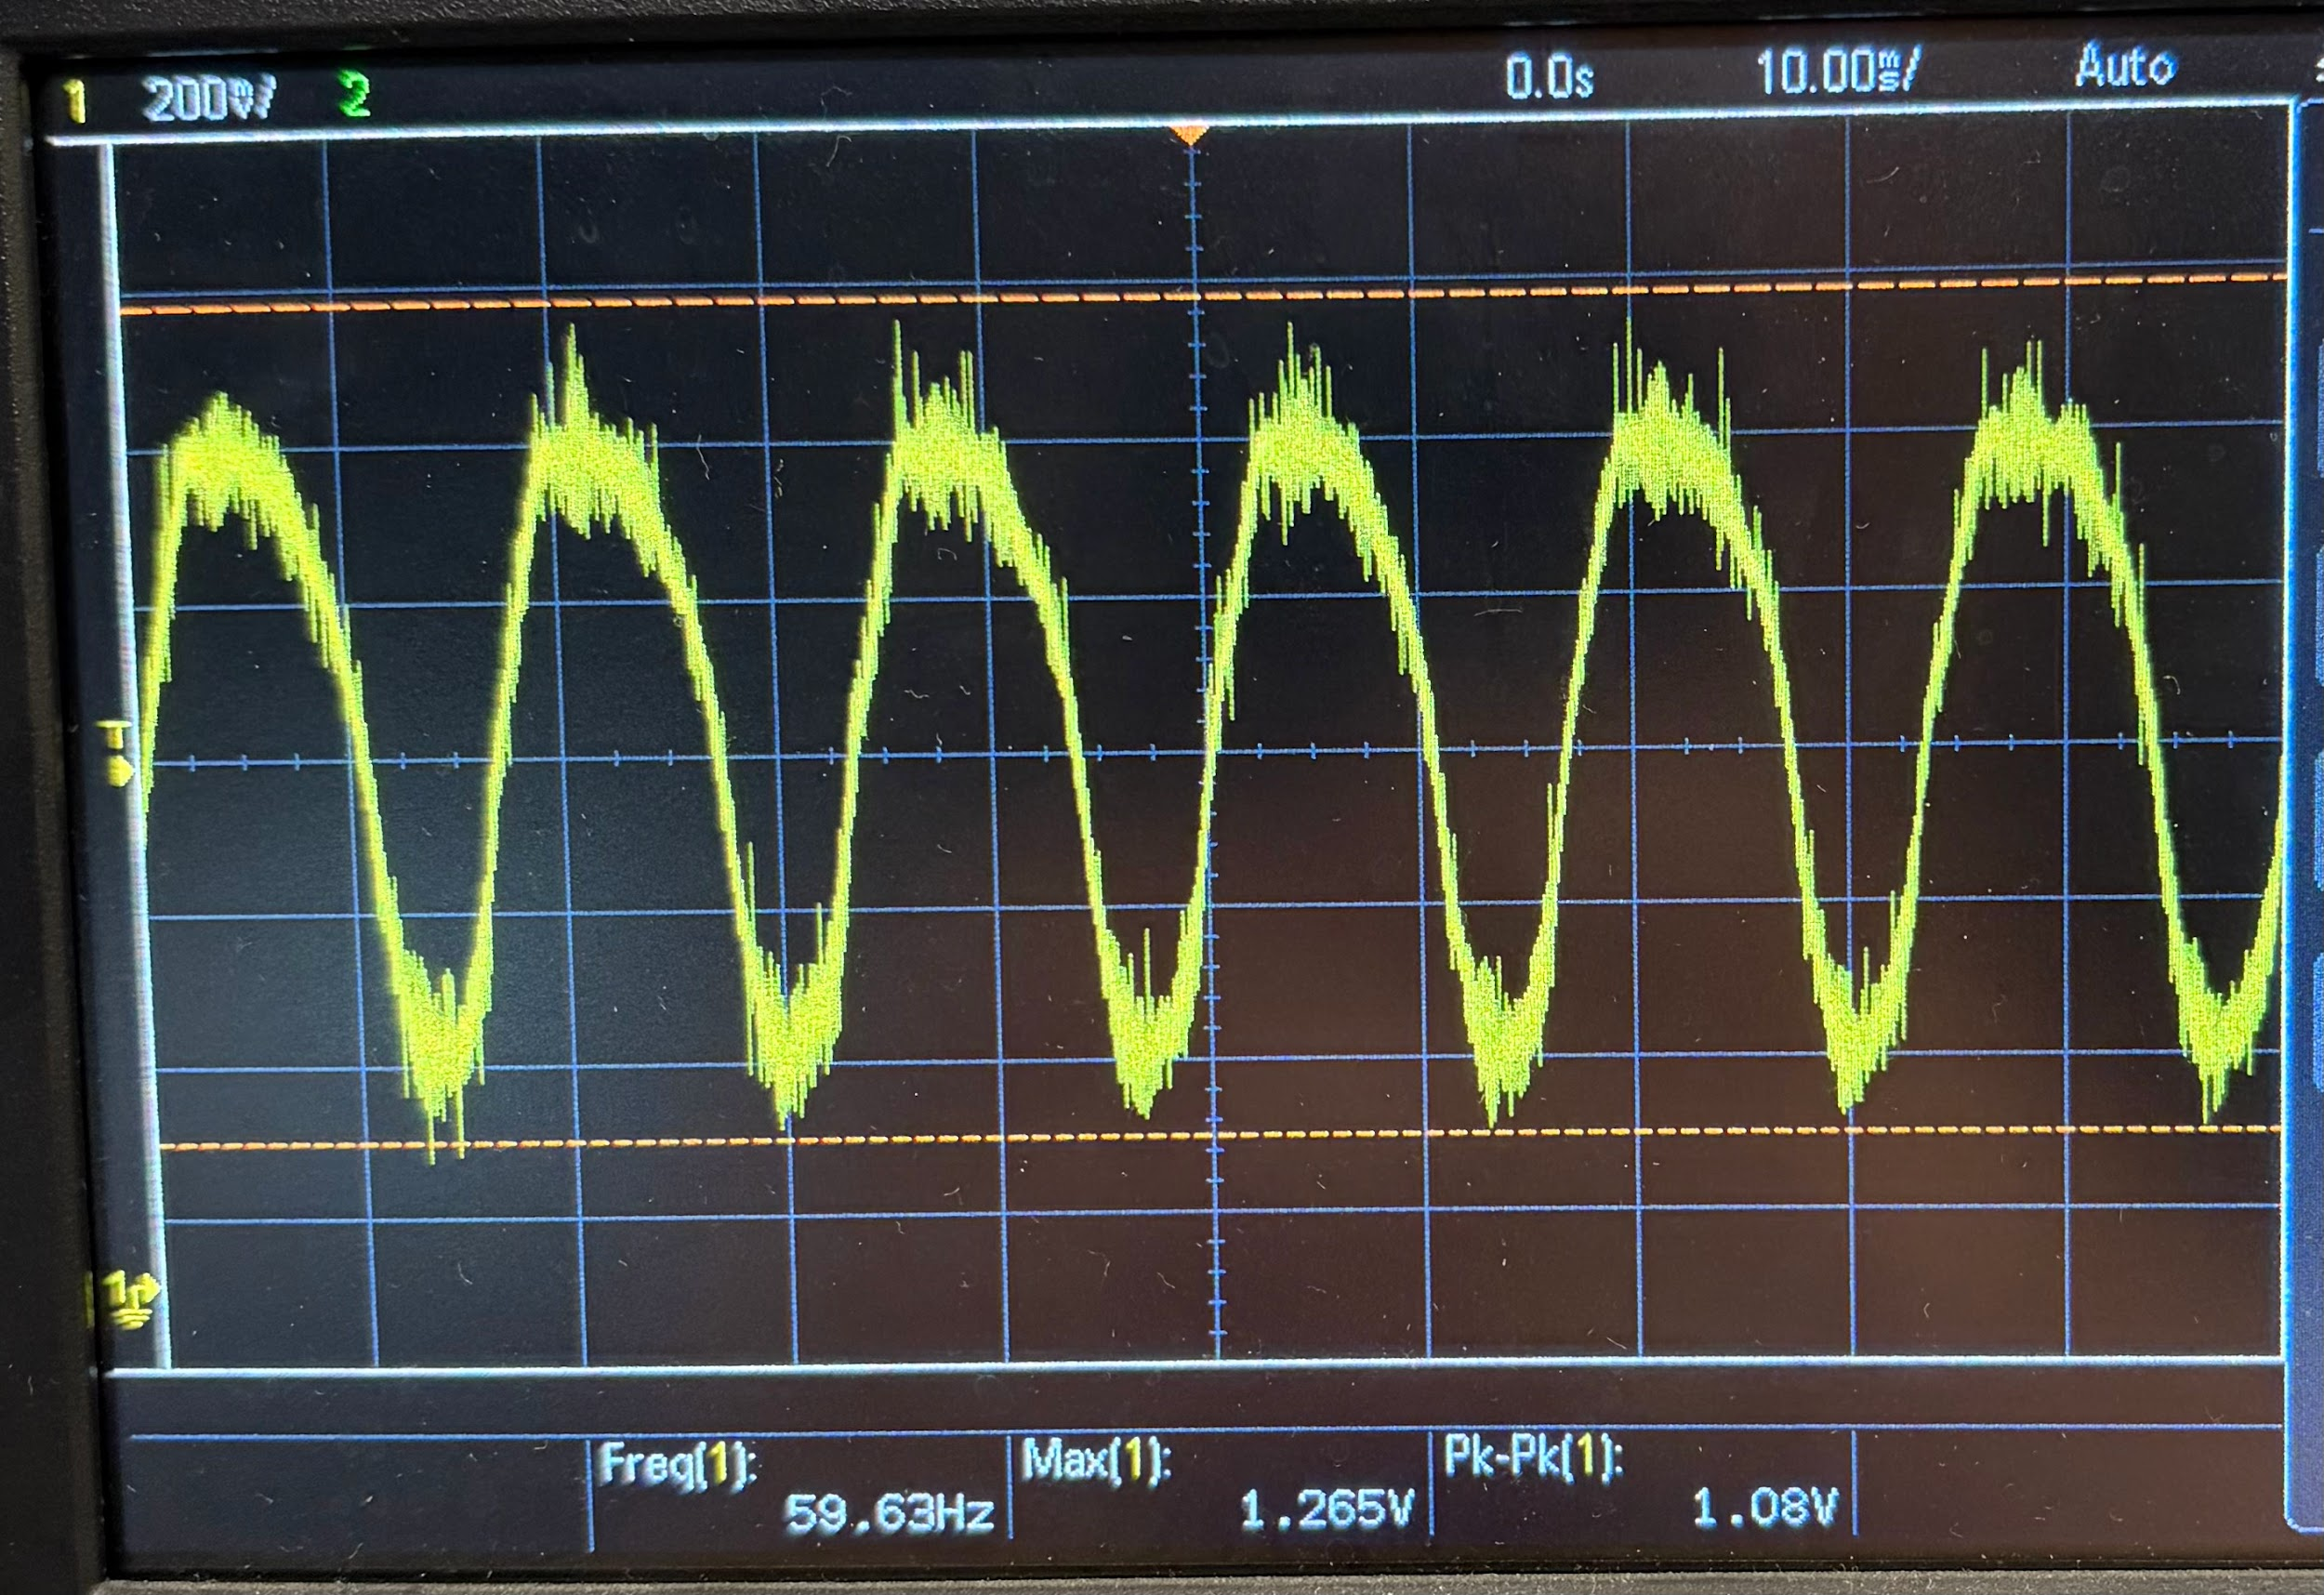
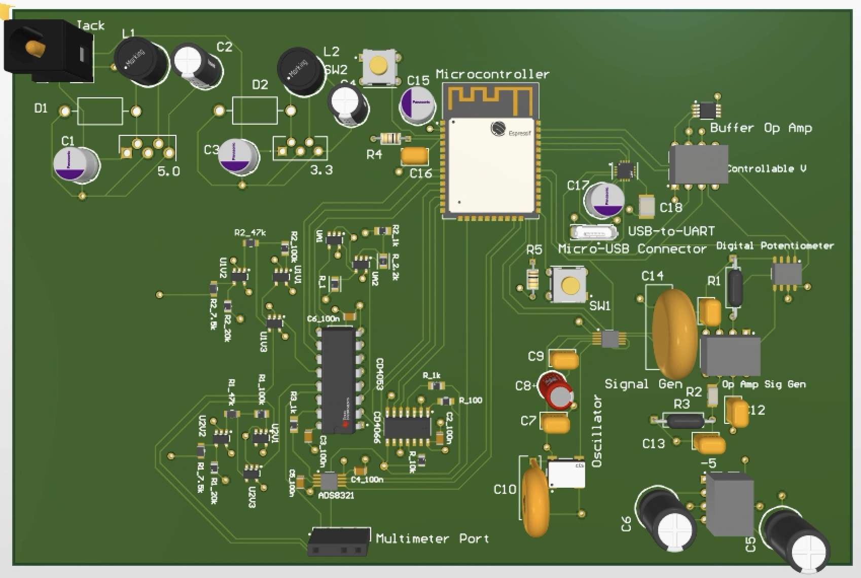
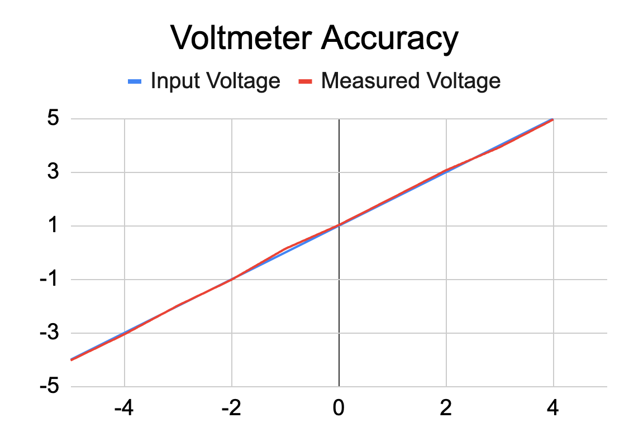
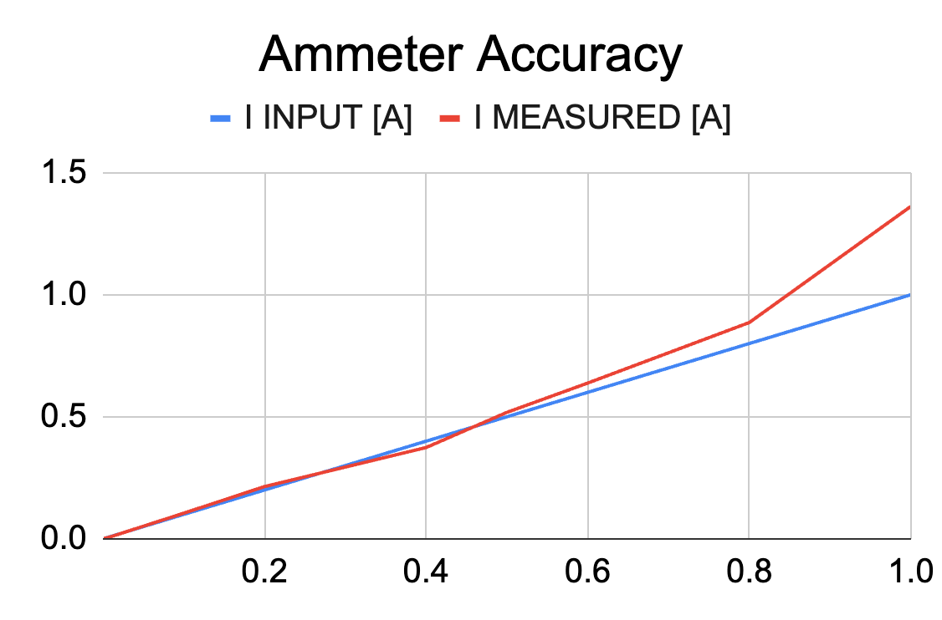
ECEN215 Lab Kit 2
Gavin Bernard, Maylun Huang, Evan Slyter John Lusher II, Department of Electrical & Computer Engineering
Problem Definition
Traditional electronics lab courses such as ECEN 215, rely heavily on in-person access to equipment such as signal generators, DC power supplies, oscilloscopes, and multimeters. This limits students who do not have physical access to lab sessions due to various reasons, including resource constraints or remote learning environments.
There is a need for an affordable, integrated, and remotely accessible lab system. By combining core instruments into a single device with an intuitive interface for control and data visualization, students can perform experiments without compromising accuracy or learning outcomes.
System Overview
Engineering Analysis (cont.)
Power Supply
DC input of 12V gets dropped by a 5V buck converter and 3.3V buck converter (Figure 4)
Each rail allows for output current of 1A, which power the entire kit and the circuits for the students
-5V charge pump inverter takes the 5V input and inverts to -5V (Figure 4)
DAC connects to the app through SPI connection and allows for a variable voltage from 0 to 5V
Outcomes
Mobile app includes all lab manuals fully integrated in the app, including support for power and measurement controls, as seen in Figure 7
Reliable bluetooth communication for real-time power regulation and data visualization through a cohesive interface
Reduced set-up and measurement time by consolidating 4 pieces of equipment into a single kit, seen in Figure 6
Low-cost solution of ~$140, compared to current device on the market (Analog Discovery 3, $379)
Figure 2. System Overview
Methodology
The project began with research into laboratory equipment and existing kit systems to identify functional and design requirements. This was followed by circuit simulations to validate hardware subsystems before implementation.
Next, each subsystem was individually built and tested using breadboards to ensure accurate operation and simplify debugging. The design then transitioned to an integrated system, using Altium to develop a printed circuit board that consolidated all components to a single board, seen in Figure 1.
Finally, the PCB was fabricated, assembled, and tested. Iterative validation was conducted to ensure measurement accuracy, stable wireless connectivity, and seamless hardware–software integration, confirming cohesive system performance.
Engineering Analysis
Mobile Application
Flutter programming language for app.
Arduino (C/C++) programming language used for ESP32.
Bluetooth Low Energy for communication between app and Labkit.
Visual Studio Code used for app coding.
Arduino IDE used for ESP32 coding.
Multimeter
Voltmeter scales -5–5V input to ESP32 0–3.3V input through voltage division seen in Figure 3
Ohmmeter utilizes bilateral switch and voltage division to accommodate 10–10kΩ range
Ammeter applies shunt resistor and gain amplifier to measure 0–1A range seen in Figure 3
3-channel SPDT multiplexer selects desired multimeter or oscilloscope function
Oscilloscope
Provides single channel analysis up to 10kHz or dual-channel up to 5kHz
Utilizes voltmeter components to reduce costs and support cross functionality
Time division multiplexing allows for dual channel oscilloscope with single channel multiplexer use
Figure 4. Power Output
Signal Generator
Uses 3.3V source that applies to an oscillator and AD9833 to generator signal
SPI connection to AD9833 allows for the app to control the output signal
Op amp circuit with digital potentiometer allows output signal amplitude change
Figure 6. Assembled Kit
Figure 5. Signal Generator Output
Impact
Hybrid or distance learning students taking ECEN215, Principles of Electrical Engineering, have a course-specific solution to lab accessibility.
Increases access to hands-on electronics experience, further supporting education and course engagement
Reduces dependence on campus labs, promoting self-paced exploration and removing need for supervising lab employees
Opens the door to more cost-effective and accessible devices to be designed and created in other classes taken remotely
Figure 7. Mobile App Integration
References
IEEE 1241-2010 Terminology and Test Methods for Analog-to-Digital Converters
IEEE 1057-2017 Digitizing Waveform Recorders
IEEE 946-2020 Recommended Practice for the Design of DC Power Systems for Stationary Applications
IEEE 1100-2005 Recommended Practice for Powering and Grounding Electronic Equipment
W. Trinh, J. Tyler, S. Villareal, M. Rahmian, and N. Gober, “ECEN 215 Lab Manual”
Figure 3. Multimeter Data
Figure 1. Integrated PCB Layout

