Slide 1
Sentiment Detection
By: Evan Timko

Slide 2

Objective
to be able to predict one’s sentiment based on one's sentence or statement

Slide 3
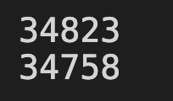
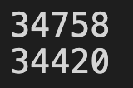
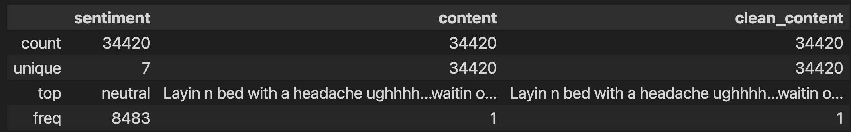
DATA PROCESSING
Retrieve data
Clean the data
Look for empty cells in the data and remove

Slide 4
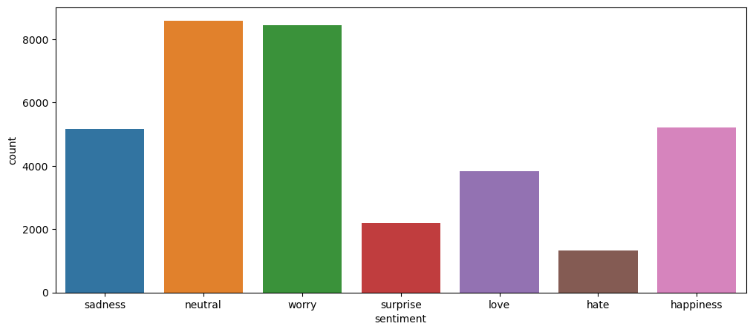
DATA

Slide 5
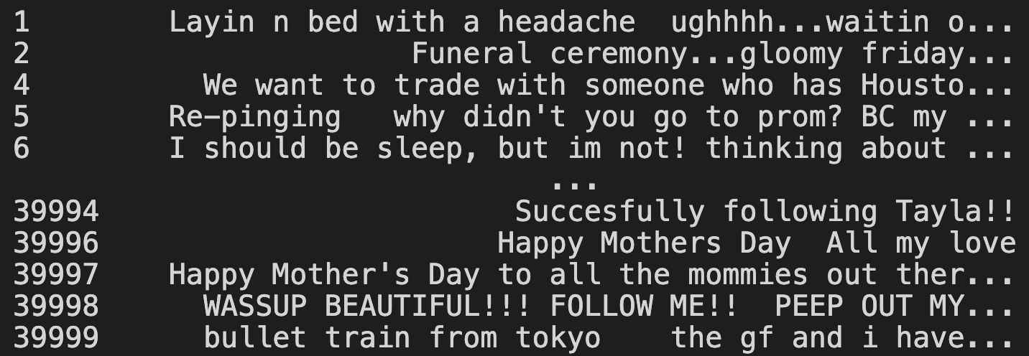
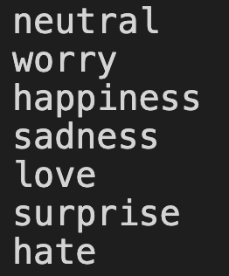
INTERPRETING SENTIMENT
Setting up our labels creating all possible outcomes
Then all the feature the clean_content which is used to trained
From which predicting one's sentiment is possible

Slide 6
CREATING PREDICTION DATA
train_test_split() performs the split and returns four sequences in this order
x_train : The training part of the first sequence
x_test : The test part of the first sequence
y_train : The training part of the second sequence
y_test : The test part of the second sequence

Slide 7
SETTING UP PREDICTION
Using Logistic regression
Machine Learning classification algorithm that is used to predict the probability of a categorical dependent variable
Using Pipeline
a sequence of data processing mechanisms
Using Countvectorizer
Convert a collection of text documents to a matrix of token counts

Slide 8
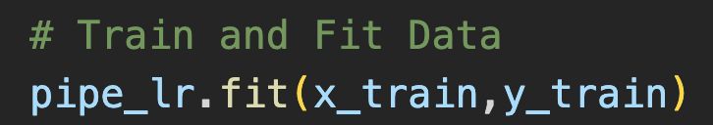
TRAINING
Now we are going to use the the prediction data
By using it to train the logistic regression pipeline

Slide 9
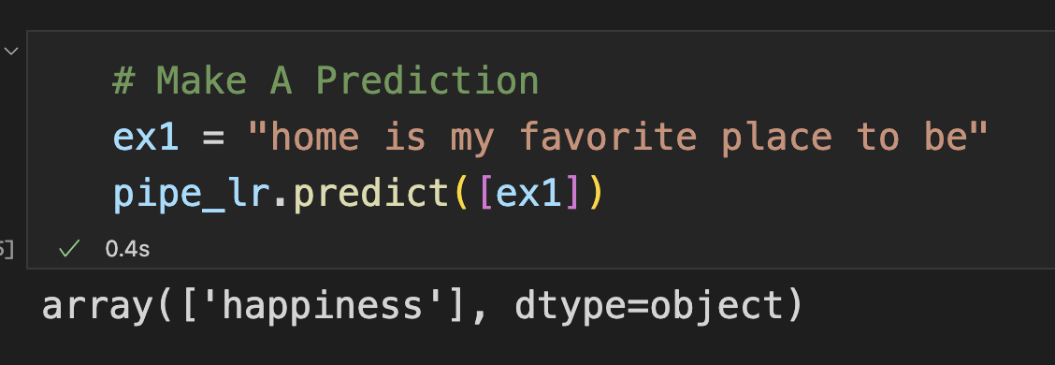
MAKING THE PREDICTION
All we need is a sentence
From that we pass it to our environment

Slide 10
Demo

Slide 11
THANK YOU
Any Question?

