Slide 1
Lesson 3: Learning About JavaScript – The Basics
C5 – Introduction to Web Development
Evan Chen
February 3, 2018

Slide 2


Welcome Back!
Hope that your week went well!

Slide 3
Lab 1
How did lab 1 go?
Were there any troubling spots? Hope not!
For those that handed it in, give yourselves a pat on your back.
Lab 1 was due last night at 11:59pm. If you haven’t done lab 1 yet, I will extend it until Sunday night, 11:59pm
Makes it easier, right?
It will be only due tomorrow night, however! No extensions!
All labs will be due on Sunday night, 11:59pm. This is to make it easier for those who may have tests or assignments due at school during the week

Slide 4
Structure of our lesson today
Today’s lesson will comprise of the following order:
The lesson (which is right now!)
The application
We will first code HTML pages using the <style> tags
Then, we will write CSS pages accompanying the HTML pages

Slide 5

Quick recap with HTML (1)
With the first lesson now over, what have you learned so far?
During the HTML lesson, you have seen how to:
Write HTML pages
What HTML tags are (and why they are useful!)
What elements and content within HTML tags are
Of course, remember that the majority of these tags need the start and end tags (the beginning of the tag block and the ending of the tag block) in order for their functionality to work
HTML pages always comes with a <head> tag and a <body> tag
<head> defines the webpage itself
<body> defines the contents that will be present (and shown) on the webpage

Slide 6
Quick recap with HTML (2)
Any questions about HTML?
Did you learn something cool in the process?
Now, onto the lesson…

Slide 7
Styling your HTML Page (1)
As you may have guessed, you can stylize your HTML page
This can make your highlighted content stand out…
Possibly in a good way (hopefully!)
But also possibly in a bad way

Slide 8
Styling your HTML Page (1)
To be able to style your HTML page, let’s take a look at <style> tags
What are <style> tags and why are they useful?
These are tags that contain elements within its tag block
It’s just like any other HTML tag… only that the elements (contents) inside the tag are not physically displayed onscreen
These elements help define the aesthetics of particular content
This depends on what you want to define (not everything gets defined here…)

Slide 9
Styling your HTML Page (2)
When using <style> tags, what does your typical element look like?
<style> tags usually contain what you want to stylize and the rules that accompany that

Slide 10
Styling your HTML Page (3)
You can style almost anything on HTML!
What I meant by “anything” really depends on what you want to style on your HTML page

Slide 11
Styling your HTML Page (4)
For starters, you can stylize specific elements inside your HTML tags
An example of this may look like the following:
<style>
h1 {
font-size: 30px;
color:blue;
}
</style>

Slide 12
Styling your HTML Page (5)
Let’s break this down.
<style>
h1 {
font-size: 30px;
color:blue;
}
</style>

Slide 13
Styling your HTML Page (6)
We can see that we will apply the following styling rules to the header h1 HTML tag.
<style>
h1 {
font-size: 30px;
color:blue;
}
</style>

Slide 14
Styling your HTML Page (7)
Whenever we call the <h1> tags, those rules will apply.
<style>
h1 {
font-size: 30px;
color:blue;
}
</style>

Slide 15
Styling your HTML Page (8)
The elements inside <h1> tags will have 30px font size and the text will be coloured blue.
<style>
h1 {
font-size: 30px;
color:blue;
}
</style>

Slide 16
Styling your HTML Page (9)
We can style much more than that…
<style>
h1 { … }
div {
font-style: bold;
color-background: coral;
}
</style>
What do you guys think this will do?

Slide 17
Styling your HTML Page (10)
Of course, before we go in-depth, we need to take a look at classes and ID attributes on an HTML page first.
They help greatly when defining what you want in your <style> tags.

Slide 18
Going back to HTML basics… Attributes (1)
What is a class attribute?
These class attributes are defined in your HTML tags
They often associate themselves with the element inside your HTML tags
You can use the same class attribute value as many times as you want
They are helpful especially when you want to stylize a particular piece of information as opposed to all of the information on the HTML page
They can also be referred to for functionality using JavaScript (but we will see that during lesson 4)
What does a class look like?
An example:
<div class=“anExample”> … </div>

Slide 19
Going back to HTML basics… Attributes (2)
You can define more class attributes within a tag
You just need to space each class out
Let’s take a look at an example
<form class=“formClass registrationForm”> … </form>

Slide 20
Going back to HTML basics… Attributes (3)
How about ID attributes?
ID attributes on HTML are unique identifiers
Although they might be similar to class attributes, these aren’t your typical attributes that you can mess around with
When an HTML tag has an ID attribute, you can add uniqueness to your element
This happens when you have too many of the same HTML tag that has different content
It can also be used when you are using the same class attribute value many times over
It helps distinguish ambiguity when you stylize certain content or add functionality to certain content
What does an id look like?
<div id=“anId”> … </div>

Slide 21
Going back to HTML basics… Attributes (4)
You can combine class and ID attributes:
<p class=“majorInfo” id=“intro”> … </p>
<div class=“majorInfo” id=“data”> … </p>

Slide 22
How are attributes referred to inside <style> tags?
When you use <style> tags (and CSS! More on that later) on attributes, you must do the following:
.[class name]
#[id name]
These specify what you want to stylize (as mentioned moments ago)

Slide 23
What about tags that allow the “style” parameter?
asdf

Slide 24
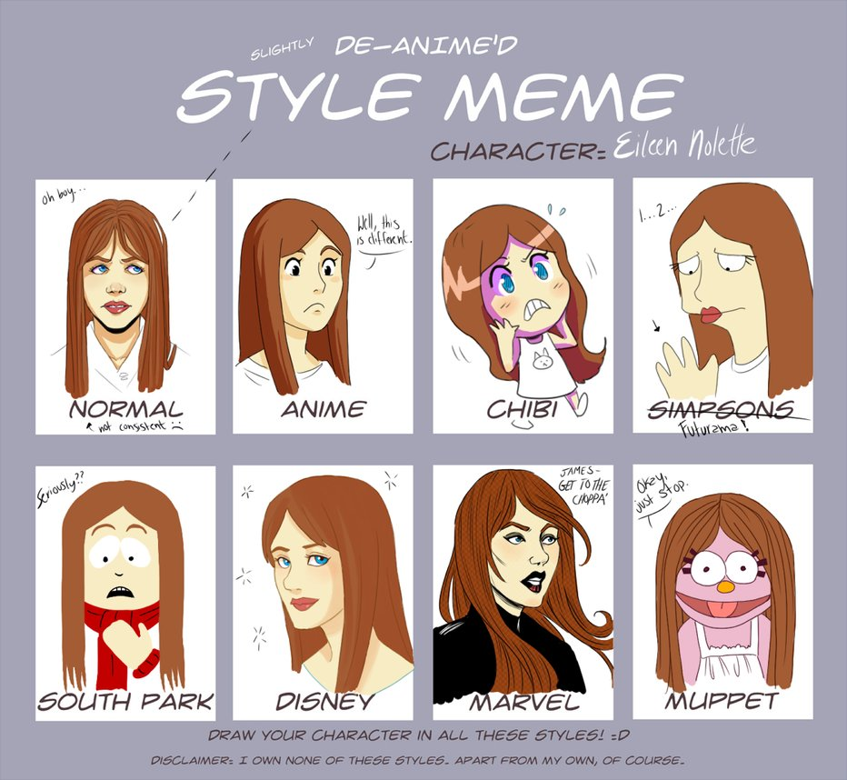
Break #1

Slide 25
Usefulness of <Style> Tags
Usually, <style> tags are not always on HTML pages all the time
They’re there if you want to stylize on the fly
Nowadays, web developers and web designers would use Cascading Style Sheets (or CSS for short) to be able to stylize their page

Slide 26
CSS (1)
CSS is the <style> tag, where the styles and instructions are represented in a CSS file as opposed to putting them in the <style> tag of an HTML page
There isn’t much to say here other than that it allows for more flexibility
You don’t want to always type out the same <style> tag on all of your HTML pages of your website all the time
Not only would it be inefficient, you would be prone to making mistakes
All you need to do is link each HTML page to that particular CSS file

Slide 27
CSS (2)
To link a CSS file on your HTML page, all you need is to put the following link in your <head> tag of the HTML page:
<link href=“[area of where your css file is located]” rel=“stylesheet” type=“text/css”/>

Slide 28
CSS (3)
One thing to note about HTML is that everything comes in blocks (or boxes, if you want to be more direct about it)
What do I mean by this?

Slide 29
Organizing Content with Flexbox (1)
asdf

Slide 30

Break #2

Slide 31
Let’s put all of this in action!
Pull up your favourite editor and let’s start coding!

