Slide 1
Lesson 3: Learning About JavaScript – The Basics
C5 – Introduction to Web Development
Evan Chen
February 3, 2018

Slide 2
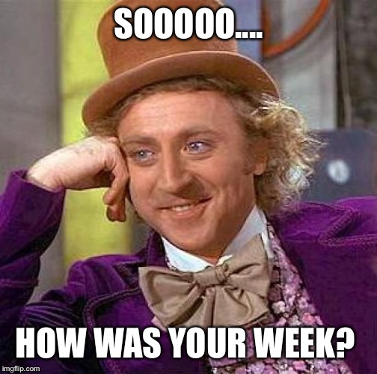
Welcome Back!
Hope that your week went well!

Slide 3
Project #1
Project #1 will be posted tonight!
It’s about frontend development
from styling something to using JavaScript on the browser
It’s putting your skills to the test!
It won’t be due until April 30th…
Remember your labs! It’s still due every Sunday 11:59pm, one week after every posting!

Slide 4
Structure of our lesson today
Today’s lesson will comprise of the following order:
The lesson (we’re learning a whole new language today!)
The application
It’s pretty much the whole lesson today. We’re going to cover the ppt first in just 15 minutes…

Slide 5
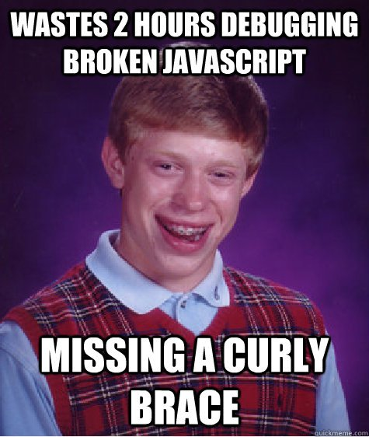
Introduction to JavaScript (1)
We will be focusing on a new language today
Learn the essentials of JavaScript
Why JavaScript?

Slide 6
Introduction to Javascript (2)
JavaScript is a scripting language that is now widely used and accepted by many
It has many fundamentals as a dynamic, but weak, scripting language
It is functional (meaning that you can create first-class functions)
It is object oriented (have you used Python, Java, C++?)
It is now coming out of the box (you can develop programs outside of web development!)

Slide 7
Introduction to Javascript (3)
It’s very neat, actually!
JavaScript programs can run quite fast now after compilation/running the program
It’s usually utilized in web development!

Slide 8
Introduction to Javascript (4)
However, don’t think of JavaScript as Java…
JavaScript is to Java as a Carpet is to a Car.

Slide 9
Introduction to Javascript (5)
In other words, JavaScript does not contain the Java language in any way possible…
Your variables are not quite typed
You can write functions in two different ways that is not like in Java

Slide 10
Javascript Essentials (1)
In other words, JavaScript does not contain the Java language in any way possible…
Your variables are not quite typed
You can write functions in two different ways that is not like in Java

Slide 11

Break #1

Slide 12
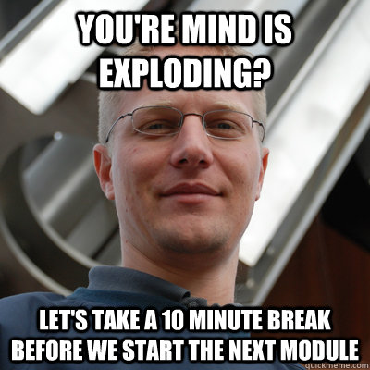
Break #2

