Slide 1
Lesson 3: Learning About JavaScript – The Basics
C5 – Introduction to Web Development
Evan Chen
February 3 and 17, 2018

Slide 2
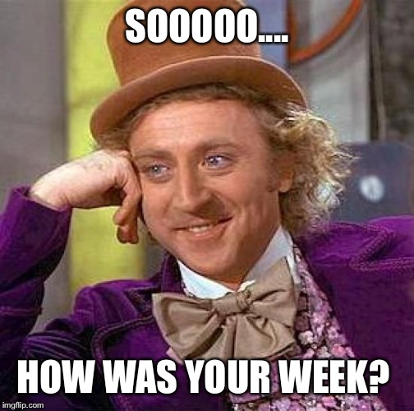
Welcome Back!
Hope that your week went well!

Slide 3
Project #1
Project #1 will be posted tonight!
It’s about frontend development
from styling something to using JavaScript on the browser
It’s putting your skills to the test!
It won’t be due until April 30th…
Remember your labs! It’s still due every Sunday 11:59pm, one week after every posting!

Slide 4
Structure of our lesson today
Today’s lesson will comprise of the following order:
The lesson (we’re learning a whole new language today!)
The application
It’s pretty much the whole lesson today. We’re going to cover the ppt first in just 15 minutes…

Slide 5

Introduction to JavaScript (1)
We will be focusing on a new language today
Learn the essentials of JavaScript
Why JavaScript?

Slide 6
Introduction to Javascript (2)
JavaScript is a scripting language that is now widely used and accepted by many
It has many fundamentals as a dynamic, but weak, scripting language
It is functional (meaning that you can create first-class functions)
It is object oriented (have you used Python, Java, C++?)
It is now coming out of the box (you can develop programs outside of web development!)

Slide 7
Introduction to Javascript (3)
It’s very neat, actually!
JavaScript programs can run quite fast now after compilation/running the program
It’s usually utilized in web development!

Slide 8
Introduction to Javascript (4)
However, don’t think of JavaScript as Java…
JavaScript is to Java as a Carpet is to a Car.

Slide 9
Introduction to Javascript (5)
In other words, JavaScript does not contain the Java language in any way possible…
Your variables are not quite typed
You can write functions in two different ways that is not like in Java

Slide 10
Console.log(…) (1)
We’ll start off with console.log( … )
console.log( … ) records whatever is inside the brackets
More specifically, string representations of what is inside the brackets
To begin, strings are represented with quotes surrounding a body of text.
An example of this is the following:
“Hello world!”

Slide 11
Console.log(…) (2)
String representations of this text, as we have seen, are often quoted.
When we want to log things onto the console (i.e. print things onto the console after compiling it and running it), we can use the console.log( … ) command and make it print strings out
One use of this:
console.log( “Hello world!” );
will print out
Hello world!
onto the console.

Slide 12
Console.log(…) (3)
So, console.log( … ) is a print statement of sorts.

Slide 13
Variables (1)
Just like in any scripting language and any object-oriented language, we have variables
You can assign values to variables
These variables keep track of these values for future use
You are able to do a lot with it, such as append (add) more to a string, compute some math, keep track of certain instances, etc.

Slide 14
Variables (2)
This is how you form variables:
var variable_name = assigned_value;
For variable names, the convention is to use lowercase variable names if you are only using one-word names
It’s up to you as to how you name variables

Slide 15
Variables (3)
As mentioned, you are able to store values in defined variables
Think of it like variables inside a mathematical function
var x = 10;
var y = x + 2*x;
When you store values into variables, this is what happens graphically:

