Slide 1
Lesson 1: Working with HTML
C5 – Introduction to Web Development
Evan Chen
January 20, 2018

Slide 2

Welcome!
Welcome to the C5 Tutorial Course: Introduction to Web Development!

Slide 3
What is web development? (1)
Specifically, what is a web developer?
We build websites from the ground up.
What does that mean?
We can customize our websites with different functionality!
At the cost of nothing (almost!)

Slide 4
What is web development? (2)
Being a Web Developer IS NOT THE SAME AS being a Web Designer.
A web designer only designs websites.
Usually, they are on the same team; the web developer would worry about the functionality of the website more than the design and art of it whereas the web designer would worry about the aesthetics of the website more than its functionality.
Both need to communicate in order to build the web application from ground up

Slide 5
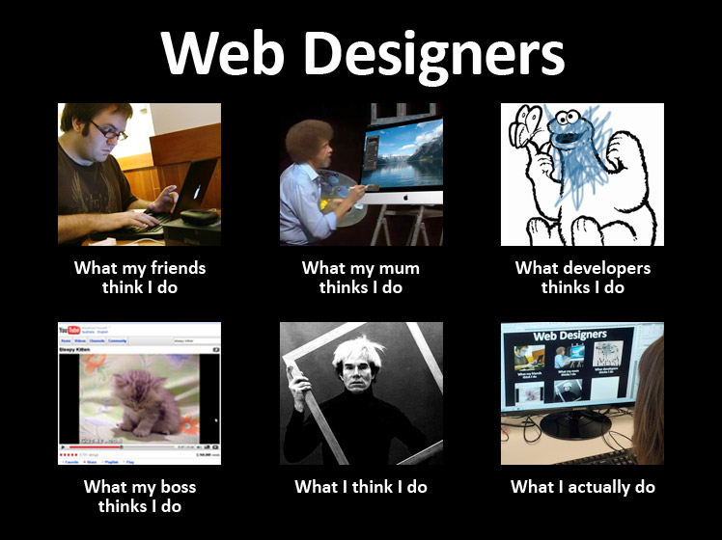
What is web development? (3)

Slide 6
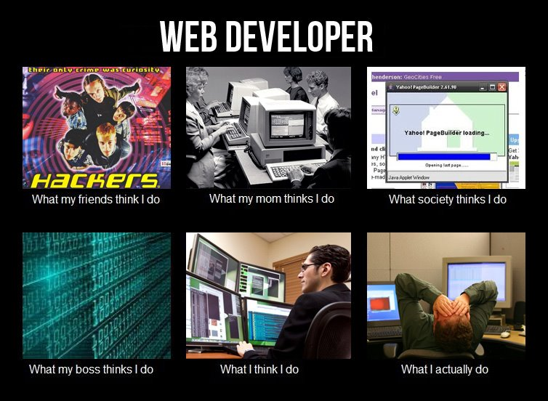
What is web development? (4)

Slide 7
What is web development? (5)
Web developers tend to take care of three roles when developing web apps:
Clients
Servers
Databases
What are these???

Slide 8


What is web development? (6)
Clients: the users and the main characters of this story
Servers: the tool that is used to communicate to the web application and to its users
It is also a tool that is used to send/receive data from the users
Databases: a system in which it stores all data

Slide 9
General Course Information (1)
C5 Tutorial Course – Introduction to Web Development
Difficulty Range: Intermediate
This tutorial course will demand a bit of your time in order to fully and properly learn the concepts!
Tutor instructor: Evan Chen
Who am I?
Recent graduate of U of T, graduating from the Computer Science and Mathematical Sciences double major program
Recently taught and tutored students – those who are aspiring to become Computer Science students or want to learn more about the world of CS - the languages of Java and C

Slide 10
General Course Information (2)
Tutorial classes will be held at U of T St. George’s Robarts Library, Study Room 1 (first floor)
Every Saturday (unless stated on the schedule), starting at 1 pm to 3:30 pm
This tutorial course is free!
Tutorial website:
https://evanturtileman.github.io/C5-IntroToWebDev/
Please look through the website for more information and for these lesson slides!

Slide 11
General Course Information (3)
There will be 10 lessons
Each lesson will touch on a different concept
All lessons will build up from each other
In addition to the lessons
There will be 8 labs
There will be 2 project assignments
There will be a written test at the end of this tutorial course

Slide 12
General Course Information (4)
This is what the grading scheme will look like:
Evaluation | Weight
Labs (x8) | 3% each (24% total)
Project 1 | 18%
Project 2 | 28%
Course-end Test | 30%

Slide 13
Github
This tutorial course requires you to have a Github account
You can create one for free!
This is where you can store your work and show it off to others!
Think of it like a portfolio but for Computer Science/Computer Engineering/<insert any other tech fields relevant here> students ☺
In this course, you will be handing in your work through Github
You cannot hand in your work through Dropbox or through email
I will only mark what is in your Github accounts
When you create your Github accounts, please send me your Github usernames.

Slide 14
Course_PORTAL
But, how can you view your marks?
I will not push your marks into the Github repository
Introducing course_PORTaL!
Here, you will be able to view your marks
In order to sign up, you must send me your email addresses
This application is created by yours truly!
One thing to note: this application will be finally ready by the end of the week, next week.

Slide 15
More info on labs
There will be 8 labs that will allow you to apply your knowledge from the lessons material
Each lab will be different from each other (unless stated otherwise!)
You don’t need to usually worry about recreating the whole application…
You just need to fill in the blanks, unless specified otherwise!
Remember, each lab focuses on different specific parts of each lesson
I won’t make you start from scratch… at least, not yet…
Each lab will be due at 11:59pm on Friday (before the next lesson)
Each lab counts for 3% of your final mark

Slide 16
More info on Projects
There will be two projects that will allow you to apply the tools you have obtained from the lessons
This will allow you to hone your skills as a web developer
The first project will be based on lessons 1 to 4 (you’re only developing the front end of your web application)
The second project will be based on your knowledge as a web developer
Please note that your projects will HAVE to be different from each other
You cannot reuse material from the labs
You also cannot plagiarise from other sources! If you take ideas from other places, please site them.

Slide 17
More info on The Course-End Test
This test will quiz you on all of the concepts you have learned from each lesson in this tutorial course
The duration of this test will be 120 minutes (2 hours)
You may bring an 8x11 in. sheet of paper as your cheat sheet; you may use both sides of your cheat sheet
The location will, again, be at Robarts Library, Study Room #1 (1st floor)
The timing and date is yet to be determined (but it will be held in the month of April)

Slide 18

Before we begin… Break time!

Slide 19
Before we begin… Introduction to Git (1)
Github is a place where you can save your work online
You can share your work publicly or allow collaborators to join in the fun!
Perhaps you can even create projects in private repositories but allow the public to visit your web projects
It’s quite portable!

Slide 20
Before we begin… Introduction to Git (2)
Before we begin, open up your terminal windows.
For Windows users, you may pull up PuTTY or Windows Powershell
Github requires us to create repositories first before we do anything, so we will do that right after.

Slide 21
Before we begin… Introduction to Git (3)
Now, create a repository on Github called “Test”
Auto-generate a README.md file so that you do not need to generate it yourself (although, it would be great practice for you! Look up how you can do that on your own time!)
Now, find the “Clone or download” button and copy the Git link.
Go to your terminal now and type in the following
git clone <your git link here>

Slide 22
Before we begin… Introduction to Git (4)
After, allow the git repository to be cloned and downloaded to your computer.
Once it has been cloned, you have more free reign in what you can do in your repository on your own computer (you do not need to rely on the internet for now)
Create a file called “test.txt”, enter the text editor after you create it, and in this file, put in “Hello world!”
Leave the text editor and type in
git add *
This allows you to add ALL files that were newly created and not recognized by the current git status of your local-to-Github repository

Slide 23
Before we begin… Introduction to Git (5)
Please note that by doing “git add *”, we haven’t really added anything to our online Github repositories yet. We want to do the following so that we can commit our changes, additions, and/or removals:
git commit –m “<insert a meaningful short message>”
By using this line, we are able to tell our local machines that our files are ready to be uploaded to the Github repository.
Once you have done that, wait for it to load. Once it finishes loading, push all your changes.
git push

Slide 24
Before we begin… Introduction to Git (6)
Now, if you want to pull new data from your online Github repository to your local machine and your local machine already has your cloned repository, just perform the following git statement under your cloned repository:
git pull

Slide 25
Before we begin… Introduction to Git (7)
So, to clone a new repo, use the following command:
git clone <Github link>
To upload your work to your Github repository, use the following commands (in order):
git add *
git commit –m “<message>”
git push
To update your work on your local cloned copy of the repository, use the following command:
git pull

Slide 26
Github Quick Tutorial
Let’s quickly brush through a Github tutorial, shall we?

Slide 27

Break #2

Slide 28
Introduction to HTML (1)
Now, let’s begin the lesson on HTML
Every website you go to uses the HTML scripting language
Pull up your favourite website. You’ll be amazed that this is done through the use of HTML...
But, what if I told you that you don’t need to always use HTML for everything?
I’m saving that lesson for another day
For now, let’s focus on HTML and the basics of designing/organizing the content on your HTML page

Slide 29
Introduction to HTML (2)
What is HTML?
HTML stands for Hyper-Text Markup Language
HTML pages usually define how a webpage should look like
“Do I want this content here or here?”

Slide 30
Introduction to HTML (3)
HTML is a markup language
You define content in different blocks
This content you define in require that you use HTML tags
What are HTML tags?

Slide 31
Introduction to HTML (4)
HTML tags help define the content to be what it should be
Some tags include:
div
a
body
table

Slide 32
Introduction to HTML (5)
What do each of those tags do?
<div> usually encapsulates the content you have
Can be used in many places; very useful when defining what a webpage should look like!
<a> is the attribute tag. It allows you to link text to websites.
<body> is the body tag. This is the main bulk of the webpage; it displays your content
<table> is the table tag. As the name suggests, it creates a table.
There are many more!

Slide 33
Introduction to HTML (5)
Why use tags?
If you had just text, your webpage would look quite bland and maybe hard to read.
Defining your content on the webpage is much better than just having text-only content.
It makes it easier on the eyes!
(Of course, this is not about just web designing. It’s helpful for web developers to organize their content as well!)
Each tag has a different purpose… think of them like functions!

Slide 34
Introduction to HTML (6)
The idea of HTML first solidified back in the early 1990’s as a means to view webpages. Of course, there weren’t too many developers back then…
HTML evolved over time, going through many iterations, from HTML2 to XHTML.
Now, we are currently using HTML5

Slide 35
HTML5: The current norm
HTML5 allows web developers and web designers to be more free with their creations
You can use it to play your videos and audio, and you can use it to also play video games!
With the mark of a new technological era, HTML5 is used across many different web browsers, such as Chrome and Firefox
Much safer to use!

Slide 36
Creating our first webpage
Let’s learn how to create our first webpage!

