Slide 1
Lesson 2: Extending Styling With HTML: CSS
C5 – Introduction to Web Development
Evan Chen
January 27, 2018

Slide 2


Welcome Back!
Hope that your week went well!

Slide 3
Lab 1 and Labs in general
How did lab 1 go?
Were there any troubling spots? Hope not!
For those that handed it in, give yourselves a pat on your back.
Lab 1 was due last night at 11:59pm. If you haven’t done lab 1 yet, I will extend it until Sunday night, 11:59pm
Makes it easier, right?
It will be only due tomorrow night, however! No extensions!
All labs will now be due on Sunday night, 11:59pm. This is to make it easier for those who may have tests or assignments due at school during the week
Every new lab will still be posted a day before the lesson though…!

Slide 4
Structure of our lesson today
Today’s lesson will comprise of the following order:
The lesson (which is right now!)
The application
We will first code HTML pages using the <style> tags
Then, we will write CSS pages accompanying the HTML pages

Slide 5

Quick recap with HTML (1)
With the first lesson now over, what have you learned so far?
During the HTML lesson, you have seen how to:
Write HTML pages
What HTML tags are (and why they are useful!)
What elements and content within HTML tags are
Of course, remember that the majority of these tags need the start and end tags (the beginning of the tag block and the ending of the tag block) in order for their functionality to work
HTML pages always comes with a <head> tag and a <body> tag
<head> defines the webpage itself
<body> defines the contents that will be present (and shown) on the webpage

Slide 6
Quick recap with HTML (2)
Any questions about HTML?
Did you learn something cool in the process?
Now, onto the lesson…

Slide 7
Prologue to <Style> and CSS: More on HTML (1)
As we’ve learned, HTML defines what the content should be
Now that we’ve learned the basics of HTML, let’s quickly head back to the drawing board and learn some actual terminology

Slide 8
Prologue to <Style> and CSS: More on HTML (2)
On HTML, we have seen the following:
Markup – These are HTML tags. Most of the time, they have a start tag and an end tag
Content – Although debatable, it is pretty much anything that can be represented as content on a website
Element – The content in-between the HTML tags, i.e. the content in-between a start tag and an end tag
Attribute – The “name”-to-“value” pairs that are specified only on the inside of a start tag
Comments – Just like any other language, there is a comment that will not affect the content or functionality of the webpage

Slide 9
Prologue to <Style> and CSS: More on HTML (4)
Element
We have already seen this back last lesson
An example of this would be
<div> This is an element. </div>
As long as the content is enclosed by a start tag and an end tag, it can be considered an element.

Slide 10
Prologue to <Style> and CSS: More on HTML (5)
Does this mean that the following content inside the <body> Markup tags are elements? How about <div> itself – can that be considered to be an element of <body>?
<body>
<div>
This is content. It is most definitely an element of div. Is this an element of body?
</div>
</body>

Slide 11
Prologue to <Style> and CSS: More on HTML (6)
Attribute
An attribute contains a name-to-value pair only mentioned inside the start tag
An example of this would be
<img src=“./helloworld.png” />
This association is additional information that allows the webpage to perform other functions/add functions to the webpage itself, albeit small functionality such as retrieving an image from a different location or linking text to another website, etc.
We have seen a bit of this last class

Slide 12
Prologue to <Style> and CSS: More on HTML (7)
Attribute (continued)
What if I mentioned that there was a “style” attribute that you can apply to your HTML tags?
You can do this without having to use the <style> tag itself!
This is considered inline style attributes

Slide 13
Prologue to <Style> and CSS: More on HTML (8)
Comment
The following is literally a comment
<!-- Hi! I am a comment! -->
It does not affect the webpage in any way possible.
It can be placed anywhere on the webpage

Slide 14
Prologue to <Style> and CSS: More on HTML (9)
With the advent of HTML turning into XHTML, we can see that it is becoming more widely used
All web browsers are able to run HTML4 and HTML5
You can run JavaScript code inside HTML webpages
With HTML5, you can do much more with your webpage such as have multimedia!

Slide 15
Prologue to <Style> and CSS: More on HTML (10)
What is cool about HTML4 is that it introduced styling that can be separated away from your HTML file
However, with the introduction of <style> tags, you do not need to use certain HTML Markup tags anymore
These include:
<b>
<i>
<u>
<br>
<center>
<font>
etc.

Slide 16
Prologue to <Style> and CSS: More on HTML (11)
In other words, these tags have become “deprecated”
Of course, some of these tags are meant to stylize content, such as <b>, <i>, <u>, <center>, etc.
How do we incorporate these into <style> tags? Does that mean we cannot use the deprecated tags anymore?

Slide 17
Styling your HTML Page (1)
As you may have guessed, you can stylize your HTML page
This can make your highlighted content stand out…
Possibly in a good way (hopefully!)
But also possibly in a bad way

Slide 18
Styling your HTML Page (1)
To be able to style your HTML page, let’s take a look at embedded <style> tags
What are embedded <style> tags and why are they useful?
These are tags that contain elements within its tag block
It’s just like any other HTML tag… only that the elements the tag are not physically displayed onscreen and that this tag is located under the <head> of the HTML page
These elements help define the aesthetics of particular content
It all comes down to what you have defined as your selectors (we’ll get more into that soon)
This also depends on what you want to define (not everything gets defined here…)
You’re adding the rules to each selector to be able to stylize the content
You want to define how your content should look overall

Slide 19
Styling your HTML Page (2)
When using embedded <style> tags, what does your typical element look like?
Embedded <style> tags usually contain what you want to stylize and the rules that accompany that
The elements inside the embedded <style> tags are selectors
What are selectors? These are the things you want to apply these styling rules to
What about the rules defining what the elements used by the selector should look like?
These rules come in “name”-to-”value” pairs; more specifically, you are adding properties that allow you to change what your content should look like if you use the content in your selector

Slide 20
Styling your HTML Page (3)
You can style almost anything on HTML!
What I meant by “anything” really depends on what you want to style on your HTML page

Slide 21
Styling your HTML Page (4)
Here is a skeleton snippet of what an embedded <style> tag contains
<style>
selector {
property (the rule you want to add): value;
property: value;
…
}
…
</style>

Slide 22
Styling your HTML Page (5)
For starters, you can stylize specific elements inside your HTML tags
An example of this may look like the following:
<style>
h1 {
font-size: 30px;
color:blue;
}
</style>

Slide 23
Styling your HTML Page (6)
Let’s break this down.
<style>
h1 {
font-size: 30px;
color:blue;
}
</style>

Slide 24
Styling your HTML Page (7)
We can see that we will apply the following styling rules to the header h1 HTML tag.
<style>
h1 {
font-size: 30px;
color:blue;
}
</style>

Slide 25
Styling your HTML Page (8)
Whenever we call <h1> tags, those rules will apply.
<style>
h1 {
font-size: 30px;
color:blue;
}
</style>

Slide 26
Styling your HTML Page (9)
The elements inside <h1> tags will have 30px font size and the text will be coloured blue.
<style>
h1 {
font-size: 30px;
color:blue;
}
</style>

Slide 27
Styling your HTML Page (10)
We can style much more than that…
<style>
h1 { … }
div {
font-style: bold;
color-background: coral;
}
</style>
What do you guys think this will do?

Slide 28
Styling your HTML Page (11)
Of course, before we go in-depth, we need to take a look at classes and ID attributes on an HTML page first.
They help greatly when defining what you want in your embedded <style> tags.

Slide 29
Going back to HTML basics… Attributes – Classes (1)
What is a class attribute?
These class attributes are defined in your HTML tags
They often associate themselves with the element inside your HTML tags
You can use the same class attribute value multiple times
They are helpful especially when you want to stylize a particular piece of information as opposed to all of the information on the HTML page
What does a class look like?
An example:
<div class=“anExample”> … </div>

Slide 30
Going back to HTML basics… Attributes – Classes (2)
Of course, with class attributes, you can use them in many ways
These can be used when you style something!
They can be used when you want to refer to something in your JavaScript code!
With class attributes, it is preferable when used to be able to define common properties

Slide 31
Going back to HTML basics… Attributes – Classes (3)
You can define more class attributes within a start tag
You just need to space each class out
Let’s take a look at an example
<form class=“formClass registrationForm”> … </form>
We see here that we have defined two different classes here

Slide 32
Going back to HTML basics… Attributes – Classes (4)
When you want to style content that has a class attribute linked with it, you must call it like so:
<style>
.[class name] {
property: value;
property: value;
…
}
…
</style>

Slide 33
Going back to HTML basics… Attributes – Ids (1)
How about ID attributes?
ID attributes on HTML are unique identifiers
Although they might be similar to class attributes, these aren’t your typical attributes that you can mess around with
When an HTML tag has an ID attribute, you can add uniqueness to your elements
This happens when you have too many of the same HTML tag that has different content
It can also be used when you are using the same class attribute value many times over
It helps distinguish ambiguity when you stylize certain content or add functionality to certain content
What does an id look like?
<form id=“login”> … </form>

Slide 34
Going back to HTML basics… Attributes – Ids (2)
You can combine class and ID attributes:
<p class=“majorInfo” id=“intro”> … </p>
<div class=“majorInfo” id=“data”> … </p>
This helps us find information much more easily and retrieve data when needed or apply the styling properties on them.

Slide 35
Going back to HTML basics… Attributes – Ids (3)
When you want to style content that has an ID attribute linked with it, you must call it like so:
<style>
#[id name] {
property: value;
property: value;
…
}
…
</style>

Slide 36
How are attributes referred to inside <style> tags?
To recap, when you want to stylize content related to your class and ID attributes, you must use the following selectors:
.[class name]
#[id name]
These specify what you want to stylize

Slide 37
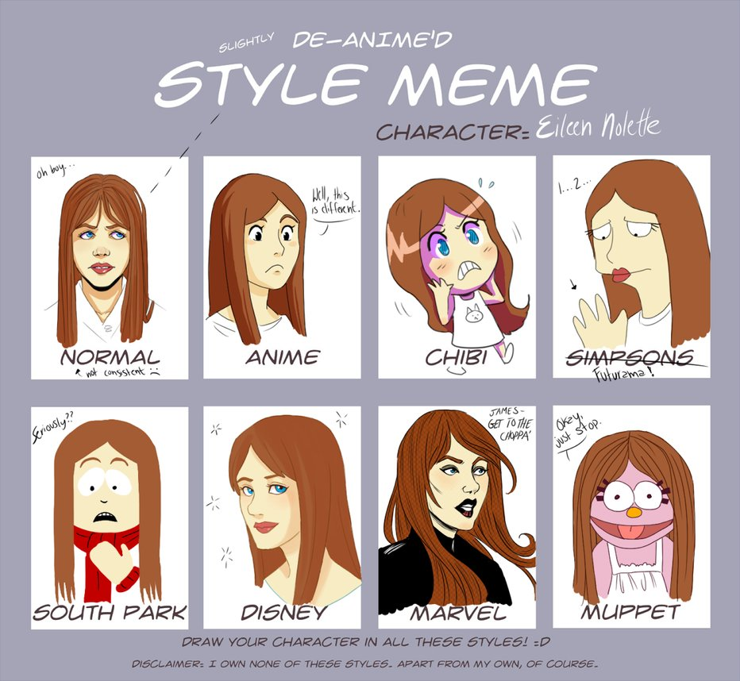
Break #1

Slide 38
Usefulness of <Style> Tags
Usually, embedded <style> tags are not always on HTML pages all the time
They’re there if you want to stylize on the fly
As I mentioned, web designers and web developers used the embedded <style> tag back then
But, with HTML4, it has become apparent that we want to break away from stuffing all of our styling properties on HTML and put it on separate files called CSS

Slide 39
Why CSS? (1)
When you use different CSS files, you do not need to always need to re-type the <style> tags all the time
You just simply link the files to your HTML page
Imagine this: multiple HTML pages use the same style. You can link all of them to that one CSS file that contains those styles.
With multiple platforms, you have different layouts
You can also customize your own layout
Take a look at your favourite website!

Slide 40
CSS (1)
CSS is a file that represents the embedded <style> tag, where the styles and instructions are in a CSS file as opposed to putting them under the <style> tag of an HTML page
There isn’t much to say here other than that it allows for more flexibility
You don’t want to always type out the same <style> tag on all of your HTML pages of your website all the time
Not only would it be inefficient, you would be prone to making mistakes
All you need to do is link each HTML page to that particular CSS file

Slide 41
CSS (2)
To link a CSS file on your HTML page, all you need is to put the following link in your <head> tag of the HTML page:
<link href=“[area of where your css file is located]” rel=“stylesheet” type=“text/css”/>

Slide 42
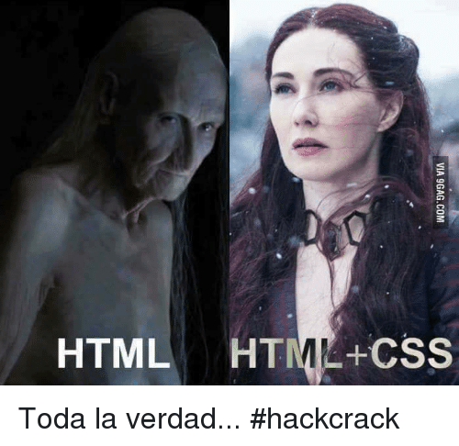
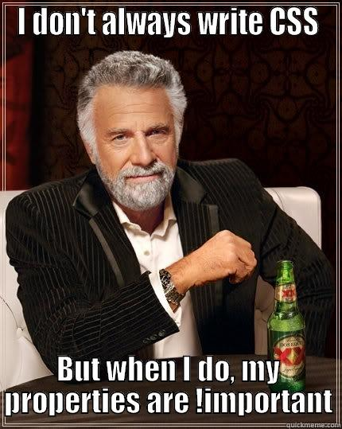
CSS (3)
One thing to note about HTML is that everything comes in blocks (or boxes, if you want to be more direct about it)
What do I mean by this?

Slide 43
CSS Boxes (1)
We need to come to realize that as we design our webpages, we need to know that it always revolves around a rectangular box
Again, take a look at some of your favourite websites
When you look at your web browser’s developer tools, you can see that there are boxes everywhere
Some of these boxes are embedded!
Some of them are bigger than the others
When you highlight certain things on an HTML file on your developer tools page, you can see the highlights on the actual page itself

Slide 44
CSS Boxes (2)
Why is it important?
Boxes usually help organize the content
They can be placed anywhere
Imagine you had to place adds on the left and right portions of your website and your content in the middle
Let’s take a look at an example, shall we?

Slide 45
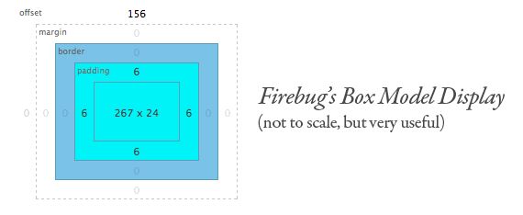
CSS Boxes (3)
As we know from our typical math class, boxes always have a height and width (well, “length,” but we don’t use it here in CS)
We can describe what those values are so that we can reshape our boxes accordingly
That leads to changing the padding’s values (padding-left, padding-right, etc.)
This can also lead to changing the border’s values! (border-left, border-right, etc.)

Slide 46
A Beginner’s Guide to CSS Flexbox (1)
Now that we have seen that CSS boxes are quite useful, let’s look at how we can organize the content inside said box
Introducing the Flexbox!
What is Flexbox?

Slide 47
A Beginner’s Guide to CSS Flexbox (2)
Flexbox is a module used inside your CSS files that allow you to organize and align your content inside a container (a box)
You can fill it up completely, making efficient use of this module
Or you can “hack” your way through the styling and try to make it look nicer inside your box
All in all, this is a neat module to use
The only thing is that you need to apply certain rules and see what you can do with these rules applied
Usually used on decently-sized applications

Slide 48
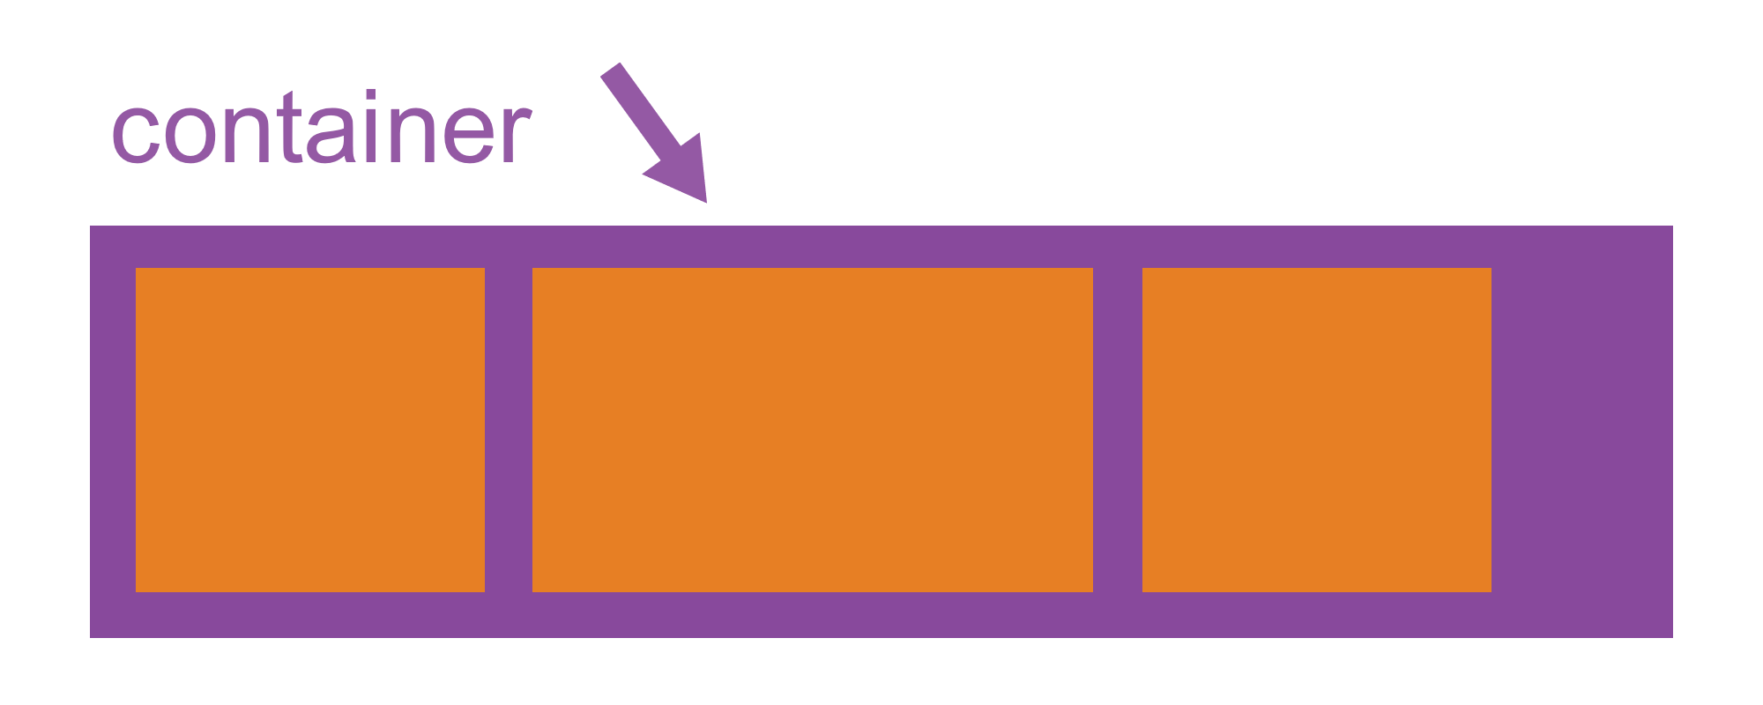
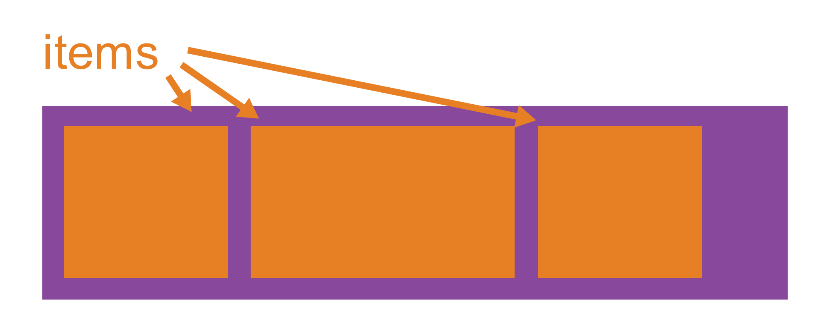
A Beginner’s Guide to CSS Flexbox (3)
How do we begin?
First off, inside one of your selectors you want to style, you need to set the display of the container
i.e. The “display” property of your container must be set to the value “flex”
Then, we can add more properties into the same container to define how this particular box should look like when under Flexbox

Slide 49
A Beginner’s Guide to CSS Flexbox (4)
Words here cannot describe how useful Flexbox is…
We might need to take a look at it in action!
In the meantime…

Slide 50

Break #2

Slide 51
Let’s put all of this inTo action!
To recap, we have seen the embedded <style> tags and the external reference to CSS files.
I briefly mentioned that you can do inline styling
These are three ways that you can style something!
But, let’s pull up your favourite editor and let’s start coding to be able to play around with these concepts!

