Slide 1
Background
This week we’re looking at two papers that are related in that they both incorporate external knowledge. Both papers are from EMNLP 2021. The first paper is from emnlp looks at the use of models trained on GLUE benchmarks as a proxy for human dialogue system evaluation. The authors find there is a correlation between how GLUE evaluates dialogue systems and how humans evaluate dialogue systems along certain dimensions. The second paper

Slide 2
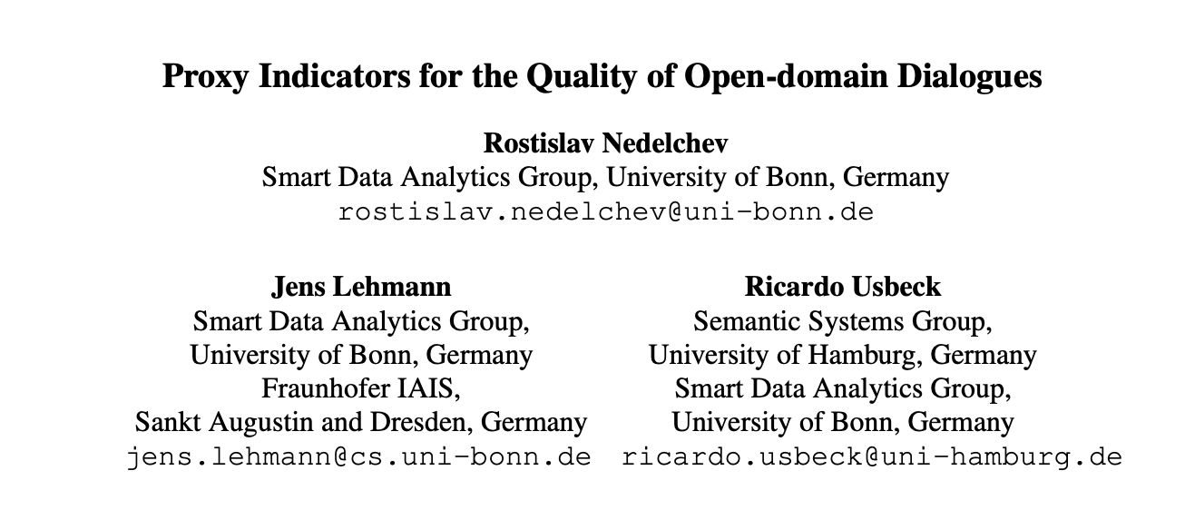

Slide 3
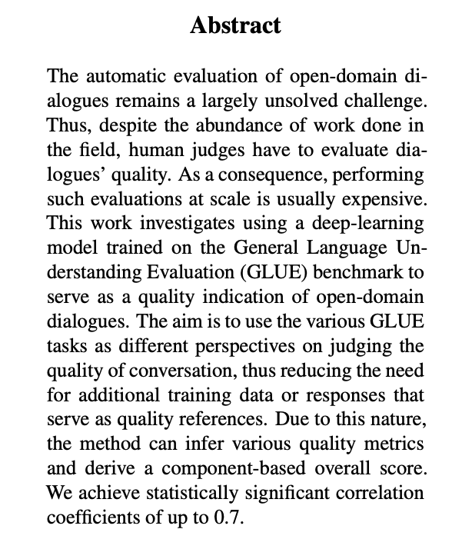
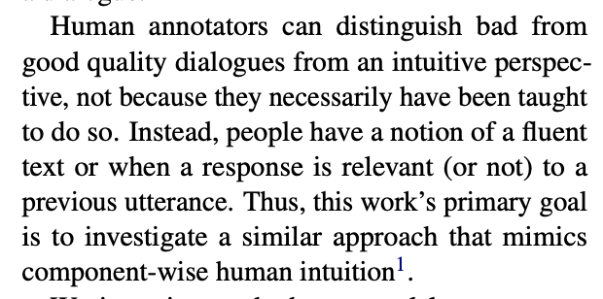

Slide 4
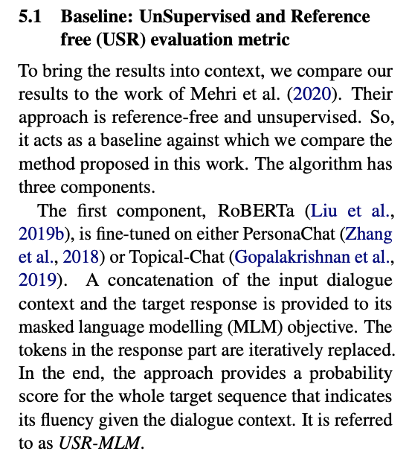
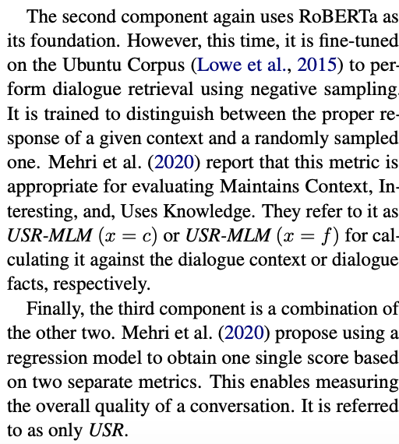

Slide 5
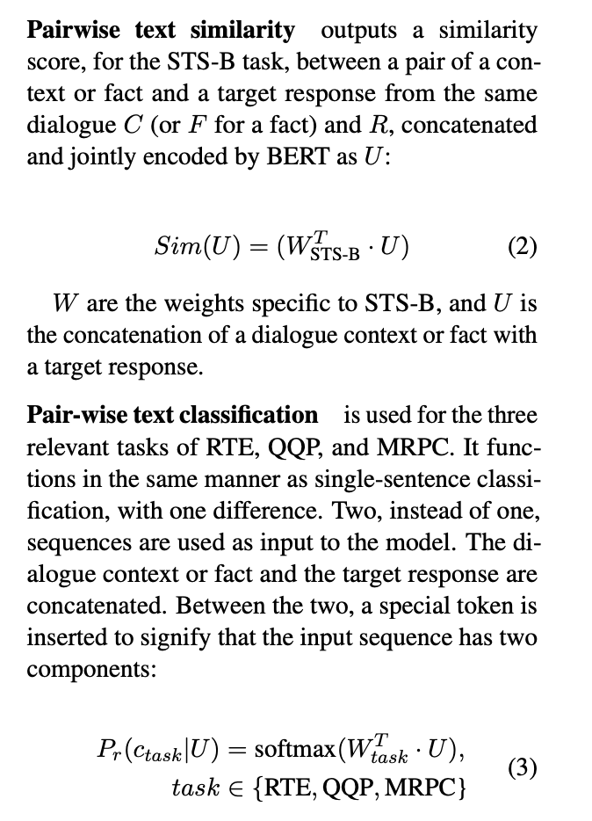
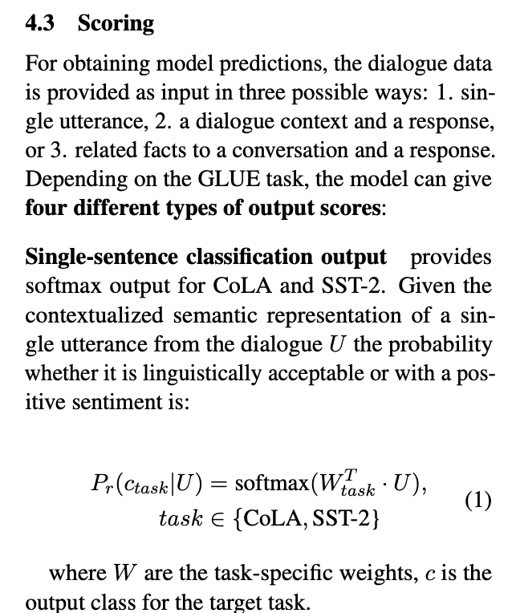

Slide 6
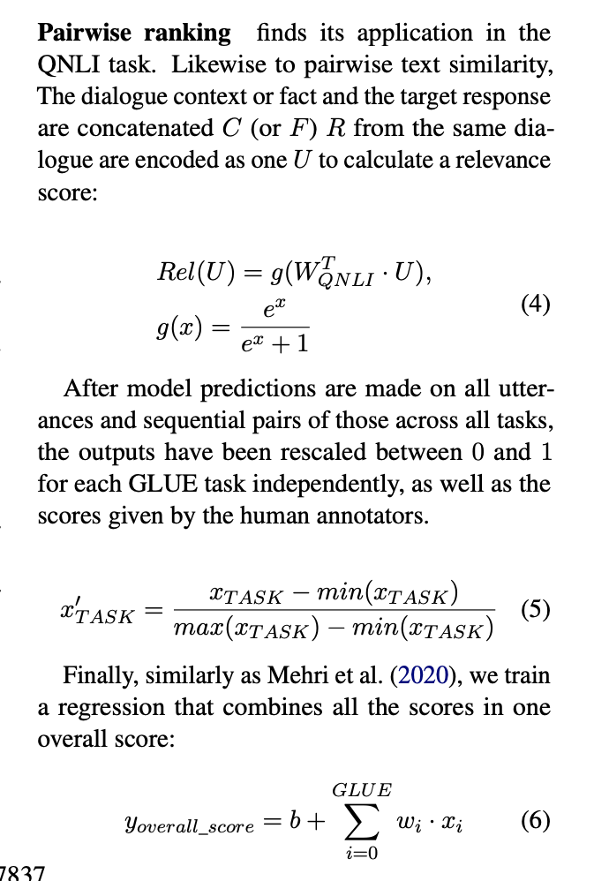

Slide 7
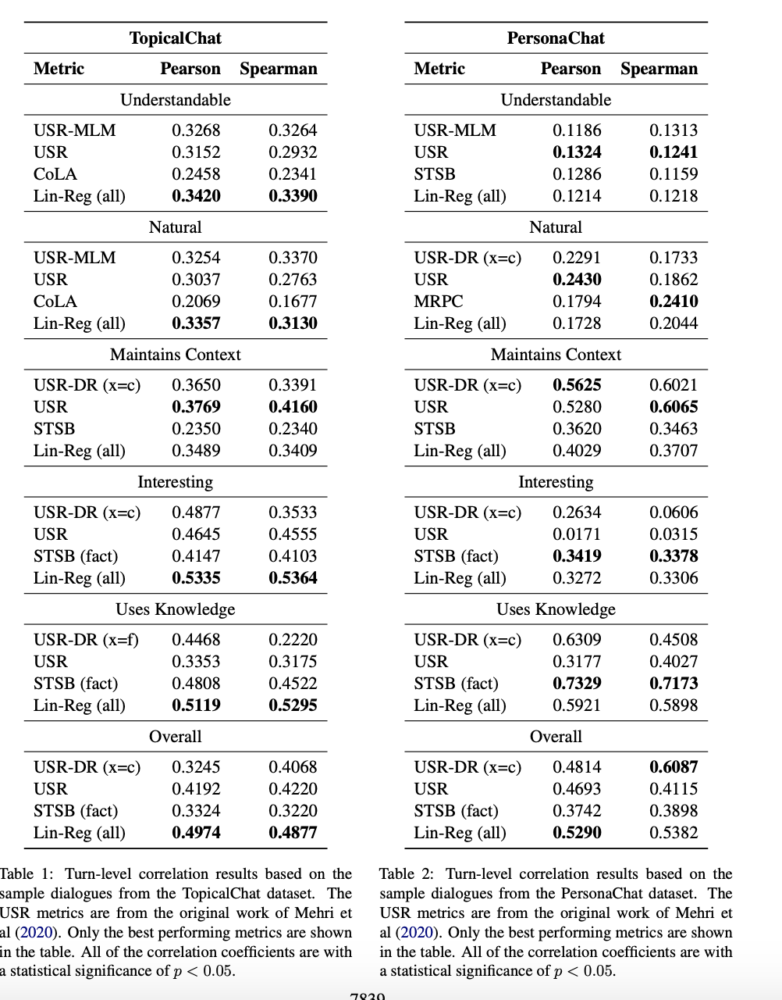

Slide 8
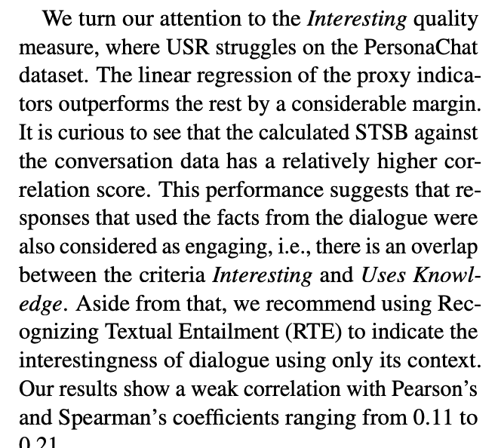

Slide 9
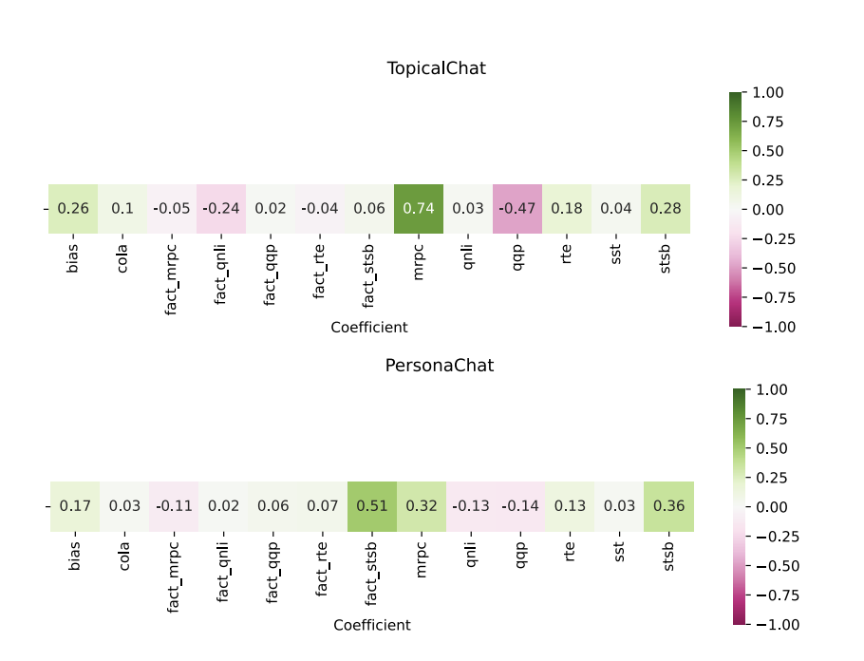

Slide 10
Synthesis
I’m not entirely sure what to think of this paper. 30-40% correlation seems fairly low. It’s an interesting line of research. I think it would be interesting to see examples where the model misclassified. I do like that this approach allows for “apples-to-apples” comparisons. The same fine-tuned bert models could evaluate many different dialogue systems given a set of prompts. However, it’s not clear to me that this is the best reward function- GLUE’s domain is limited in some ways. For example, grammatical mistakes made by foreign speakers might not be the same types of mistakes made by a dialogue system.

