Slide 2
SmartKom Scientific Goals
explore and design new symbolic and statistical methods for the seamless fusion and mutual disambiguation of multimodal input on semantic and pragmatic levels
generalize advanced discourse models for spoken dialogue systems so that they can capture a broad spectrum of multimodal discourse phenomena
explore and design new constraint-based and plan-based methods for multimodal fission and adaptive presentation layout
integrate all these multimodal capabilities in a reusable, efficient and robust dialogue shell that guarantees flexible configuration, domain independence and plug-and-play functionality

Slide 3
“ The long-term goal of the research in multimodal dialogue systems is to allow the average person to interact with computerized technologies anytime and anywhere without special skills or training, using such common devices as a smartphone or a PDA”

Slide 4
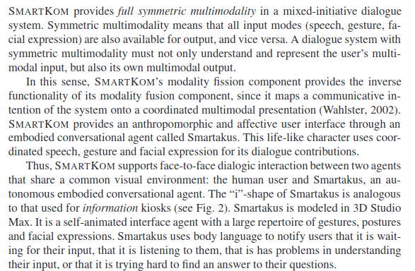

Slide 5
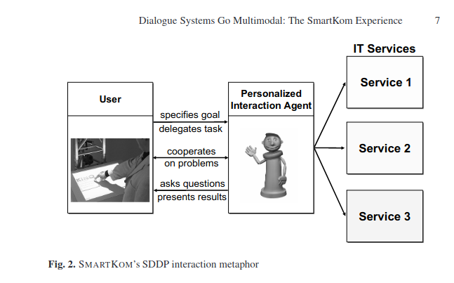

Slide 6
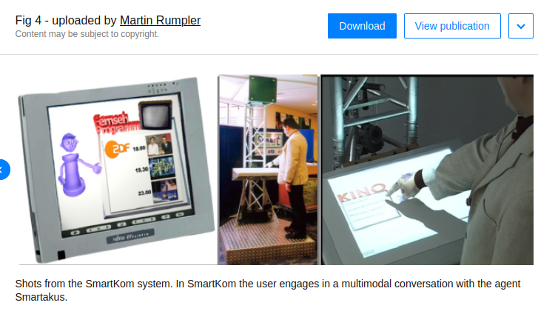

Slide 7
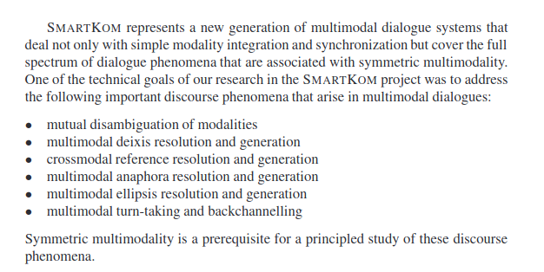

Slide 8
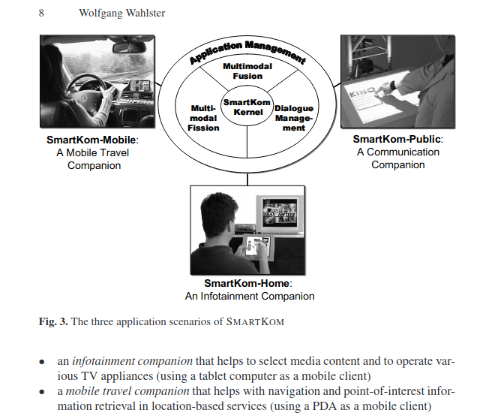

Slide 9
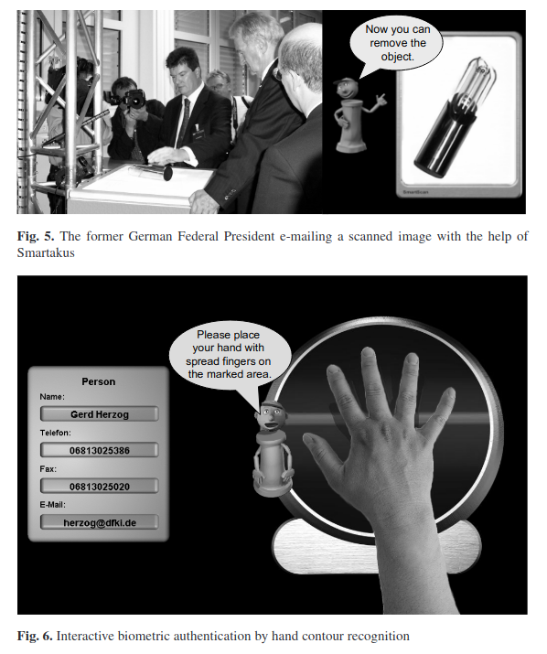

Slide 10
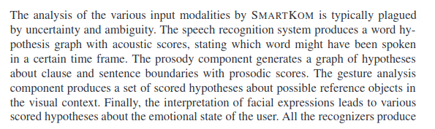
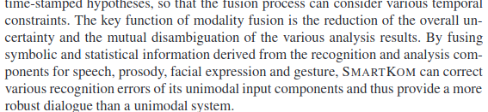

Slide 11
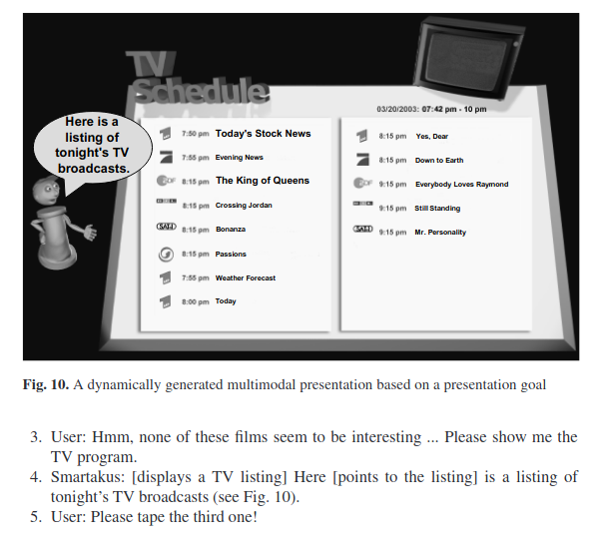

Slide 12
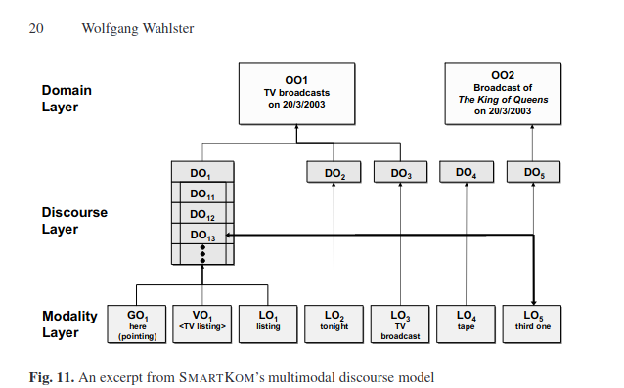

Slide 13
Synthesis
Reminded me of Instructional AI- could be really useful in the near future http://www.cs.cmu.edu/~NatProg/papers/HCIC%20Sugilite%20-%20Myers%202018.pdf
I think it’s a good software/ system description paper, but it never clearly divulged what models are being used or how inputs are being fused. In some ways that may be a good thing, as it was written in 2006 and those methods are sub-optimal in 2021. I still would’ve been interested in a formal description of how the inputs were processed and modeled. I can actually imagine this becoming a big thing in the next few decades- Tom Mitchell mentioned something similar.

Slide 14
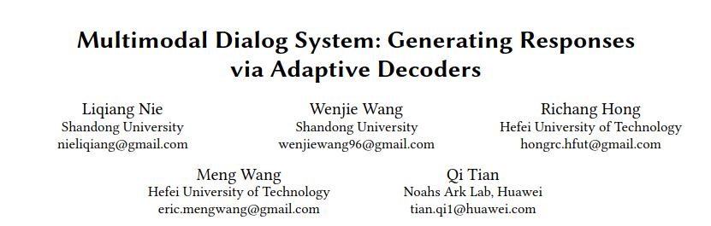

Slide 15
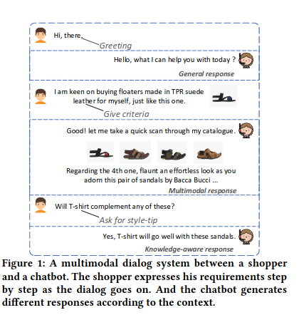

Slide 16
Process
To be more specific, our proposed MAGIC model first embeds the historical utterances via a multimodal context encoder. It then understands users’ diverse intentions conveyed in the multimodal context by classifying them into 15 categories, such as greeting, giving criteria, and purchasing. According to our statistics over the MMD dataset, responses to these 15 kinds of intentions are in three variants without exception: general responses in texts, knowledge-enriched responses in texts, and the multimodal responses in the form of texts and images

Slide 17
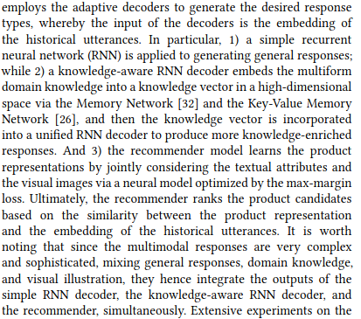

Slide 18
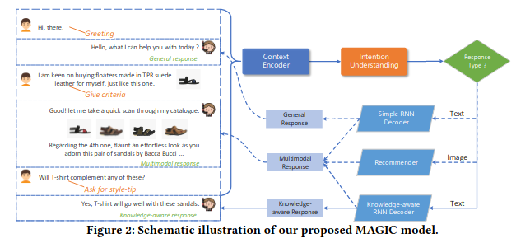

Slide 19
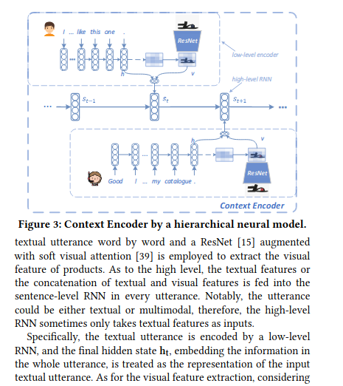
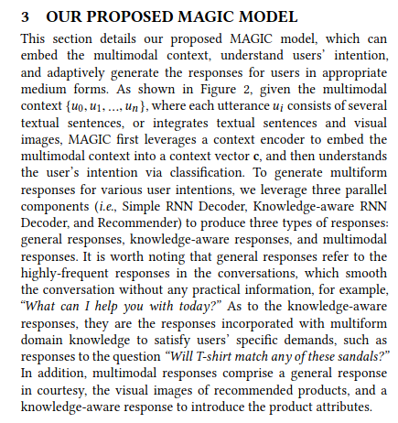

Slide 20
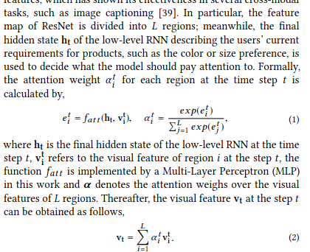
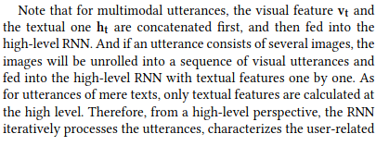

Slide 21
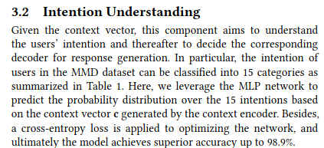

Slide 22
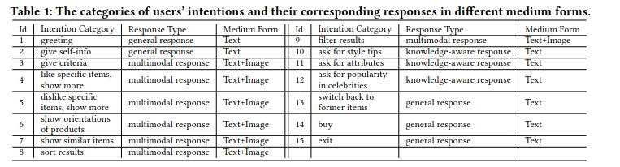

Slide 23
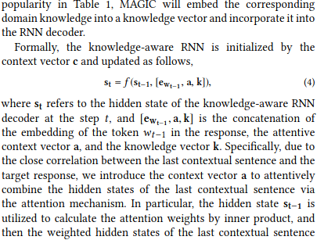
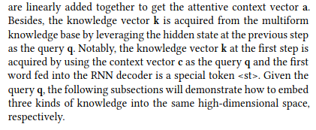

Slide 24
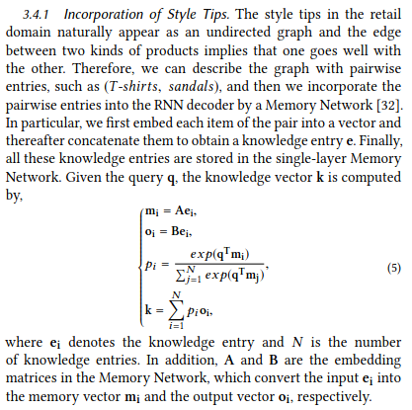
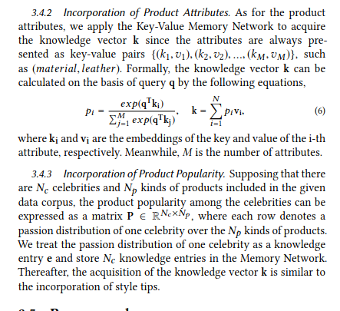

Slide 25
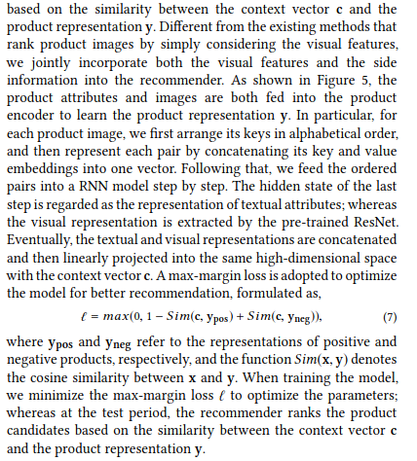

Slide 26
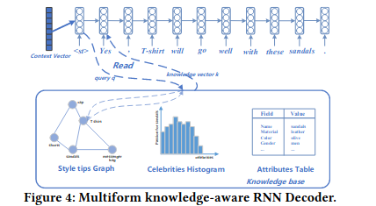

Slide 27
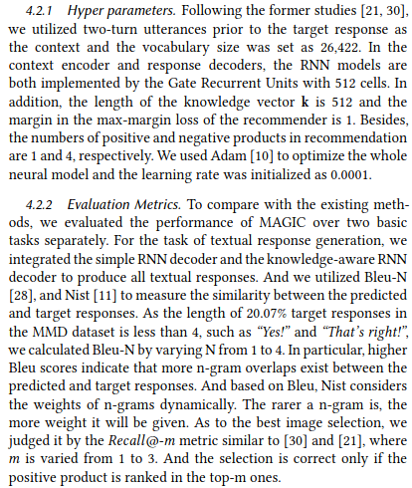

Slide 28
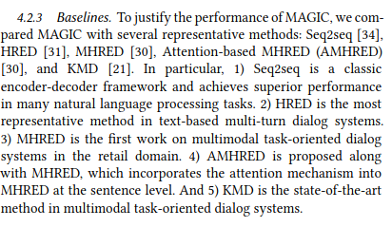

Slide 29
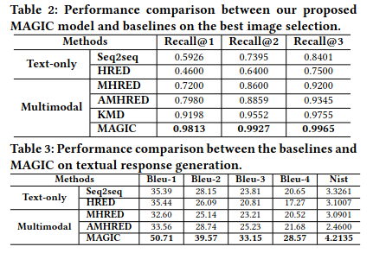

Slide 30
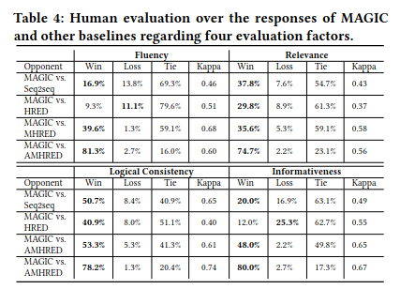

Slide 31
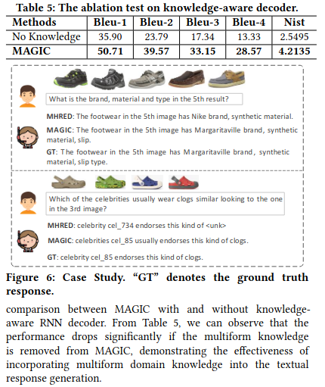

Slide 32
Synthesis
Generally a strong paper with detailed descriptions of their model and approach. I don’t think this approach could be extended very far – resnet encodings only encode a few dimensions of objects. If logos or brand mattered, this model probably wouldn’t be very helpful. These are the highest BLEU scores I’ve seen yet in a dialogue system paper- this makes sense given that this is largely an IR task.

Slide 33
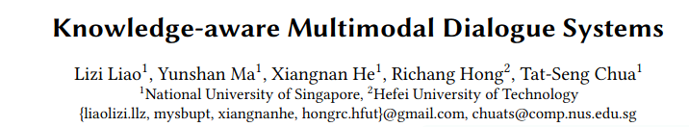

Slide 34
(1) In each turn, given a multimodal utterance, the agent attempts to understand the semantics inherent in product images via a taxonomy-based learning model which captures the category and attributes of product.
(2) Besides modeling utterances using the HRED network, the agent employs an attention mechanism over the extracted domain knowledge and decides which knowledge is relevant to the current context. The agent thus generates responses based on the conversation history and relevant knowledge stored in a memory network.
(3) Based on the extended HRED backbone network, we apply deep reinforcement learning that accounts for future awards to optimize the neural conversational model using policy gradient methods.

Slide 35
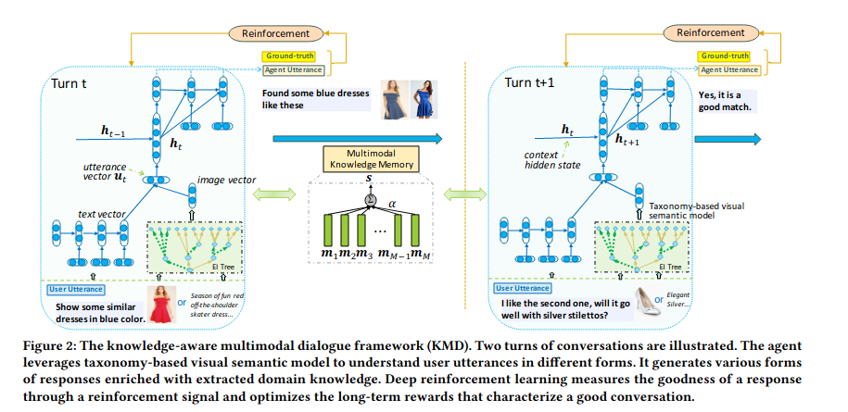

Slide 36
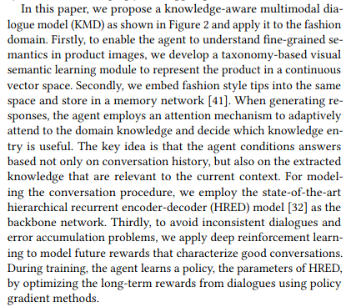

Slide 37
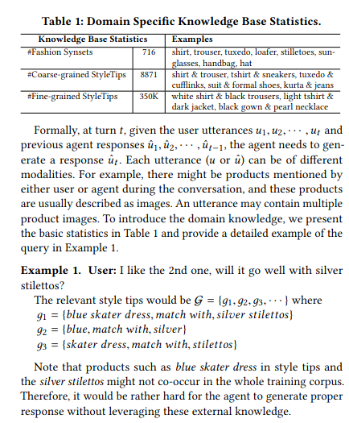

Slide 38
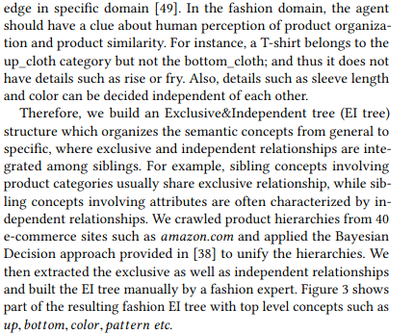

Slide 39
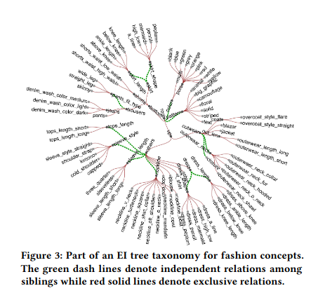
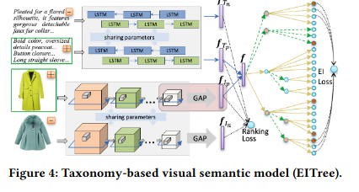

Slide 40
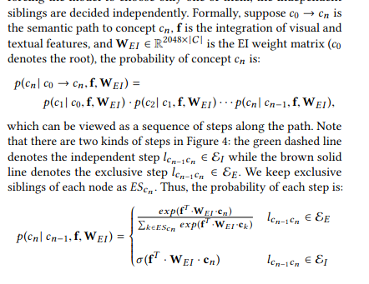
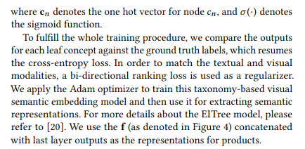

Slide 41
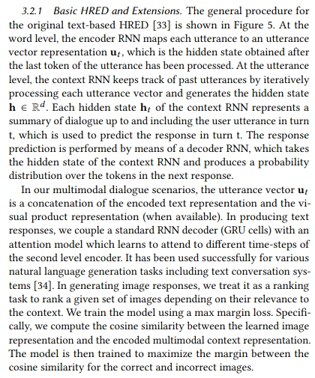
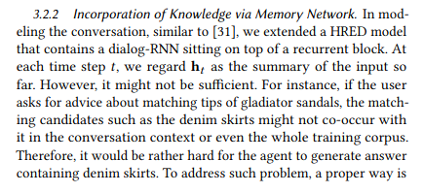

Slide 42
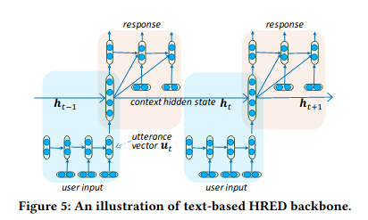

Slide 43
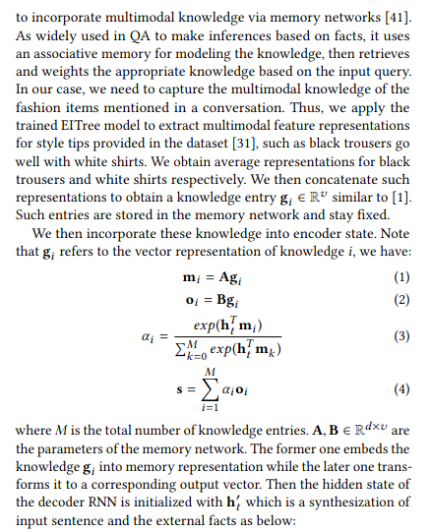
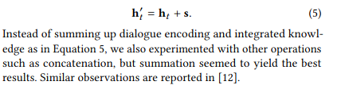

Slide 44
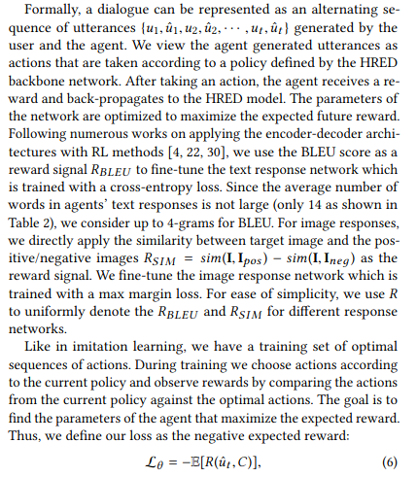
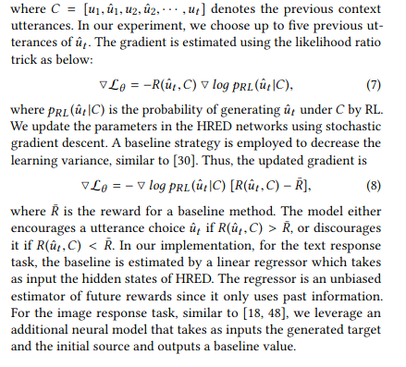

Slide 45
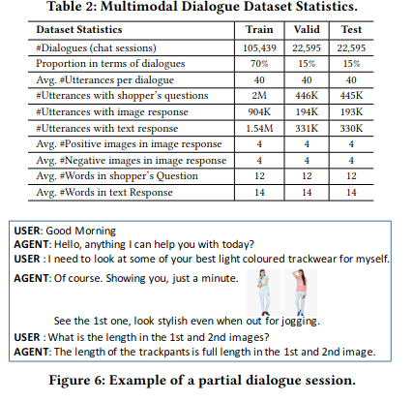
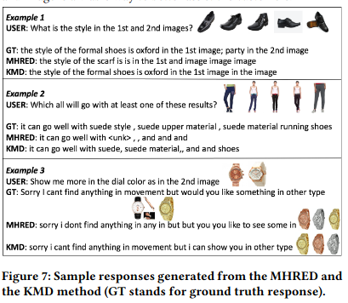

Slide 46
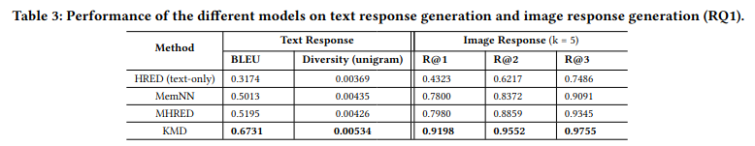


Slide 47
Synthesis
Technically, a very strong paper. I didn’t fully understand the intuition behind using RL as opposed to other approaches that increase response diversity (e.g., diverse beam search, diversity promoting loss functions). In most dialogue scenarios, it seems like BLEU would be a bad reward and evaluation metric, but for a system with such a clear goal and scope, maybe it does make sense? I wish they’d included more evaluation metrics and examples of the dialogue system.

