Slide 1


Slide 2
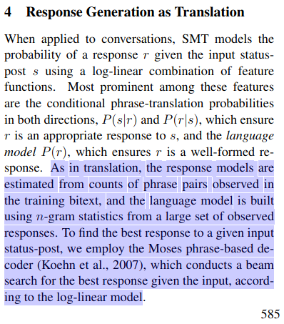

Slide 3
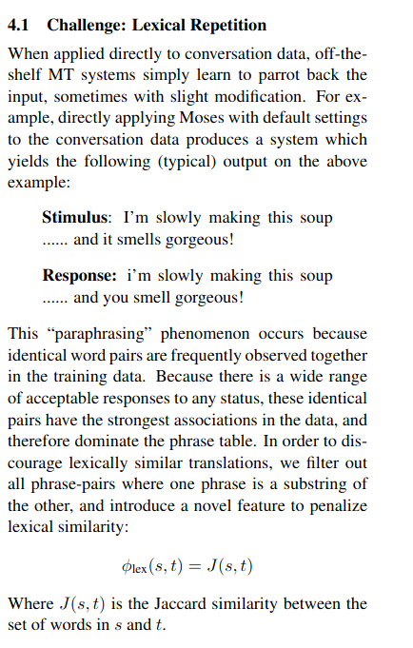

Slide 4
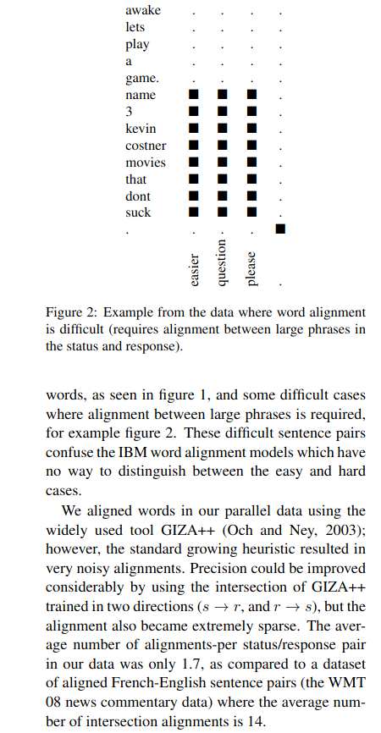

Slide 5
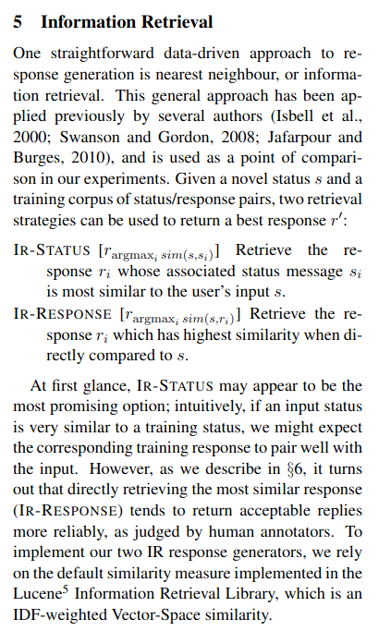

Slide 6
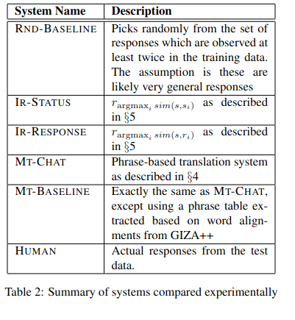

Slide 7
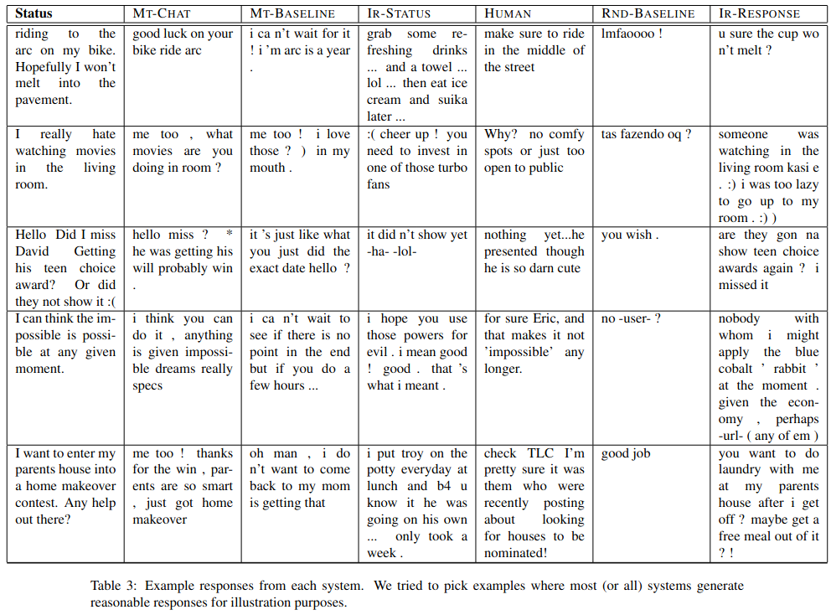

Slide 8
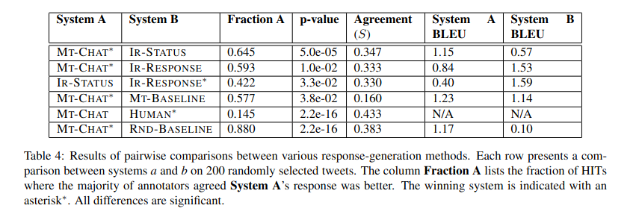

Slide 9
Synthesis
System is fairly rudimentary by today’s standards and even the cherry-picked results shown in the paper were pretty bad. The authors seem to have concluded early on that BLEU isn’t fit for this task, so it’s somewhat surprising that current papers still rely on it. However, this was early work and possibly the first attempt to cast dialogue processing as an MT problem, so it was significant and trailblazing despite its limitations. Additionally, the authors clearly thought through many of the problems that would arise when thinking about dialogue as an MT system.

Slide 10
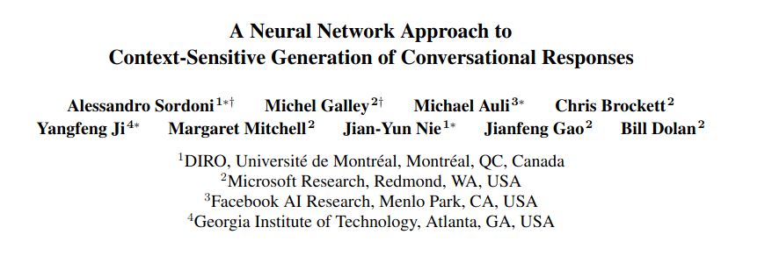

Slide 11

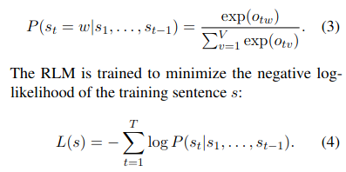
ΘRNN = 〈Win,Wout,Whh〉: an in-
put matrix Win, a recurrent matrix Whh and an output
matrix Wout
ΘRNN = 〈Win,Wout,Whh〉: an input matrix Win, a recurrent matrix Whh and an output
matrix Wout
Let us denote by st both the vocabulary token and its one-hot representation, i.e., a zero vector of dimensionality V with a 1 corresponding to the index of the st token.

Slide 12
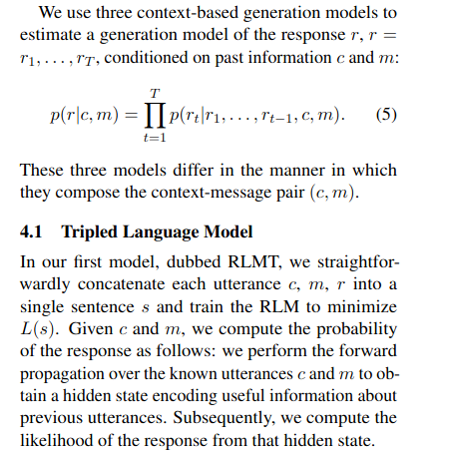
C = context, m = message, r = response

Slide 13
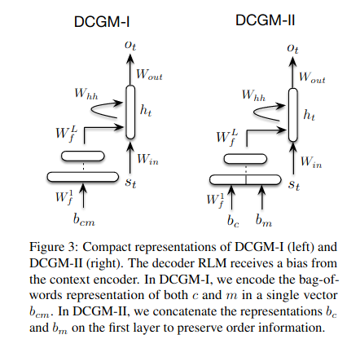
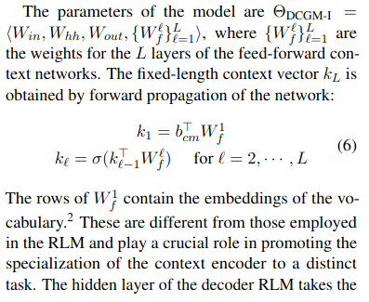

Slide 14
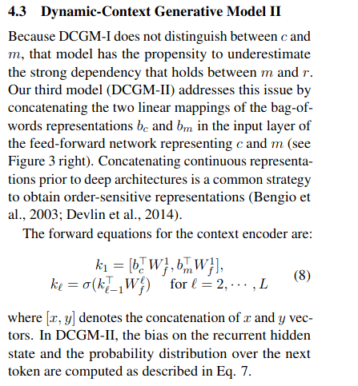
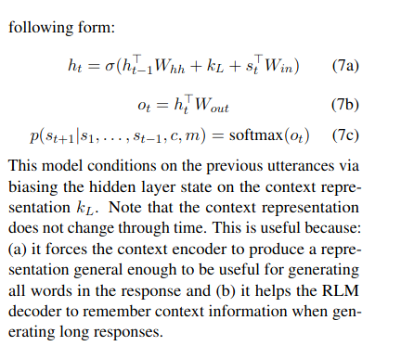

Slide 15
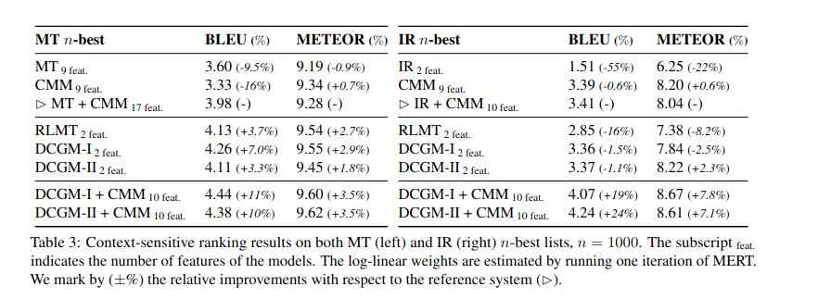

Slide 16
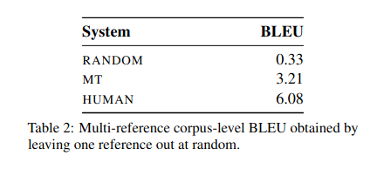

Slide 17
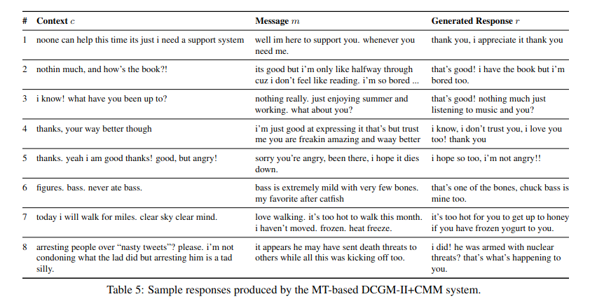

Slide 18
Synthesis
A more advanced approach by modern standards, but still simple in many ways. The kl vector was an interesting idea- it seems like they wanted a kind of a proto-LSTM/GRU. They stated the kl vector was important, but didn’t really say why. Along with BLEU, the authors also used METEOR, but it seems clear that these are bad metrics to evaluate this task.

Slide 19
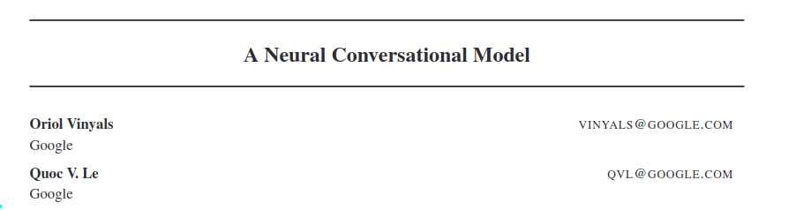

Slide 20
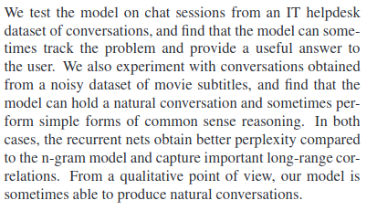

Slide 21
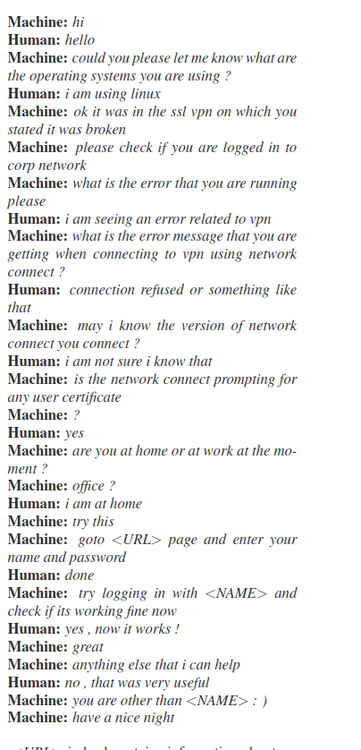
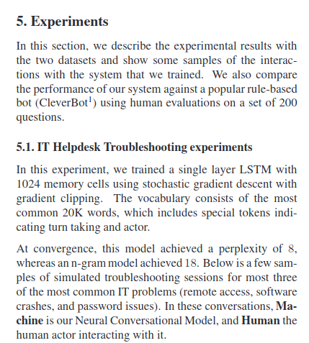

Slide 22
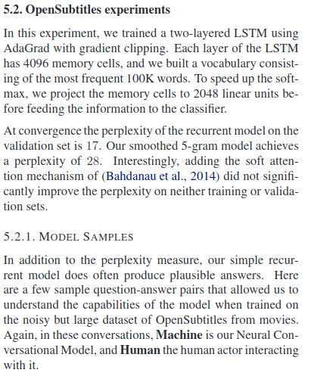
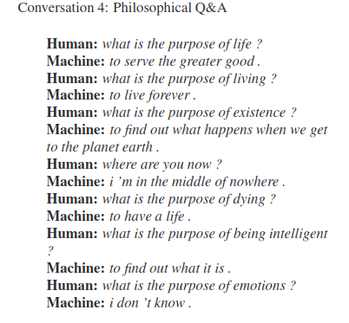

Slide 23
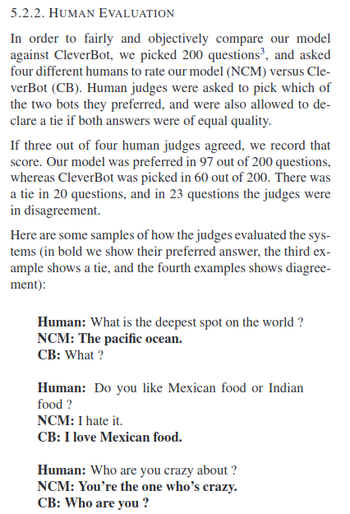

Slide 24
Synthesis
Seemed more like a white paper than a conference paper. They only spent a paragraph outlining the architecture, which I kind of enjoyed. I liked being able to see all of the examples. It seems like this was a substantial improvement over the quality of the SMT and the RNN-based (non-LSTM) dialogue systems- at least based on cherry-picked examples. It’s a shame there’s not consistent evaluation across systems.

Slide 25
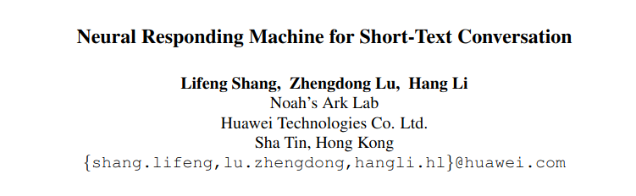

Slide 26
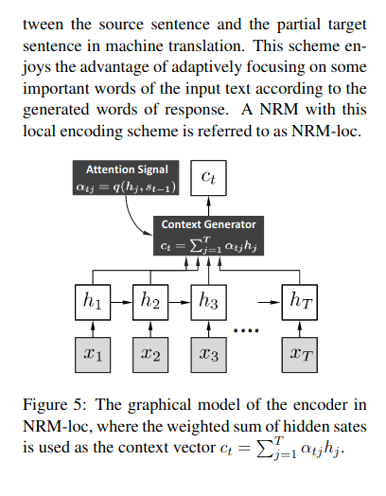
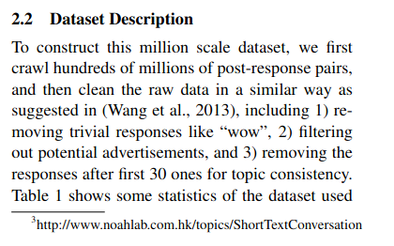

Slide 27
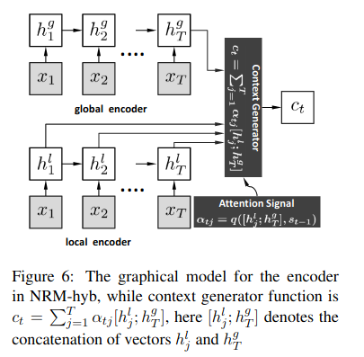
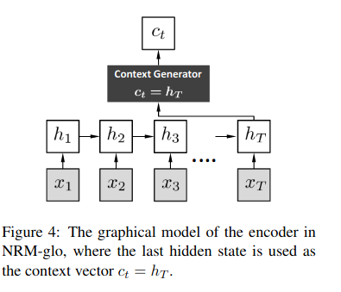

Slide 28
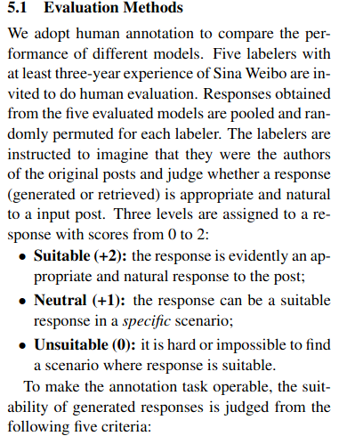

Slide 29
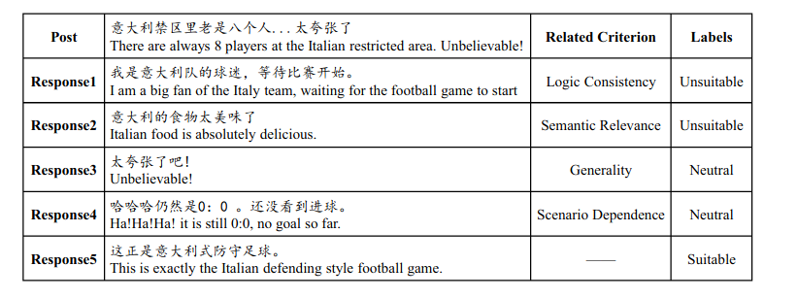

Slide 30
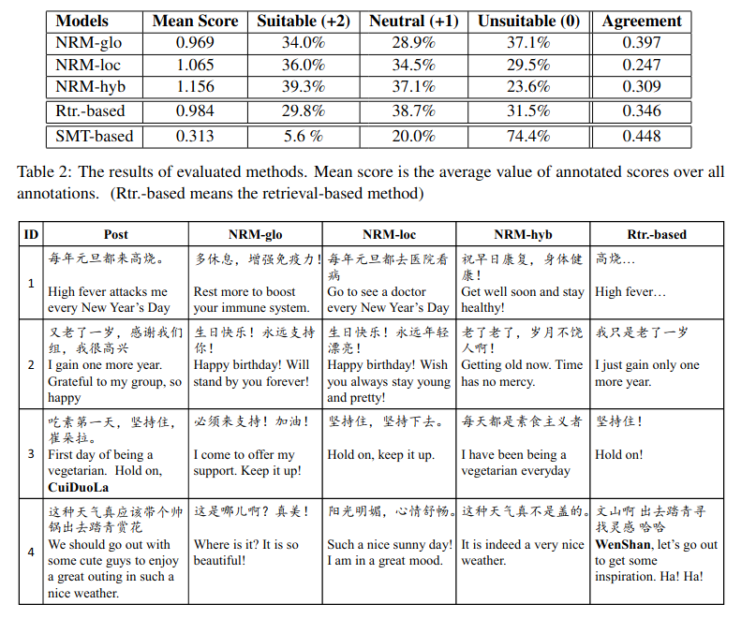

Slide 31
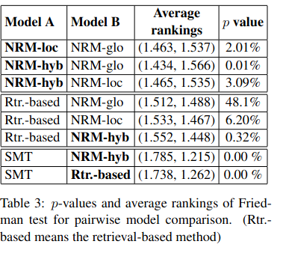
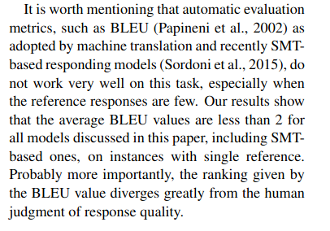

Slide 32
Synthesis
Really cool that attention was being used back in 2014. If I had to bet money on which of these systems could be the strongest, if trained and evaluated by humans on the same data, I’d probably vote this one. I really like how the authors spelled out evaluation metrics in this paper and include strict annotation guidelines on what constitutes acceptable and unacceptable responses. This was also the only paper that talked about cleaning data prior to training. This was probably the strongest of these papers IMO.

