Slide 1
CpE2210
Introduction to Digital Logic
Dr. Minsu Choi
CH 1,2. Introduction to Concepts in Digital Systems & Computer Arithmetic

Slide 2
What is a Digital System?
A digital system is an electronic network that processes information using only digits (numbers) to implement calculations and operations.
Binary number system is used for digital systems in general.

Slide 3
Binary number system
The mostly used number system for a digital system.
Base-2 number system.
Base-10 number system, decimal.
Base-8 number system, octal
Base-16 number system, hex
Each digit can be either a value of 0 or 1. The number themselves (0 or 1) are called bits.

Slide 4
Digital system tasks
Input translation: translates information from our world into a binary “language" that can be understood by the digital network.
Data processing: performs the required calculations and operations using only the binary digits 0 and 1.
Output: returns an answer to our world in a form that we can understand.

Slide 5
Views of a Digital System
A digital network can be viewed in different ways:
  Hierarchies - primitive units -> more complex units -> even larger units.
  Logic networks - digital network is based on the behavior of Binary numbers. It is possible to describe any digital network in terms of the fact that groups of binary variable can be used to represent virtually any set of data.
  Electrical circuits - the physical realization of a digital network is accomplished by using electronic components that control the flow of electric current in a manner that implements logic operations.
  Formal description - it is possible to describe the behavior of a digital system by using only descriptive phrases that are defined within a context of a "language" HDLs (hardware description languages) can be used.

Slide 6
The Personal Computer (PC)
An excellent example of digital system.

Slide 7
Binary Number System
A Binary variable can store either 0 or 1.
ex) Binary var A = 1(T), A = 0(F)
Unary operation NOT (also called inversion).

Slide 8
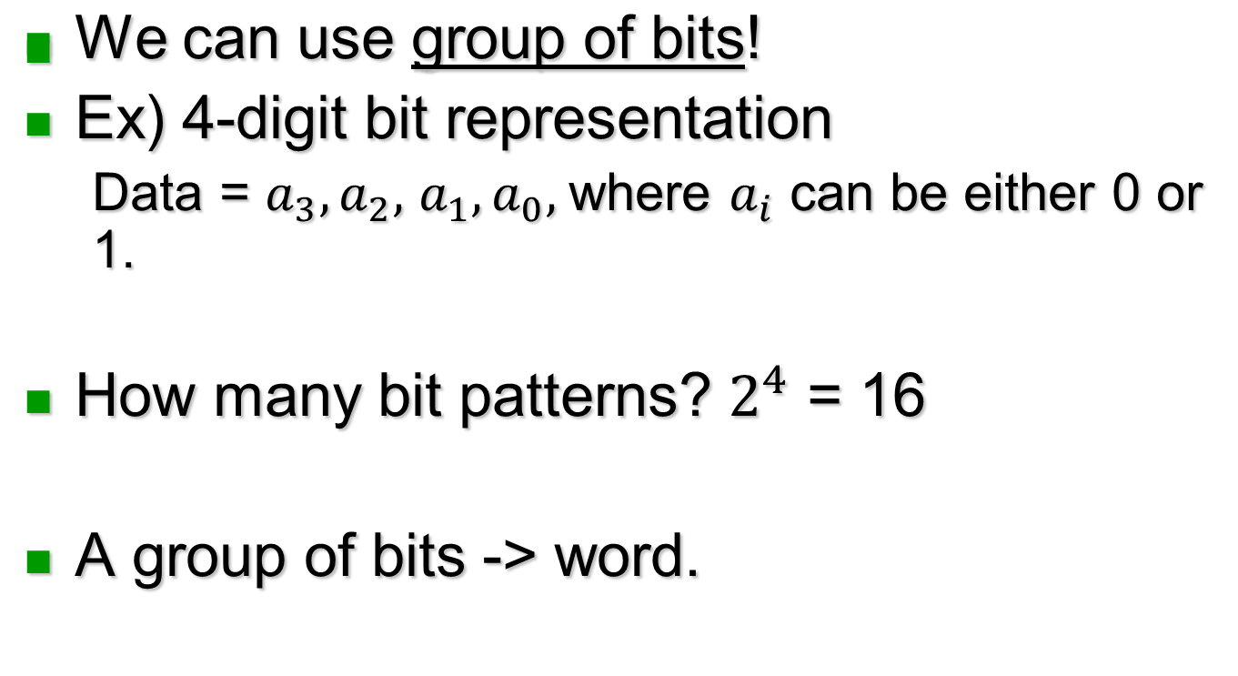
How to describe more complex situations?

Slide 9
Bit & Byte
Suffix b – bit and suffix B – byte such that 1B = 8b (e.g., 1KB = 8Kb = 8 x1024 bits).

Slide 10
Data Representations
Binary numbers can be used to represent anything that we want by designing them in an appropriate manner.
Ex) 4 directions (left, right, forward, backward)

Slide 11
Encoding & Decoding
Encoding: The process of giving meaning to a group of bits.
Decoding: The reverse process where a binary number is interpreted for our use.

Slide 12
Binary and Decimal Numbers
We live in a world where there are ten symbols (0-9) -> Decimal number system.
Digital systems use binary number system in general.
Dec -> Bin and Bin -> Dec translations are discussed in this section.

Slide 13
Number Theory
Each number system has base (or radix).
Decimal number system’s base is 10.
Each digit can be either one of 10 symbols from 0 to 9 in decimal.
Base or radix r for a number system.
r=2 -> Binary (Base-2)
r=8 -> Octal (Base-8)
r=10 -> Decimal (Base-10)
r=16 -> Hexadecimal or Hex (Base-16)

Slide 14
Binary to decimal conversion
To represent 0-9 (decimal) using binary words, 4 binary digit word is required, since 2^3 = 8 < 10 < 2^4 = 16.
Let us construct a 4-bit Binary word.
This shows that a binary digit in N_{j} has a base-10 weighting of 2^j.

Slide 15
Examples
0101 1100 = 0*2^7 + 1*2^6 + 0*2^5 + 1*2^4 + 1*2^3 + 1*2^2 + 0*2^1 + 0*2^0 = 4+8+16+64
Bin -> Dec conversion can be used to decode binary number output to human-friendly decimal number output.

Slide 16
Decimal to binary conversion: successive division algorithm
Ex) Convert 19₁₀ into binary number.

Slide 17
Continued,
Ex) Convert 56₁₀ to binary number.

Slide 18
Fractions
Bin->Dec: a binary fraction can be written in the form...
Its corresponding decimal fraction is…
Ex)

Slide 19
Continued,
Dec->Bin: successive multiplication algorithm.
Ex)

Slide 20
Round-off error
The accuracy of the translation from decimal to binary depends on the number of bits that are used in the base-2 word.
Ex)

Slide 21
Continued,
The smallest resolution allowed is 0.0625. So, it is not possible to represent numbers between these decimal values using the 4-bit binary fraction.

Slide 22
Round-off error calculation
Ex)

Slide 23
How to overcome this problem?
Add more bits to the binary representation.
Ex)

Slide 24
Hexadecimal (base-16, radix r=16) numbers
It has 16 symbols for each digit.
Each digit is called “Hex” digit.
Hex -> Bin and Bin -> Hex conversions are easy due to the fact that 4-bit binary word is equivalent to single hex digit.

Slide 25
Examples

Slide 26
Cells & Hierarchy
Cells: fundamental building blocks to create a digital system.
Logic diagrams: Graphical representations of digital networks can be used for both analysis and design.

Slide 27
Ex) 3 binary input variables and one output cell
The input & output points of the cell are called ports. They allow the cell to be connected to their cells.

Slide 28
Creating a large system
Use small cells to build larger cells with more complex functions.
Signal flow paths (= transmission wires = interconnects) are used to interconnect cells.
Ex) Serial data flow path connecting two units.

Slide 29
Continued,
Ex) Parallel data flow connection.

Slide 30
Hierarchical design
The idea of using cells as building blocks is called “hierarchical design”.
This concept gives us a structured technique for analyzing and designing complex digital systems.
Two approaches to designing a digital network:
  Top-down : start with large-scale system specs then choose the cells that are needed.
  Bottom-up : start with basic cells to build more complex cells.

Slide 31
System Primitives
A system primitive: a basic function that is used several times to create the entire unit.
Clocks: a periodic signal to synchronize operations. Always makes a transition from 0 to 1 and back.

Slide 32
Examples

Slide 33
Measurement units

Slide 34
Logic gates
Takes input bits and produces an output bit as defined by the logic operation.
Ex) AND gate

Slide 35
Continued,
Ex) Memory cell: capable of capturing and holding the value of a binary variable.
Suppose input D = 1. Then, "1" is stored (= written or loaded) in the memory cell. Once a data bit is stored in the cell, it can be accessed (or read) at the output port X. The clock Φ is used to allow the operation to be synchronized with the rest of the system.

Slide 36
Continued,
Registers: A register is a block of memory cells that can be used to store a word.
This allows for parallel loading and reading of an 8-bit word, synchronized by a clock signal Φ.

Slide 37
Design Metrics
To compare different design solutions, we introduce the concepts of a metric (a unit of measurement).
  Temporal metric (time): ex) 1GHz vs 2GHz CPU.
  Size : PCB based system vs. SoC.
  Electric power consumption: ex) cell phones (battery life 1hr vs. 2hr).

Slide 38
Program Completed
© 2015 Curators of University of Missouri

