Slide 1
CpE2210
Introduction to Digital Logic
Dr. Minsu Choi
CH 5: Digital Hardware & Logic Components

Slide 2
Hardware?
The physical realization of a digital element or system.
How to represent logic 0 and logic 1 states?
  Voltage V, which has units of volts (v).
  Electrical current I, which has units of ampres (A or amps).
Two are related: a voltage causes electrical current to flow.
Most digital logic chips use two different voltage ranges to define logic 0 and logic 1 conditions.

Slide 3
Power Supply
All electronic networks require a power supply to operate.
In digital circuits, the power supply is usually modeled as a voltage source with a value that we will denote by V_{DD} (usually 5v, 3.3v or 2.5v).
Ex) schematic diagram of a digital system with a power supply (since the drawing shows the “scheme” used to construct the circuit).

Slide 4
Logic Levels
Logic 0 -> 0v and Logic 1 -> V_{DD} (ex., 5v), in general.
  Low voltage represents logic 0 & high voltage represents 1 -> called positive logic.
  High voltage represents logic 0 & low voltage represents 1 -> called negative logic.
Two voltage ranges are used in practice.

Slide 5
Digital Integrated Circuits
ICs (Integrated Circuits) = Computer chips.
Dual Inline Package (DIP) is very common packaging technology for computer chips.
To build more complex digital systems -> use PCB (Printed Circuit Board).

Slide 6
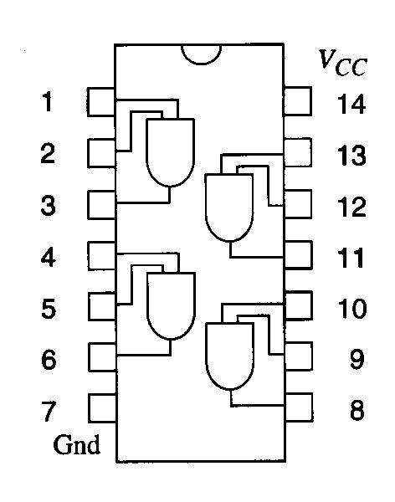
Pin-Out Diagram
The logic functions that a particular chip implements are usually shown by embedding equivalent logic diagrams in package outline drawings.
Ex) Quad-AND chip. V_{CC} is an alternative notation for the power supply voltage.

Slide 7
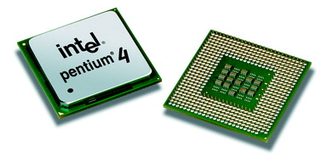
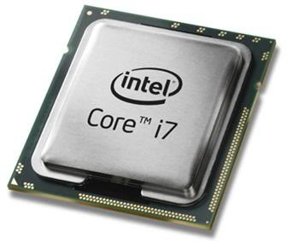
Different Packaging Technologies?
PGA (Pin Grid Array) is used for most microprocessor chips, since larger chip can be embedded and larger # of pins can be allocated.
There are different variations.

Slide 8
IC Integration Levels
SSI (Small-Scale Integration): ICs with a few gates.
MSI (Medium-Scale Integration): ICs with a few hundred gates.
LSI (Large-Scale Integration): 1K – 100K gates.
VLSI (Very Large-Scale Integration): a few million gates.
ULSI (Ultra Large-Scale Integration): around one billion gates.
Ex) INTEL six-core i7 processor has about 1.27 billion gates.

Slide 9
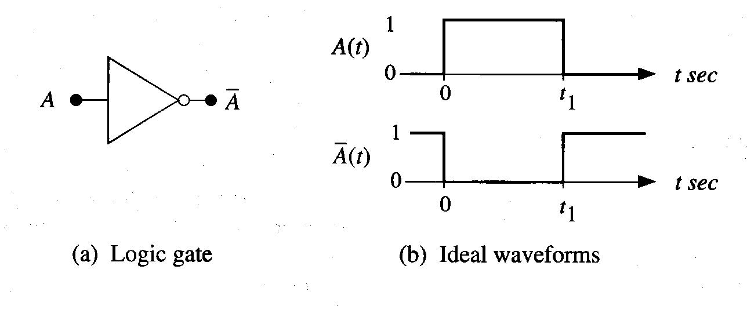
Logic Delay Times
Waveform ( a plot of a variable as a function of time) is used to measure the behavior of a gate.
Ex)
In the real world, a voltage cannot chance instantaneously.

Slide 10
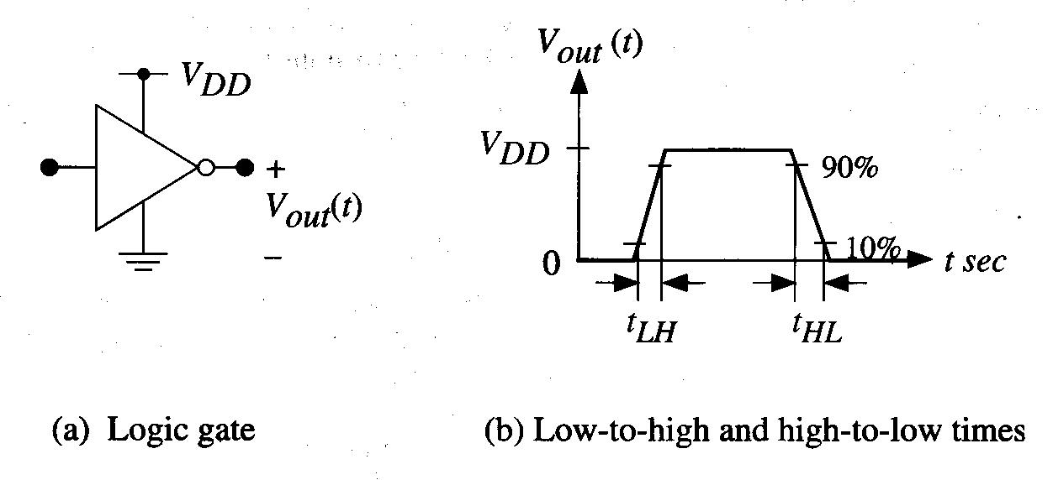
Output Switching Times
Two time intervals must be considered:
  t_{LH}, the output low-to-high time, also called the rise time, t_{r}.
  t_{HL}, the output high-to-low time, also called the fall time, t_{f}.
  By convention, these time intervals are not measured between 0v to VDD, but represent the transition required between 10% to 90% voltage levels, as shown below.

Slide 11
Continued,
The minimum amount of time needed for the gate to switch from 0 to 1 then back again is given by:
The maximum switching frequency is:
=max # of logic transitions that the gate can make in 1 sec.
Ex)

Slide 12
Propagation Delay
It can be hard to keep track of both delay times for every logic gate.
At the logic design level, it is simpler to introduce a single delay time that represents an average switching time, called “propagation delay”, from the input to the output.
This is to include the physical delay of a logic signal as it “propagates” through a chain of gates.

Slide 13
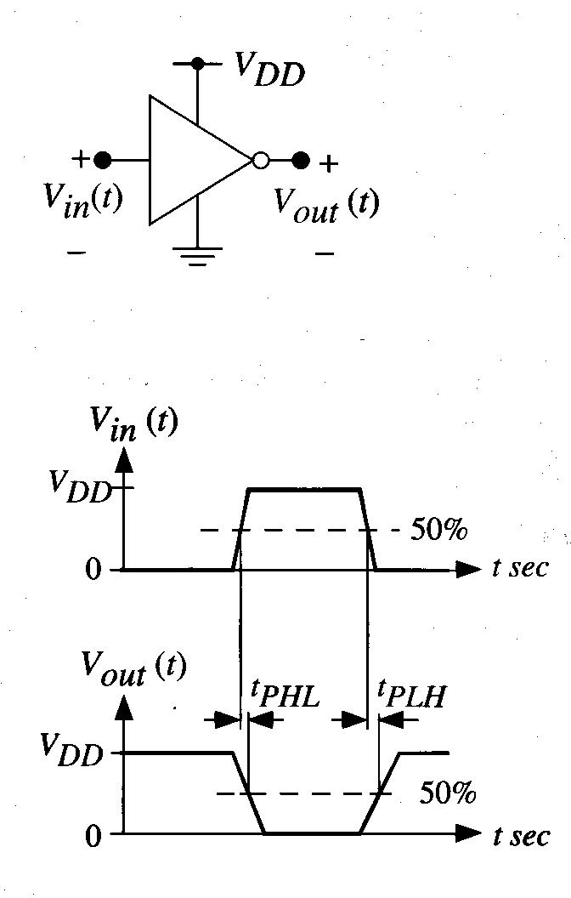
Inverter Gate Example
Then, t_{P} (=propagation delay) = 1/2 (t_{PHL} + t_{PLH}) or =max(t_{PHL}, t_{PLH}), alternatively.

Slide 14
Fan-In & Fan-Out
The fan-in of a digital logic gate refers to the number of inputs.
Ex) inverter has fan-in of 1 and NAND2 has fan-in of 2.
The fan-in provides information about intrinsic speed of the gate -> the propagation delay increases with the fan-in.
Ex)

Slide 15
Continued,
The switching time of an electronic gate depends on the number of gates that are driven (or connected) at the output.
The fan-out of a gate is the number of gates that are driven by the output, and it depends how the gate is used in the logic chain -> increasing the fan-out slows down the logic flow through the gate.
If no additional gate -> no load (fan-out=0)
Fan-out=1 ->
Fan-out=N ->

Slide 16
Logic Cascades and Delays
Ex) linear chain of 4 inverters.

Slide 17
Continued,
Ex) Inverter chain with increased internal delay.

Slide 18
Application to Digital Circuits
Transitions 0->1 and 1->0 take time.
The switching time of every digital electronic network is governed by any resistance and capacitance in the network.
Parasitic elements: unwanted resistance and capacitance contributions that cannot be eliminated and that act to slow down the network response.
So, keeping R and C as small as possible is desired!

Slide 19
Transmission Lines
Another type of logic delay arises when we analyze the physics of transmitting a voltage along a wire.
Transmission line signal delay (= t_{s}) + the voltage at the end of transmission line takes time to “build up” to the final value = t_{d}.

Slide 20
Digital Logic Component Concept
It is very difficult to keep track of each gate in designing a large digital system such as a computer.
The hierarchical design approach where a large (“macro”) function is defined using a large block is called a digital component (= element, unit or module).
Ex)

Slide 21
4-Bit Equality Detector
Suppose that we have two 4-bit words
That we wish to compare.

Slide 22
BCD Validity Detector
Bit patterns from 0000 to 1001 are used.
How can we design a detector?
If (ABCD is valid) then F=0 else F=1.
Let’s build a K-map!

Slide 23
Line Decoders
Line decoder is a circuit that allows us to “activate” an output line by specifying a control word.
Ex) Active-high 2/4 decoder

Slide 24
Active-Low 2/4 Decoder

Slide 25
Multiplexer (MUX)
A MUX is a logic component that has several inputs but only a single output. It provides the capability to direct one of the inputs to the outputs.
Ex) 4:1 MUX

Slide 26
4:1 MUX: Internal Circuitry and IEEE Symbol

Slide 27
8:1 MUX
Internal circuitry will be very complex.
2 4:1 MUXs & 1 2:1 MUX can be combined to implement 8:1 MUX.
-> Hierarchical design approach.

Slide 28
Continued,
The select word s₂s₁s₀ can be split into two groups: s₁s₀ to control the 4:1 MUXs and s₂ to select a desired output from them.
Two internal signal x₁ and x₂ can be defined as:
Then,

Slide 29
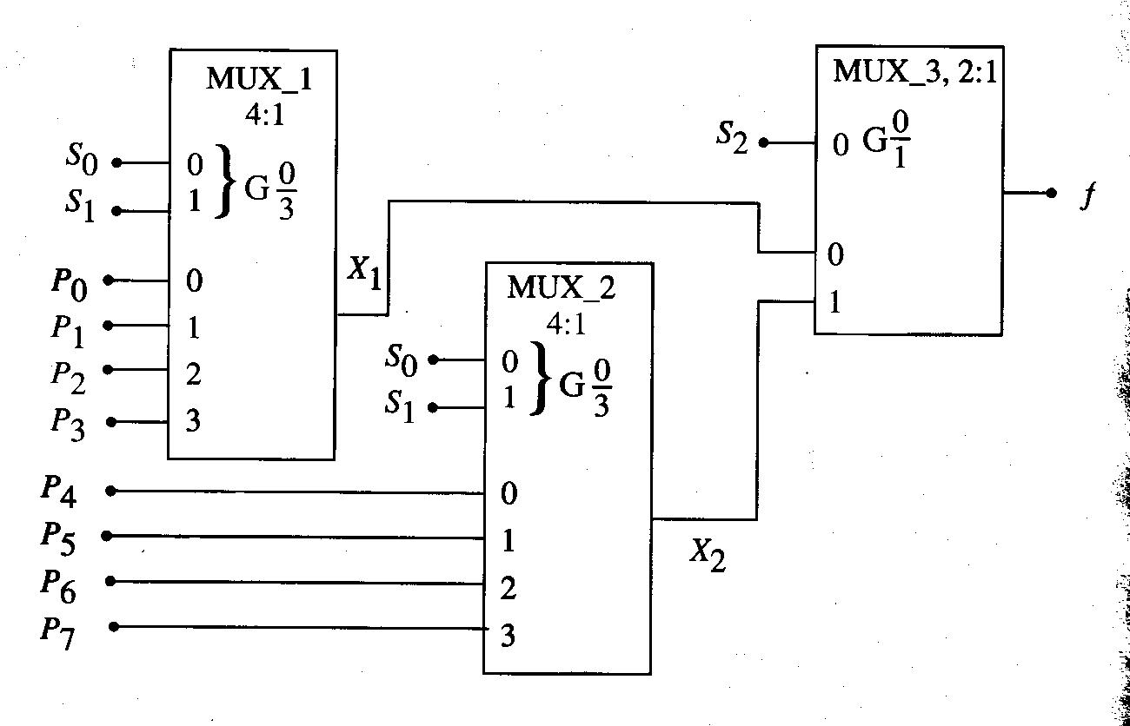
Completed 8:1 MUX Design

Slide 30
MUXs as Logic Elements
A MUX can be programmed to function as a logic element.
Ex) 4:1 MUX OR implementation.

Slide 31
Continued,
Ex) XOR
Ex) XNOR

Slide 32
VHDL Description of 4:1 MUX
entity mux4 is
port(d0, d1, d2, d3: in bit; s : in bit_vector(1 downto 0); f : out bit);
end mux4;
architecture basic of mux4 is
begin
f<=d0 when (s=“00”) else
f<=d1 when (s=“01”)
else
f<=d2 when (s=“10”)
else
f<=d3 when (s=“11”)
end basic;

Slide 33
Demultiplexer (DEMUX)
A DEMUX is the opposite of a MUX. It takes a single input and directs it to one of several outputs.
Ex) 1:4 DEMUX

Slide 34
VHDL Code
entity demux1_4 is
port(x: in bit; s: in bit_vector(1 downto 0); p0,p1,p2,p3 : out bit);
end demux1_4;
architecture operation of demux1_4 is
begin
if s=“00” then
p0<=x;
p1<=‘0’;
p2<=‘0’;
p3<=‘0’;
else if s=“01” then
…
end operation;

Slide 35
Binary Adders
Arithmetic functions such as addition and subtraction can be performed using binary numbers. These types of operations are central to building a computer.
4 cases can be identified for 1-bit addition:
  0 + 0 = 0
  0 + 1 = 1
  1 + 0 = 1
  1 + 1 = 0 with a carry of 1 (called “carry bit”)
The output column is equivalent to XOR function.

Slide 36
Full Adder
A logic network that provides the operations needed to add the bits in an arbitrary column.
3 input bits: a_{n}, b_{n} (data bits) and c_{n} (carry-in bit from the column immediately to the right).
2 output bits: s_{n} (sum bit) and c_{n+1} (carry-out bit).

Slide 37
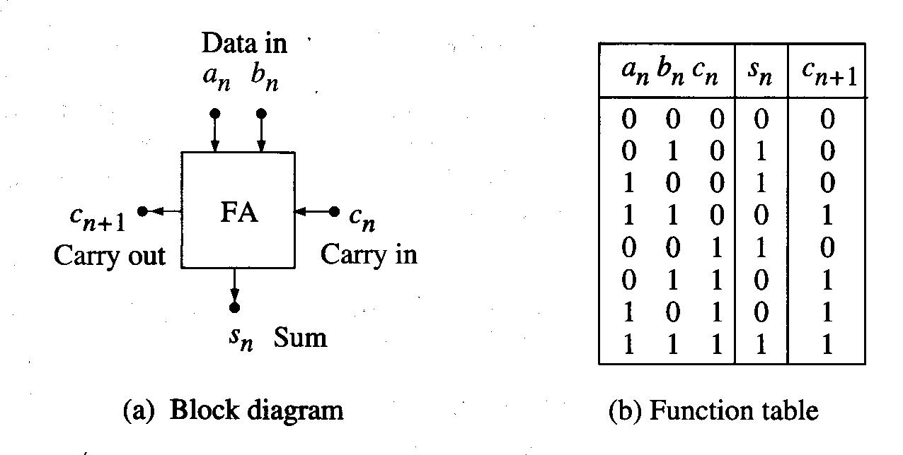
Block Diagram and Truth Table

Slide 38
Simplified Function Forms of s_{n} and c_{n+1}

Slide 39
Half Adder
A special case of the full adder when c_{n}=0 (no carry-in bit considered).

Slide 40
Parallel Adders
Half-adders and full-adders are used to add individual bits together. An extension of this problem is the addition of two n-bit binary words.
Ex)
This shows that we can use a single-bit adder for each column and connect the carry-out bit to the adjacent column to the left.

Slide 41
Overflow Bit
Also note that the sum may be larger than 4 bits.
So, an overflow bit c_{o} is provided such that c_{o} =0 means that 4 bits are sufficient to express the sum, while c_{o} =1 implies that the sum requires more than 4 bits.
Ex)

Slide 42
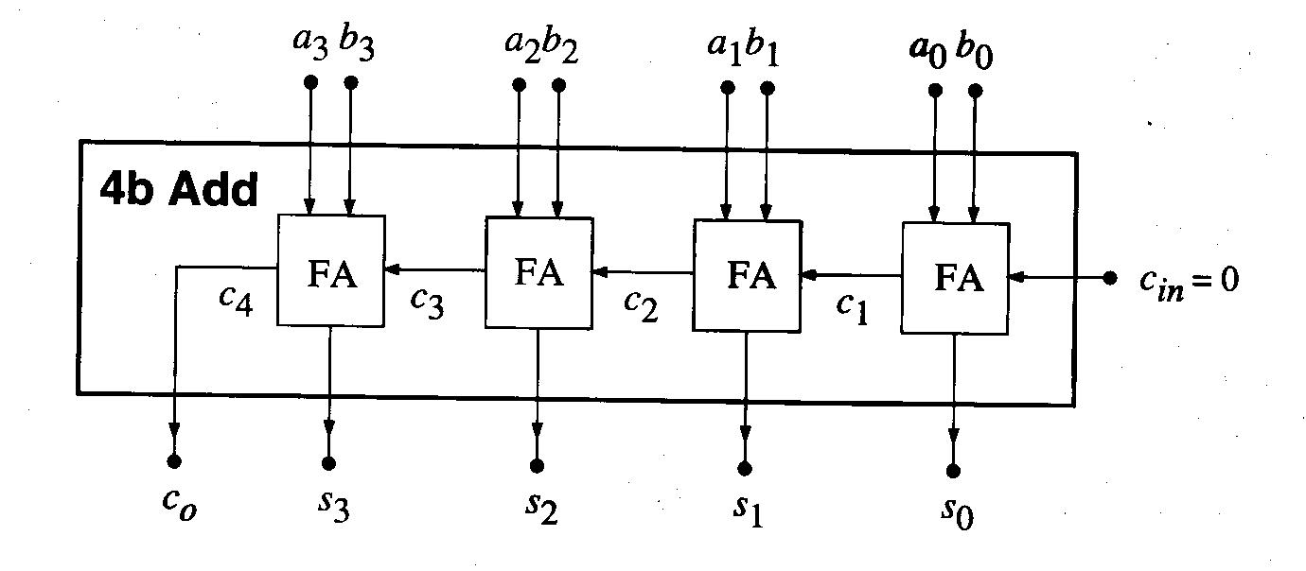
Parallel Adder Design with Ripple Carry Scheme
The carry “ripples” from the right to the left.

Slide 43
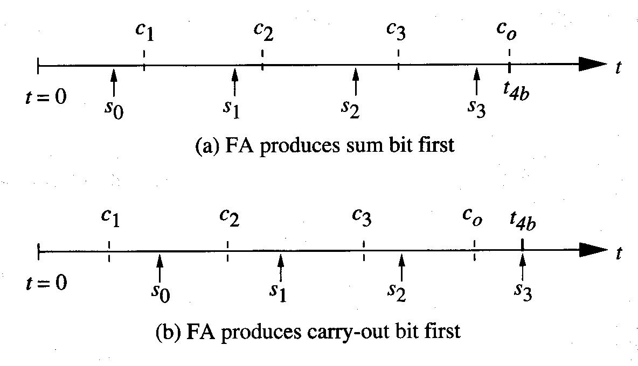
Timing
There are two cases we must consider:
  FA generates s first, then c.
  FA generates c first, then s.

Slide 44
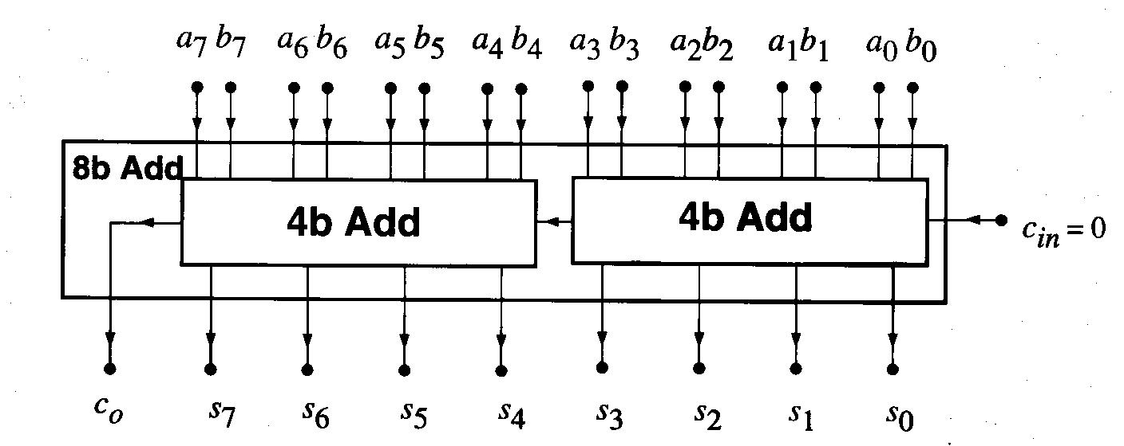
8-Bit Adder Design using Cascaded 4-Bit Adders
Likewise, 16-bit or more can be designed.

Slide 45
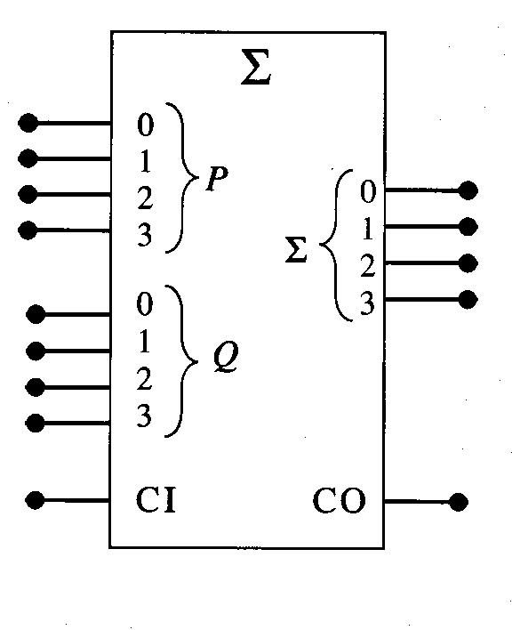
IEEE Adder Symbol
P: input word 1
Q: input word 2
Sigma: output word
CI: carry-in bit
CO: carry-out bit

Slide 46
Subtraction
It is more complex since we need to “borrow”.
Ex)
Very hard to implement with digital network.

Slide 47
More Efficient Way?
X – Y = D is equivalent to saying that X + (-Y) = D where Y + (-Y) = 0.
So, we can find (-Y). Then, using the adder, add X & (-Y) to perform subtraction.
Ex)

Slide 48
1’s Complement and 2’s Complement
Then, how we can express (-Y) in binary?
2’s complement number can be used.
  First, complement each bit: called 1’s complement.
  Then, add 1 to it: called 2’s complement.
  Y + 2’s complement Y = 0, if we discard overflow bit.
  So, (X – Y) = X + 2’s complement Y -> we can use the adder to perform subtraction.
Ex) X = 0101 and Y = 0011. Then, (X – Y) = ?

Slide 49
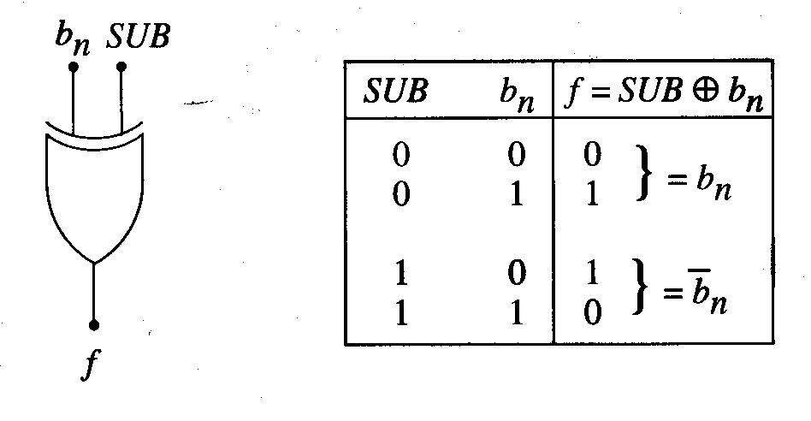
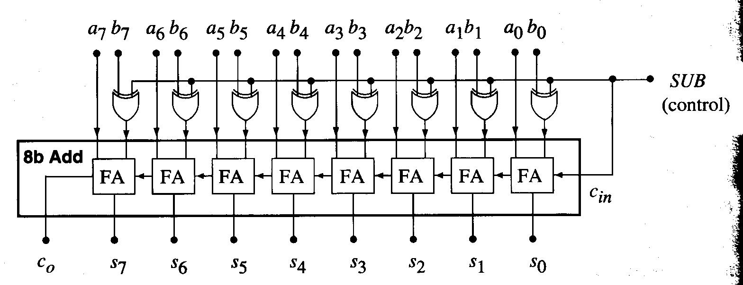
Subtraction Logic Circuit
XOR gate can be used to generate 1’s complement number.
C_{in} must be 1 so that we add 1 to 1’s complement to make 2’s complement.

Slide 50
Positive and Negative Integers in 2’s Complement
n-bit binary word has 2^n bit patterns.
The total number of bit patterns is divided into two groups.
If MSB is 0, positive integer.
If MSB is 1, negative integer.
So MSB is also called as “sign bit”.
Since all-zero bit pattern is used to represent 0, the range of positive values is one less than the range of negative values.
For example, 8-bit 2’s complement word has 256 bit patterns. So, it is possible to express -128₁₀ to +127₁₀.

Slide 51
8-Bit 2’s Complement Number
The MSB is used as sign bit of -2^7 weight and the other bits have weight of 2^i.
Ex)

Slide 52
Multiplication
AND function can be used to implement 1-bit multiplication.
For multi-bit multiplication, 1-bit multiplier and HA can be used.
Ex) 2-bit multiplication

Slide 53
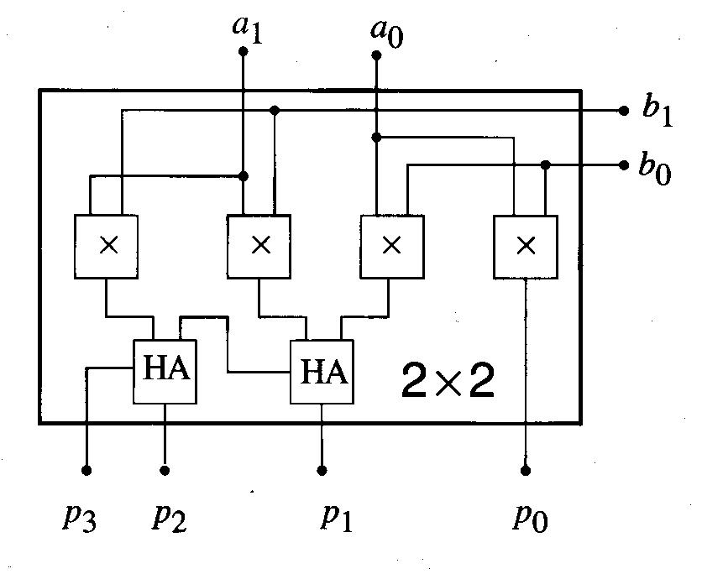
2-Bit Multiplier Internal Circuitry

Slide 54
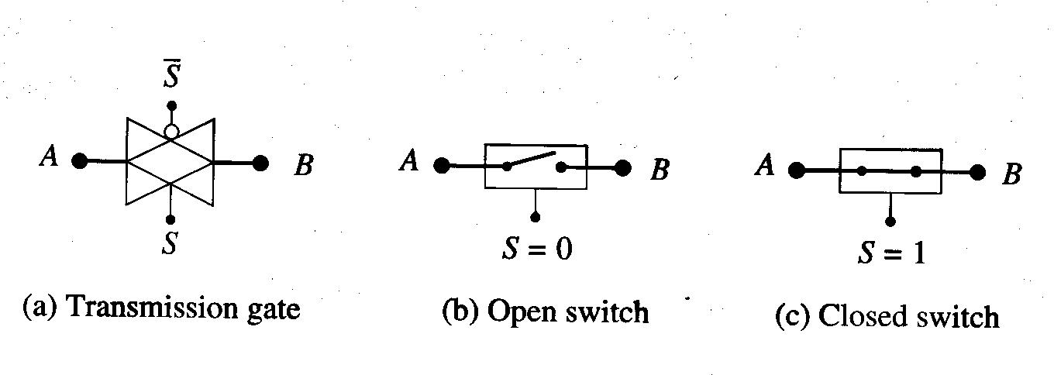
Transmission Logic Gate
TGs are logic-controlled switches that can be used to construct a wide variety of logic networks.
CMOS TG has very simple structure:

Slide 55
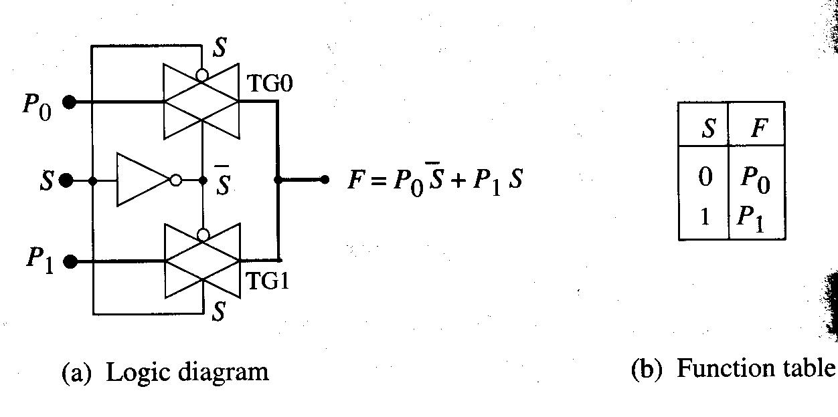
2:1 MUX using TGs

Slide 56
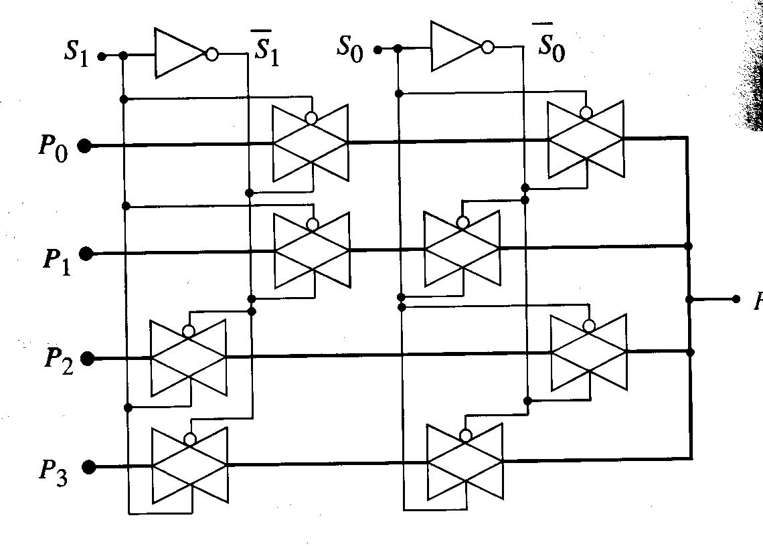
4:1 MUX using TGs

Slide 57
TG XOR and XNOR Gates

Slide 58
Program Completed
Missouri S&T
© 2015 Curators of University of Missouri

