Slide 1
CpE2210
Introduction to Digital Logic
Dr. Minsu Choi
CH 7&8: Sequential Logic Networks

Slide 2
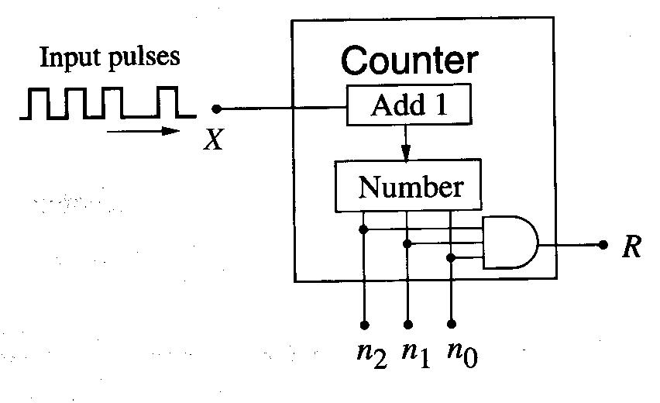
Sequential Logic Networks?
A sequential logic network is a digital system where the output is determined by both the present input and the result of a previous event.
Ex) 3-bit counter

Slide 3
Formal Description of the System: State Diagram
We define each possible value of the word as a distinct state of the machine.

Slide 4
Sequential Network Requirements
A combinational logic network to perform Boolean operations.
A memory element that stores the result of an earlier event.
If we require a clock signal to synchronize the events, it is called “synchronous logic network”, also.
Clocking signal convention: T = 1 is assumed.
(t-1) to t called previous cycle, t to (t+1) called present cycle and (t+1) to (t+2) called next clock cycle.

Slide 5
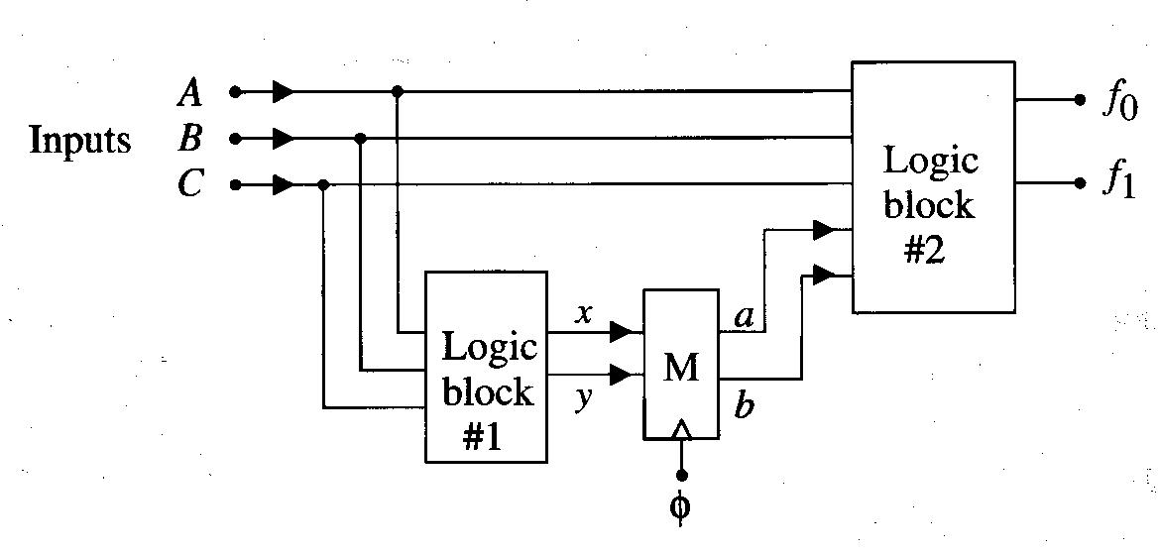
Ex) General Sequential Network #1
Two combinational logic blocks #1 and #2 and a state element (a clocked memory) M.

Slide 6
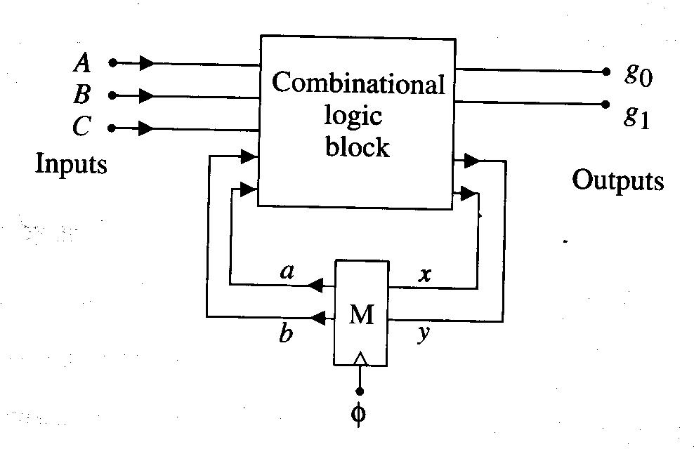
Ex) General Sequential Network #2
1 combinational logic block & 1 memory element and feedback wires.

Slide 7
Single State Variable Networks
Ex1)

Slide 8
Continued,
Ex2)

Slide 9
Continued,
Ex3)

Slide 10
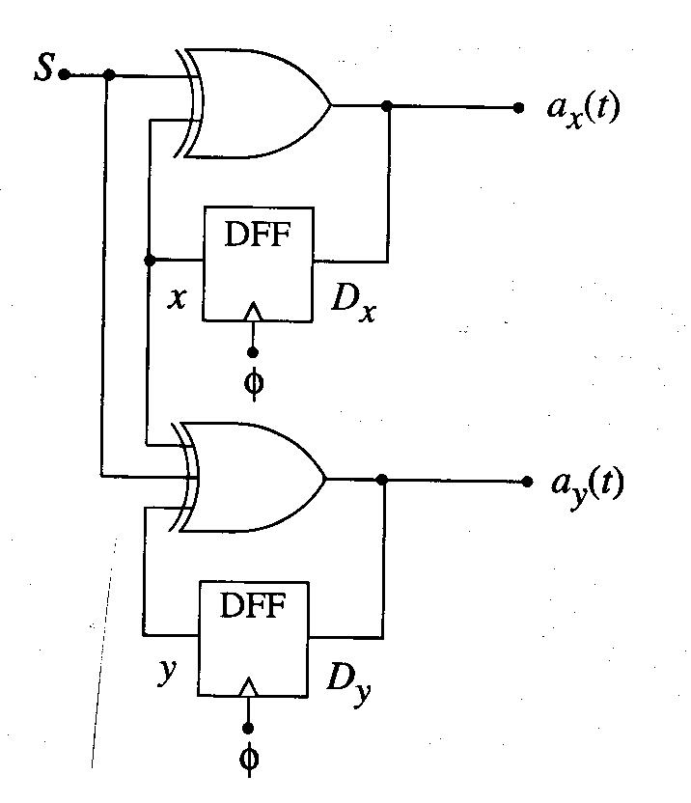
Multi-State Variable Networks
If we have n state variables, then 2^n states are needed when we draw a state diagram.
Ex)

Slide 11
State Diagram to State Table

Slide 12
Sequential Network Design
We start with a listing of the desired transition characteristics (state table, etc) and use the information to create the network.
Ex)

Slide 13
Continued,

Slide 14
Binary Counters
Ex) 2-bit counter

Slide 15
Continued,
Ex) 3-bit counter

Slide 16
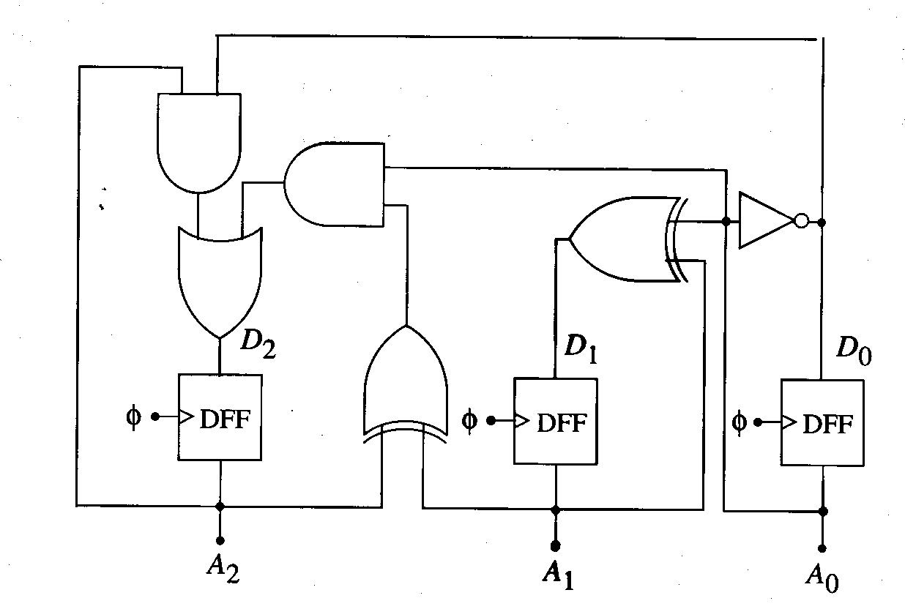
Continued,

Slide 17
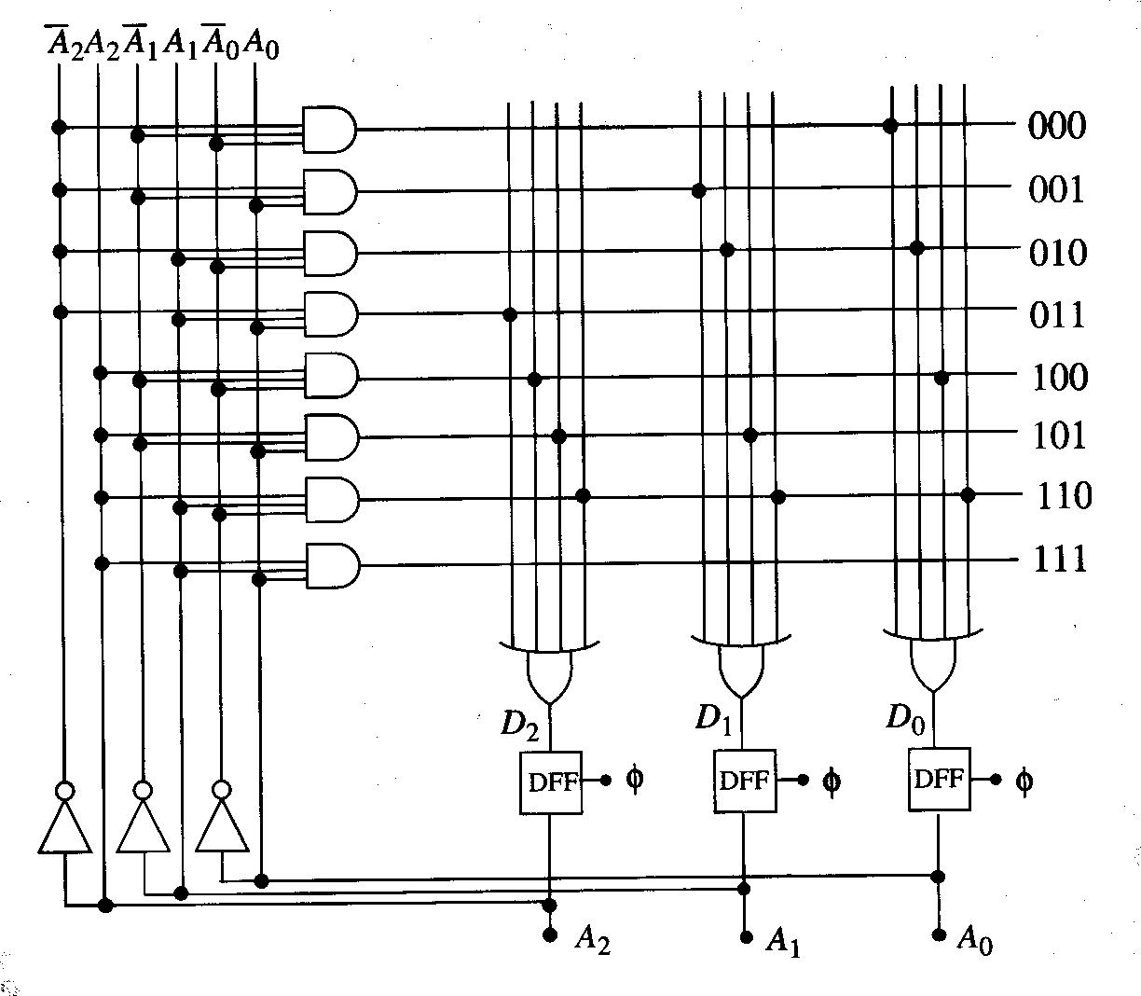
PLA Implementation of 3-Bit Counter (using SOP forms)

Slide 18
Two Different Types of State Machine
Mealy model (machine)
  Outputs are determined by both present inputs and present state.
  State diagram: each transition edge labeled with the input triggering the transition and the output resulted from the transition.
Moore model (machine)
  Output values are determined solely by its current state.
  State diagram: associates an output value with each state.

Slide 19
Mealy Machine Model

Slide 20
Moore Machine Model

Slide 21
Ex) Non-resetting sequence detector
Input: Random bit stream
Output: = 1 if 0100 sequence is detected. Otherwise = 0.
Non-resetting means state machine does not reset to the initial state when the desired sequence is detected (which means it keeps detecting the given sequence).

Slide 22
Mealy Machine

Slide 23
Moore Machine

Slide 24
Program Completed
Missouri S&T
© 2015 Curators of University of Missouri

