Slide 1
CpE2210
Introduction to Digital Logic
Dr. Minsu Choi
Supplemental CH 1: CMOS Logic Circuits

Slide 2
Introduction to CMOS
CMOS is an acronym that stands for Complementary Metal-Oxide-Semiconductor and refers to a specific type of electronic integrated circuit (IC).
CMOS is widely used in practice, since:
  Logic functions are very easy to implement.
  CMOS allows for very high logic integration density. This means that the logic circuits are very small and can be built in extremely small areas.
  The technology used to make silicon CMOS chips is very well known, and the chips can be manufactured and sold for a reasonable price.
Use low and high voltages to represent logical 0 and 1 values.

Slide 3
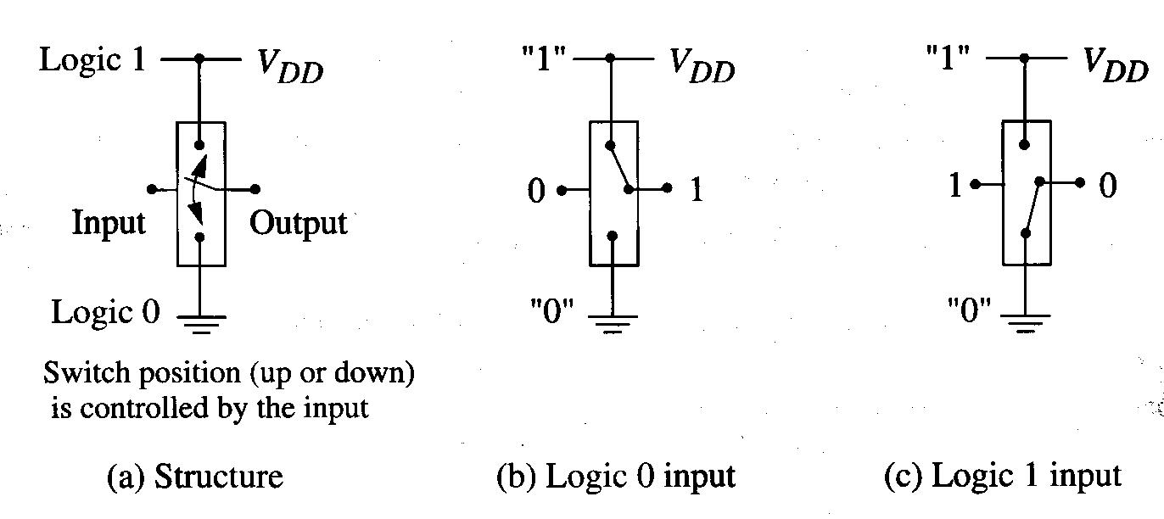
Ex) Inverter
Electronic switch can be used to implement an inverter.
=> in CMOS, the switching action is implemented using electronic switching devices called “transistors”.

Slide 4
MOSFETs
Metal-Oxide-Semiconductor Field-Effect Transistors.
Electronic devices that are used as switches.
n-FET (n-channel FET)

Slide 5
Continued,
p-FET (p-channel FET)
-> voltage-controlled or logic-controlled devices.

Slide 6
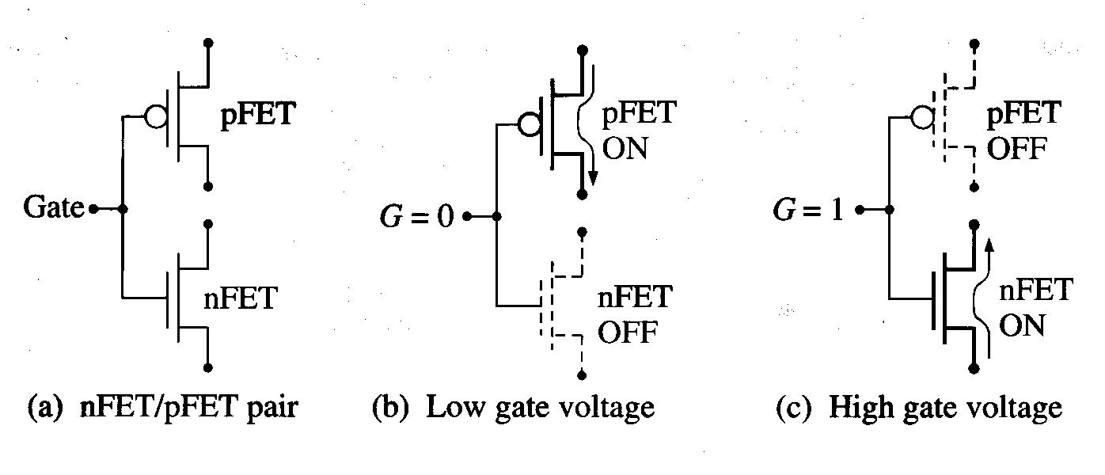
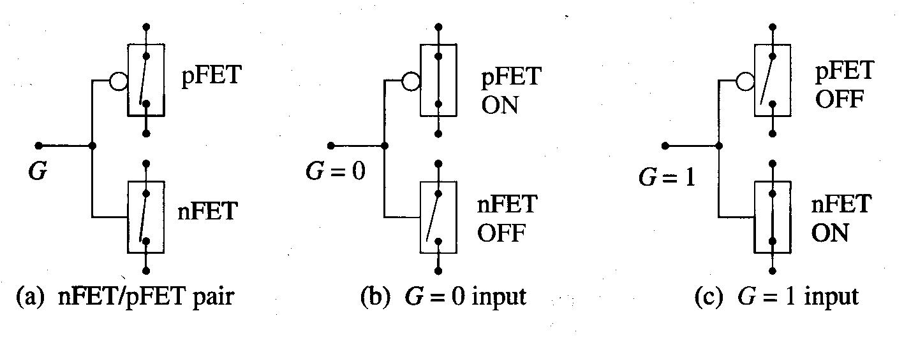
Complementary Pairs
CMOS logic circuits use nFET and pFET transistors that are arranged as complementary pairs.
Ex) Inverter implementation

Slide 7
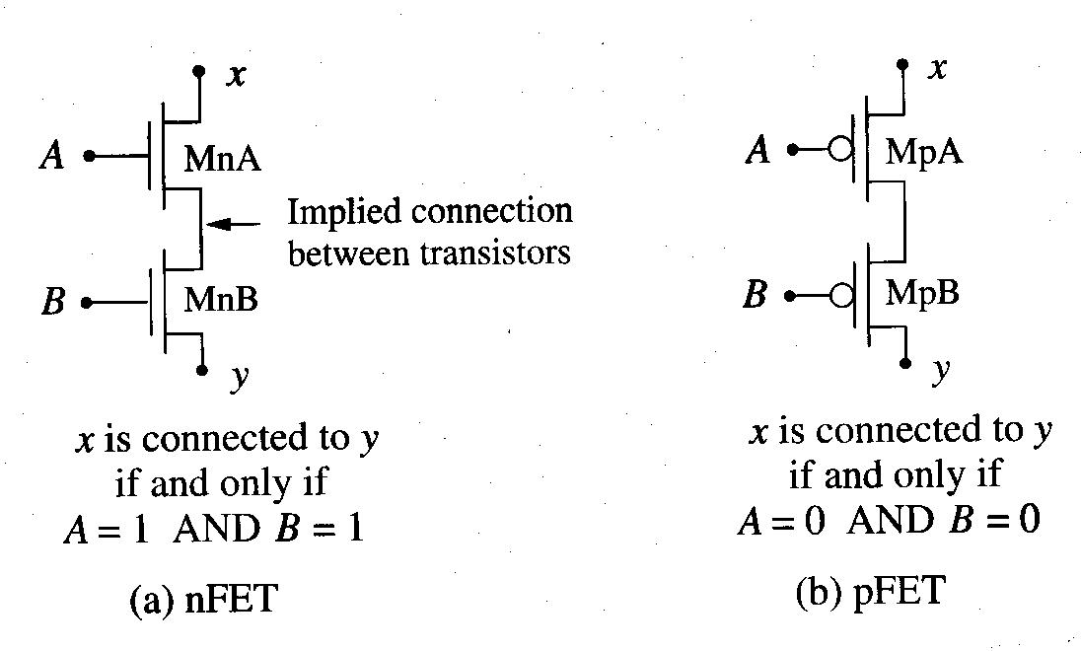
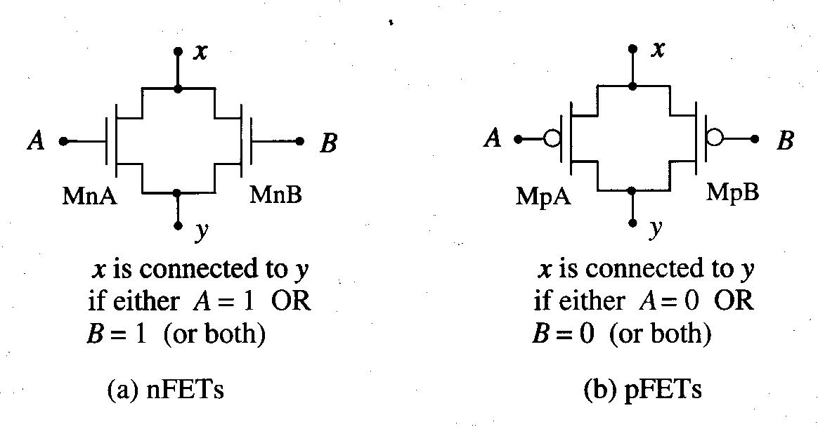
Logic Formulation using MOSFETs
Series-connected MOSFETs and parallel-connected MOSFETs:

Slide 8
Continued,
Series-connected nFETs can be used to create the AND function for logic 0.
Parallel-connected nFETs can be used to create the OR function for logic 0.
Series-connected pFETs can be used to create the NOR function for logic 1.
Parallel-connected pFETs can be used to create the NAND function for logic 1.
In CMOS, NOR and NAND and NOT gates are used as the basic gates.
nFET arrays and pFET arrays can be combined accordingly to implement NOR, NAND and NOT gates.

Slide 9
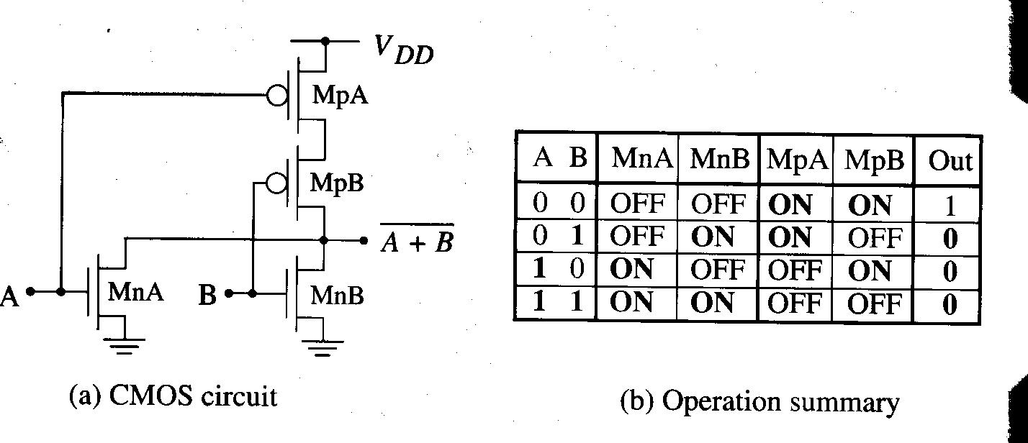
The NOR Gate

Slide 10
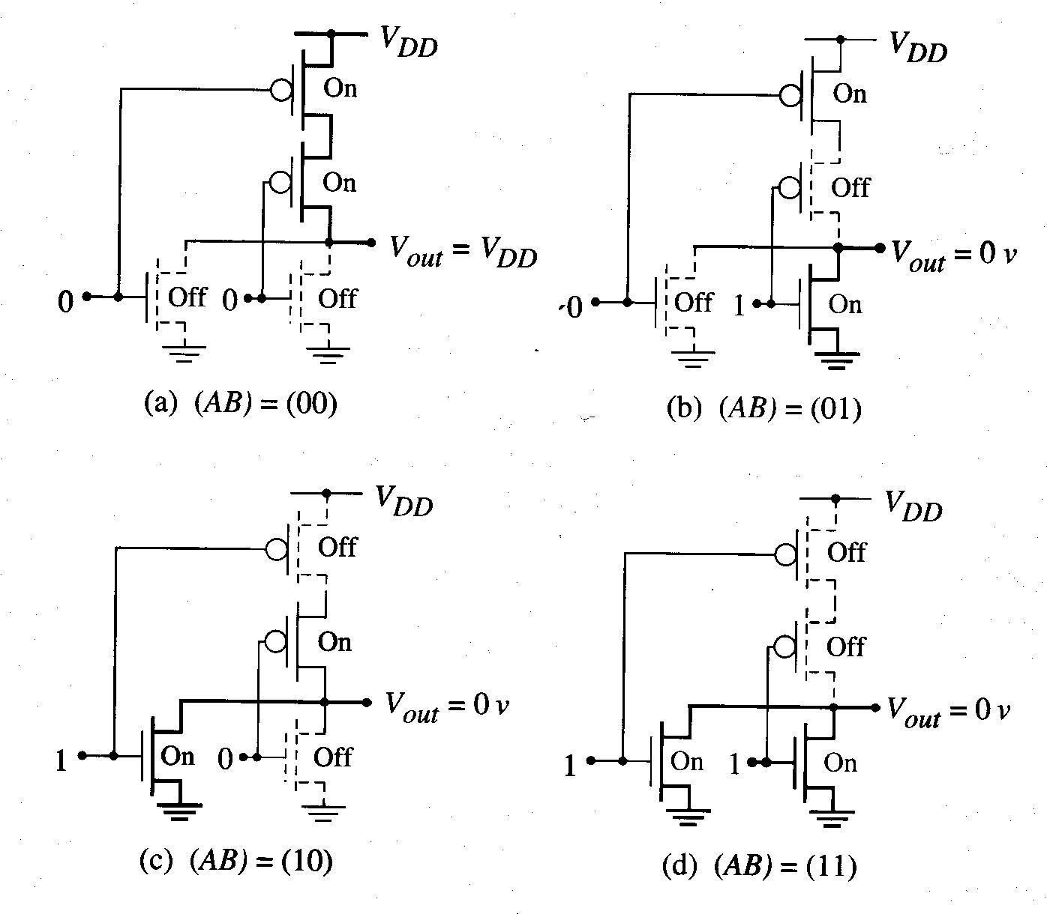
Four Possible NOR2 Circuit States

Slide 11
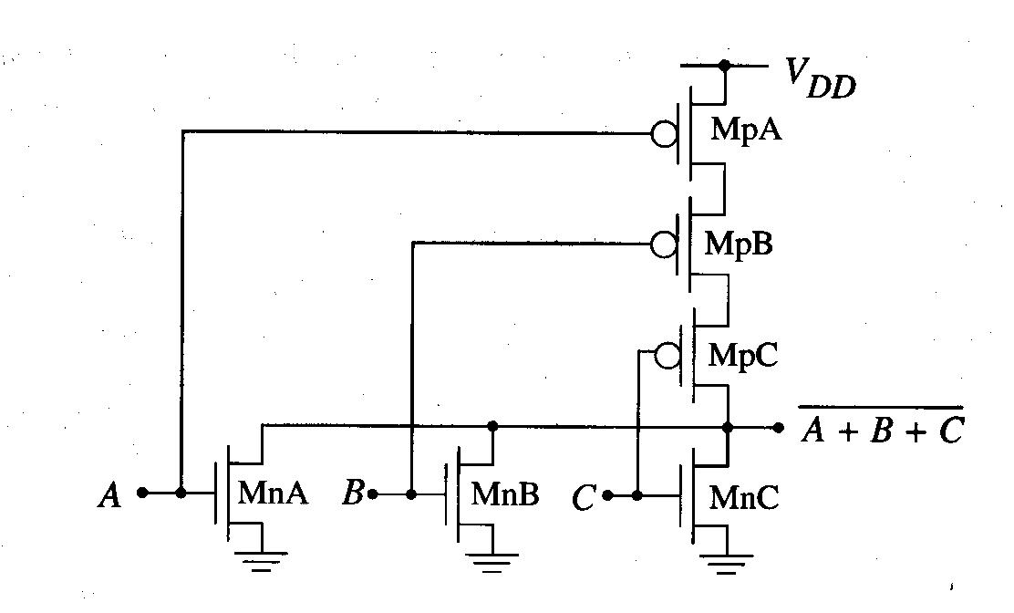
N-Input NOR gate
The structure of the NOR2 gate can be easily extended to create NOR gates with more inputs.
Ex) NOR3

Slide 12
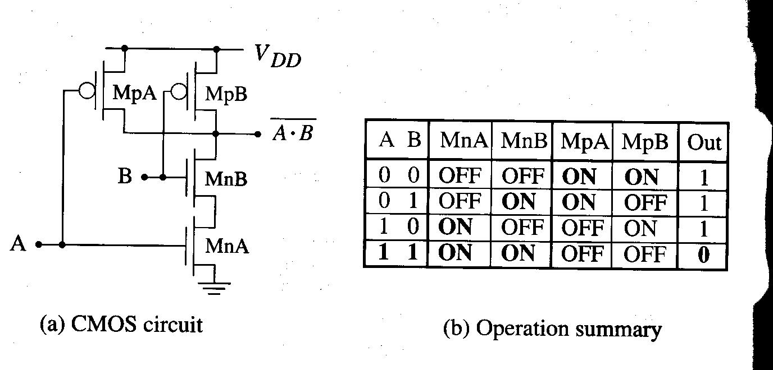
NAND2 Gate

Slide 13
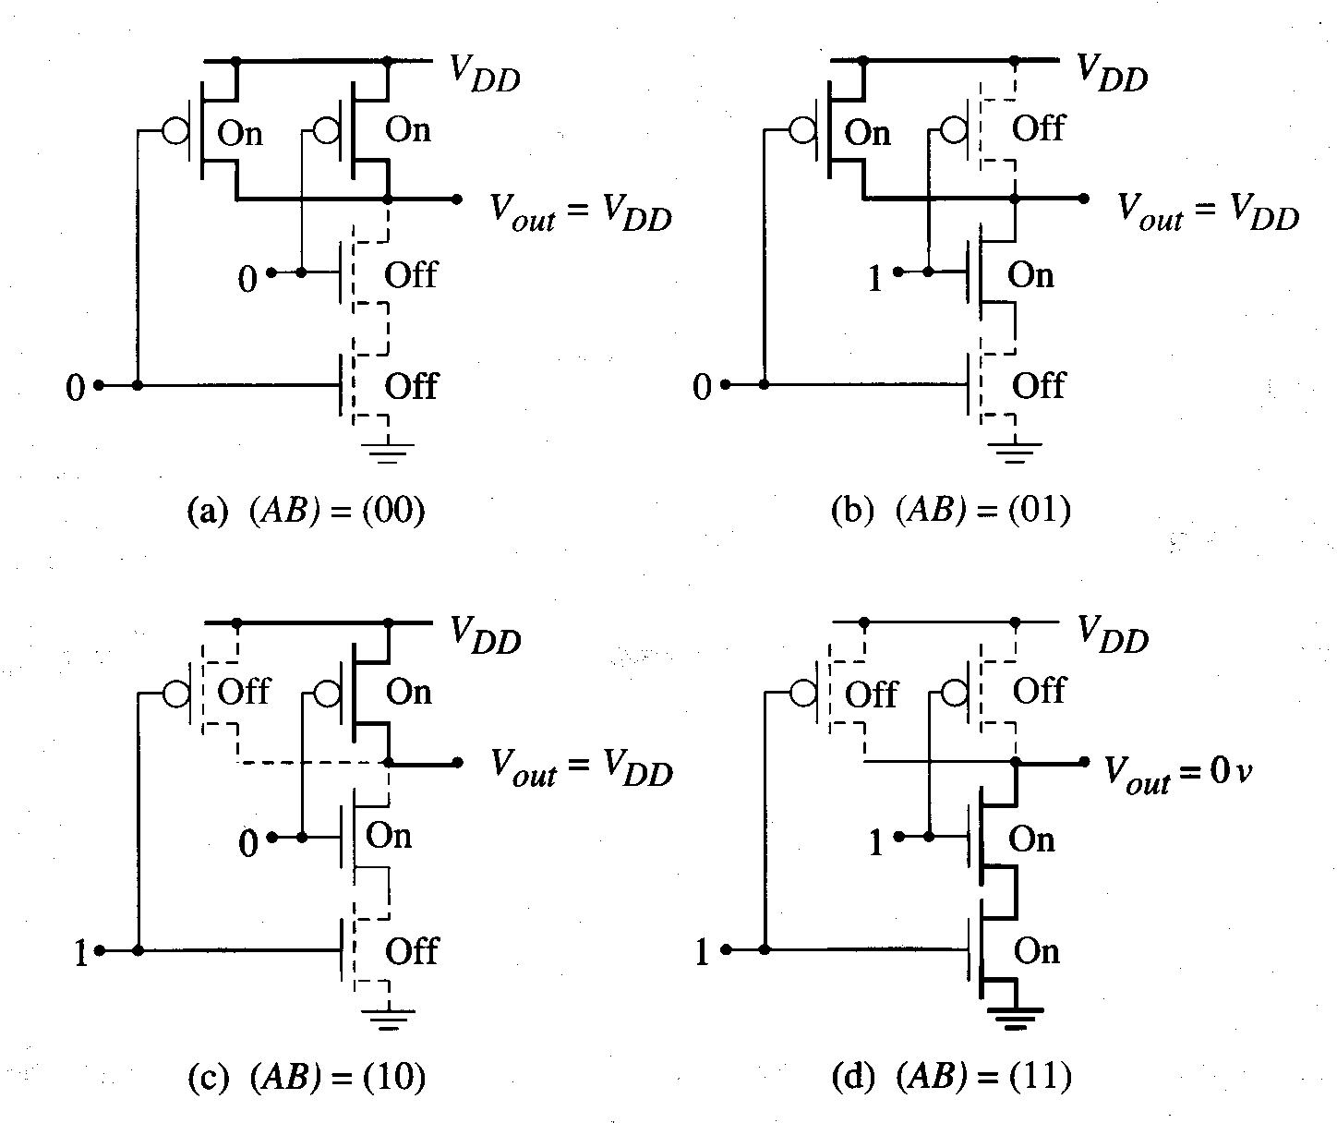
Four Possible NAND2 Circuit States

Slide 14
Complex Logic Gates in CMOS
We know how to build NOT, NAND and NOR gates.
Theoretically, any logic function can be constructed.
Complex logic gate: implements a function that can provide the basic NOT, AND, OR operations but integrate them into a single circuit.
  Complementary pairs of MOSFETs are used, so that input is connected to both an nFET and pFET.
  Complex logic gates will be constructed using the general nFET and pFET arrays.
  Series-parallel combinations of nFETs and pFETs will be used (when nFETs are in parallel, pFETs are in series and vice versa).

Slide 15
AOI and OAI
We will find that CMOS is ideally suited for creating gates that have logic equations that exhibit…
AOI: AND-OR-INVERT (=complemented SOP form).
OAI: OR-AND-INVERT (=complemented POS form).
Ex) AOI example
    Find complemented SOP of the given function.
    nFETs for AND terms -> serial, then connect in parallel to OR them up.
    pFETs for AND terms -> parallel, then connect in series to OR them up.

Slide 16
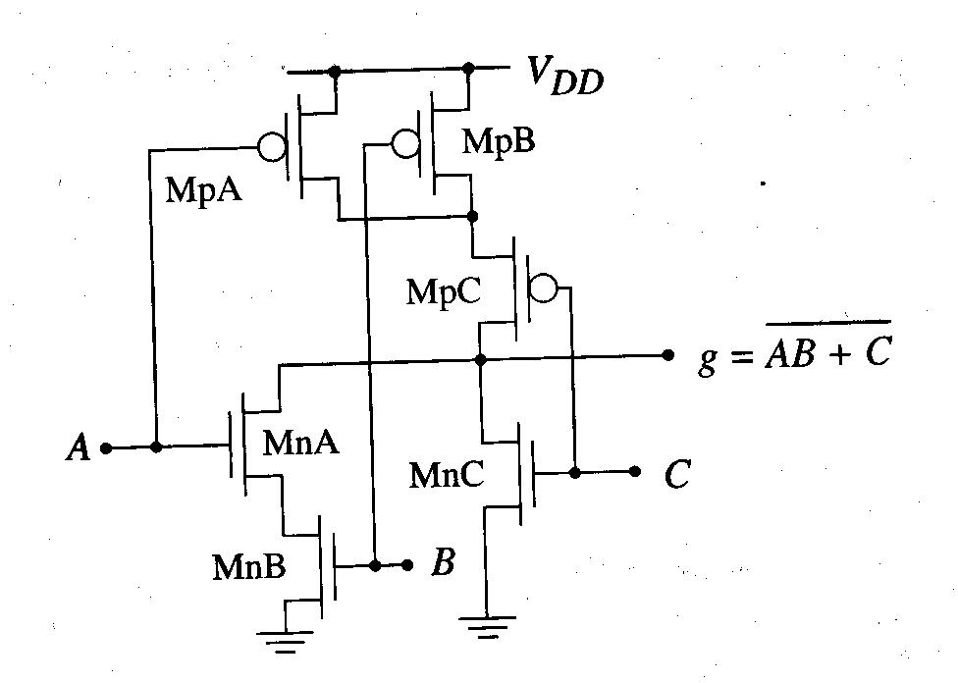
Continued,

Slide 17
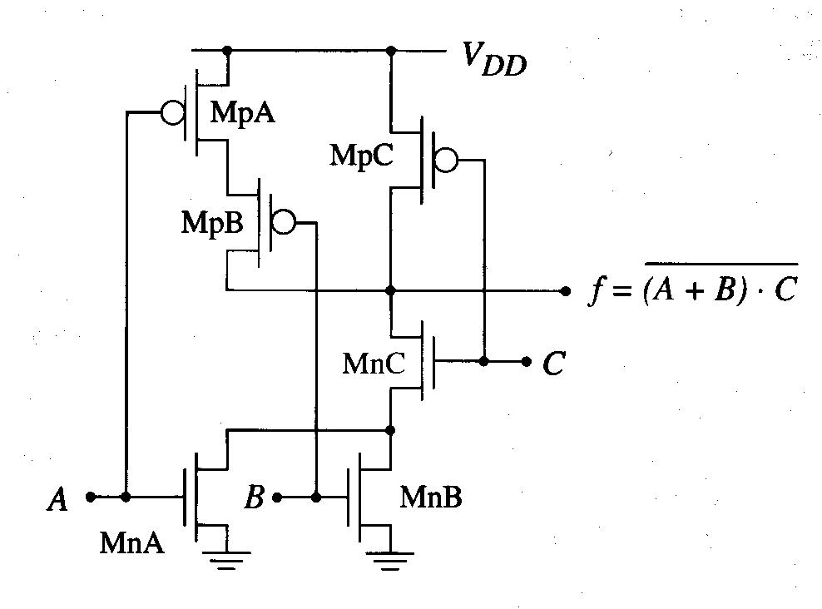
OAI Example
nFETs for OR terms -> parallel, then connect in series to AND them up.
pFET for OR terms -> series, then connect in paralllel to AND them up.

Slide 18
Program Completed
Missouri S&T
© 2015 Curators of University of Missouri

