Slide 1

C++ Basic Course
Chapter 1 —— Hello C++!
Yufeng Huang

Slide 2
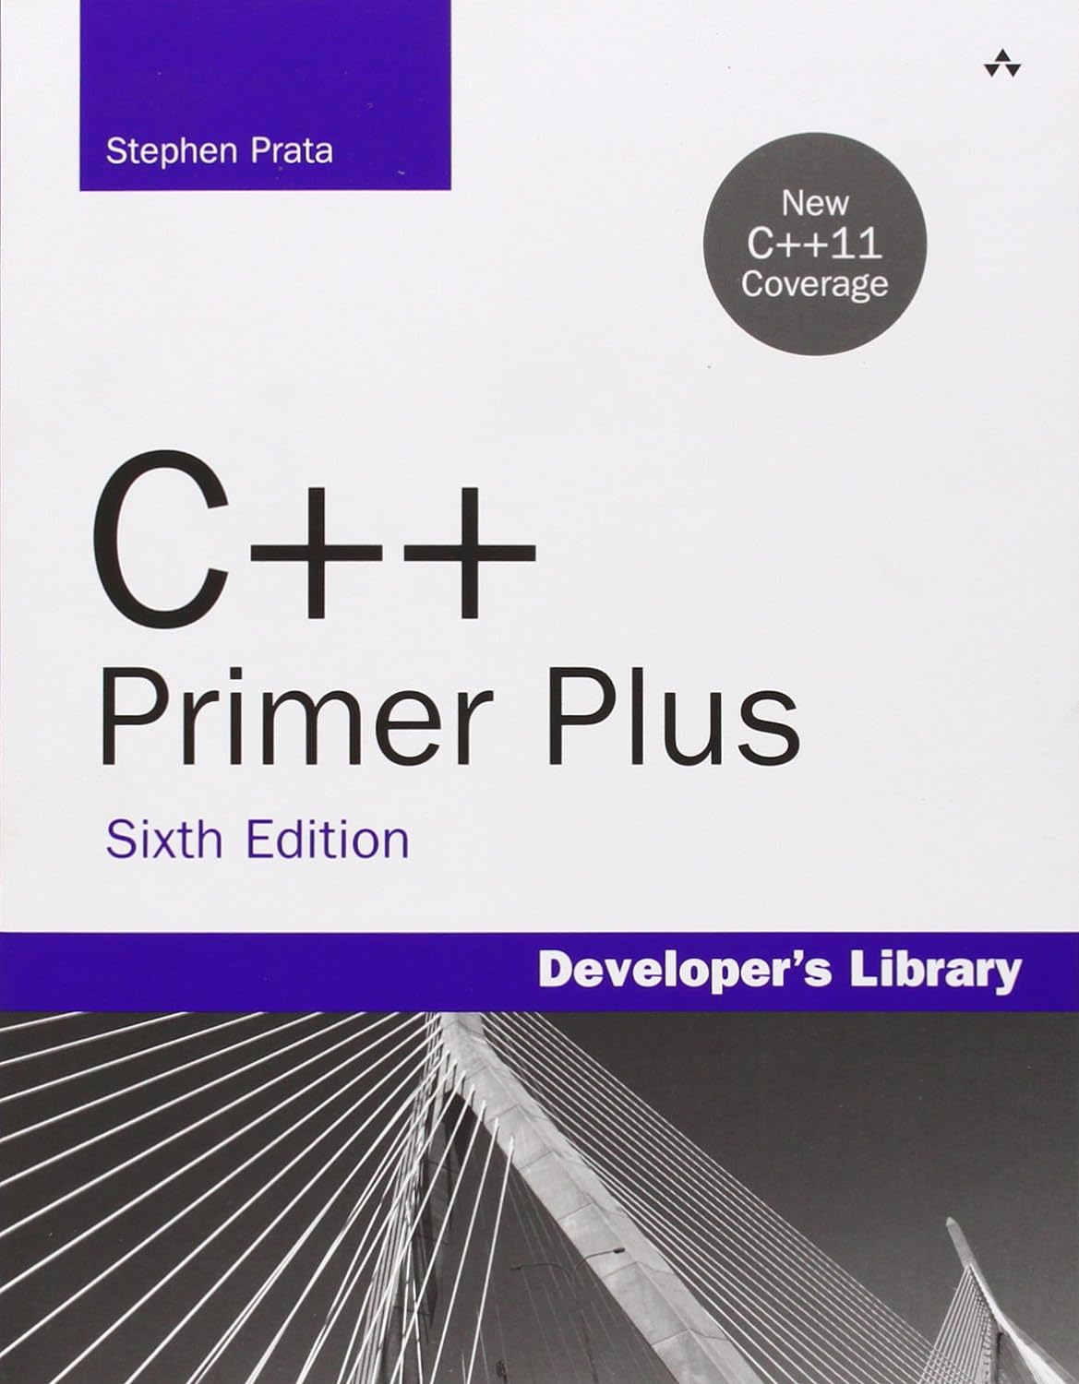
Recommended Reading
C++ Primer Plus

Slide 3
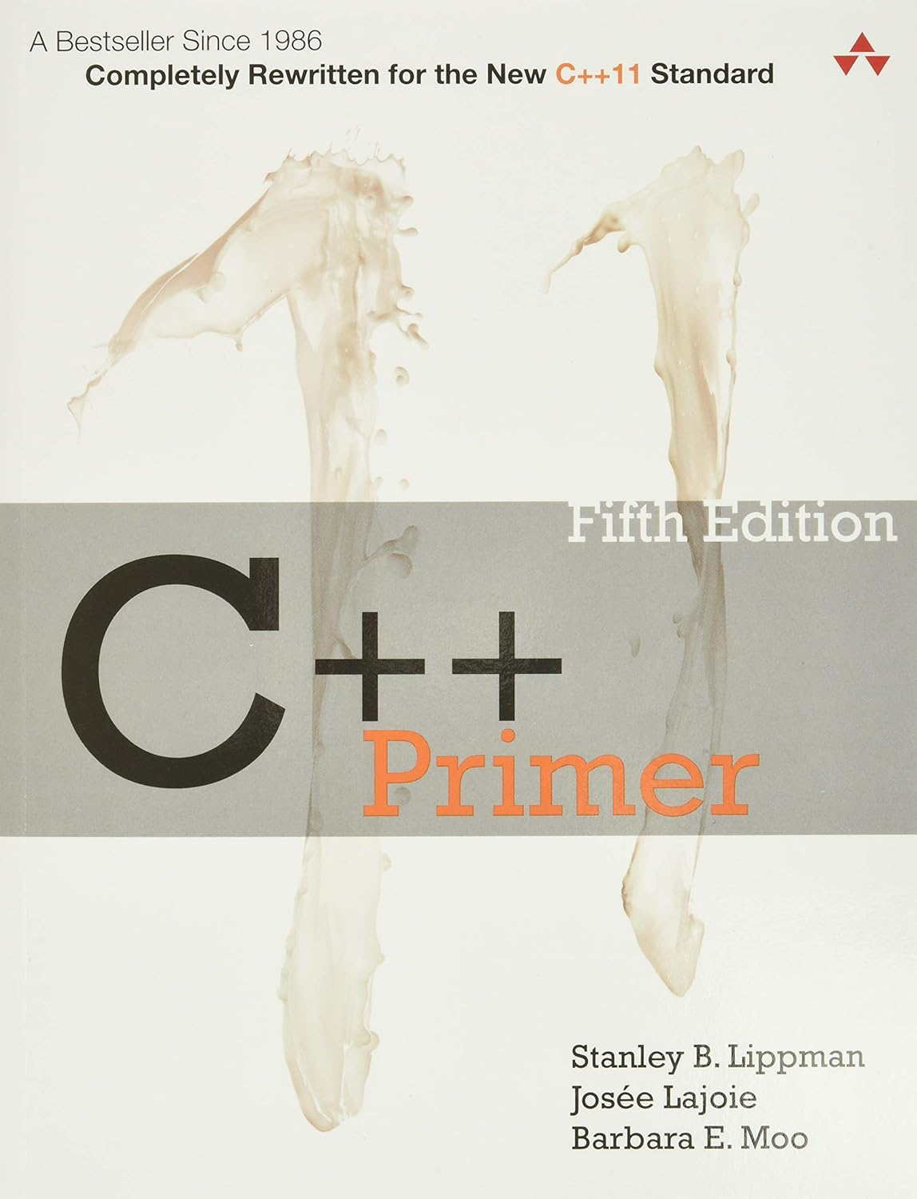
Recommended Reading
C++ Primer

Slide 4

Recommended Reading
Essential C++

Slide 5
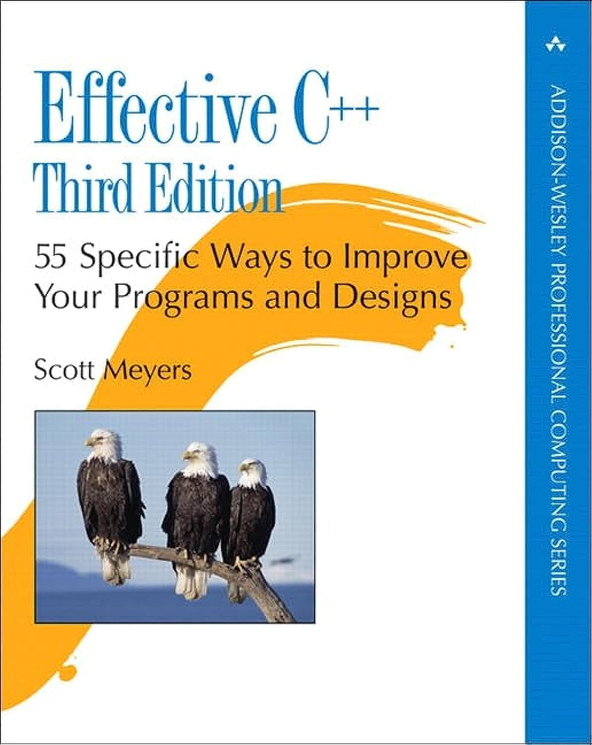
Recommended Reading
Effective C++

Slide 6
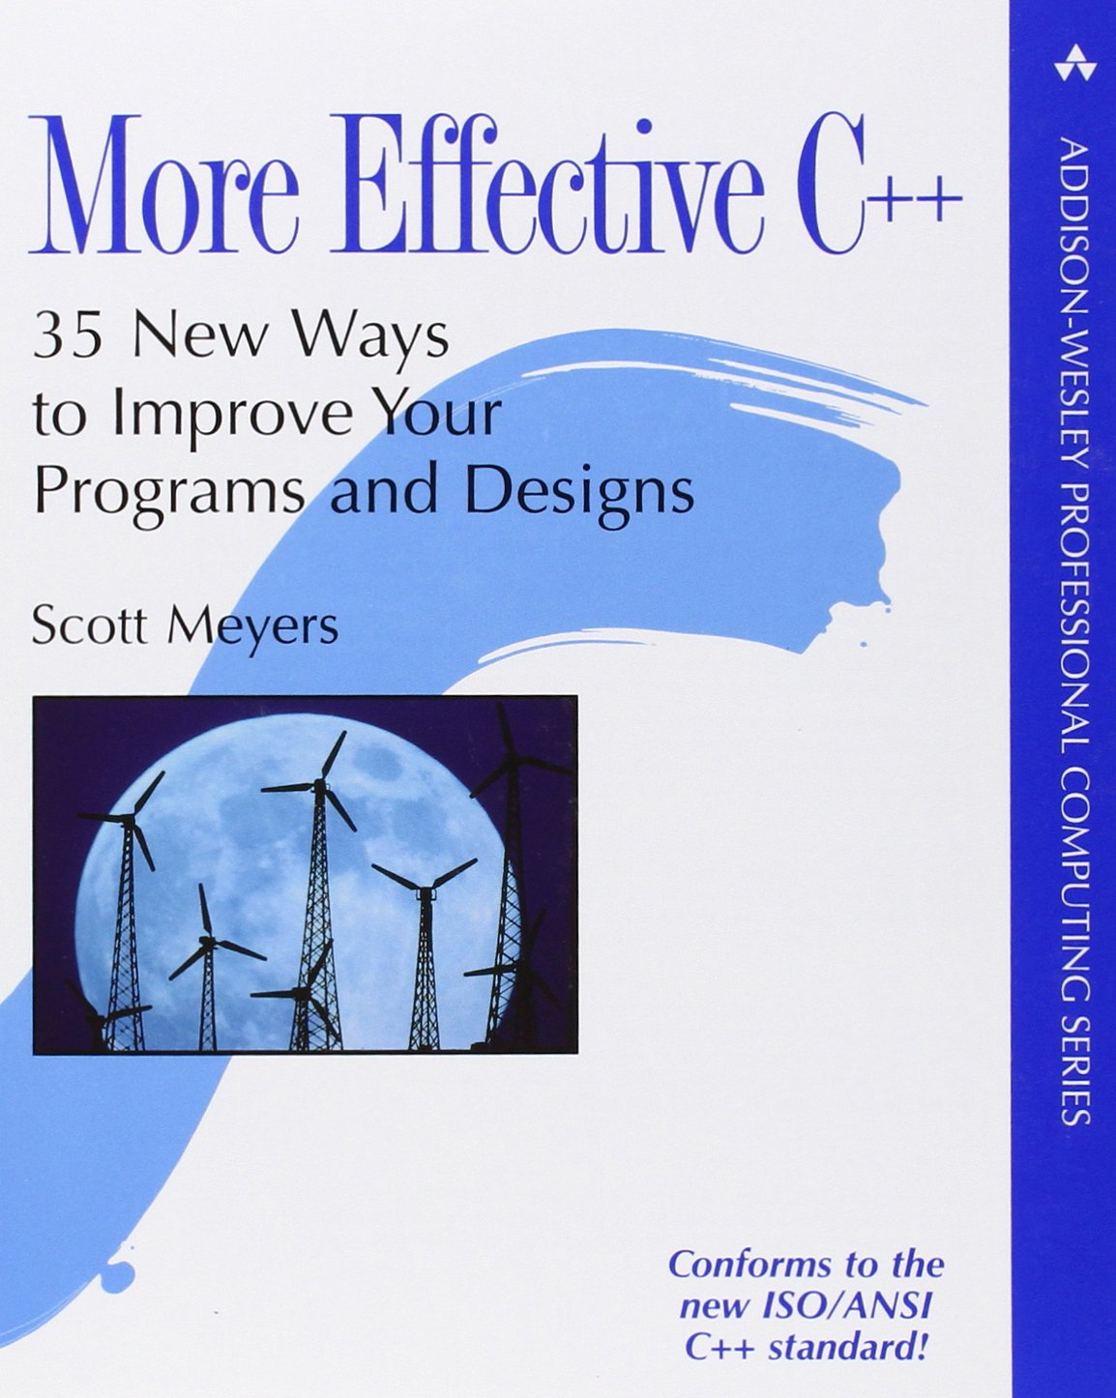
Recommended Reading
More Effective C++

Slide 7
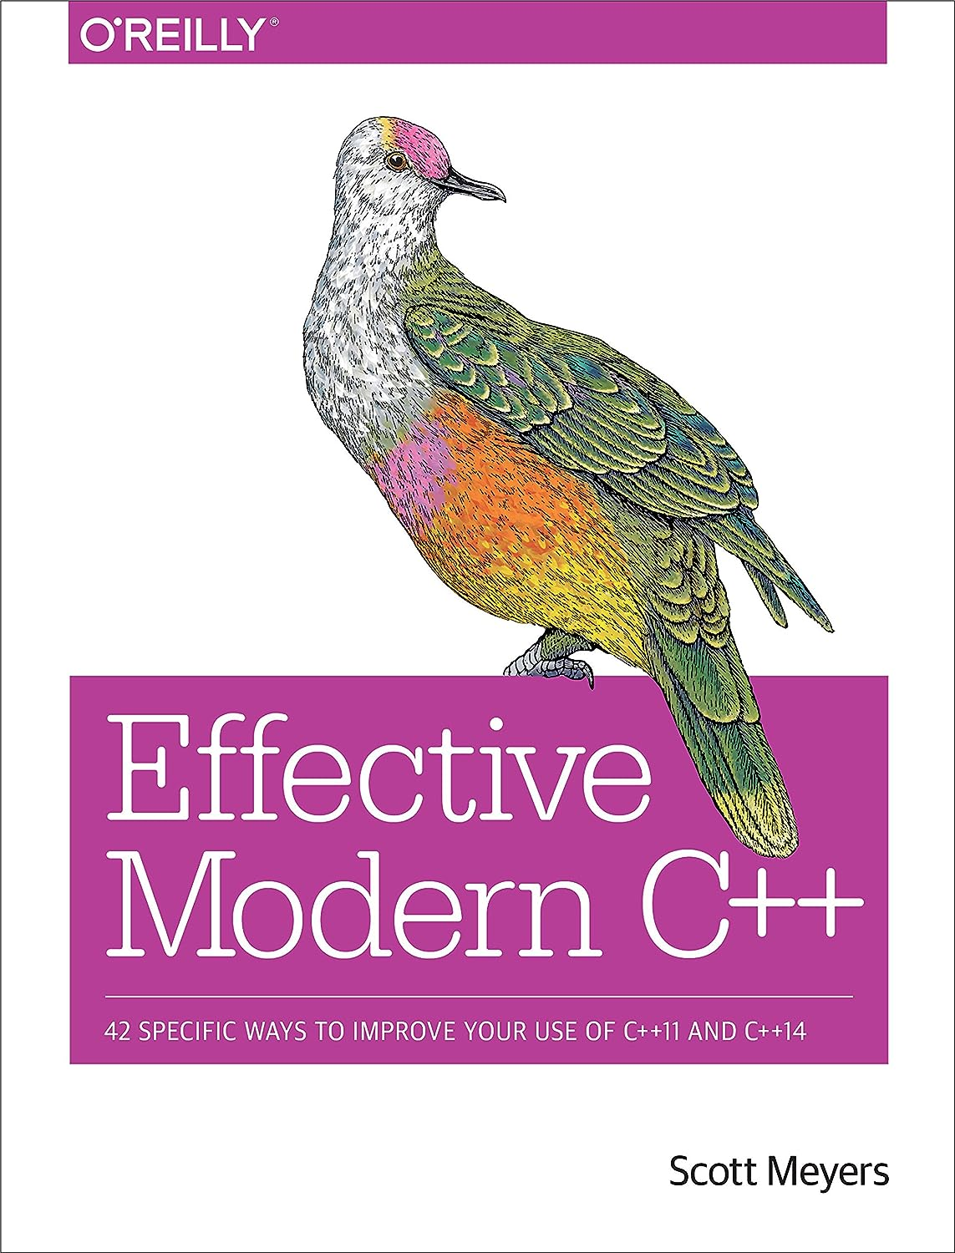
Recommended Reading
Effective Modern C++

Slide 8
Recommended Website
C++ Reference https://en.cppreference.com/w/
Microsoft C++, C, and Assembler documentation
https://learn.microsoft.com/en-us/cpp
GeeksforGeeks
https://www.geeksforgeeks.org/c-plus-plus
Learn C++ https://www.learncpp.com/

Slide 9
Why C++?

Slide 10


Hello C++!
Why C++?
Why C++?
Popular

Slide 11
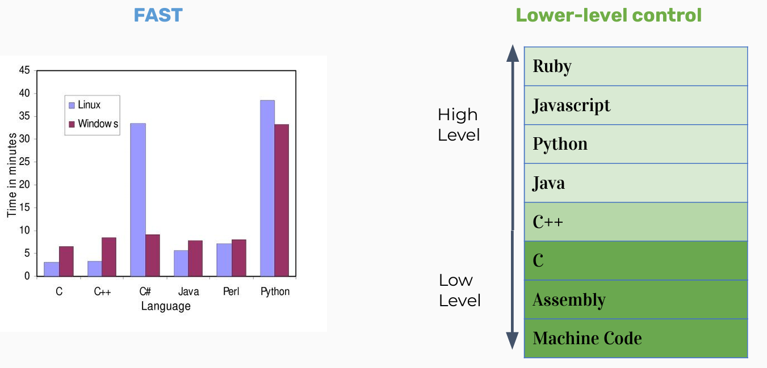
Hello C++!
Why C++?
Why C++?
Fast && Lower level control

Slide 12
What is C++?

Slide 13
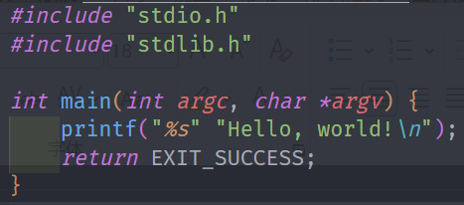
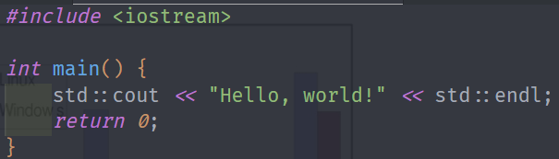
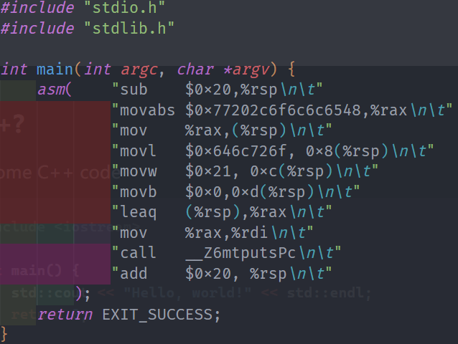
Hello C++!
What is C++?
This is some C++ code
This is also some C++ code
Also technically
C++ code!

Slide 14
Hello C++!
What is C++?
C++ is backwards compatible with lower level languages! Neat!

Slide 15
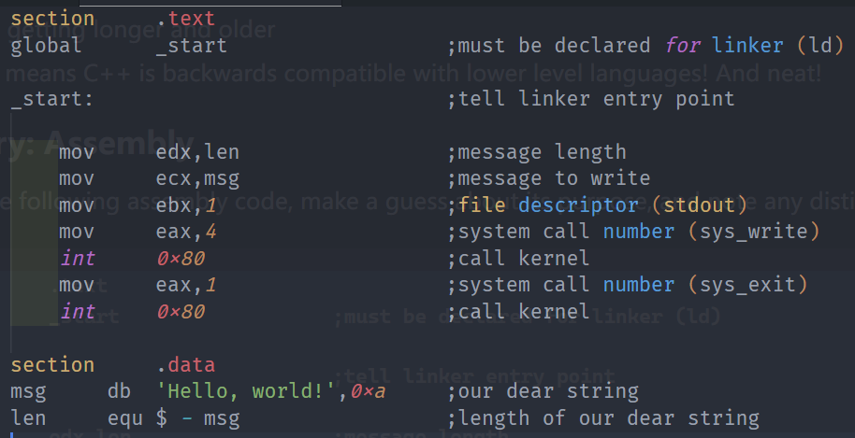
Hello C++!
C++ History: Assembly
Start with assembly

Slide 16
Hello C++!
C++ History: Assembly
Start with assembly
Benefits:
- Unbelievable simple instructions
- Extremely fast (when well-written)
- Complete control over your program
Why don’t we always use assembly?

Slide 17
Hello C++!
C++ History: Assembly
Start with assembly
Drawbacks:
- A LOT of code to do simple tasks
- Very hard to understand
- Extremely unportable
(hard to make work cross all systems)
That why we don’t always use assembly.

Slide 18
Hello C++!
C++ History: Invention of C
Problem: computers can only understand assembly!
Idea:
- Source code can be written in a more intuitive language for humans.
- An additional program can convert it into assembly!
- This additional program is called a compiler!

Slide 19
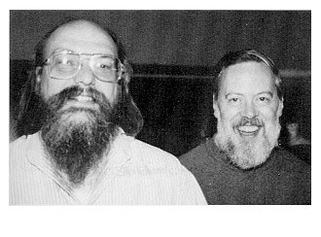
Hello C++!
C++ History: Invention of C
Ken Thompson and Dennis Ritchie created C in 1972, to much praise.
C made it easy to write code that was:
- Fast
- Simple
- Cross-platform

Slide 20
Hello C++!
C++ History: Invention of C
C was popular because it was simple,
this was also its weakness：
- No objects or classes
- Difficult to write generic code
- Tedious when writing large programs

Slide 21

Hello C++!
C++ History: Welcome to C++
In 1983, the beginnings of C++ were created by Bjarne Stroustrup.
He wanted a language that was:
- Fast
- Simple
- Cross-platform
- Had high-level features

Slide 22
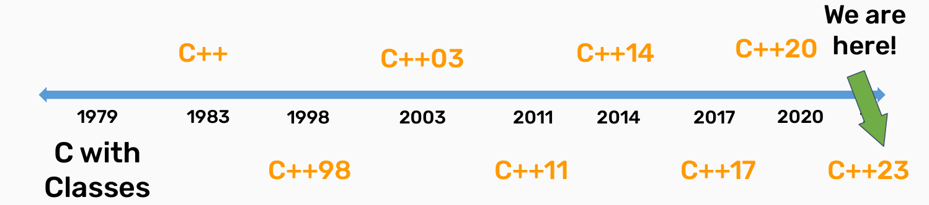
Hello C++!
C++ History: Evolution of C++
Evolution of C++

Slide 23
Hello C++!
Design Philosophy of C++
Design Philosophy of C++
- Only add features if they solve an actual problem
- This principle emphasizes that new language features should be added to address real-world programming problems rather than introducing complexity for its own sake. It helps maintain the simplicity and maintainability of the language.

Slide 24
Hello C++!
Design Philosophy of C++
Design Philosophy of C++
- Programmers should be free to choose their own style
- C++ provides multiple programming paradigms (such as procedural, object-oriented, and generic programming) and doesn't impose a specific coding style. This allows programmers to write code according to their own needs and preferences.

Slide 25
Hello C++!
Design Philosophy of C++
Design Philosophy of C++
- Compartmentalization is key
- This means that programs should be broken down into small, independent modules, each responsible for specific tasks. Modular code is easier to maintain, test, and reuse.

Slide 26
Hello C++!
Design Philosophy of C++
Design Philosophy of C++
- Allow the programmer full control if they want it
- C++ offers low-level memory access and operations to satisfy the needs of programmers who require a higher degree of control. This is valuable for system programming and performance optimization.

Slide 27
Hello C++!
Design Philosophy of C++
Design Philosophy of C++
- Don't sacrifice performance except as a last resort
- C++ places a high priority on performance and encourages programmers to write efficient code. Performance should only be sacrificed when there are no other alternatives.

Slide 28
Hello C++!
Design Philosophy of C++
Design Philosophy of C++
- Enforce safety at compile time whenever possible
- C++ strives to catch and prevent common programming errors, such as type errors and null pointer references, at compile time. This reduces runtime errors, enhancing code quality and reliability.

Slide 29
But… What is C++?

