Slide 1
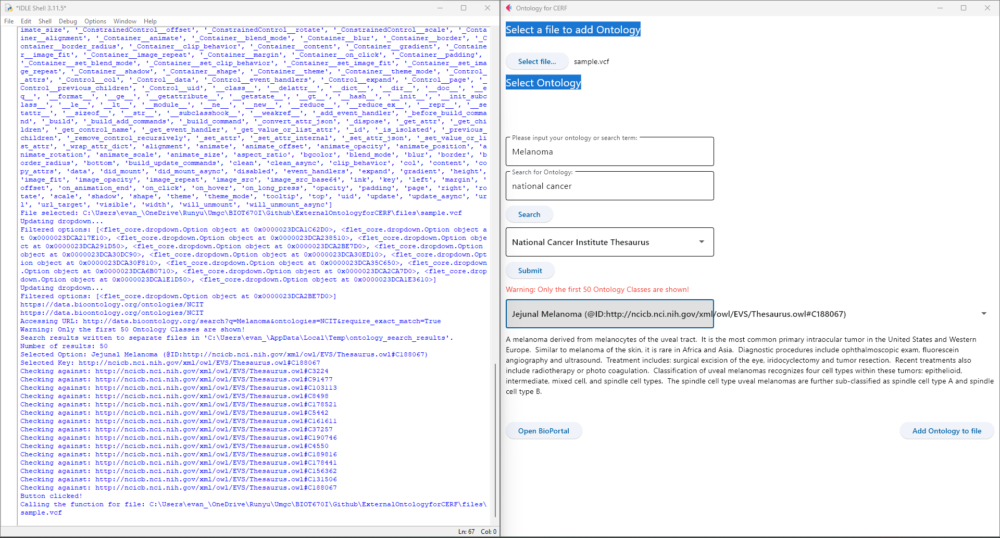
1. Select File user want to modify
2. User can input their own ontology term, or search term for bioportal
3. User input search text for the ontology they want
4. Click “Search” will update the dropdown below based on input in 3
5. Show the dropdown of ontologies matched to input in 3
6. Click “submit” will use input in 2 do term search through API in ontology selected in input 5. Result will showed in dropdown below.
7. Select the exact Ontology terms user want to use, definition will show below
8. Click “Add Ontology to file”, depending on if use input in 7. If user selected something in 7, the accordingly ID will be added to bioinformatic file, and a Jason file related to it will be created in the folder of the bioinformatic file; if user did not select anything in 7, the input in 2 will be added to bioinformatic file. The bioinformatic file will be backed up, and the csv log file will be updated.

